Slide 1
AI for Accessibility: Image Classification of the ASL Alphabet
Landon Buell – August 2023

Slide 2
Breakdown
Introduction
The Dataset
Preprocessing Procedures
The Classification Model
Architecture
Optimizer
Cross Validation
Performance Analysis
Conclusion
Appendix

Slide 3
Introduction
Large Language Models (LLM’s) have made their way into the public eye over the course of the last 10 years
These models rely on text-based or speech-based input to operate
No LLM uses image-based or video-based input to allow for the use of American Sign Language (ASL) for communication
Apple’s Siri and Amazon’s Echo remain largely inaccessible to the deaf and hard of hearing (DHH) community

Slide 4
Introduction (cont.)
We train an image classifier neural network to recognize characters from the ASL alphabet
The complete ASL lexicon consists of a rich vocabulary of complex ideas, thoughts, and phrases, not captured by this dataset
This idea of classifying images and relating them to letters can be thought of as a proof-of-concept for a much larger work
Can be extended to recognize a wide range of ASL words, phrases, and inflections in the future

Slide 5
The Dataset
We have acquired a large library of 87,000 images that cover 29 unique classes [See Appendix]
Each image is 200 pixels x 200 pixels x 3 channels. Each pixel is represented by a byte, but is cast to a single-precision float on the interval [0.0 , 255.0]
The first 26 classes represent the characters of the Latin alphabet, and the last three classes represent a space, delete, and nothing.
There are approximately 3,000 images for each class

Slide 6
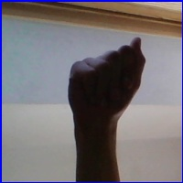

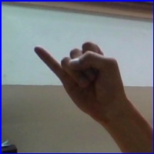
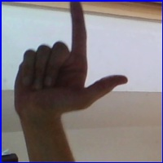
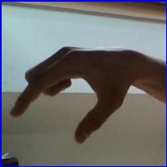

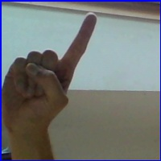
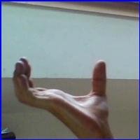
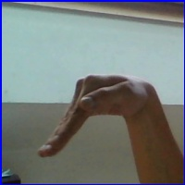

Select Examples from the Dataset
Class 0 - A
Class 1 - B
Class 9 - J
Class 11 - L
Class 16 - Q
Class 20 - U
Class 25 - Z
Class 26 - Space
Class 27 - Delete
Class 28 - Nothing

Slide 7
Preprocessing – Remove Padding
Every image is padded by a blue border.
This provides unneeded information that does not vary with each class
We choose to crop out 8 pixels from every edge of the image
This removes information that is not useful for discriminating classes, and preserves key information in the center of the image
Added benefit of reducing the size of the classifiers input/feature-space
Image size: 200 x 200 x 3 to 184 x 184 x 3

Slide 8
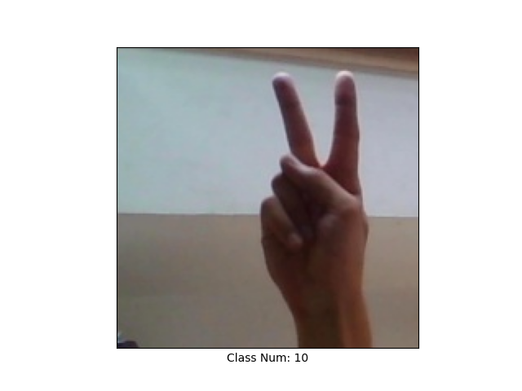
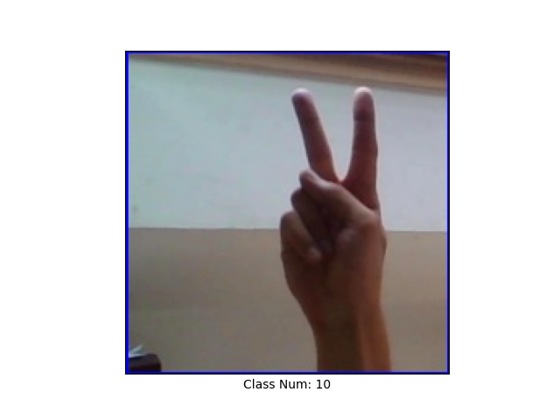
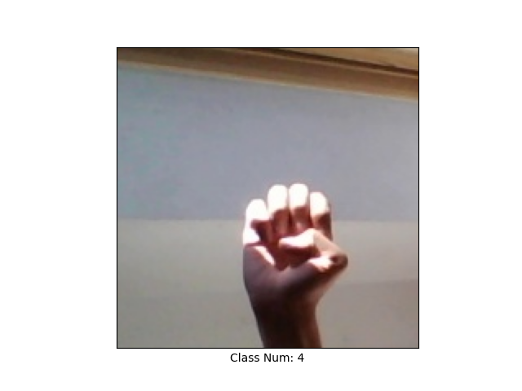
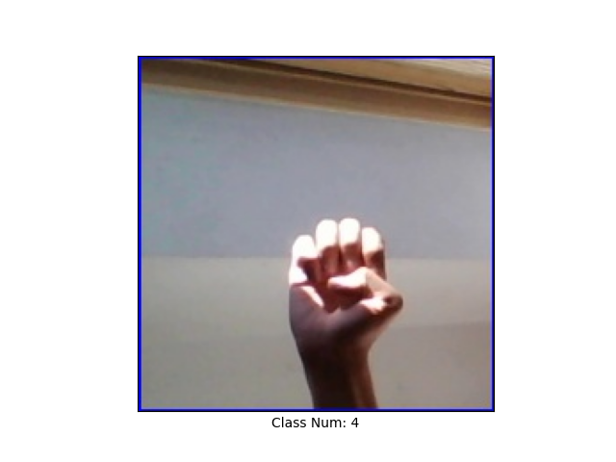
Preprocessing: Remove Padding Example

Slide 9
Preprocessing – Rescaling
We can further reduce the size of the input space by rescaling each image to a smaller size
Rescaling will allow each sample to retain the key properties that can be used for discerning between classes
By creating a smaller input space, we can also shrink the number of parameters required by the model to classify images
A smaller model width can help mitigate any overfitting problems
Image size: 164 x 164 x 3 to 128 x 128 x 3

Slide 10


Preprocessing: Rescaling Example

Slide 11
Preprocessing – Normalizing
Normalization is the process of scaling all samples within a batch of data such that each feature by itself has a zero-mean and unit-variance
First, we divide all pixel values by 255.0, such that every entry sits between 0.0 and 1.0
We then apply a built-in TensorFlow function that will normalize a batch of input images according to the rule above
In general, this prevents any one feature/pixel from contributing more than any other in the optimization process

Slide 12
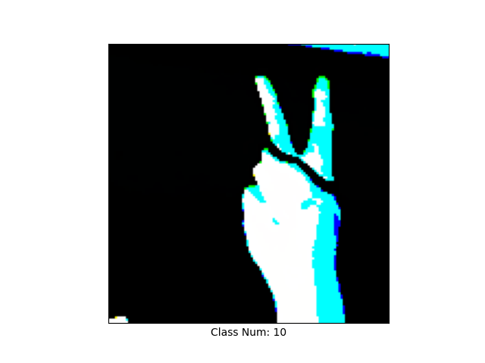
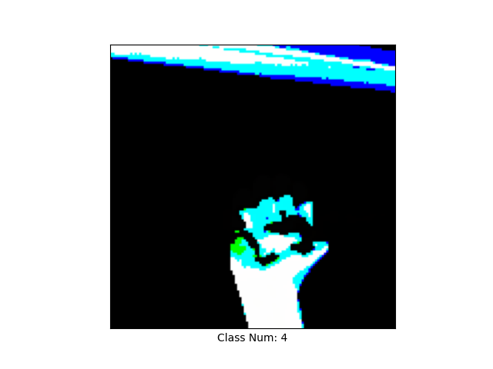
Preprocessing: Normalizing Example

Slide 13
The Classification Model
This is an image classification task where we seek to categorize an entire input image based on its contents
We are not trying to locate or isolate a hand creating the ASL character, only assign a label to the image as a whole
The entire data set is already labeled which makes this a supervised classification task

Slide 14
The Classification Model (cont.)
The most common architecture of neural network for supervised image classification is a convolutional neural network
Convolutional neural networks use a combination of 2D-convolution and 2D-maximum-pooling operations to build a feature map which we can then run a classifier one
Convolution operations use 2D kernels to parse across the rows and columns of an input image to locate key features
Maximum-Pooling operations use 2D kernels to parse across the rows and columns of an input image to extract the pixel with the largest value in a 2D group of pixels

Slide 15
The Classification Model (cont.)
The output of a convolutional neural network is a feature map, or a lower-dimensional, but highly descriptive representation of the original input
The feature map is vector of numbers that we call a layer of neurons
The layer of neurons is passed through a multilayer perceptron which applies repeated affine transformations
The final layer has one neuron per unique class in the dataset – 29 in our case

Slide 16
Example Output
It is scaled such that it can be treated as a probability distribution for what class a sample is likely to belong to
The neuron with the highest number or brightest activation is the class that the sample is predicted to belong to
A simple example with 10 classes:
The sample is predicted to belong to class #4 (zero-indexed)
0.05
0.1
0.05
0.04
0.6
0.06
0.05
0.02
0.02
0.01

Slide 17

The Optimizer
To train the model, we use an iterative gradient-descent algorithm called ADAM
ADAM gets its name from using an ADAaptive Momentum parameter which allows it to handle discontinuities and other obstacles that it might find during training
We apply the ADAM optimizer implemented through TensorFlow to train/optimize our model

Slide 18
K-Folds Cross Validation
K-Folds Cross Validation is a procedure where we chop up a dataset into K subsets
We iterate through the subsets and for each iterations, we do the following
Train an unoptimized model on K-1 of the subsets of data
Test that newly trained model on the one remaining subset of data
This process ensures that our model can handle variations in the dataset
Ensures that there are no subtleties in the dataset that allowed us to perform better or worse than any other experiment

Slide 19
Executing K = 10 Folds X-Validation
To test the stability of our classifier, we have chosen to execute K = 10 folds X-validation
For each fold, we record the training loss at each epoch to understand the rate of converge
We also produce a classification report which shows the precision, recall, and F1 when evaluating the final fold

Slide 20
Notes about Metric Computation
Precision, recall, and F1-score typically apply to problems with binary labels
For each metric, we compute and report the macro-average
For any class, we compute the one-vs-all score for that metric – which acts like 29 binary classification task (e.g. a sample is a selected class or is not that selected class)
We then average the metric score across the 29 cases

Slide 21
Classification Metric: Precision/Specificity
The precision score for a any class is the ration of true-positives to true-positives + false-positives
It measures the relevant instances among all found instances
Bound between 0 and 1 – higher is better

Slide 22
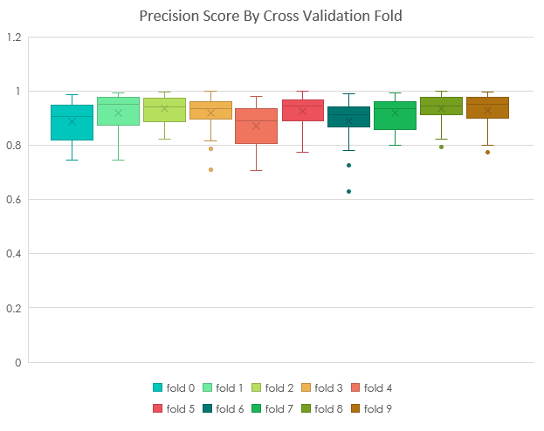
Precision Score for K = 10 Folds

Slide 23
Classification Metric: Recall/Sensitivity
The recall score for a any class is the ratio of true-positives to true-positives + false-negatives
The fraction of all relevant instances that were retrieved
Bound between 0 and 1 – higher is better

Slide 24
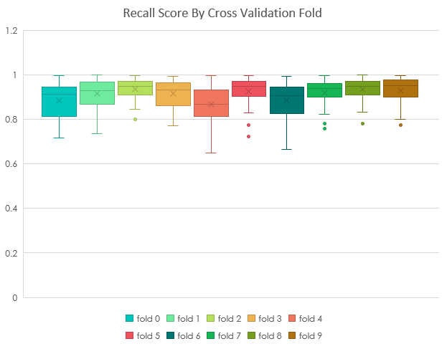
Recall Score for K = 10 Folds

Slide 25
Classification Metric: F1-Score
F1-Score is the harmonic mean of precision and recall scores
Score is better when both precision and recall are higher
Bound between 0 and 1 – higher is better

Slide 26
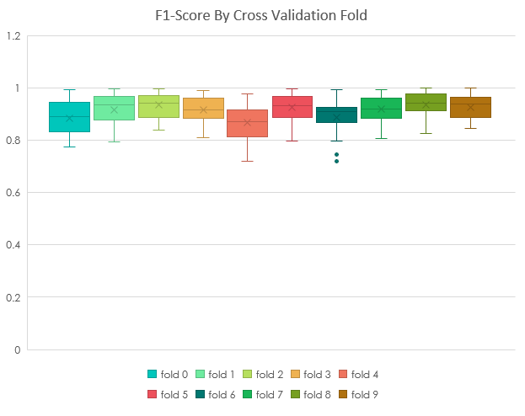
Recall Score for K = 10 Folds

Slide 27
Discussion on Metric Reports
For all metrics, there is little variance within the score of each class, and little variance across each fold
Cross validation confirms that the model performs reasonably consistently across different train/test splits within the larger dataset
F1-Score report shows that the U character has the smallest F1-Score average of ~0.81 and a variance of ~1.5E-3
F1-Score report shows that the Nothing character has the largest F1-Score average of ~0.99 and a variance of ~3.6E-5

Slide 28
Classification Score: Confusion Matrix
A confusion matrix shows the counts that any sample in class A was predicted to be in class B
Correct predictions appear only in the main diagonal, where the predicted class index is equal to the actual class index
Entries in the off-diagonal are misclassifications

Slide 29
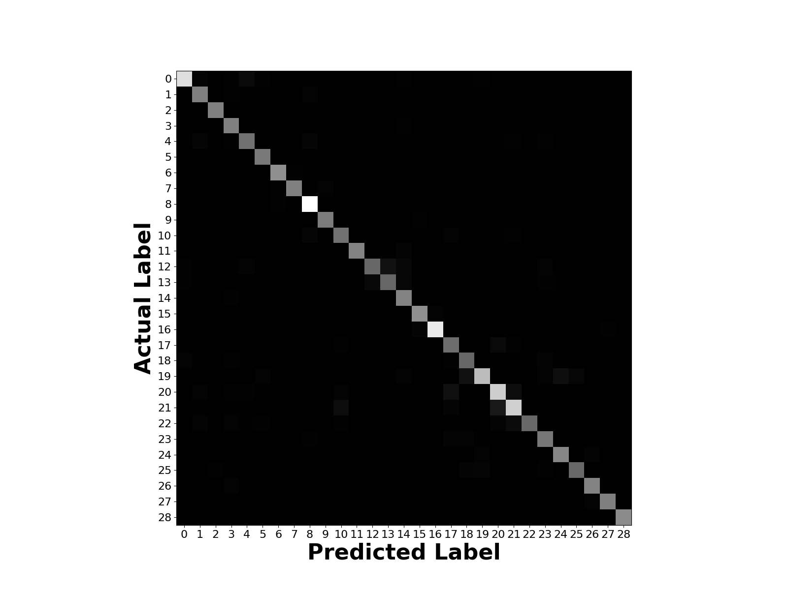
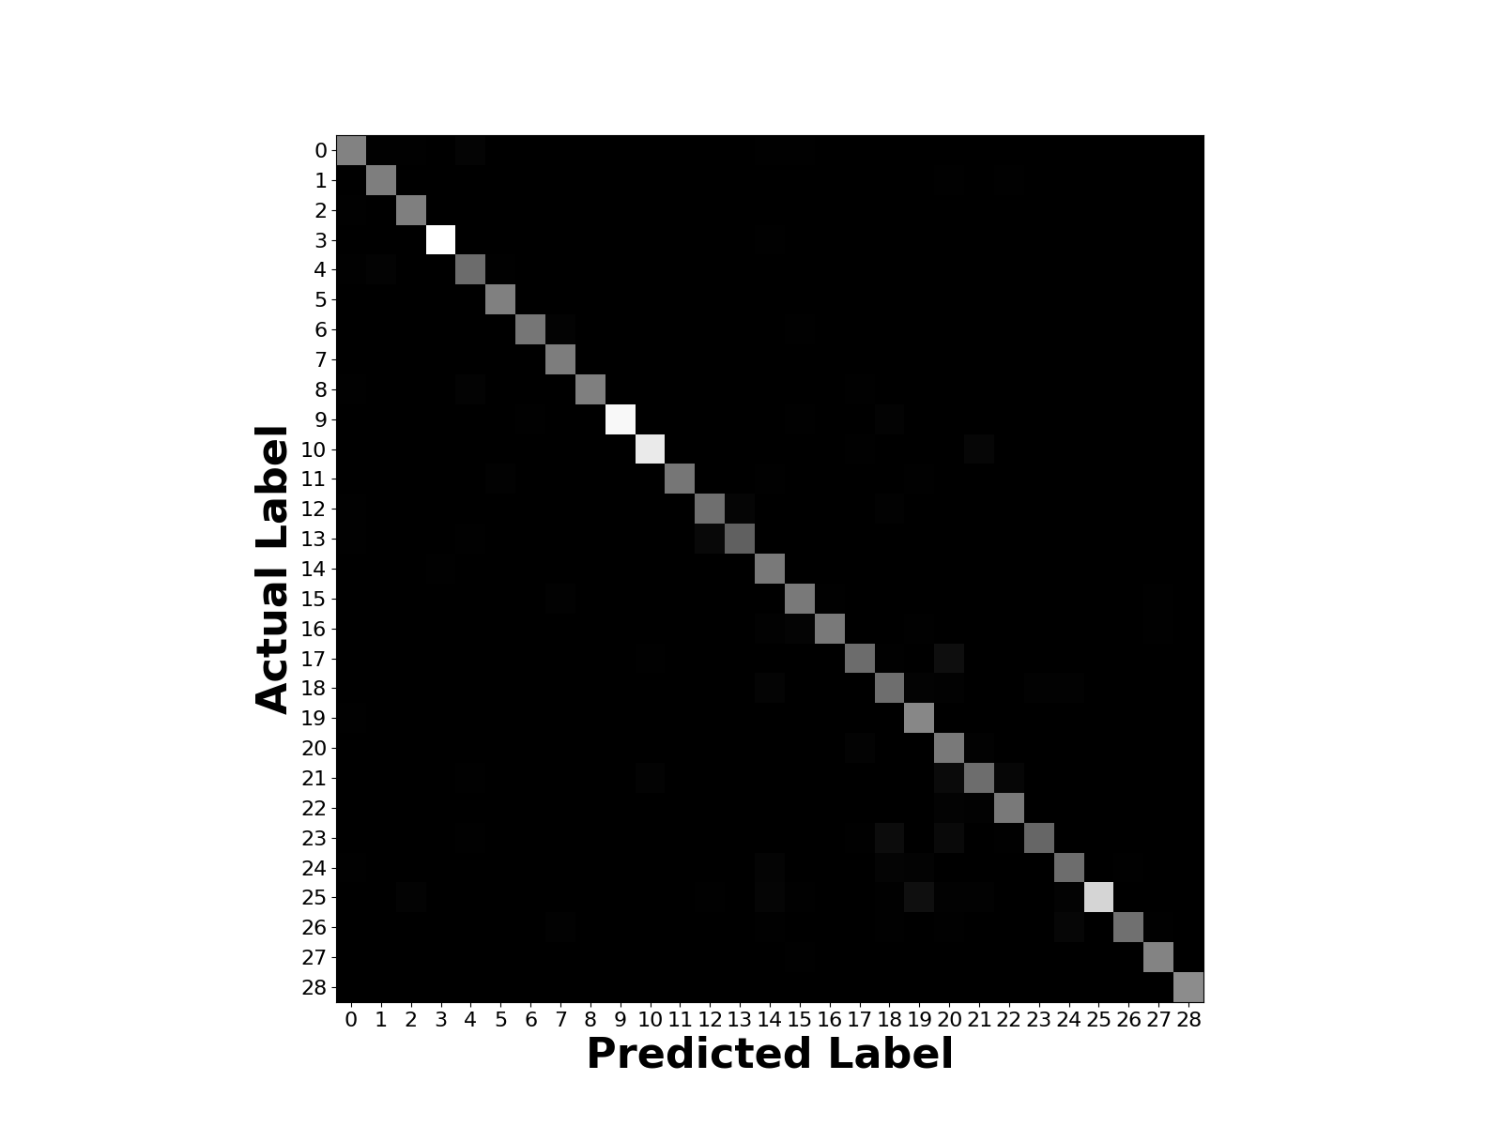
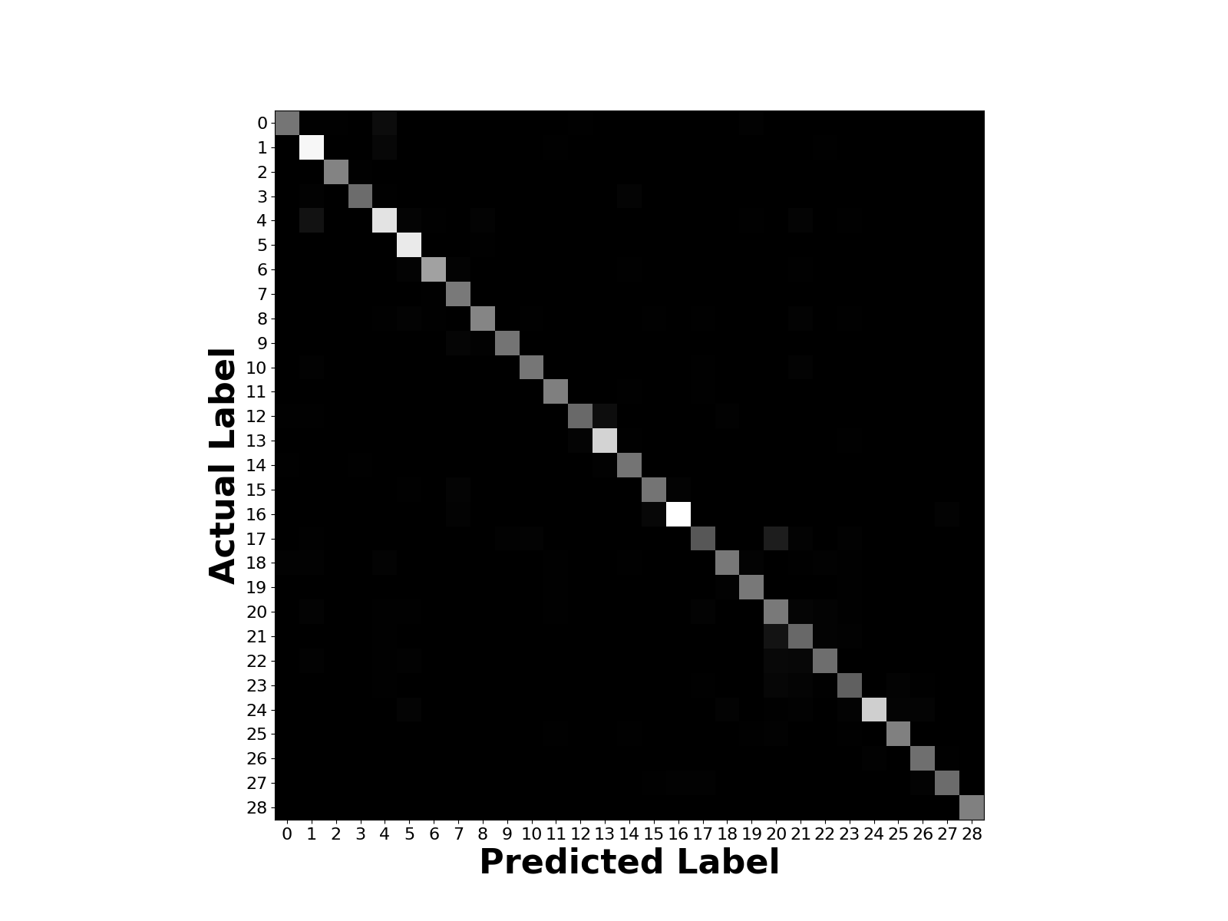
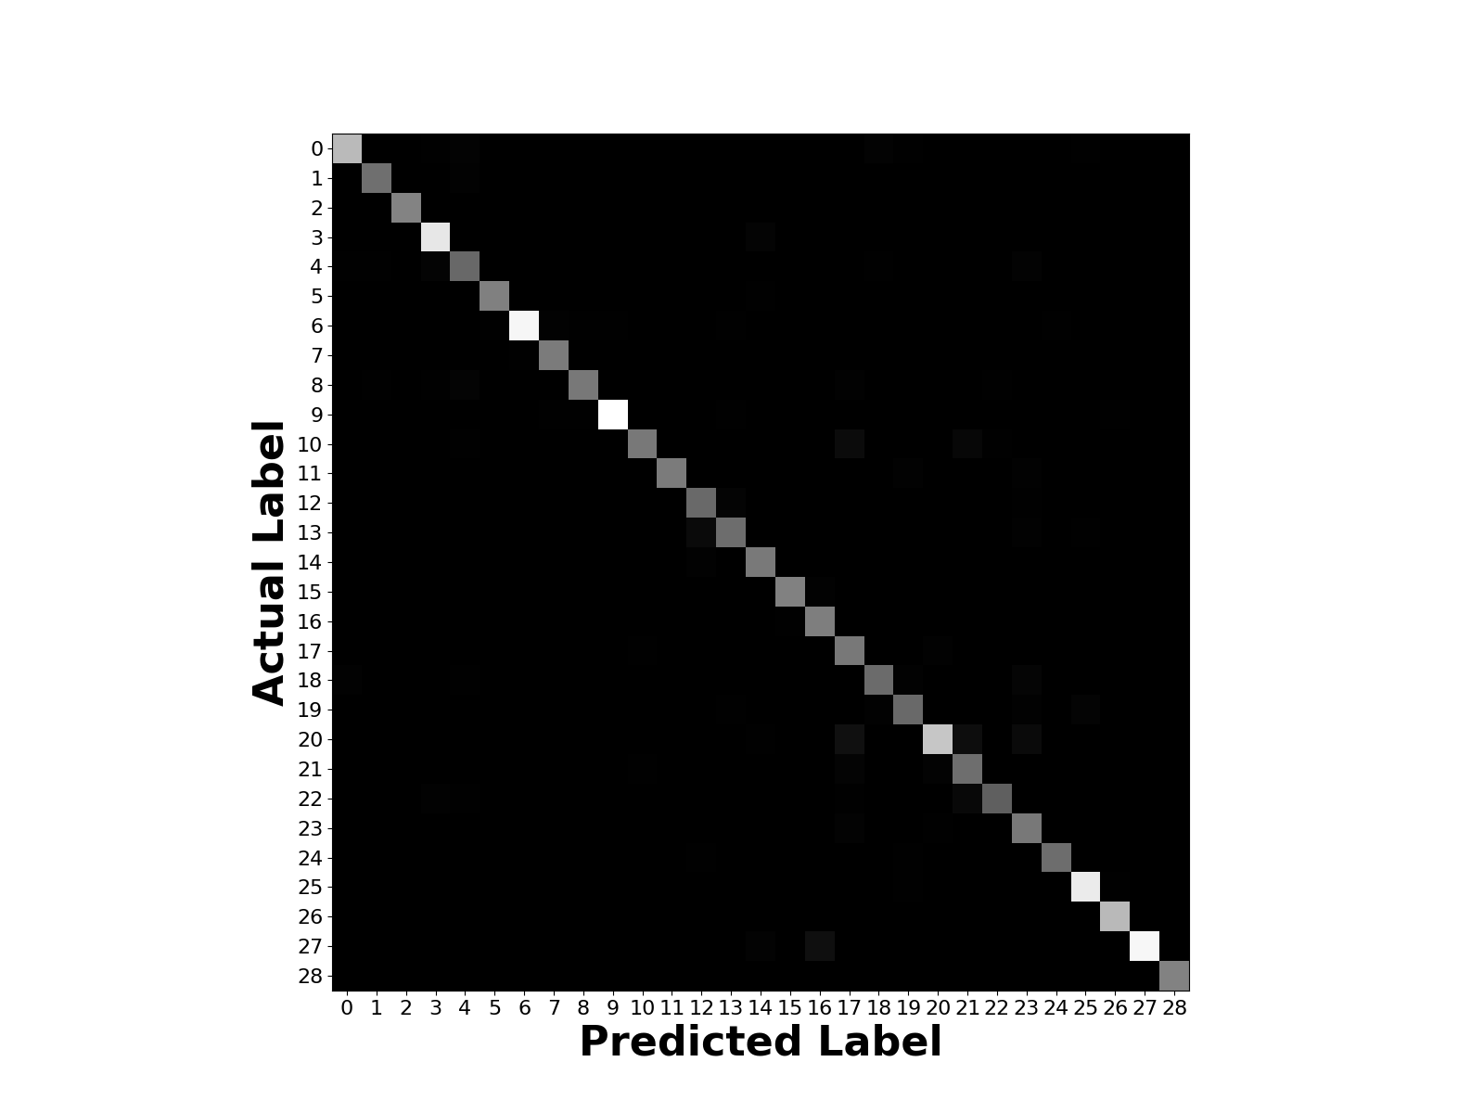
Example Confusion Matrices
Fold #0
Fold #3
Fold #6
Fold #9
All folds shows very strong main diagonal entries compare to the off-diagonals
Indicates classifiers that in general make correct predictions

Slide 30
Discussion on Confusion Matrices
Similar strong main diagonal and occasional off-diagonal are present in all folds
Shows consistency of the model when presented with different train/test permutations
Observation: In many cases, classifiers are prediction U when the correct class is K
Exploring the input samples shows that the signs for these characters differ only by the subtle placement of the thumb
Any new ASL learner is likely to make the same misjudgement

Slide 31
Concluding Remarks
Classifiers demonstrate exemplary performance in cross validation
Each model has a high successful classification rate with occasional misclassifications
Frequently confused classes show similar features that humans may also
The model shows little sensitivity to different subsets of training data from cross validation
This experiment can be expanded to include ASL words and phrases and could potentially allow to interface with LLMs

Slide 32
Appendex

Slide 33
Appendix: Tensor Flow
Main Documentation: https://www.tensorflow.org/
End-to-End python, C++, Java library for math and machine learning
Open source, continuously updated by Google

Slide 34
Appendix: Kaggle Dataset
The dataset use to train and evaluate in this project is sourced from Kaggle
Link: https://www.kaggle.com/datasets/grassknoted/asl-alphabet
DOI: 10.34740/kaggle/dsv/29550

