Slide 1
AI for Accessibility: Image Classification of the ASL Alphabet
Landon Buell – August 2023

Slide 2
Breakdown
Introduction
The Dataset
Preprocessing Procedures
The classification model
Architecture
Optimizer
Performance metrics
Cross Validation
Performance Analysis
Future work: Image generation
Citations

Slide 3
Introduction
Large Language Models (LLM’s) have made their way into the public eye over the course of the last 10 years [citation]
These models rely on text-based or speech-based input to operate
No LLM uses image-based or video-based input to allow for the use of American Sign Language (ASL) for communication
Apple’s Siri and Amazon’s Echo remain largely inaccessible to the deaf and hard of hearing (DHH) community

Slide 4
Introduction (cont.)
To provide a proof-of-concept, we train an image classifier neural network to recognize characters from the ASL alphabet
The complete ASL lexicon consists of a rich vocabulary of complex ideas, thoughts, and phrases
This concept of classifying images, and relating them to letters can be thought of as a proof-of-concept
Can be extended to recognize a wider range of ASL ideas

Slide 5
The Dataset
We have acquired a large library of 87,000 images that cover 29 unique classes
The first 26 classes represent the characters of the Latin alphabet, and the last three classes represent a space, delete, and nothing.
There are approximately 3,000 images for each class

Slide 6



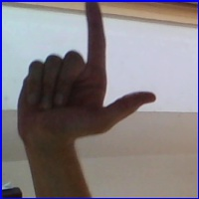
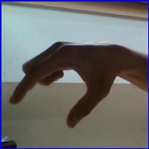


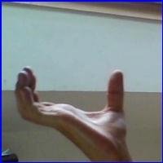
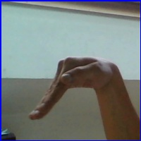

Select Examples from the Dataset
Class 0 - A
Class 1 - B
Class 9 - J
Class 11 - L
Class 16 - Q
Class 20 - U
Class 25 - Z
Class 26 - Space
Class 27 - Delete
Class 28 - Nothing

Slide 7
Preprocessing Procedures

