Slide 1

Classification through Frequency Bands
Landon Buell - 8 January 2020

Slide 2
The Goal
Build a Stochastic Gradient Descent Classifier Object
Classify any arbitrary waveform into one of 19 instrument classes
Classes are labeled 0 - 18

Slide 3
Raw Data Set
Approximately 1050 raw ‘.aif’ audio file stored locally
Use MATLAB to read them, isolate L & R channels
Rewrite them as L & R Mono ‘.wav’ files
Now, 2100 raw ‘.wav’ files

Slide 4
Labeled Data Sets
Class | Instrument
0 | Alto Flute
1 | Alto Saxophone
2 | Bass
3 | Bass Clarinet
4 | Bass Flute
5 | Bassoon
6 | Bass Trombone
7 | Bb Clarinet
8 | Cello
9 | Eb Clarinet
Class | Instrument
10 | Flute
11 | Horn
12 | Oboe
13 | Soprano Saxophone
14 | Tenor Trombone
15 | Trumpet
16 | Tuba
17 | Viola
18 | Violin
- | -

Slide 5
Assembling the Data
A Python program reads through all ~2100 files
Compute Discrete FFT
Stepped by 1/10 Hz
Normlized Amplitude
Divide up each FFT into N bands
Establish Frequency bands
Hardcoded in for now
Write out to respective CSV file

Slide 6
Frequency Bands
Band Name | Low Frequency [Hz] | High Frequency [Hz]
Band 1 | 0 | 200
Band 2 | 200 | 500
Band 3 | 500 | 1000
Band 4 | 1000 | 1500
Band 5 | 1500 | 2000
Band 6 | 2000 | 2500
Band 7 | 2500 | 3000
Band 8 | 3000 | 3500
Band 9 | 3500 | 4000

Slide 7
Finished Data set
- | Low Freq [Hz] | … | … | … | … | High Freq [Hz]
File#1 L |  |  | … | …
File#1 R |  |  | … | …
File#2 L |  |  | … | …
File#2 R |  |  | … | …
… | … | … | … | … | … | …
… | … | … | … | … | … | …
File#N L |  |  | … | …
File#N R |  |  | … | …
Each row is a file – a sample
Each column is a power spectrum value – a feature
This is a common convention
N samples x M features
Ready to be used by scikit learn

Slide 8
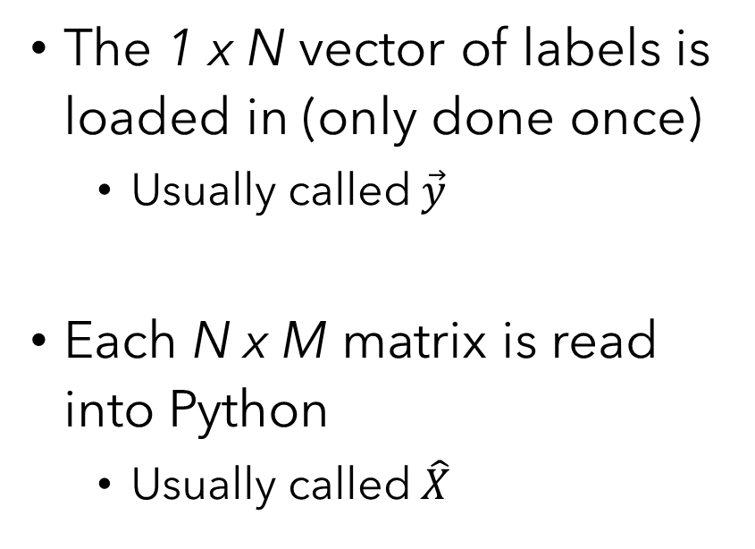
Training Each Band Classifier
The 1 x N vector of labels is loaded in (only done once)
Usually called $\vec{y}$
Each N x M matrix is read into Python
Usually called $\hat{X}$
Data is shuffled accordingly
Random or Stratified
Broken into Train/Test sets
Data is them “fit” to the classifier object

Slide 9
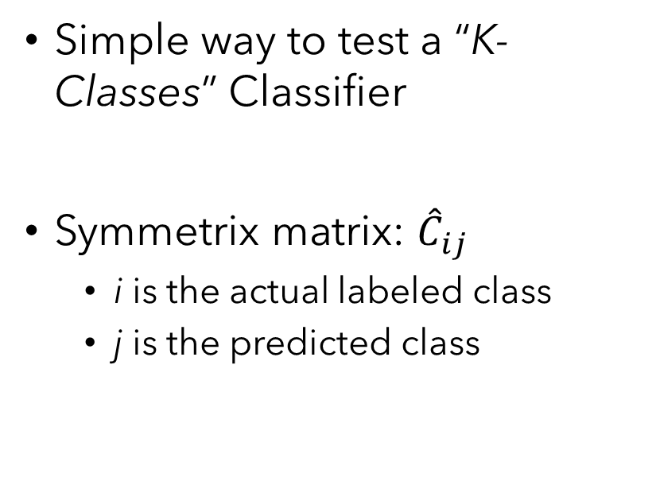
Confusion Matrix
Simple way to test a “K- Classes” Classifier
Symmetrix matrix: ${\hat{C}}_{ij}$
i is the actual labeled class
j is the predicted class
A “Good” classifier has a strong main diagonal
Large number of predictions match labels
Ideally weak off diagonals as well
Great for figuring out what classes are often confused

Slide 10
Confusion Matrix (Cont.)
Quick Example for a “Good” 4-Classes Classifier
Let all values be out of 1000 for example
 | Predicted 1 | Predicted 2 | Predicted 3 | Predicted 4
Actual 1 | 912 | 215 | 134 | 202
Actual 2 | 134 | 798 | 401 | 290
Actual 3 | 566 | 423 | 812 | 64
Actual 4 | 243 | 304 | 98 | 902

