Slide 1

Classification through Frequency Bands
Landon Buell - 8 January 2020

Slide 2
Preliminaries
Work & Methodology

Slide 3
Raw Data Set
Approximately 1050 raw ‘.aif’ audio file stored locally
Use MATLAB to read them, isolate L & R channels
Rewrite them as L & R Mono ‘.wav’ files
Now, 2100 raw ‘.wav’ files

Slide 4
The Goal
Build a Stochastic Gradient Descent Classifier Object
Classify any arbitrary waveform into one of 19 instrument classes
Classes are labeled 0 - 18

Slide 5
Labeled Data Sets
Class | Instrument | Class | Instrument
0 | Alto Flute | 10 | Flute
1 | Alto Saxophone | 11 | Horn
2 | Bass | 12 | Oboe
3 | Bass Clarinet | 13 | Soprano Saxophone
4 | Bass Flute | 14 | Tenor Trombone
5 | Bassoon | 15 | Trumpet
6 | Bass Trombone | 16 | Tuba
7 | Bb Clarinet | 17 | Viola
8 | Cello | 18 | Violin
9 | Eb Clarinet | - | -

Slide 6
Assembling the Data
A Python program reads through all ~2100 files
Compute Discrete FFT
Stepped by 1/10 Hz
Normalized Amplitude
Divide up each FFT into N bands
Establish Frequency bands
Hardcoded in for now
Write out to respective CSV file for each Band
One CSV file contains:
2100 rows x M columns

Slide 7
Frequency Bands
Band Name | Low Frequency [Hz] | High Frequency [Hz]
Band 1 | 0 | 200
Band 2 | 200 | 500
Band 3 | 500 | 1000
Band 4 | 1000 | 1500
Band 5 | 1500 | 2000
Band 6 | 2000 | 2500
Band 7 | 2500 | 3000
Band 8 | 3000 | 3500
Band 9 | 3500 | 4000

Slide 8
Finished Data set
- | Low Freq [Hz] | … | … | … | … | High Freq [Hz]
File#1 L |  |  | … | …
File#1 R |  |  | … | …
File#2 L |  |  | … | …
File#2 R |  |  | … | …
… | … | … | … | … | … | …
… | … | … | … | … | … | …
File#N L |  |  | … | …
File#N R |  |  | … | …
Each row is a file – a sample
Each column is a power spectrum value – a feature
This is a common convention
N samples x M features
Ready to be used by scikit learn

Slide 9
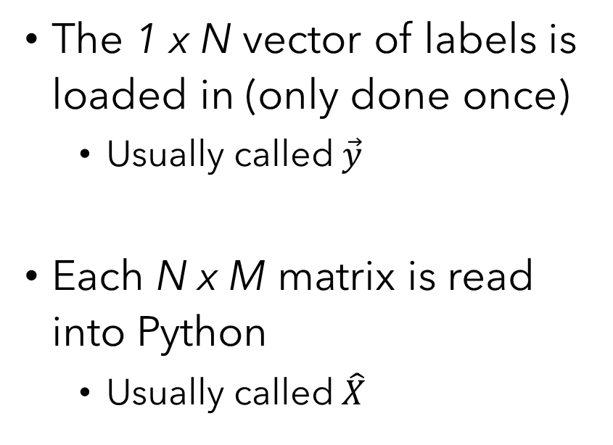
Training Each Band Classifier
The 1 x N vector of labels is loaded in (only done once)
Usually called $\vec{y}$
Each N x M matrix is read into Python
Usually called $\hat{X}$
Data is shuffled accordingly
Random or Stratified
Broken into Train/Test sets
Data is them “fit” to the classifier object

Slide 10
One vs. All (OvA) Classifier
Under the Hood: We have 19 binary Classifiers
Tests validity of one case against all other cases
Can use Decision function
Returns array of likelihoods of prediction
Can be normalized to determine % chance for each class

Slide 11
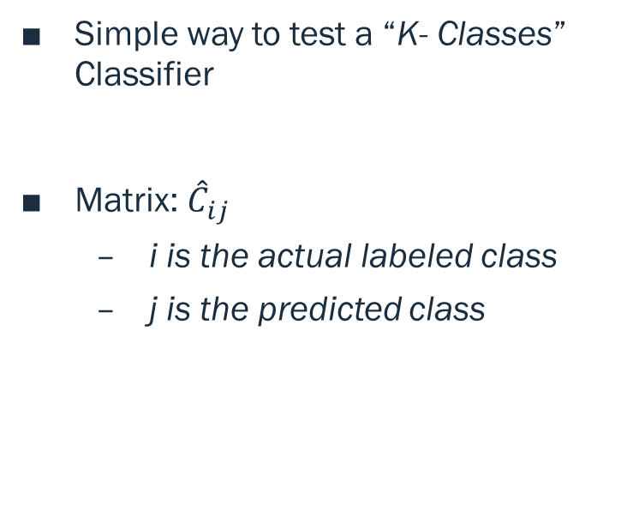
Confusion Matrix
Simple way to test a “K- Classes” Classifier
Matrix: ${\hat{C}}_{ij}$
i is the actual labeled class
j is the predicted class
A “Good” classifier has a strong main diagonal
Large number of predictions match labels
Ideally weak off diagonals as well
Ideally “almost” symmetric
Great for figuring out what classes are often confused

Slide 12
Confusion Matrix (Cont.)
 | Predicted 1 | Predicted 2 | Predicted 3 | Predicted 4
Actual 1 | 912 | 215 | 134 | 202
Actual 2 | 134 | 798 | 401 | 290
Actual 3 | 566 | 423 | 812 | 64
Actual 4 | 243 | 304 | 98 | 902
Quick Example for a “Good” 4-Classes Classifier
Let all values be out of 1000 for example

Slide 13
Confusion Matrices
Matrices for 9 different 19-Fold Classifiers
Colors Coded in Grayscale
White means higher value in entry
Black means lower value in entry

Slide 14
Results of Initial Attempt
9 Frequency Bands

Slide 15
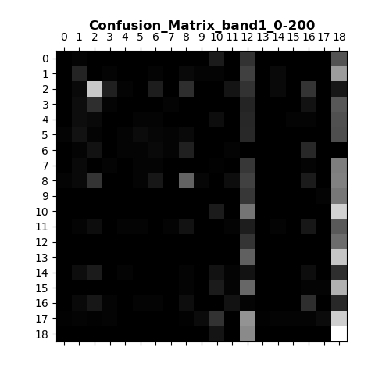
0 – 200 Hz Band
2001 Input Layer Features
2 = Bass
8 = Cello
12 = Oboe
17 = Viola
18 = Violin

Slide 16
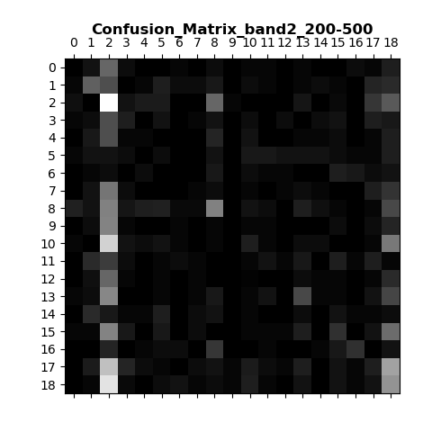
200 – 500 Hz Band
3001 Input Layer Features
A Main Diagonal appears slightly

Slide 17
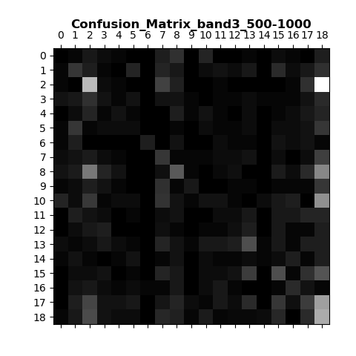
500 – 1000 Hz Band
5001 Input Layer Features

Slide 18
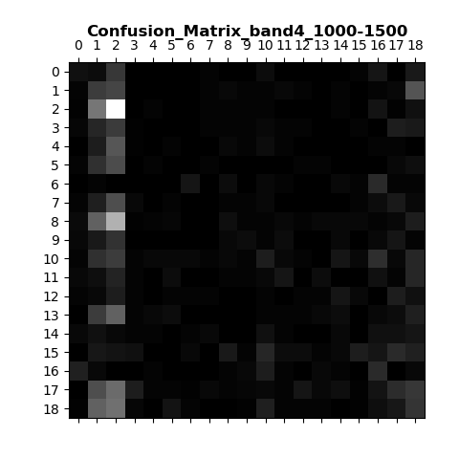
1000 – 1500 Hz Band
5001 Input Layer Features

Slide 19
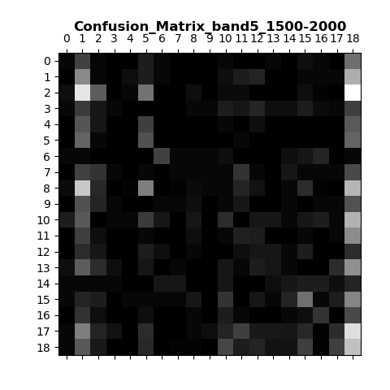
1500 – 2000 Hz Band
5001 Input Layer Features

Slide 20
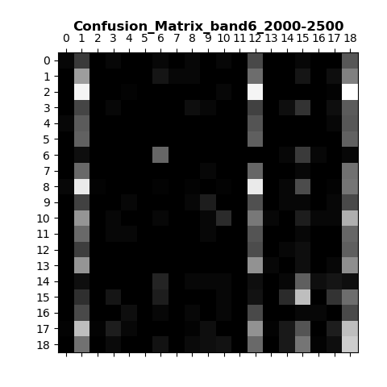
2000 – 2500 Hz Band
5001 Input Layer Features
A Main Diagonal appears slightly

Slide 21
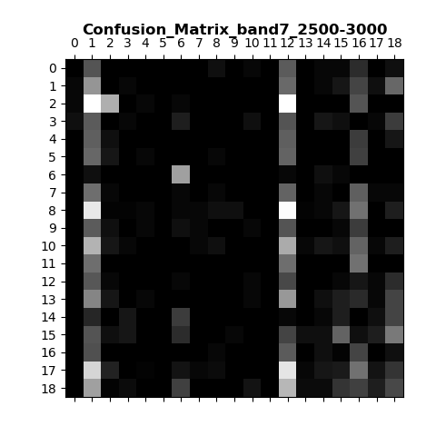
2500 – 3000 Hz Band
5001 Input Layer Features

Slide 22
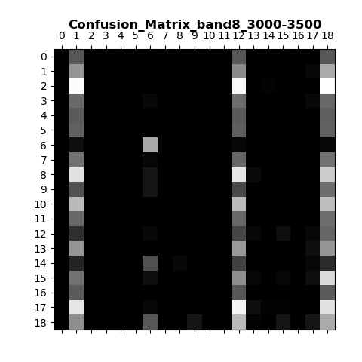
3000 – 3500 Hz Band
5001 Input Layer Features
Values almost exclusive to 3 columns
1 = Salto Sax
12 = Oboe
18 = Violin

Slide 23
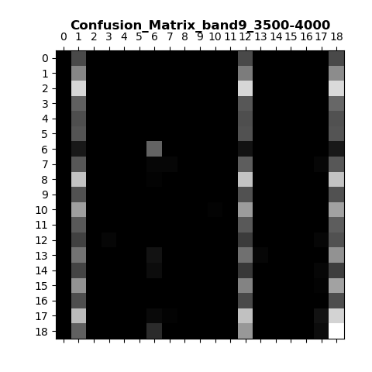
3500 – 4000 Hz Band
5001 Input Layer Features
Values almost exclusive to 3 columns
1 = Salto Sax
12 = Oboe
18 = Violin
Same columns as previous bands

Slide 24
Analysis
All Frequency Bands seem to have strong columns
This means this classifier is constantly predicting the same few classes
Columns That Appear:
1 = Alto Sax
2 = Bass
8 = Cello
12 = Oboe
18 = Violin
All classifiers can find a Ten. Tromb. Consistently

Slide 25
Analysis (cont.)
For Higher Bands:
Classifier predicts same three classes more often
Alto Sax, Oboe, Violin
For Lower Bands
Predictions are far More Chaotic
Some Good News
Main Diagonals Appear slightly in the 200 – 1500 Hz
This is where most instruments in this set lie

Slide 26
Where Do We Go Now?
(Sweet Child)

Slide 27
The Idiot Checks
Data is Arranged Properly when fed into classifier
N_samples x N_features
Labels Match accordingly
Test Classifier w/o shuffeling
Classifier is used as per documentation
Confusion Matrix is used as per documentation

Slide 28


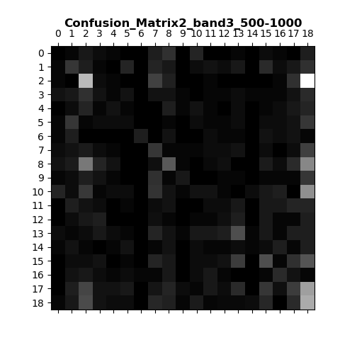






Test Without Shuffling Data

Slide 29
What Now?
Best Guess: Confused by position of Spikes in the FFT Spectrum
Example:
Cello at A3 ~ Trombone at A3
Cello at Eb3 ≠ Cello at A4
Some of Landon’s Possible Solutions :

Slide 30
“Normalize” Frequencies
Use a Shift command to roll the position of the frequency spikes
First spike lies at some frequency ‘f’
Subsequent overtones remain at integer multiples of f
Can be done before or after the separation of frequency bands

Slide 31
Examine Individual Spikes
Use a peak detection algorithm (scipy, numpy or from scratch)
Isolate arbitrary peaks in each FFT and use that shape as a basis
Shape to model, independent of exact pitch
Allows us to say “Instrument A has a spike shaped like f(x) in frequency band B”
Eliminates bias of location of spike and prioritizes shape
Allows for adjusting of shape in different bands as well

Slide 32
Build a More General Classifier
Use Classification to Identity Families of instruments
Winds vs. Brass vs. Strings vs …
Allows for More General Identification into families
More specific parameters can be tested afterwards
Then identify a specific instrument in that category

Slide 33
Adjust Weighting Matrix
Can Build a matrix to prioritize certain features
This would be tough to Code
Computationally expensive to implement
Each weighting matrix would be different for each sample

Slide 34
Alternate Classification Algorithm
Stochastic Gradient Descent is among the most common methods
This will require a lot time – need to research these methods more
Possible Include Decision trees for certain parameters
Account for pitch range

Slide 35
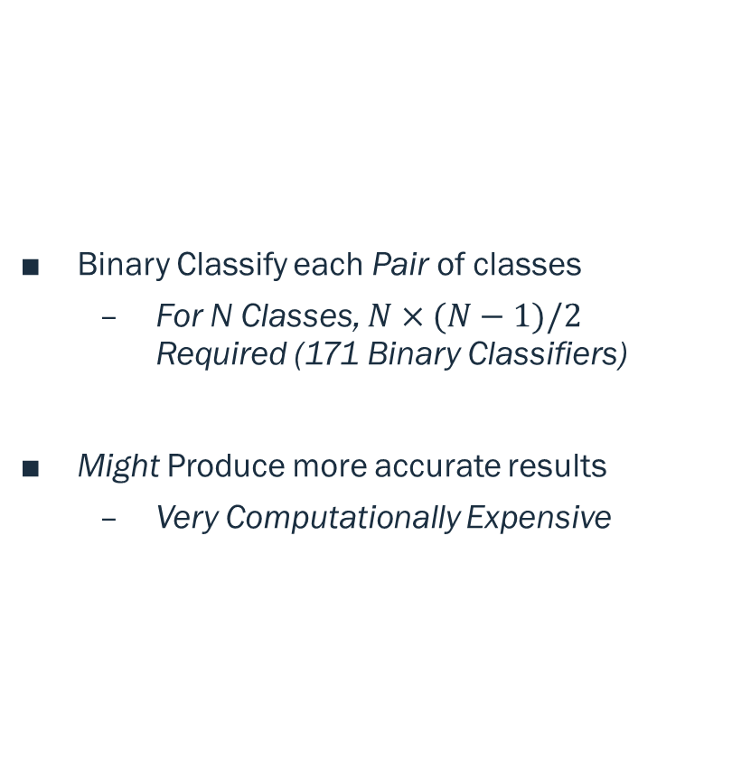
One vs. One (OvO) Classifier
Binary Classify each Pair of classes
For N Classes, $N×(N−1)/2$ Required (171 Binary Classifiers)
Might Produce more accurate results
Very Computationally Expensive

Slide 36
K – Nearest Neighbors
This would be best when combined with other methods
Use KNN of individual spikes
Can help identify shapes and smaller spikes in the FFT domain

Slide 37
Other Data In the Waveform
Use Time – Space data – Just the wave form
This is going to be too volatile, even normalized
Phase, length, Dead noise, etc.
Use Hilbert Transform to Build Amplitude envelope
Break into Attack, Decay, Sustain, Release

Slide 38
The Current Plan – A Combination
Normalize Frequency spectrum
Eliminates Bias based on position of spike
Favors shape of Spike
Examine Individual Spikes
Use KNN to test shape of each spike
Also forces to favor the spike

Slide 39
Next Meeting…
Next Stage of Frequency Classifier
Test for shapes in FFT spectrum
Remove position-based parameters
Finer parameters in Scipy’s SGD Classifier
Alternate test Methods

