Slide 1
Features for Audio Classification
Landon Buell
August 2020

Slide 2
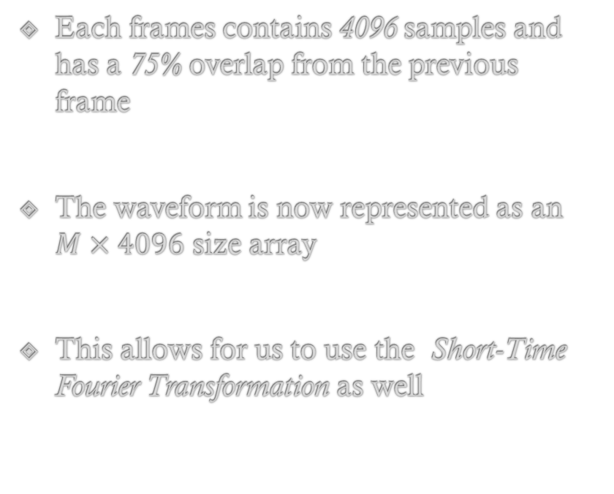
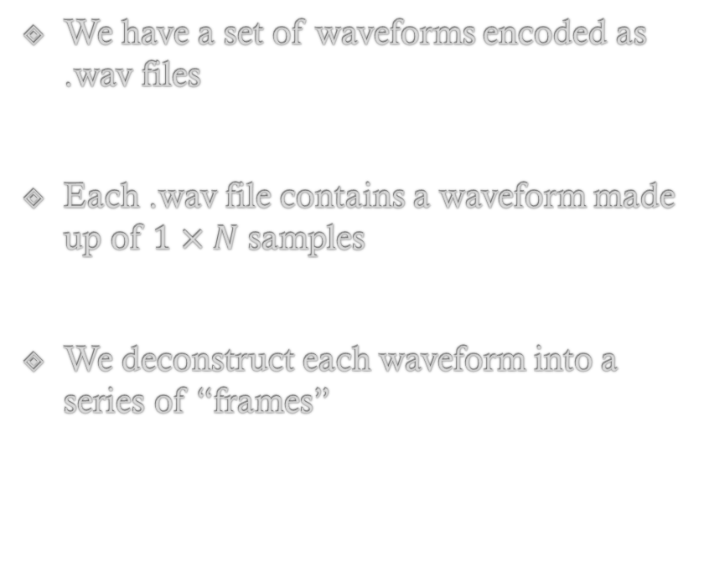
Time Frame Object
We have a set of waveforms encoded as .wav files
Each .wav file contains a waveform made up of $1×N$ samples
We deconstruct each waveform into a series of “frames”
Each frames contains 4096 samples and has a 75% overlap from the previous frame
The waveform is now represented as an $M×4096$ size array
This allows for us to use the Short-Time Fourier Transformation as well

Slide 3
Time Frame Object (Cont.)

Slide 4

Time – Domain Features
Waveform $x$ containing N discrete samples
Indexed by $x\left[i\right], i ∈\{0,1,2,…,N−2,N−1\}$

Slide 5
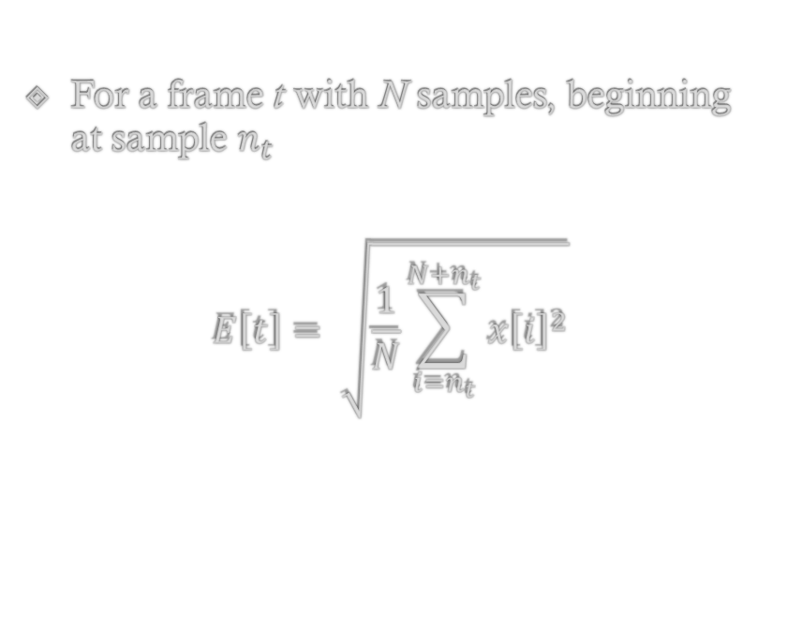
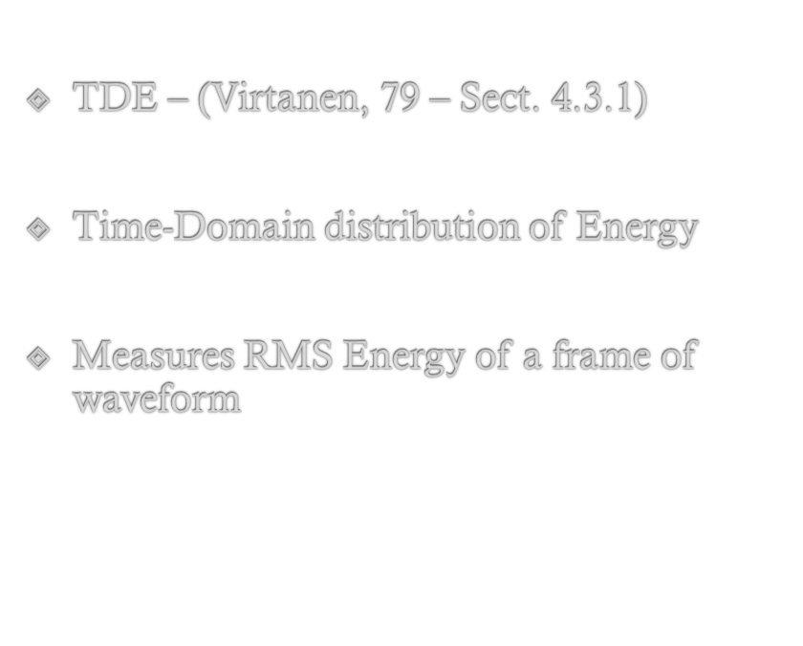
Time Domain Envelope
TDE – (Virtanen, 79 – Sect. 4.3.1)
Time-Domain distribution of Energy
Measures RMS Energy of a frame of waveform
For a frame t with N samples, beginning at sample $n_{t}$
$$E\left[t\right]= \sqrt{\frac{1}{N}\sum_{i=n_{t}}^{N+n_{t}}{{x\left[i\right]}^{2}}}$$

Slide 6
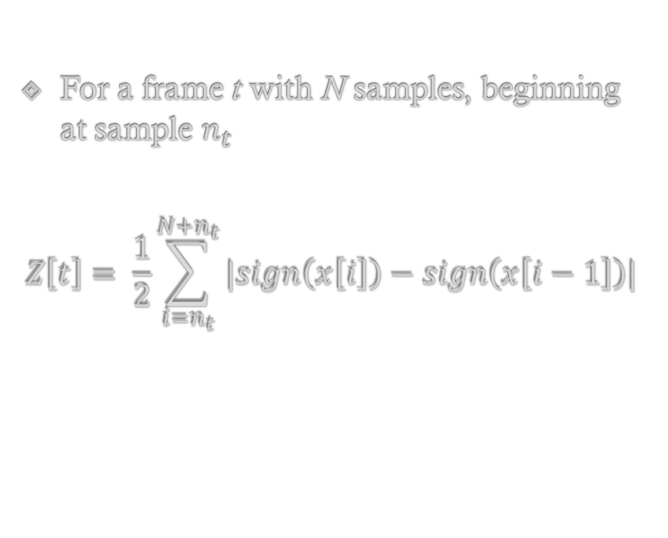
Zero – Crossing Rate
ZXR – (Virtanen, 79 – Sect. 4.3.1)
Measures the Amount of times a signal crosses the x-axis of a waveform
Mostly used in Speech Classification
See Kahn & Al-Kathib
For a frame t with N samples, beginning at sample $n_{t}$
$$Z\left[t\right]= \frac{1}{2}\sum_{i=n_{t}}^{N+n_{t}}{|sign\left(x\left[i\right]\right)−sign\left(x\left[i−1\right]\right)|}$$

Slide 7
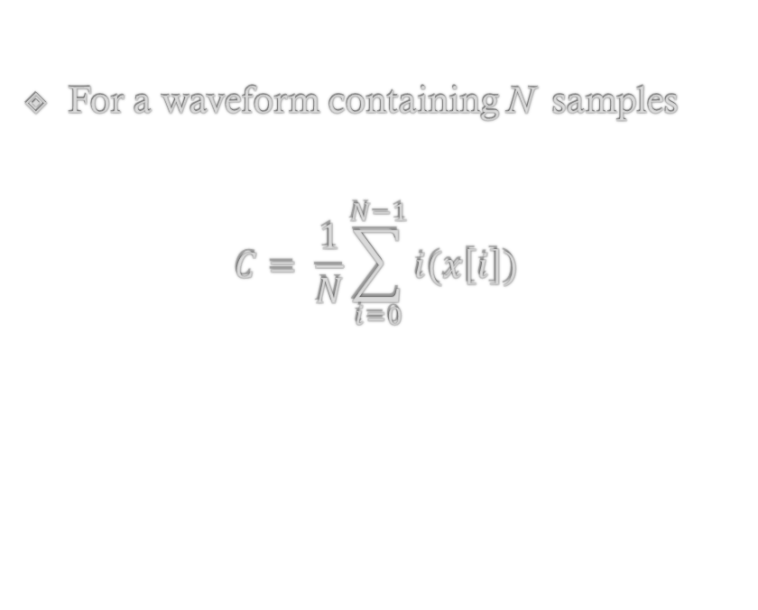
Center of Mass
COM – (Virtanen, 79 – Sect. 4.3.1)
Measure’s “Center of Gravity” of waveform or frame
Temporal “Centroid”
Surprisingly Useful Feature
For a waveform containing N samples
$$C= \frac{1}{N}\sum_{i=0}^{N−1}{i(x\left[i\right])}$$

Slide 8
Waveform Distribution Statisitics
WDS – (Virtanen, 79 – Sect. 4.3.1)

Slide 9
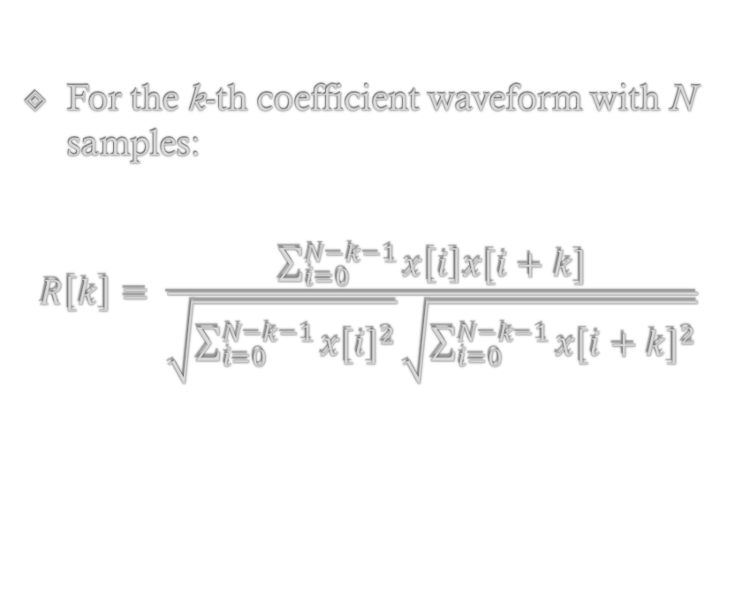
Auto – Correlation Coefficients
ACC – (Virtanen, 80 – Sect. 4.3.1)
Signal Spectral Distribution in Time Domain
Use first “k” coefficients in practice
For the k-th coefficient waveform with N samples:
$$R\left[k\right]= \frac{\sum_{i=0}^{N−k−1}{x\left[i\right]x[i+k]}}{\sqrt{\sum_{i=0}^{N−k−1}{{x[i]}^{2}}}\sqrt{\sum_{i=0}^{N−k−1}{{x[i+k]}^{2}}}}$$

Slide 10
Waveform Rise - Time
Time between l0% - 90% amplitude rise time
Measures waveform “attack time” in units of time or samples

Slide 11
Waveform Decay - Time
Time between 90% - 10% amplitude fall time
Measures waveform “Release time” in units of time or samples

Slide 12
Frequency – Domain Features

Slide 13

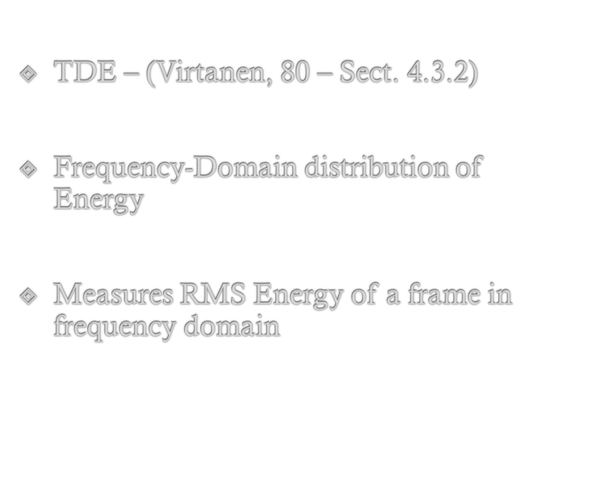
Frequency Domain Envelope
TDE – (Virtanen, 80 – Sect. 4.3.2)
Frequency-Domain distribution of Energy
Measures RMS Energy of a frame in frequency domain
For a frame f with N samples, beginning at sample $n_{t}$
$$E\left[f\right]= \sqrt{\frac{1}{N}\sum_{i=n_{f}}^{N+n_{f}}{{x\left[i\right]}^{2}}}$$

