Slide 1

BY: LANDON MICHAEL
Paul wakes up to the sound of his phone buzzing, it’s 8:05 a.m. and he has class in 25 minutes! Living off campus, Paul has to commute and find a parking spot in very little time which is hard enough when not in a rush.

Slide 2

Hurrying to get ready, Paul throws on his clothes, grabs his computer bag, and gets his keys and runs out the door. Panicking, Paul starts to remember a parking app for college students that helps them find parking. PARKING APP! Quickly he downloads it and puts in his info.

Slide 3
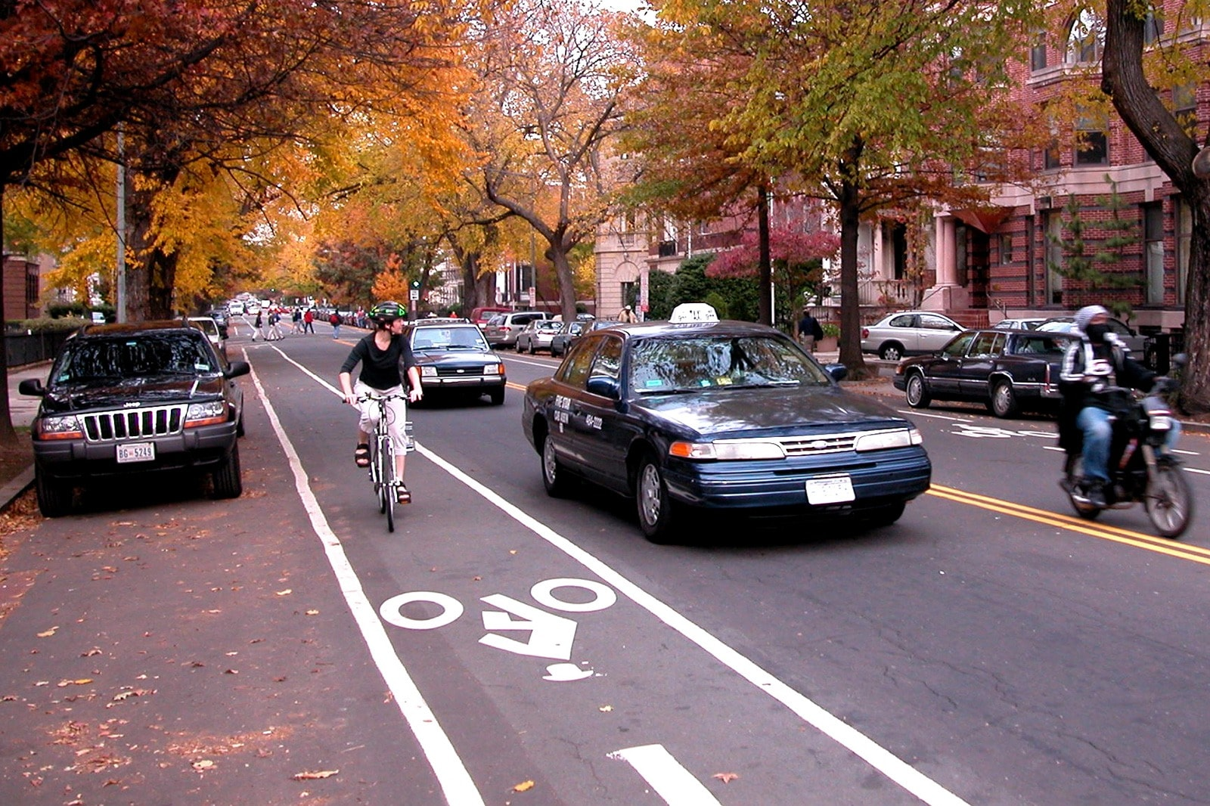
As Paul drives through traffic (making sure not to speed too much!), the “PARKING APP” is directing and showing him where available parking spots near his desired location.

Slide 4
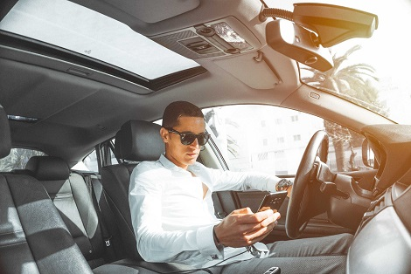
As Paul continues driving, the ”PARKING APP” notified him that the current parking area he was looking at became FULL! Quickly, he refreshed the search engine, the app showed another nearby parking spot with 8 spots still available.

Slide 5

After parking, Paul looks at his watch to check the time. He is astonished to find out he has 7 minutes to get to class; which is plenty of time. He knows that without have using that app to help him find parking he would have easily been late trying to find somewhere to park.

Slide 6
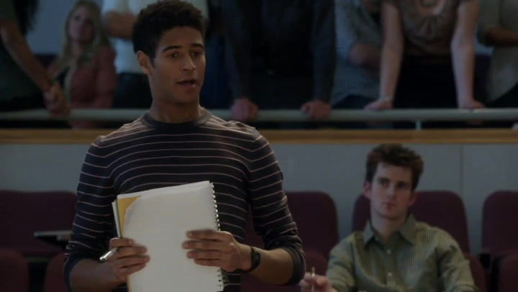
Thanks to “PARKING APP” Paul was able to find a parking spot on campus near his class with ease. Allowing him to get to class on time and present his project he had been working on.

