Slide 1
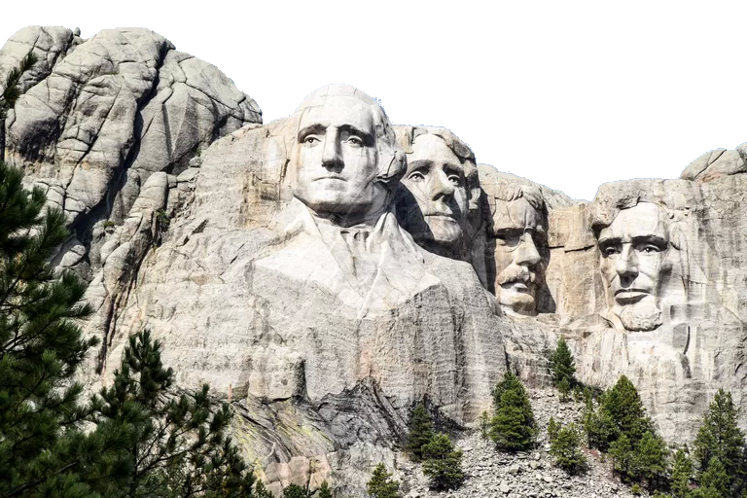
Presidential Inaugural Speeches
Orange 9
Presenters:
Landon Wilson and Helen Blades
Other Contributing Team Members:
McLeod Brown, Liam Dao, Pranav Ram

Slide 2
Warning
IN NO WAY DOES THE FOLLOWING INFORMATION PORTRAY POLITICAL IDEOLOGY, OPINIONS, OR PREFERENCES.

Slide 3
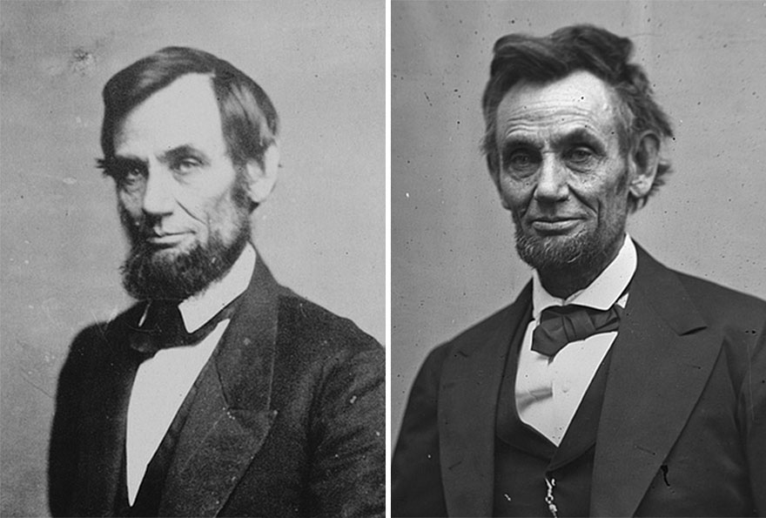
Pre-1900 reelected Presidents’ negativity score increased on average by
74% in their second speech as compared to their first speech

Slide 4



Agenda
Trends in Word Frequency
Sentiment Analysis
Multiple Terms

Slide 5
Trends in Word Frequency

Slide 6
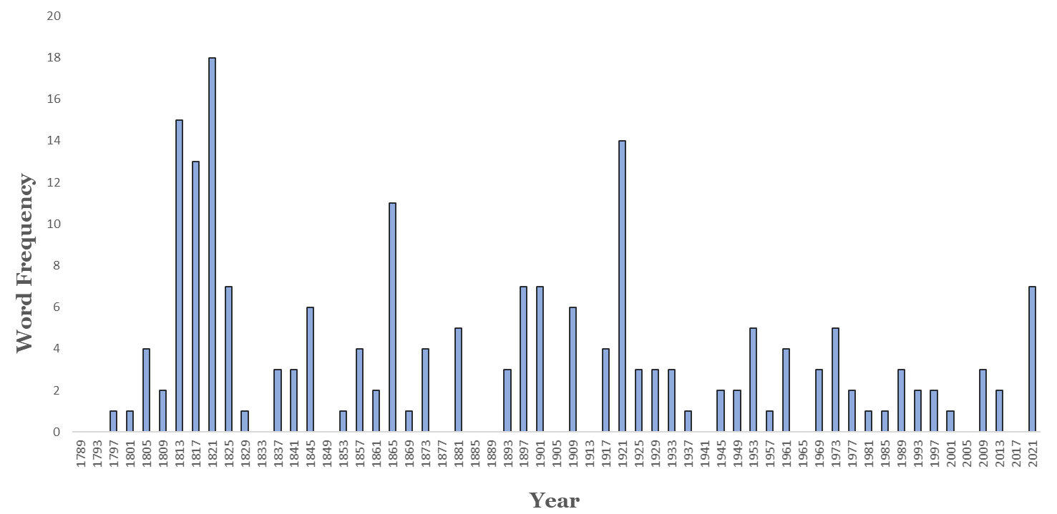
War
War of 1812
WWI
Civil War
Spanish
American
War
Mexican
American
War
Vietnam War
WWII

Slide 7
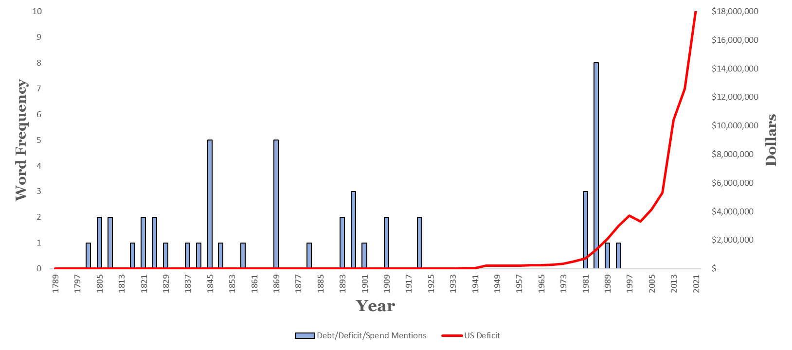
Debt (1789-2021)

Slide 8
Debt (1789-2021)

Slide 9
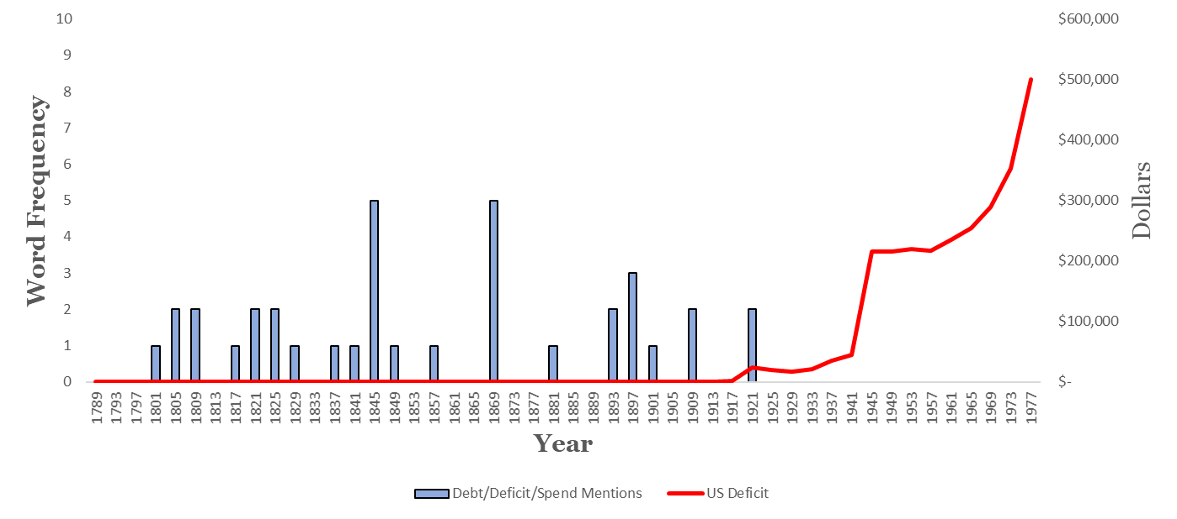
Debt (1789-1977)
“War on Poverty”
WWI
WWII

Slide 10
Debt (1789-2021)

Slide 11
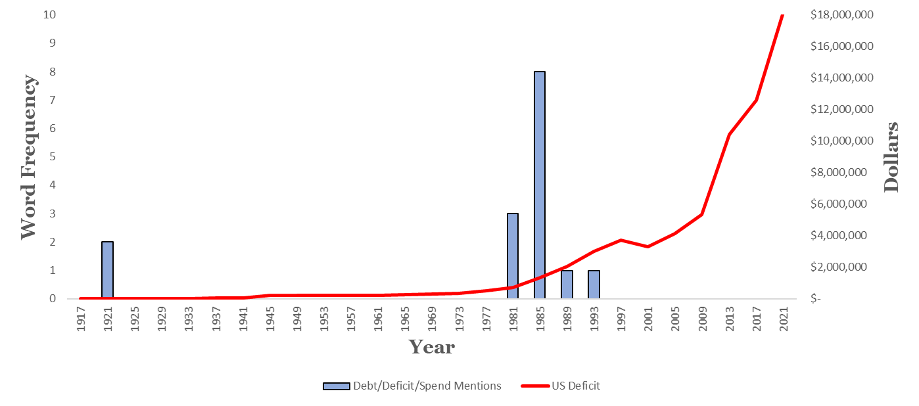
Debt (1917-2021)
President Reagan
War in the Middle East
The Great Recession
COVID-19
Cold War
President Clinton

Slide 12
Differences in Sentiment by Party

Slide 13
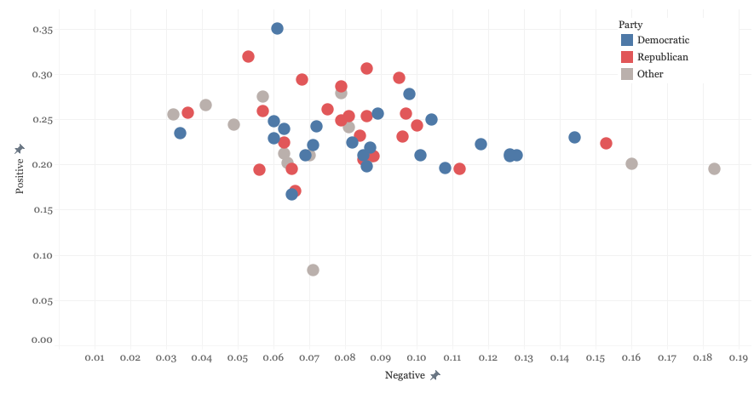
All Speeches

Slide 14
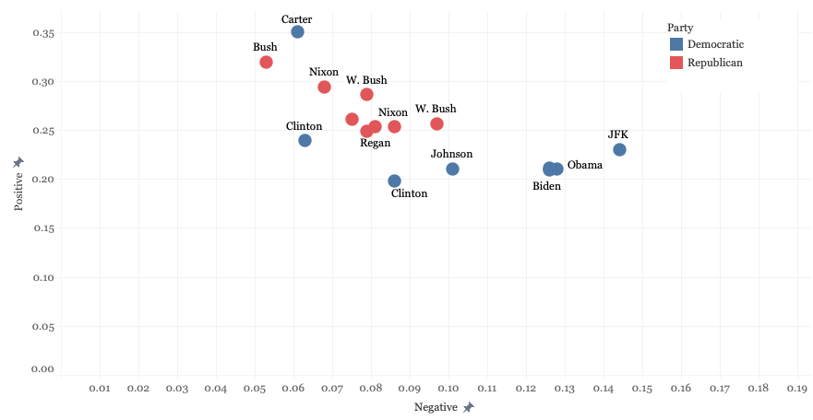
After 1960

Slide 15
Multiple Terms

Slide 16
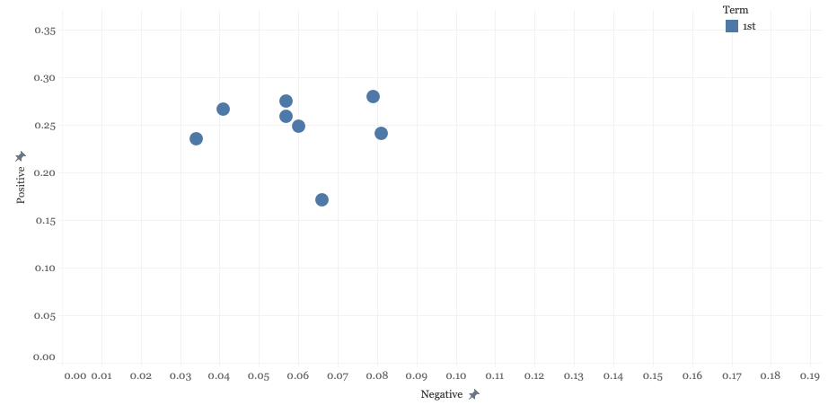
Before 1900 1st term

Slide 17
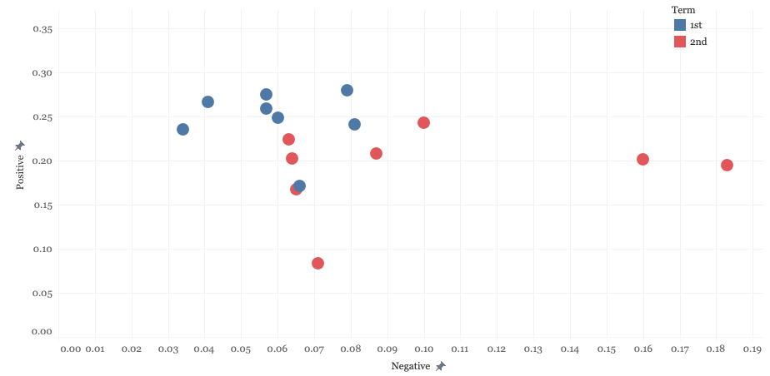
Before 1900 2nd term

Slide 18
Before 1900 2nd term
Madison, 1st
2nd

Slide 19
Before 1900 2nd term
Washington, 1st
Madison, 1st
2nd
2nd

Slide 20
Before 1900 2nd term
Washington, 1st
Madison, 1st
2nd
2nd
Lincoln, 1st
2nd

Slide 21
Before 1900 2nd term
74% increase in negativity score
Washington, 1st
Madison, 1st
2nd
2nd
Lincoln, 1st
2nd

Slide 22
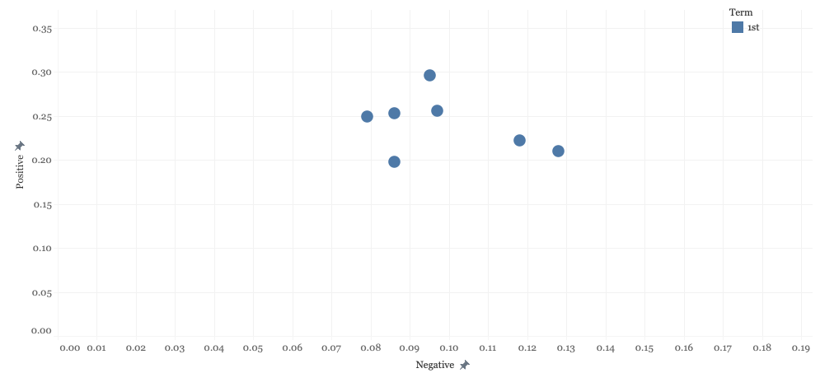
After 1900 1st term

Slide 23
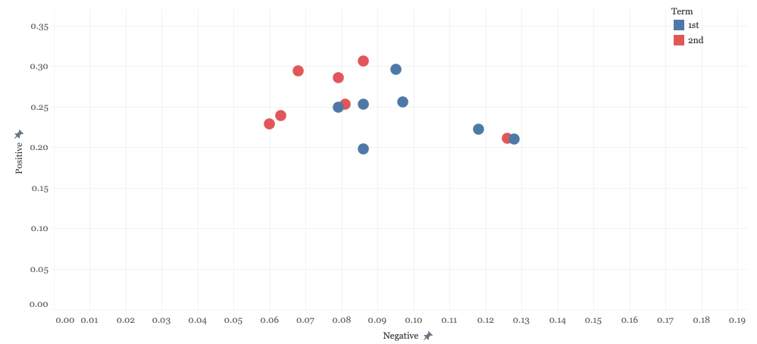
After 1900 1st and 2nd term

Slide 24
After 1900 1st and 2nd term
Wilson, 1st
2nd

Slide 25
After 1900 1st and 2nd term
2nd
Wilson, 1st
2nd
Clinton, 1st

Slide 26
After 1900 1st and 2nd term
2nd
GW. Bush, 1st
2nd
Wilson, 1st
2nd
Clinton, 1st

Slide 27
After 1900 1st and 2nd term
2nd
GW. Bush, 1st
2nd
Wilson, 1st
2nd
2nd
Obama, 1st
Clinton, 1st

Slide 28
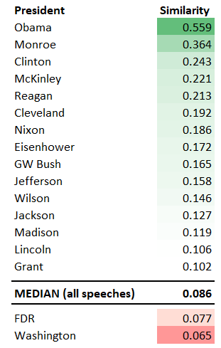
Speech Similarity

Slide 29
Take Away
Presidential inaugural speeches have generally become more ambiguous and generalized over time.

