Slide 1


Predictive Global Climate Modeling Using Teleconnection Patterns
By Tyson Stewart, Landon Moeller, Owen Cutinello, and Matthew Woods
Everstream Liaison: Dr. Logan Bundy

Slide 2
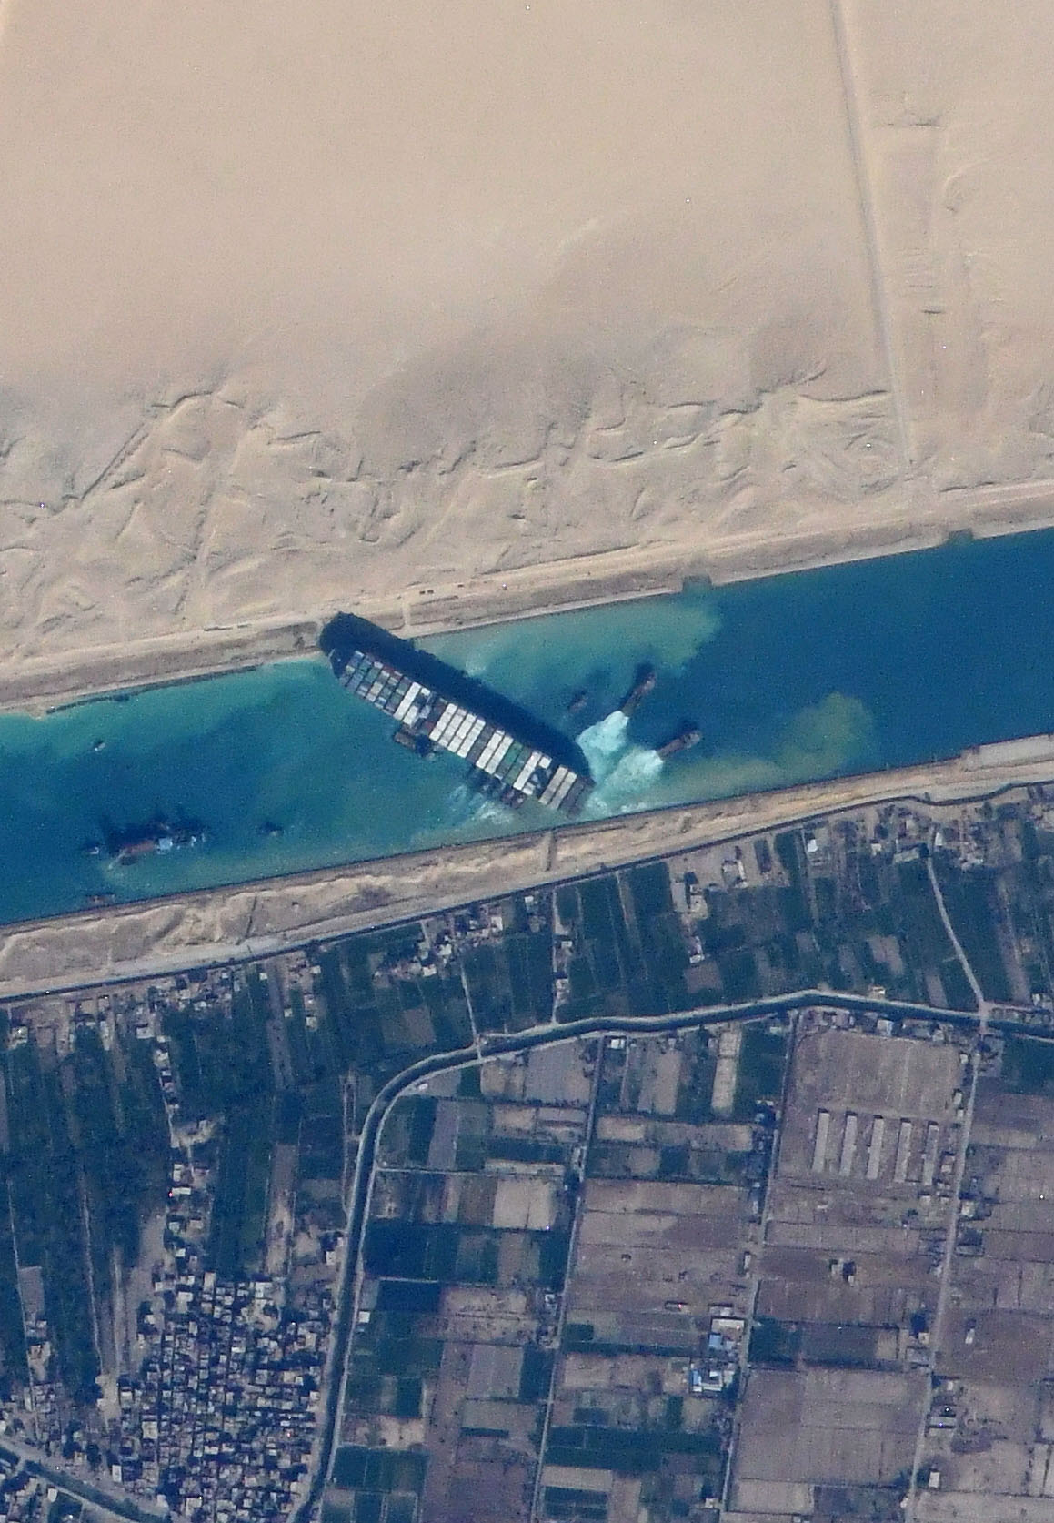
Background
Supply chain operations are increasingly interconnected
One event can quickly cascade into side effects seen months after
Decisions often need to be made well in advance of potential hazards
A vital need exists for reliable, long-term forecasting to aid supply chain risk assessment and decision-making
Such long-term forecasts present several challenges however
Photo from the ISS of the container ship Ever Given stuck in the Suez Canal. (Photo courtesy of NASA Johnson Space Center; ISS064-E-48480)

Slide 3
Long-Term Forecasting Challenges
Limitations of Numerical Weather Models
Most common weather models work in the 1-10 day range
Longer time scale models exist but come with their own caveats
Longer forecast period = Less accuracy
Different regions present drastically different seasonal conditions due to geography
Winter in Michigan is different from winter in Australia
Climate Change adds another element of variability
Potential changes to climate systems like monsoons
Further complicates risk assessment

Slide 4
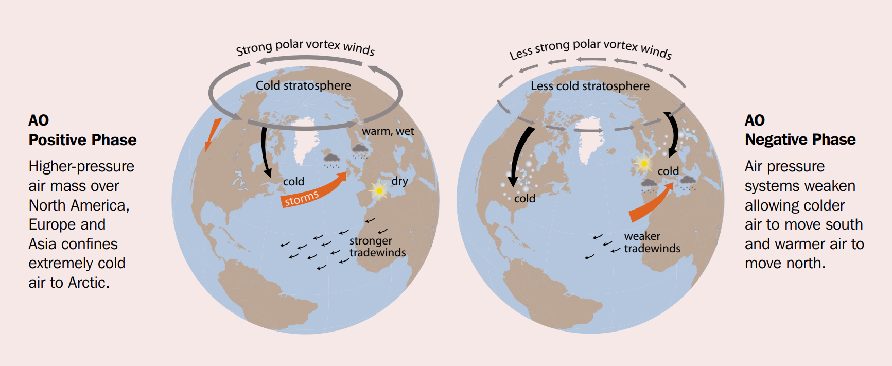
Teleconnections
AMAP, 2012. Arctic Climate Issues 2011: Changes in Arctic Snow, Water, Ice and Permafrost. SWIPA 2011 Overview Report. Arctic Monitoring and Assessment Programme (AMAP), Oslo. xi + 97pp

Slide 5
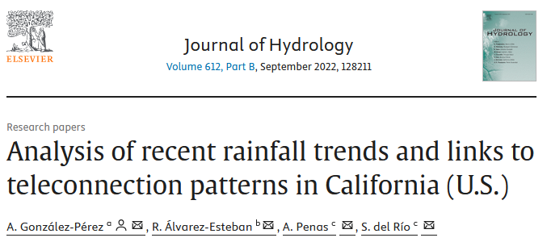
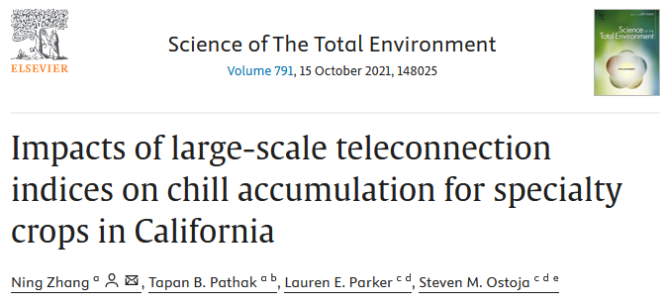
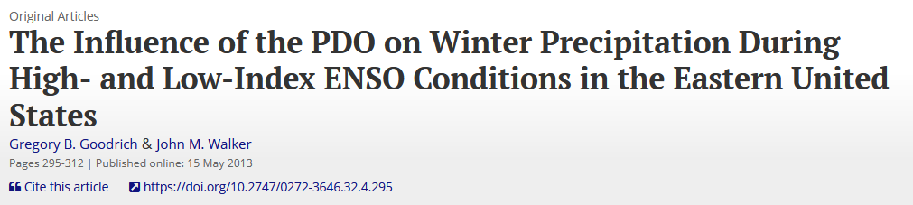
Teleconnections
Teleconnections can be very useful for regional long-term/climate forecasting
Phases corresponding to different predominant atmospheric patterns
However, teleconnection indices only measure one particular pattern/oscillation
Additionally, teleconnection pattern effects are regionalized
In certain instances, teleconnection indices can conflict with one another
Raises questions of how to “break the tie” to make a decision

Slide 6
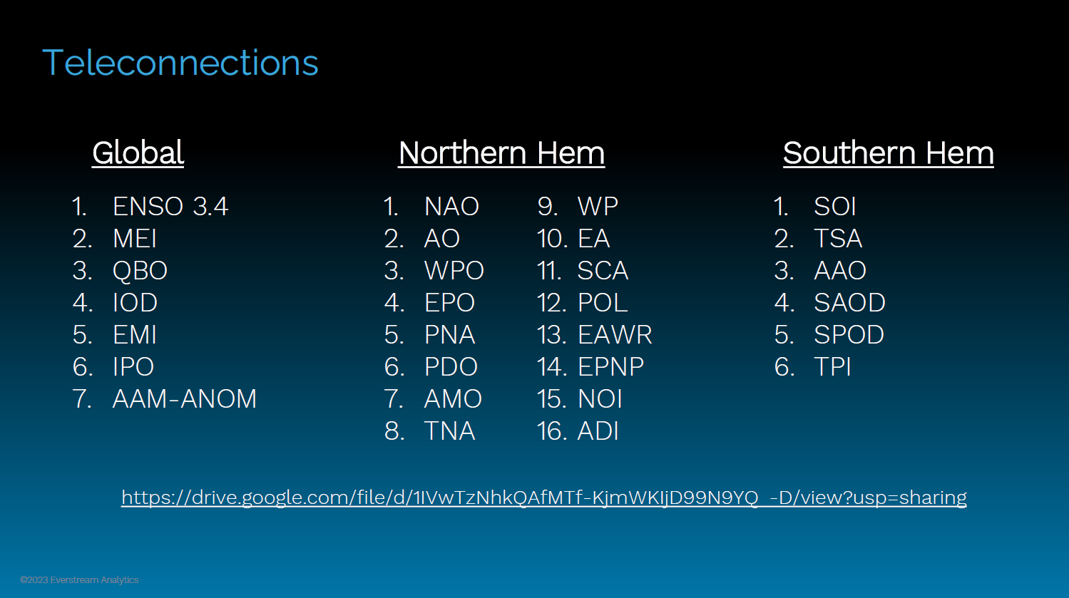

Slide 7
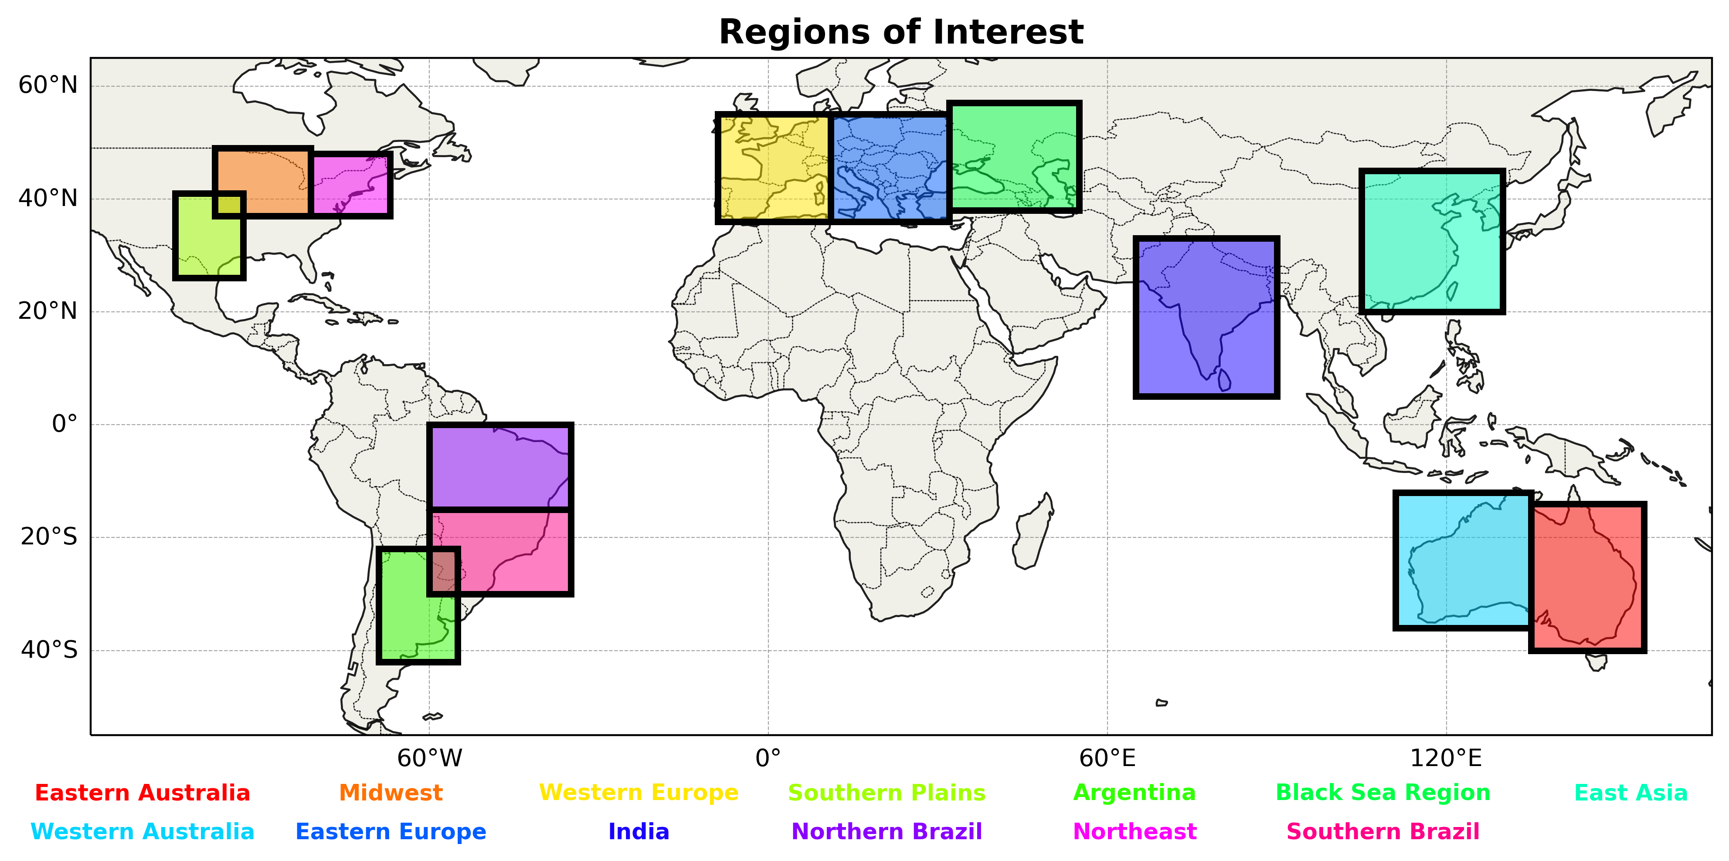

Slide 8
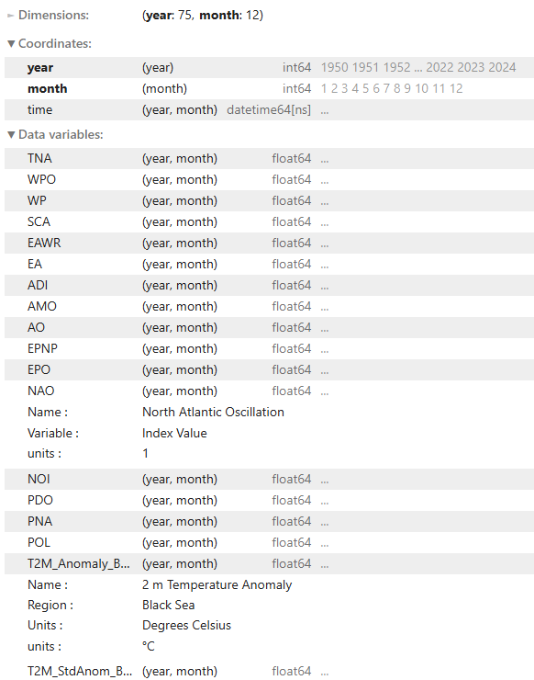


Data Sources
Teleconnection Data (1950-2024)
Monthly Index Value
NOAA, Climate Prediction Center
Climate Anomaly Data (1950-2024)
Monthly Temp and Precip Anomalies*
ECMWF Reanalysis v5 (ERA5)
Baseline period (1980-2010)
*now detrended!!

Slide 9
Methodology
​

Slide 10
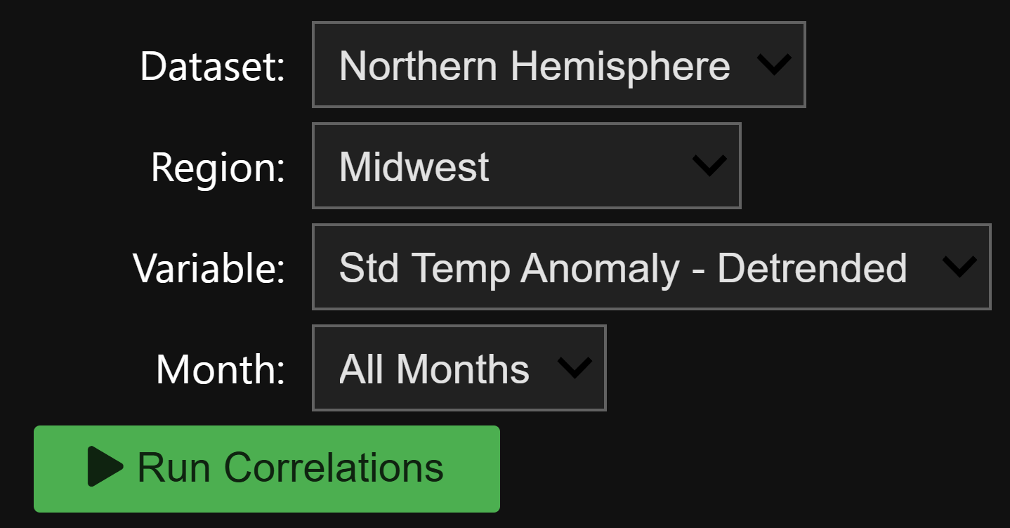
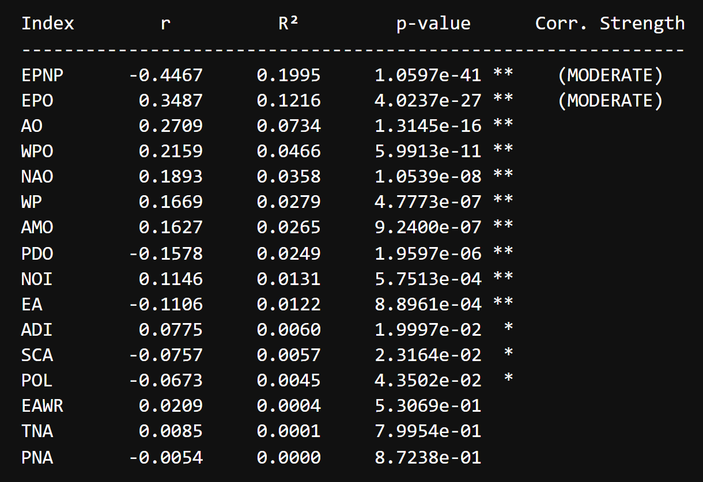
Correlation Analysis
Calculated Pearson correlation strength and sign (r)
Determined statistical significance (p-value < 0.05)
Ran this for all 13 regions, both variables, all months, and individual months
Used correlations strength to identify preferred model input (top 5)

Slide 11


Methodology
Statistical (Multi-Linear Regression) Based Model
Machine Learning (Random Forest) Based Model
Inform a statistical model with Pearson correlation analysis
Build a statistical model using statsmodels in Python
WLS vs. OLS (Breusch-Pagan test)
Create 312 different versions (by region, month and variable)
Apply a statistical model with input
Manually input teleconnection values
Predict for the next month
Inform a statistical model with Pearson correlation analysis
Build a machine learning model using YDF in Python
Random Forest model using teleconnection and month values as inputs
Split by region/variable pairs
Apply a machine learning model with input

Slide 12
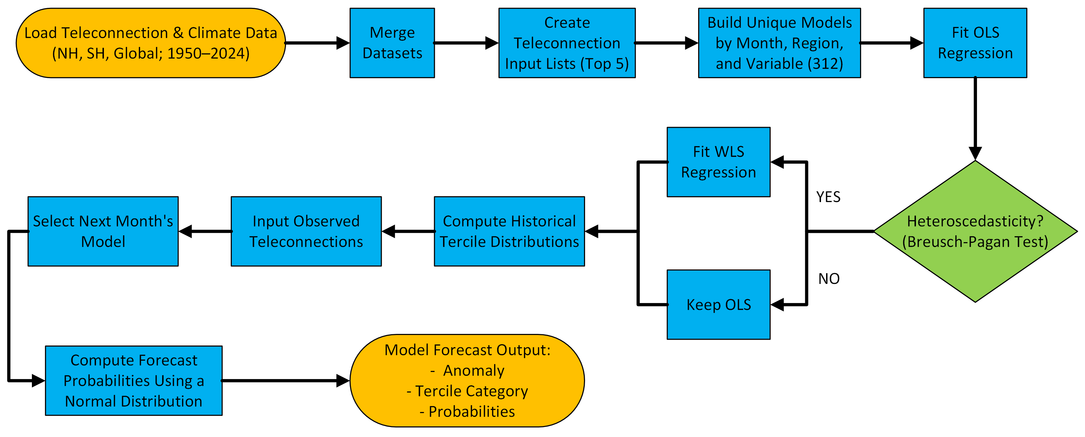
Statistical Model Workflow

Slide 13
ML Model Workflow
Load Teleconnection and Climate Data
Merge Datasets
Filter Null Values
Create Teleconnection Index Lists
Build Unique Models by Region and Variable
Train Model on Training Data (70% of total data)
Compare to MLR Model
Final Prediction Metrics (RMSE)
Test Model with Testing Data (30% of total data)
Parameter Tune Based on Accuracy Metrics

Slide 14
Results
​

Slide 15
Results
Temperature
Strongest Correlation for All Months
Precipitation
Strongest Correlation for All Months
Region | Relevant Hemisphere | Global
Eastern EU | EA: 0.4082 | AAM: -0.0928
Western EU | EA: 0.3659 | IOD: 0.0619
Black Sea Region | EAWR: -0.4686 | AAM: -0.1076
Midwest US | EPNP: -0.4467 | EMI: -0.0974
Northeast US | EPNP: -0.3636 | EMI: -0.1240
East Asia | EA: 0.2363 | IPO: -0.1033
Southern Brazil | EA: 0.1344 | ENSO: 0.1925
Southern Plains US | EPNP: -0.2783 | IPO: -0.2130
Northern Brazil | AMO: 0.4268 | ENSO: 0.2743
Western AU | AAO: -0.2145 | ENSO: 0.2163
India | PDO: 0.2116 | IPO: 0.2028
Eastern AU | AAO: -0.2085 | ENSO: 0.1829
Argentina | TPI: 0.1403 | MEI: -0.0498
Region | Relevant Hemisphere | Global
Eastern AU | SOI: 0.4518 | ENSO: -0.2791
Eastern EU | AO: -0.3663 | IPO: 0.0481
Western AU | SOI: 0.3292 | ENSO: -0.2201
Western EU | AO: -0.2906 | IPO: 0.1267
Black Sea Region | EAWR: 0.2634 | MEI: 0.1938
Southern Brazil | SPOD: 0.2098 | MEI: 0.2444
East Asia | AMO: -0.1756 | MEI: 0.1560
Argentina | SOI: -0.1603 | MEI: 0.2438
Midwest US | PNA: -0.1951 | MEI: 0.0888
Southern Plains US | PDO: 0.1819 | MEI: 0.1871
India | PDO: -0.1311 | IPO: -0.1286
Northeast US | NAO: 0.0776 | IOD: 0.0248
Northern Brazil | AAO: 0.0524 | AAM: 0.1288

Slide 16
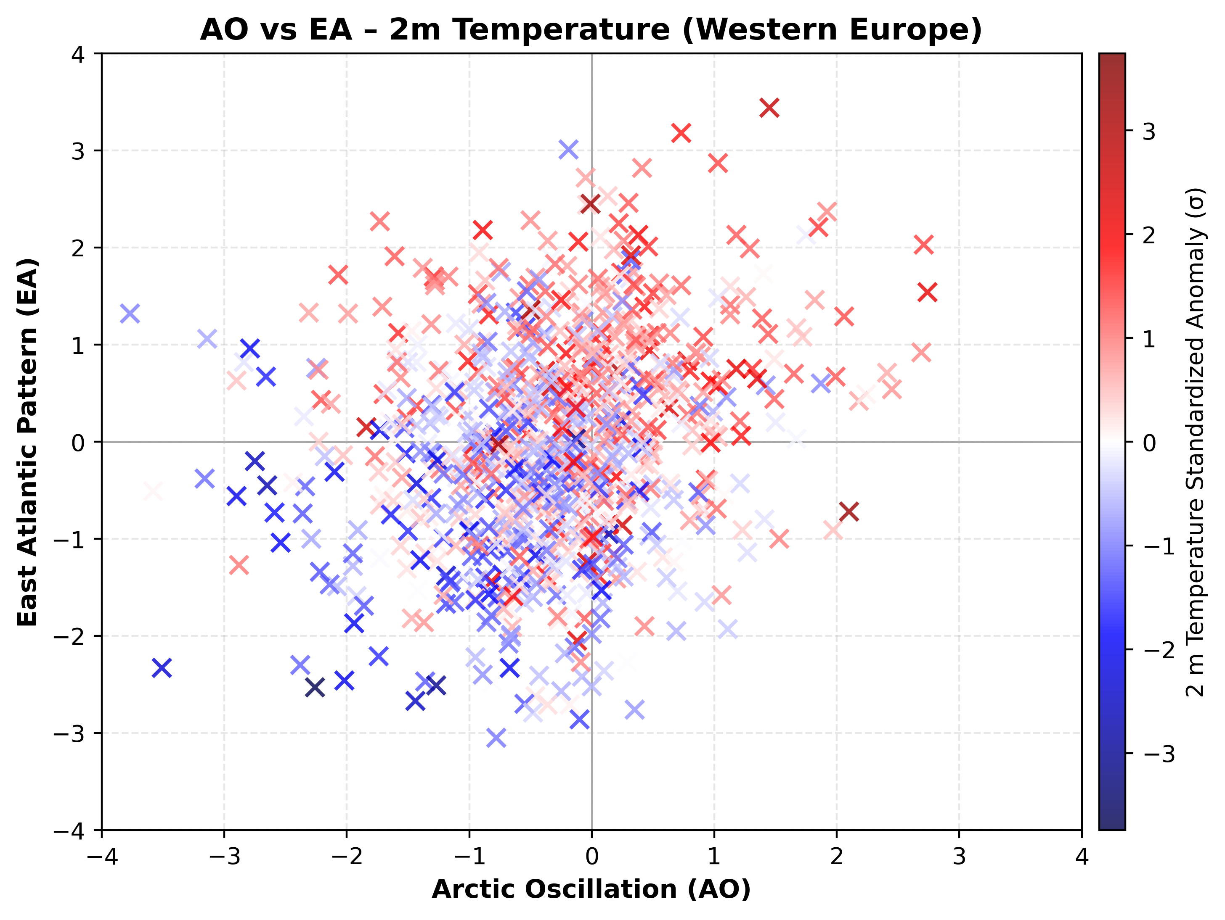
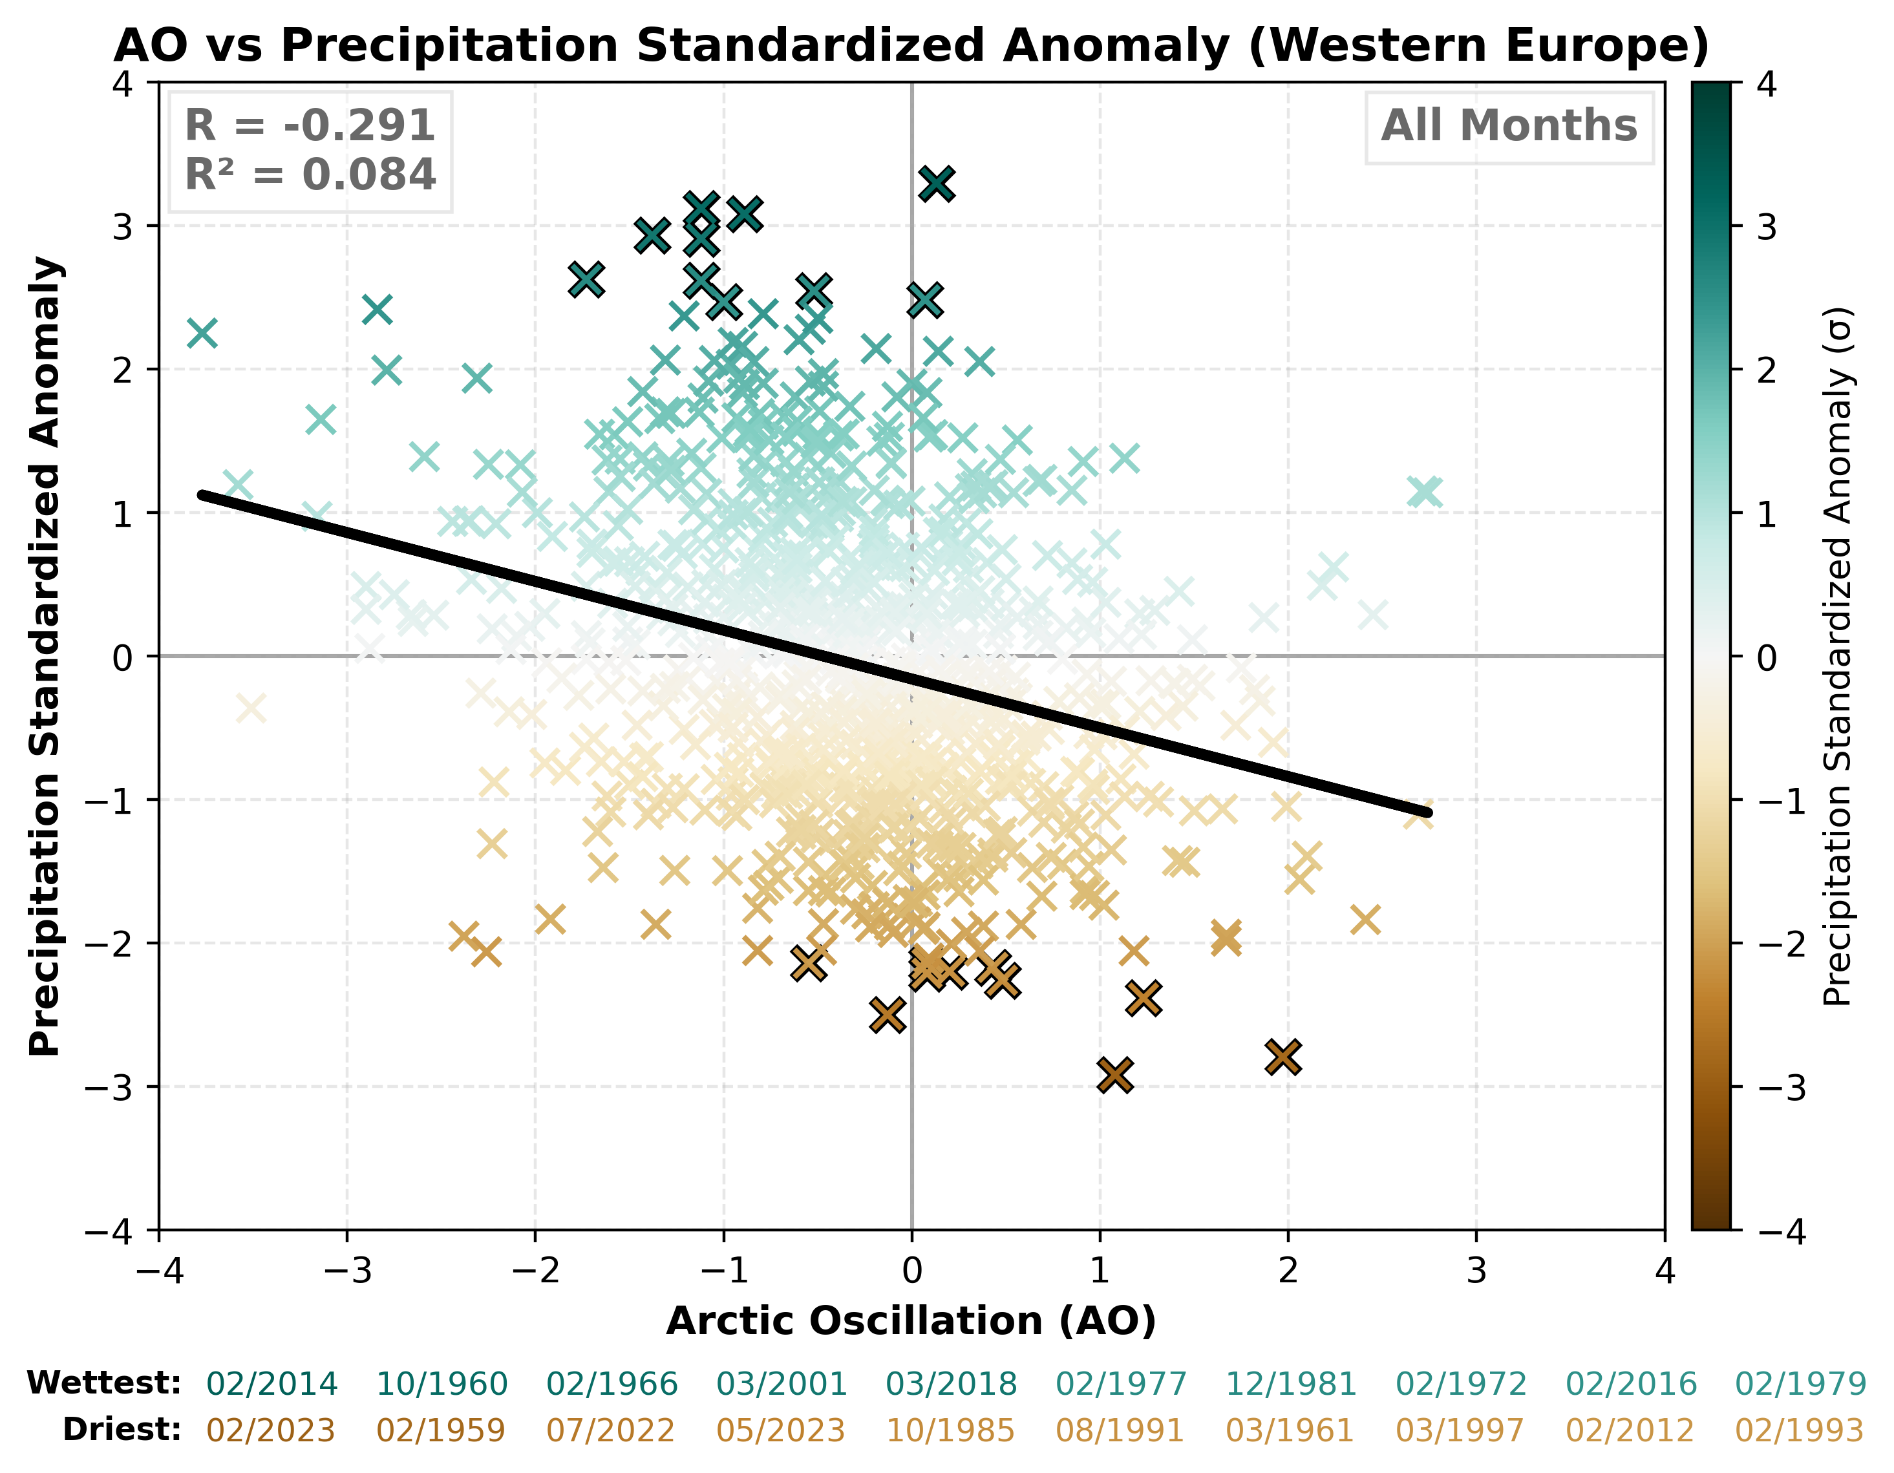

Slide 17
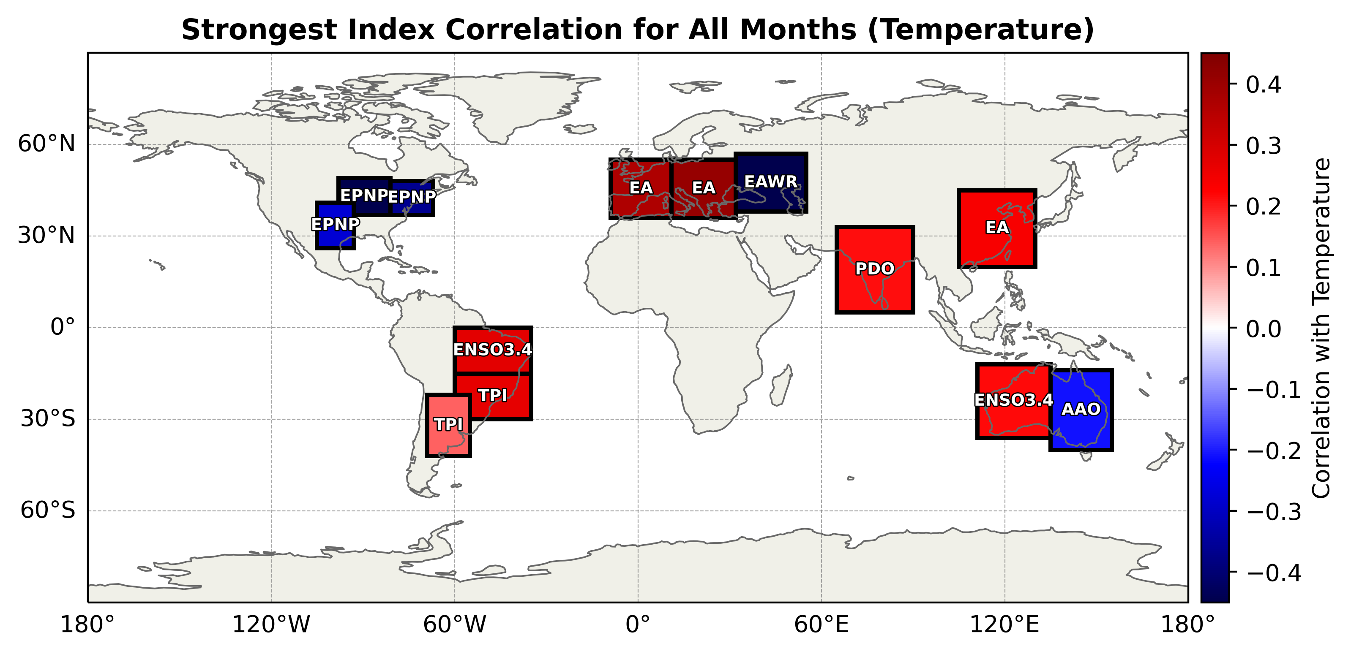
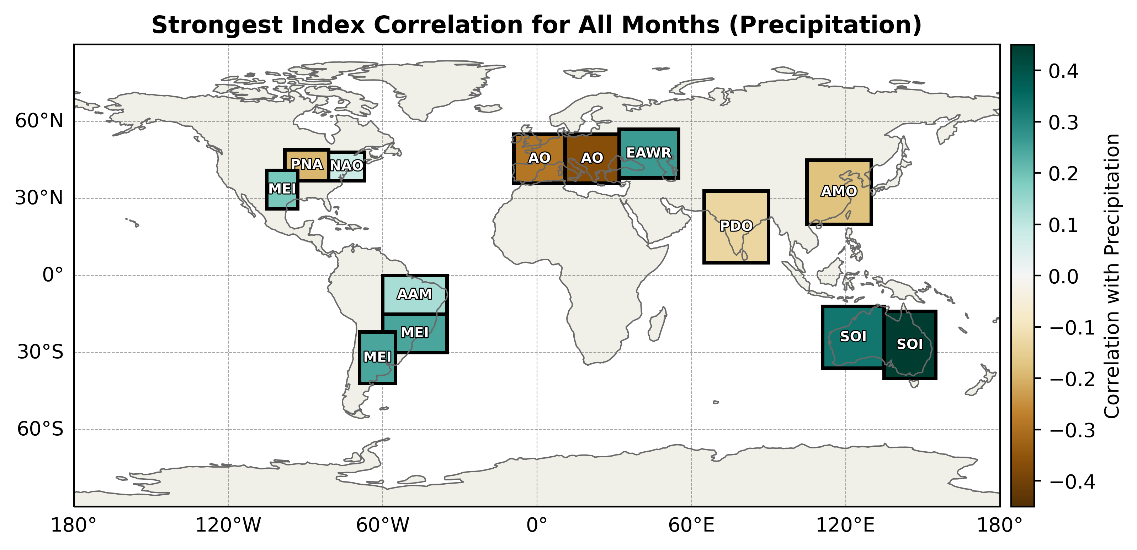

Slide 18
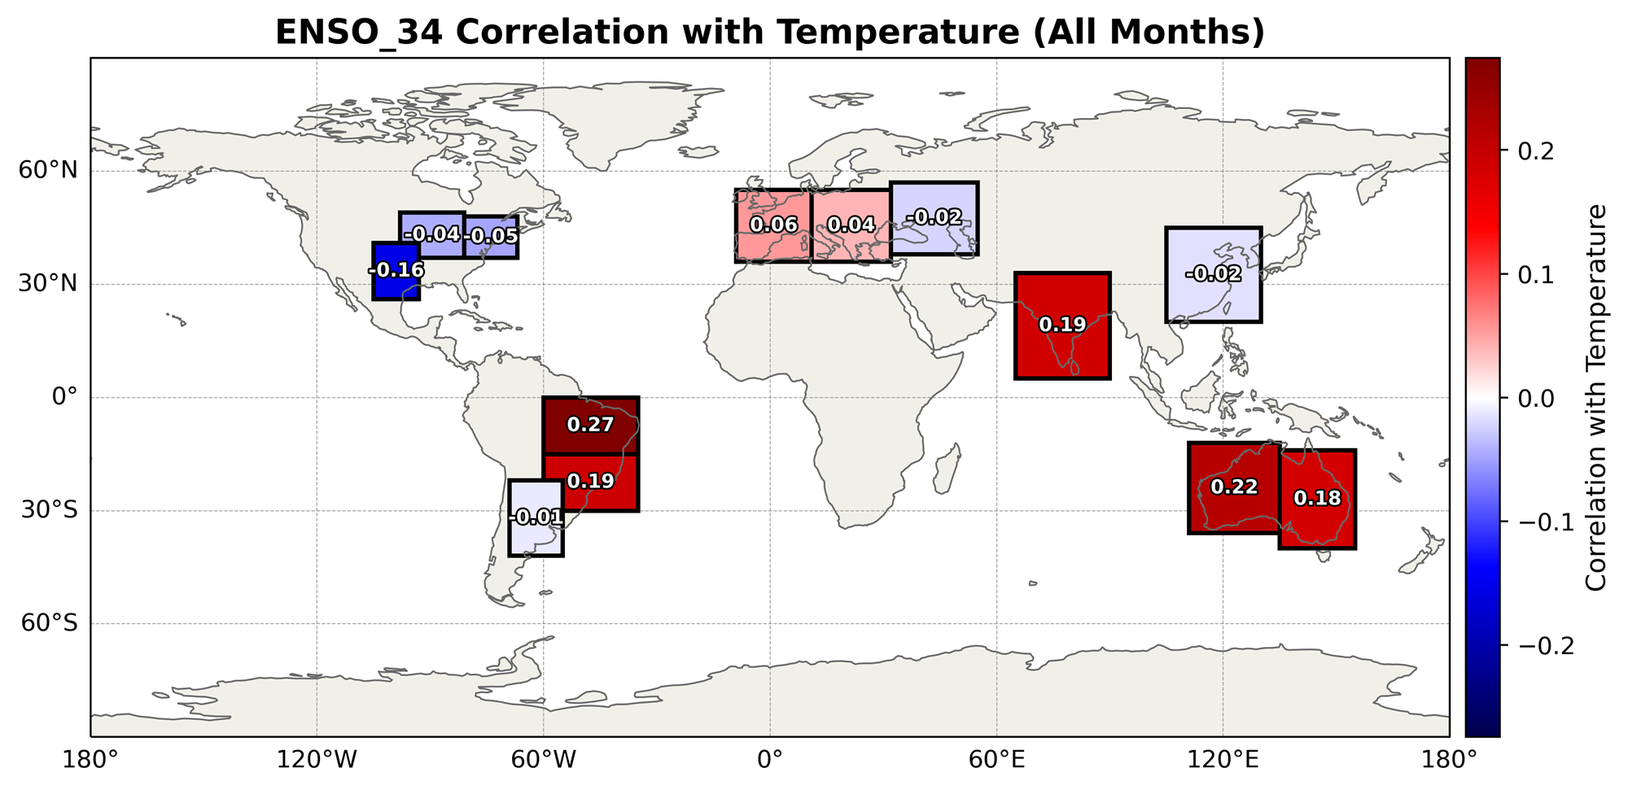
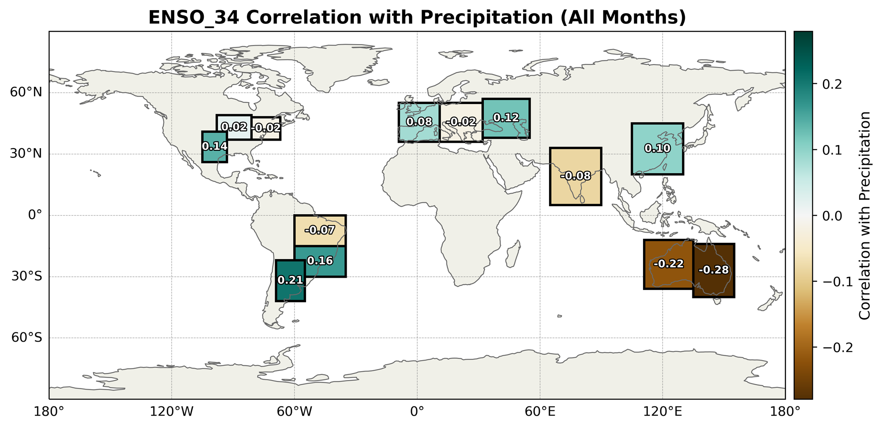

Slide 19
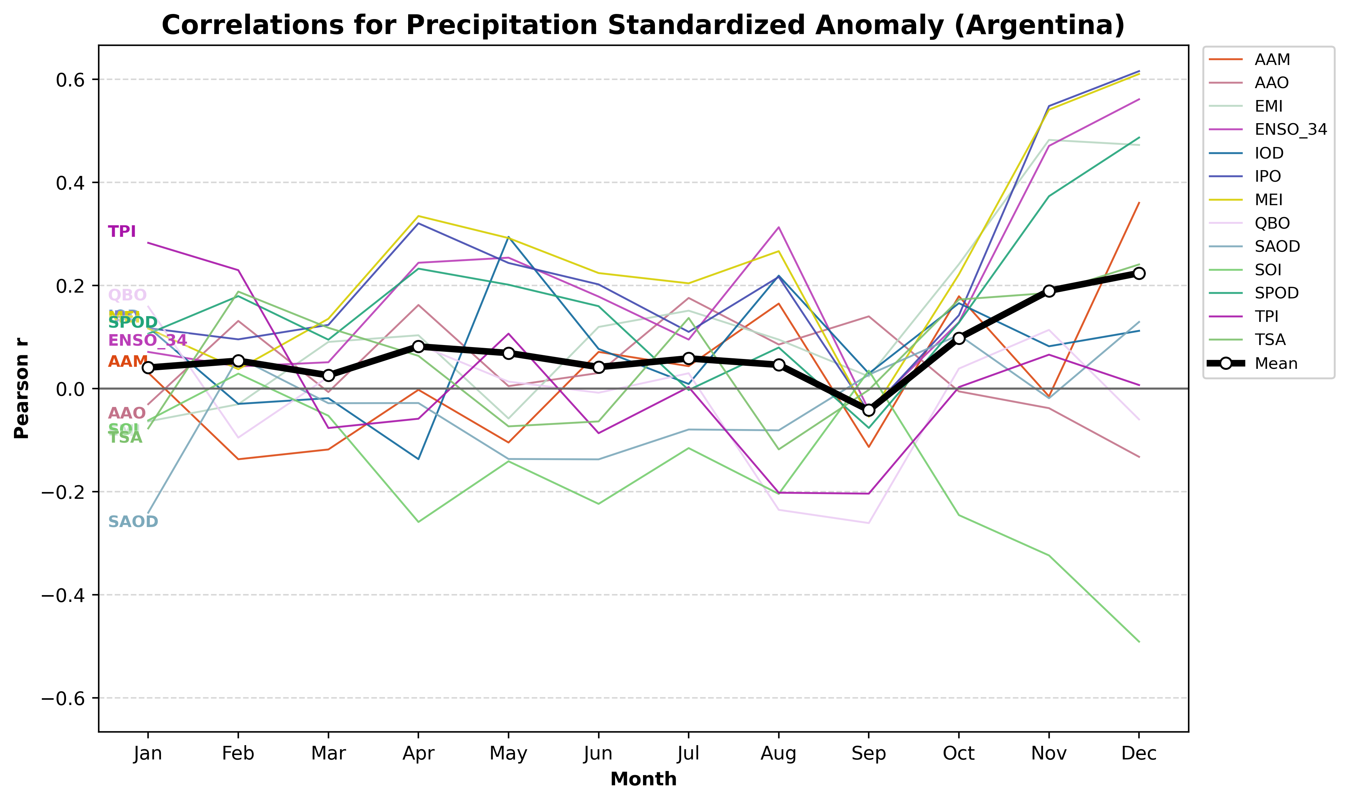

Slide 20
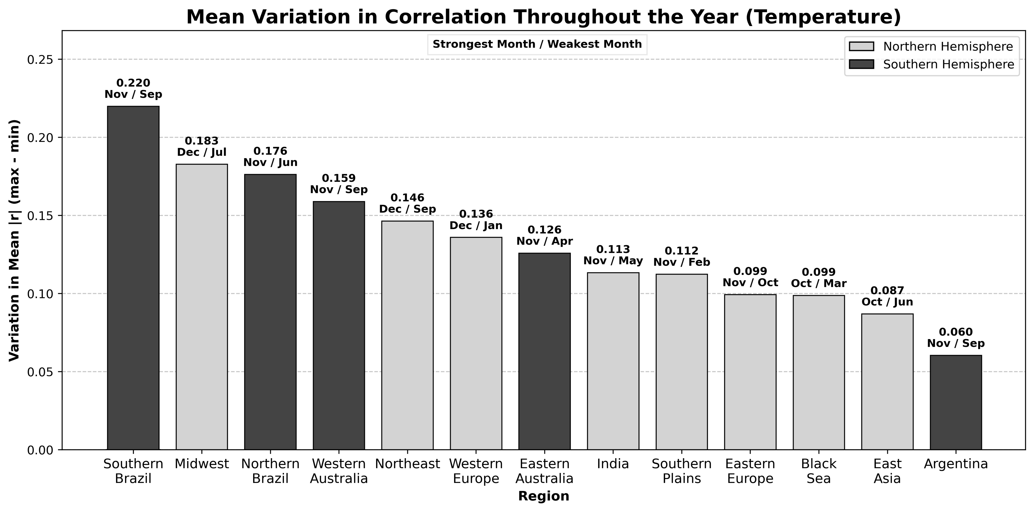
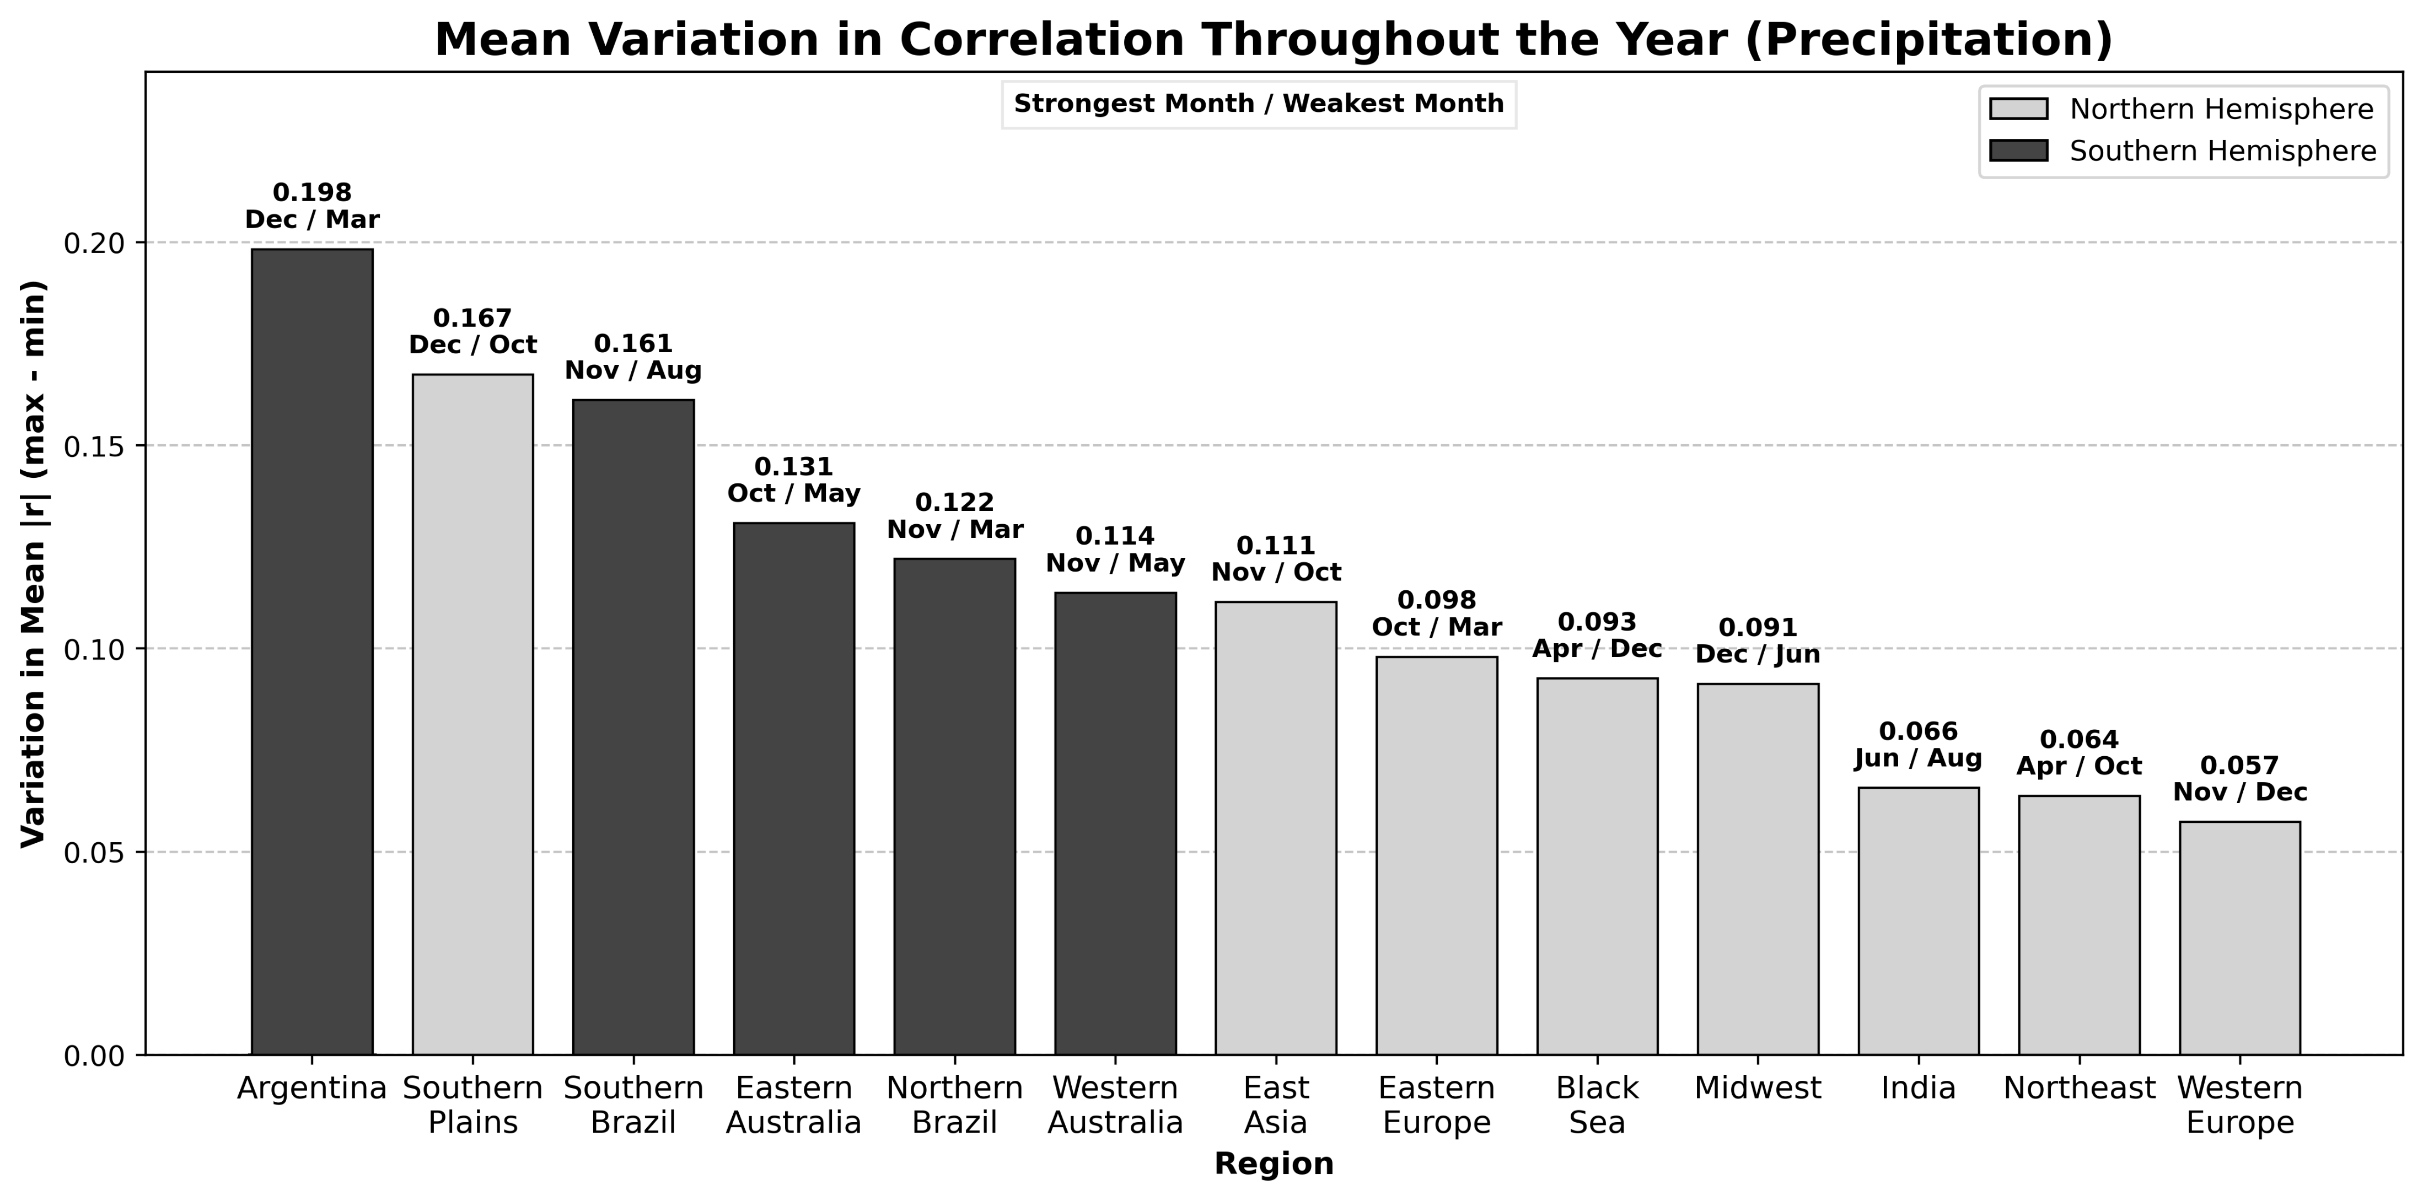

Slide 21
Model Performance
​

Slide 22
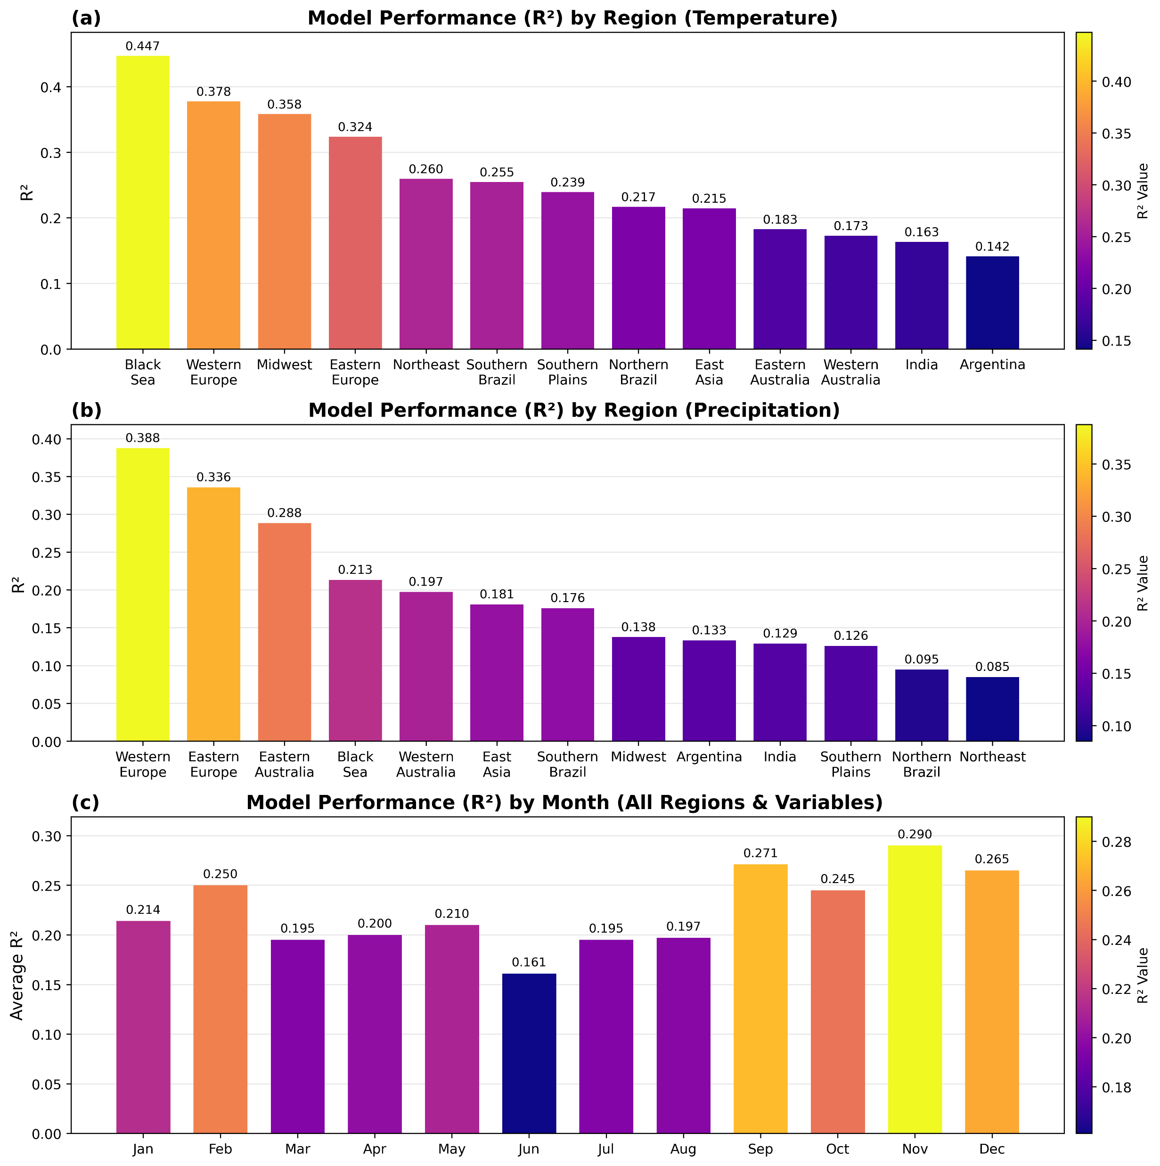
Performance (R²) of the multi-linear regression model for (a) T2M_Std in each region, (b) TP_Std in each region, and (c) for all variables and regions in each month.
​

Slide 23
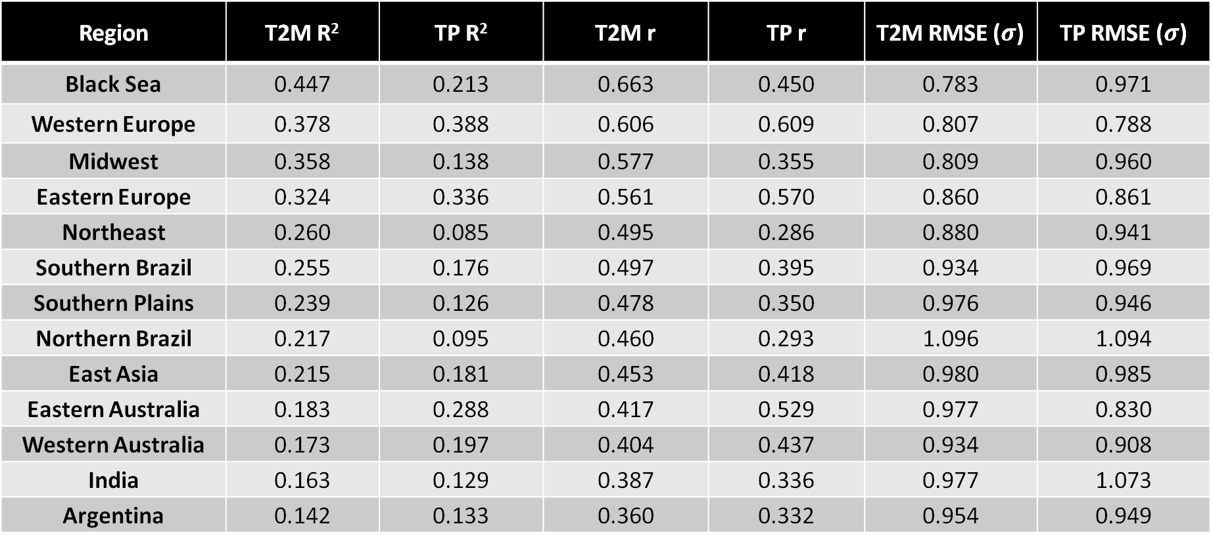
variance explained
direction captured
error
Region | T2M R² | TP R² | T2M r | TP r | T2M RMSE ($σ$) | TP RMSE ($σ$)
Black Sea | 0.447 | 0.213 | 0.663 | 0.450 | 0.783 | 0.971
Western Europe | 0.378 | 0.388 | 0.606 | 0.609 | 0.807 | 0.788
Midwest | 0.358 | 0.138 | 0.577 | 0.355 | 0.809 | 0.960
Eastern Europe | 0.324 | 0.336 | 0.561 | 0.570 | 0.860 | 0.861
Northeast | 0.260 | 0.085 | 0.495 | 0.286 | 0.880 | 0.941
Southern Brazil | 0.255 | 0.176 | 0.497 | 0.395 | 0.934 | 0.969
Southern Plains | 0.239 | 0.126 | 0.478 | 0.350 | 0.976 | 0.946
Northern Brazil | 0.217 | 0.095 | 0.460 | 0.293 | 1.096 | 1.094
East Asia | 0.215 | 0.181 | 0.453 | 0.418 | 0.980 | 0.985
Eastern Australia | 0.183 | 0.288 | 0.417 | 0.529 | 0.977 | 0.830
Western Australia | 0.173 | 0.197 | 0.404 | 0.437 | 0.934 | 0.908
India | 0.163 | 0.129 | 0.387 | 0.336 | 0.977 | 1.073
Argentina | 0.142 | 0.133 | 0.360 | 0.332 | 0.954 | 0.949
​

Slide 24
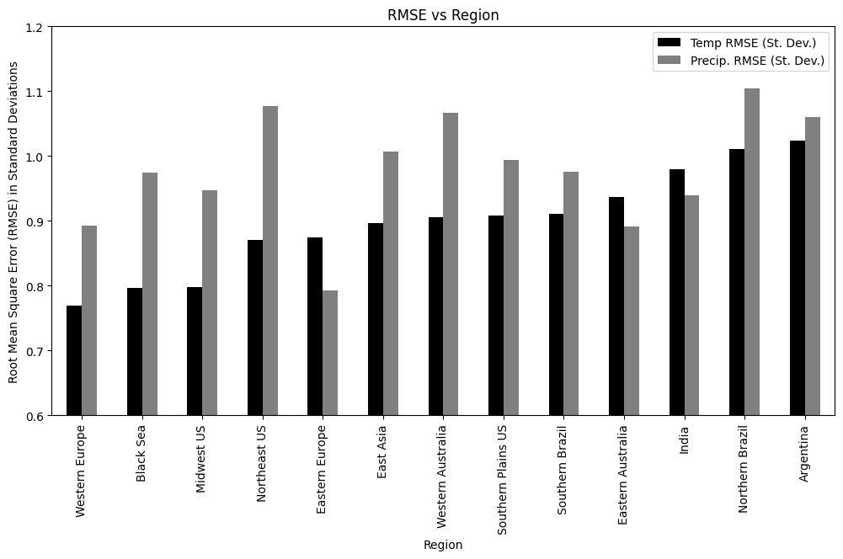

Slide 25
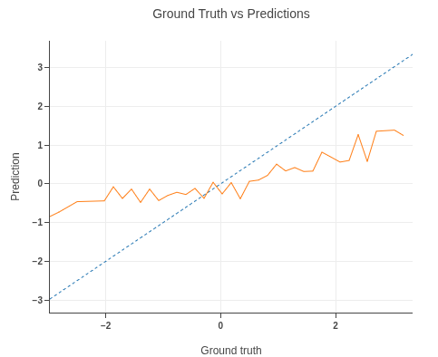
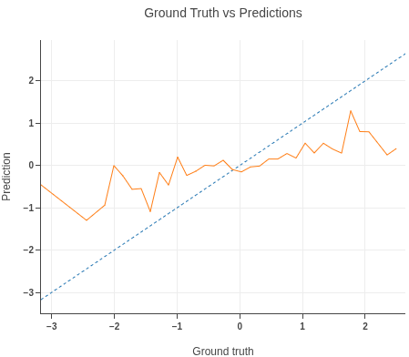
Eastern Europe
Temperature Anomaly
Eastern Europe
Precipitation Anomaly

Slide 26


Deliverables
Comprehensive & Organized GitHub Repository
A multi-linear regression model that predicts climate anomalies in 13 regions across the world for the next month
Takes manual user input
A random forest regression model designed similarly to the MLR model
Does not currently have a user input option but can be implemented in the future
Full correlation analysis widgets
Supplemental figure and map generation widgets
Produces all individual months with the click of a button
Supplemental Figures Pre-Generated in a Shared Folder
Global teleconnection correlation maps
Temperature
Precipitation
All Months (averaged)

Slide 27
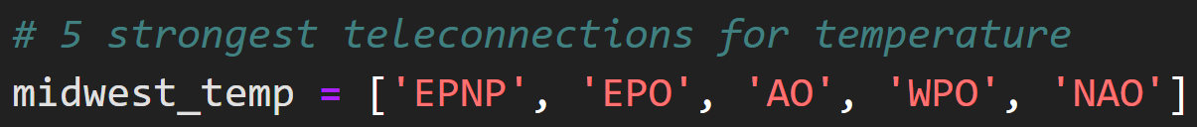
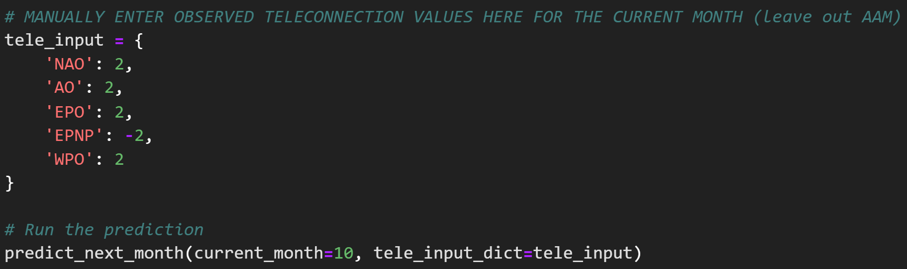
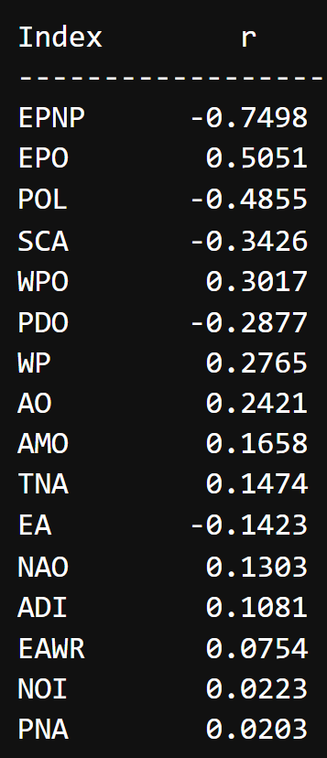
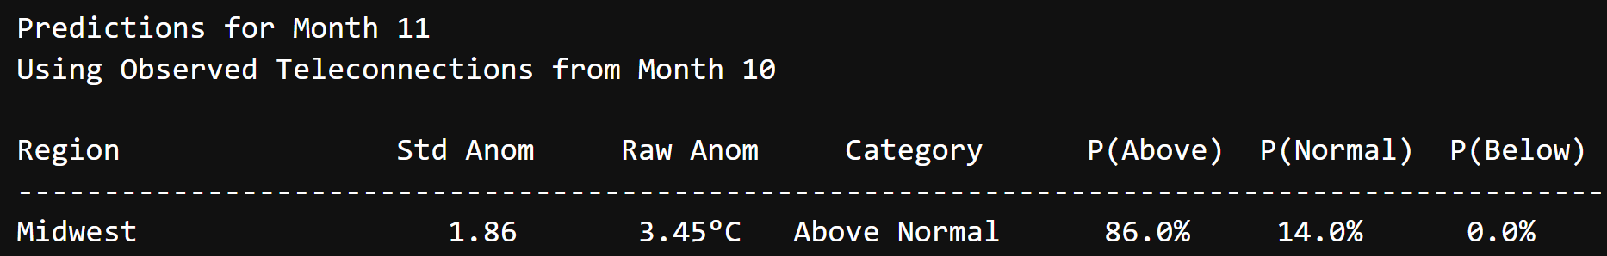
An Example
Midwest Temperature Anomaly Correlations in November

Slide 28
Future Work
Expanded ML Approach
Addressing major issues of sample size, robustness, and accuracy along extremes
Could offer more insights and determine more accurate patterns
Improved MLR Model
Month-specific input lists
Map output
"Proxy Years" Product
Attempt to match observed teleconnection index values with the closest historical analog
“This year is most similar to year XXXX.”

Slide 29




Questions?
Tyson Stewart
Team Lead
tstewart@niu.edu
Graduating this summer!
Landon Moeller
Methodology Lead
lmoeller2@niu.edu
Prospective NIU EAE Master’s Student!
Owen Cutinello
Support Team
owencutinello@gmail.com
Graduating this semester!
Matthew Woods
Support Team
Woodsmatthew222
@gmail.com
Graduating this semester!

Slide 30
References
AS, 2024: WLS. Amazonaws.com,. https://rstudio-pubs-static.s3.amazonaws.com/1248584_e57ba116e2fb4f97995987db27b7cc67.html (Accessed March 1, 2026).
Breusch, T. S., and A. R. Pagan, 1979: A Simple Test for Heteroscedasticity and Random Coefficient Variation. Econometrica, 47, 1287, https://doi.org/10.2307/1911963.
Everstream Analytics, 2026: Everstream Analytics. https://www.everstream.ai/.
EPA, 2024: Random Forest Modeling. United States Environmental Protection Agency, https://www.epa.gov/streamflow-duration-assessment/random-forest-modeling.
Gerson, A., 2023: Stranding of the Mega-Ship Ever Given in the Suez Canal: Causes, Consequences, and Lessons to Be Learned. The Suez Canal: Past Lessons and Future Challenges, C. Lutmar and Z. Rubinovitz, Eds, Palgrave Studies in Maritime Politics and Security, Springer International Publishing, 231–252, https://doi.org/10.1007/978-3-031-15670-0_12.
González-Pérez, A., R. Álvarez-Esteban, A. Penas, and S. Del Río, 2022: Analysis of recent rainfall trends and links to teleconnection patterns in California (U.S.). Journal of Hydrology, 612, 128211, https://doi.org/10.1016/j.jhydrol.2022.128211.

Slide 31
References
NASA Johnson Space Center, 2021: ISS064-E-48480.
Perktold, J., S. Seabold, J. Taylor, and statsmodels-developers, 2025: statsmodels. www.statsmodels.org,. https://www.statsmodels.org/stable/index.html.
Reid, A.-K., and N. Allum, 2019: Learn to Test for Heteroscedasticity in Stata With Data From the Canadian Fuel Consumption Report (2015). SAGE Publications, Ltd. https://doi.org/10.4135/9781526472601
Zhang, N., T. B. Pathak, L. E. Parker, and S. M. Ostoja, 2021: Impacts of large-scale teleconnection indices on chill accumulation for specialty crops in California. Science of The Total Environment, 791, 148025, https://doi.org/10.1016/j.scitotenv.2021.148025.
Goodrich, G. B., and J. M. Walker, 2011: The Influence of the PDO on Winter Precipitation During High- and Low-Index ENSO Conditions in the Eastern United States. Physical Geography, 32, 295–312, https://doi.org/10.2747/0272-3646.32.4.295.

Slide 32
References
Helali, J., M. Nouri, M. Mohammadi Ghaleni, S. A. Hosseni, F. Safarpour, A. Shirdeli, P. Paymard, and Z. Kalantari, 2023: Forecasting precipitation based on teleconnections using machine learning approaches across different precipitation regimes. Environ Earth Sci, 82, 495, https://doi.org/10.1007/s12665-023-11191-9.
Hersbach, H., and Coauthors, 2020: The ERA5 global reanalysis. Quart J Royal Meteoro Soc, 146, 1999–2049, https://doi.org/10.1002/qj.3803.
Hill, A. J., G. R. Herman, and R.S. Schumacher, 2020: Forecasting Severe Weather with Random Forests. Monthly Weather Review, 148, 2135-2161, https://doi.org/10.1175/mwr-d-19-0344.1.
Huston, R., and A. Dastrup, 2020: People, Places, and Cultures. J. Holmes, Ed. Tulsa Community College, https://open.library.okstate.edu/culturalgeography/chapter/5-3-2/.
Mucci, Ti., Overfitting vs. Underfitting. IBM Think, https://www.ibm.com/think/topics/overfitting-vs-underfitting.

Slide 33
References
NOAA, 2025: El Niño & La Niña (El Niño-Southern Oscillation). Climate.gov, https://www.climate.gov/enso.
Rust, H. W., A. Richling, P. Bissolli, and U. Ulbrich, 2015: Linking teleconnection patterns to European temperature – a multiple linear regression model. metz, 24, 411–423, https://doi.org/10.1127/metz/2015/0642.
Wu, Z., N. E. Huang, S. R. Long, and C.-K. Peng, 2007: On the trend, detrending, and variability of nonlinear and nonstationary time series. Proc. Natl. Acad. Sci. U.S.A., 104, 14889–14894, https://doi.org/10.1073/pnas.0701020104.
Zhang, N., T. B. Pathak, L. E. Parker, and S. M. Ostoja, 2021: Impacts of large-scale teleconnection indices on chill accumulation for specialty crops in California. Science of The Total Environment, 791, 148025, https://doi.org/10.1016/j.scitotenv.2021.148025.

