Slide 1

Gambas
Almost
Means
BASIC
...really?

Slide 2
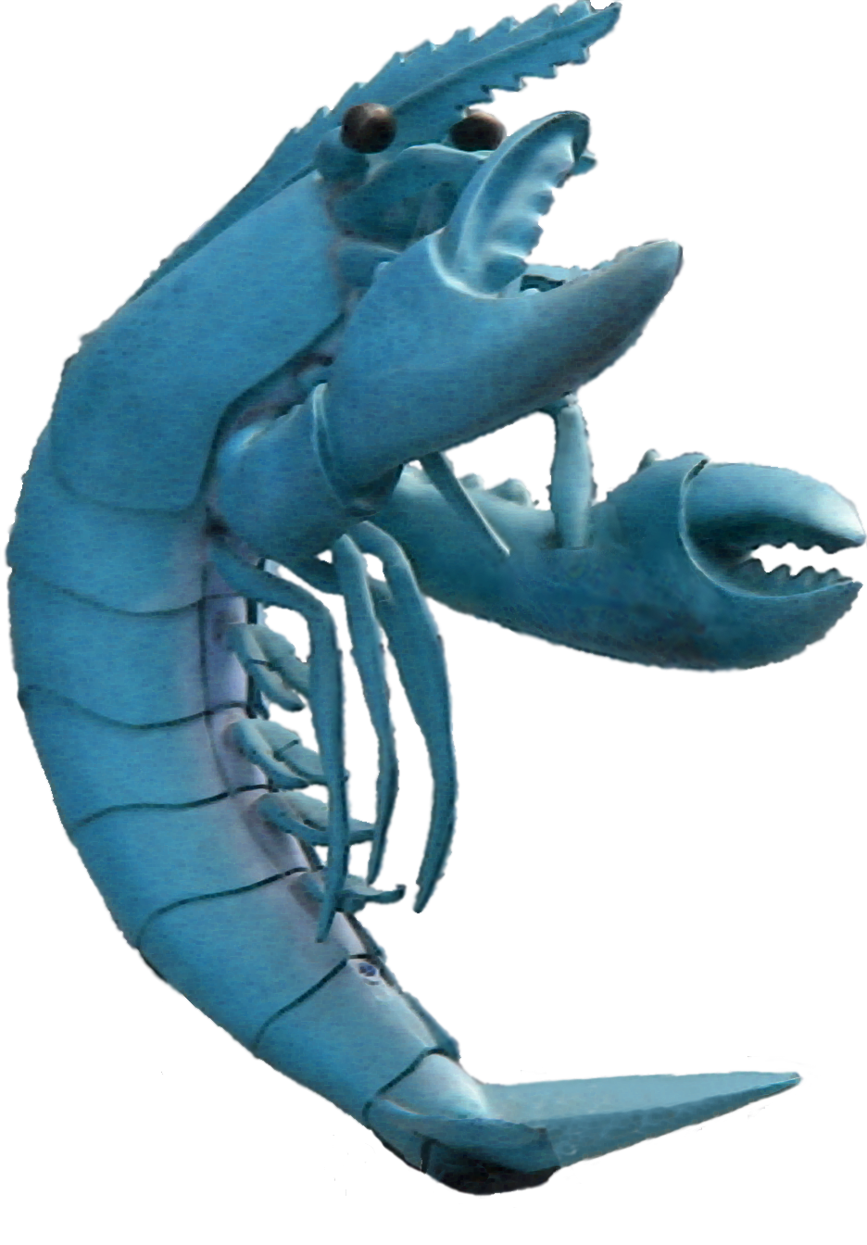
Gambas 2.0 RC 1
Two years of development since the release of Gambas 1.0.
Seven years since the first beginning.
400,000+ lines of code.
About 350 classes.
Notes:
Two years , seven years since the beginning.

Slide 3
Quick introduction
Gambas is a full-featured object language and development environment built on a BASIC interpreter.
It is released under the GNU General Public Licence.
Its architecture is largly inspired by Java.

Slide 4
The Gambas BASIC
About 250 keywords and native functions.
Full error management.
Full process control.
Full support for watching file descriptors.
Event loop support with timers.
Native UTF-8 string support.
Full internationalization and translation support.
External function calls in shared libraries.

Slide 5
The Gambas Object Language
Gambas is a true object-oriented language:
Objects and classes.
Properties, methods, constants and events.
Public and private symbols.
Polymorphism, i.e. virtual method dispatching.
Single inheritance.
Constructors and destructors.
Array accessors, enumerators, sortable objects.

Slide 6
The Gambas Object Language
Inheritance is entirely dynamic, and allows you to
Create a more specialized version of an already existing class.
Reimplement a class and extend it.
Override some methods or properties of a class.
"Inheritance" means how and when symbols are linked.

Slide 7
The Gambas Object Language
Any classes can be inherited, reimplemented or overridden, even the native ones written in C/C++.
Finally, a native class named Observer allows you to intercept any event raised by any object.
Events
Observer
GridView
TableView
C++ / Qt
Gambas

Slide 8
The Components
Access to many database systems: MySQL, PostgreSQL, SQLite, Firebird, ODBC.
Graphical user interface programming, based on the QT toolkit, or the GTK+ toolkit.
Network programming, with advanced protocol management: HTTP, FTP, SMTP, DNS.
SDL and OpenGL programming.
XML programming.
CGI programming with session management.

Slide 9
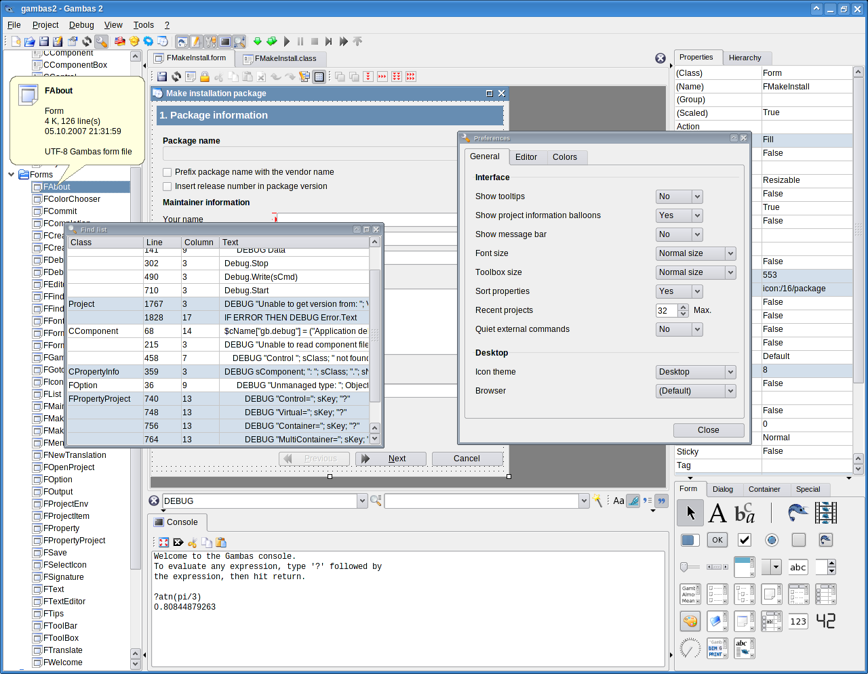
The Development Environment

Slide 10
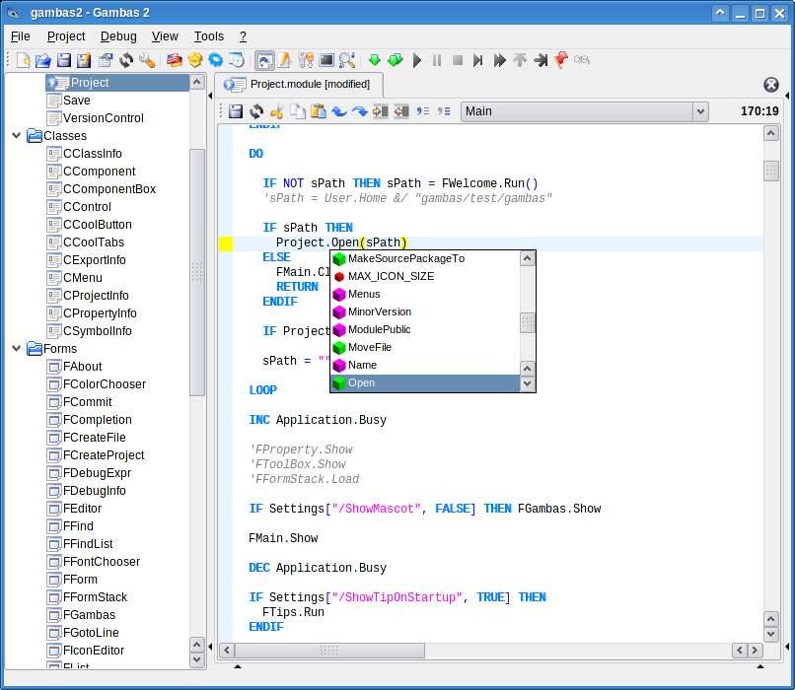
The Development Environment

Slide 11
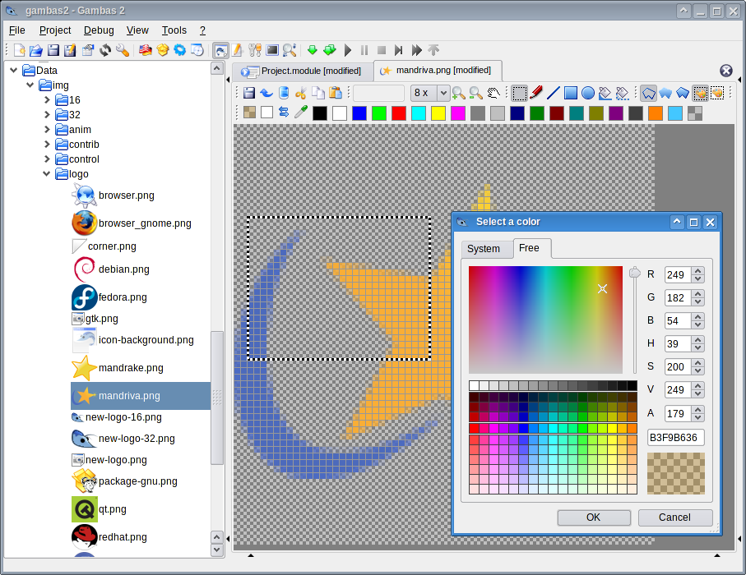
The Development Environment

Slide 12
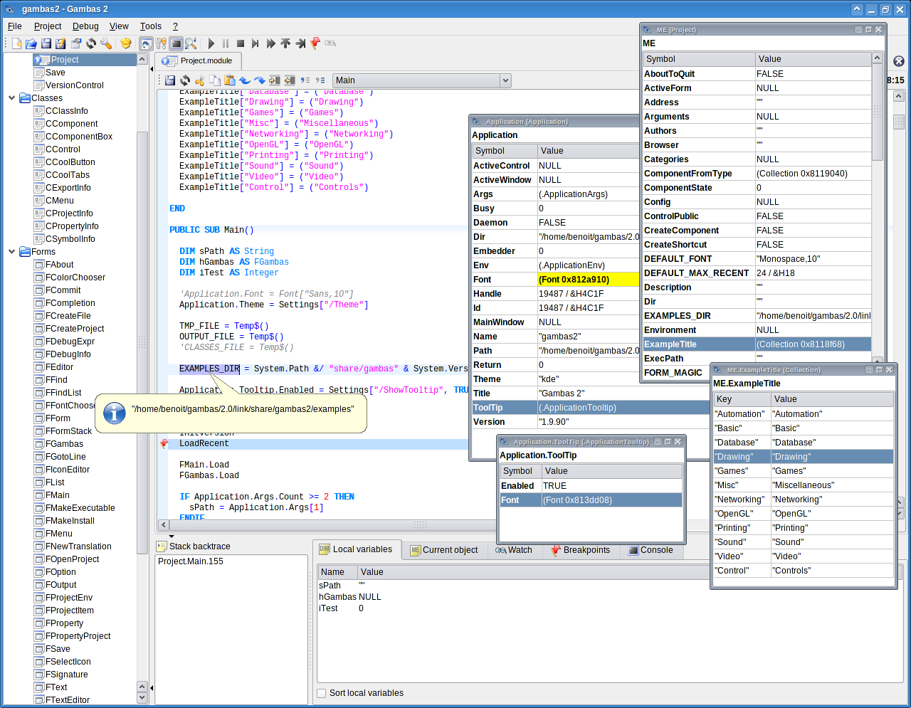
The Development Environment

Slide 13
The Declaration of Independance

Slide 14
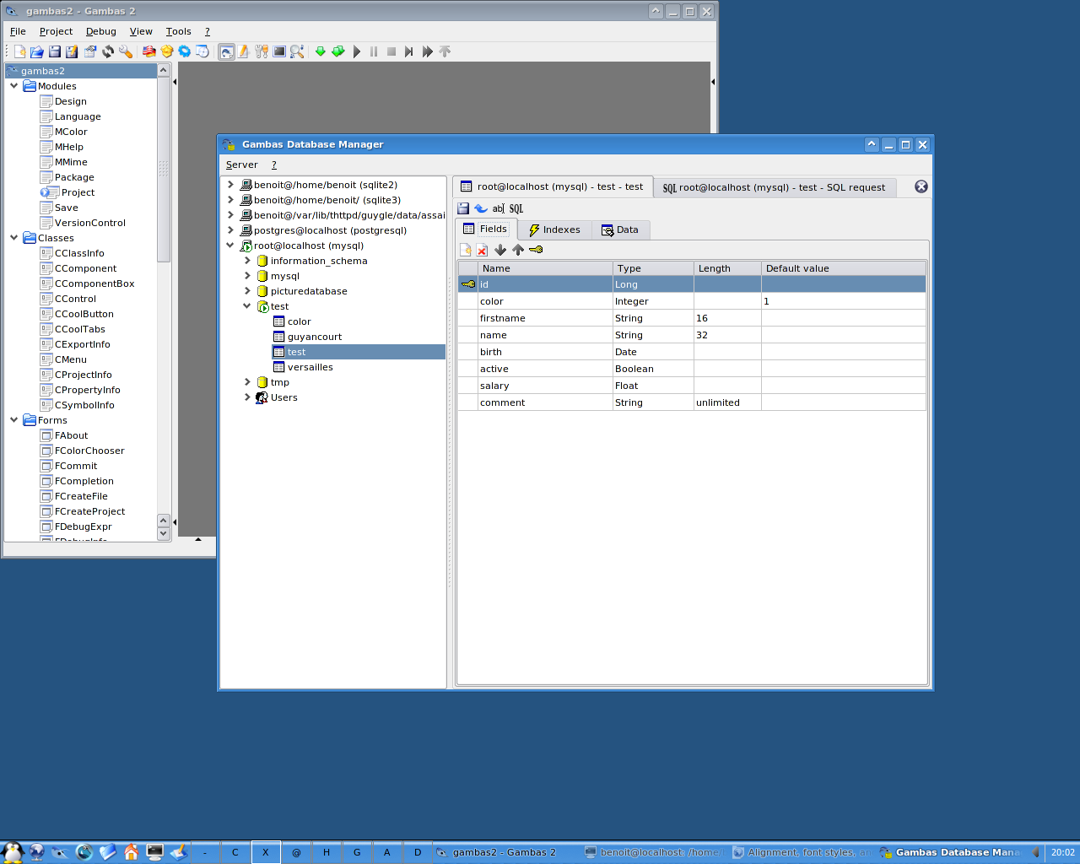
Database independance
Every database system is accessed through the same API.

Slide 15
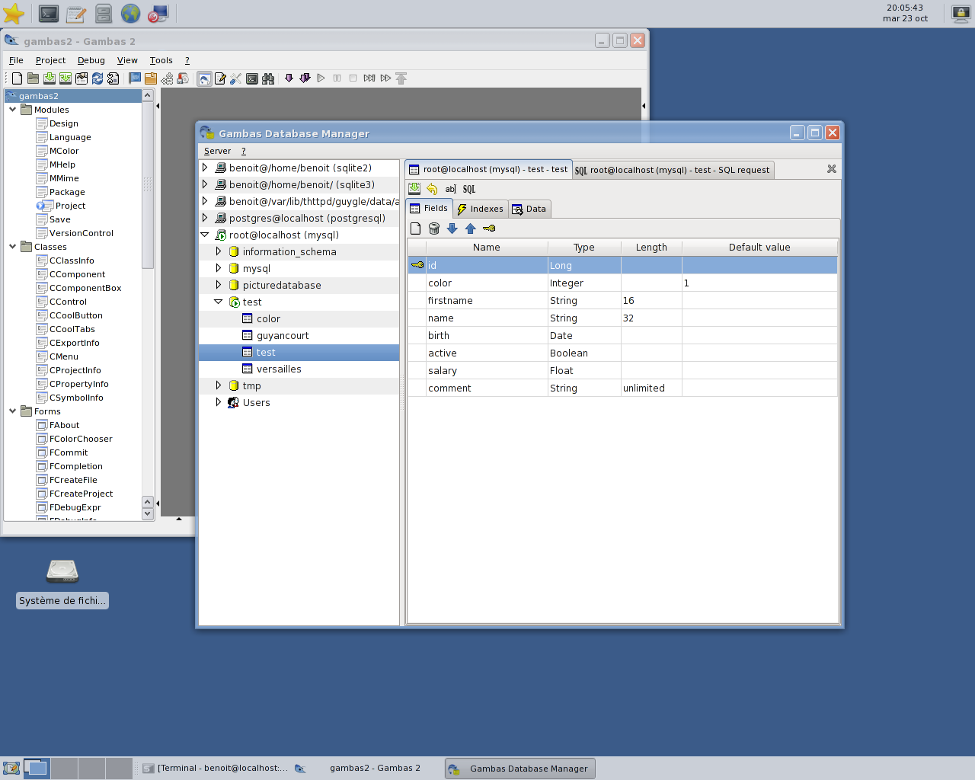
GUI independance
The QT component and the GTK+ component have the same interface!
KDE
XFCE

Slide 16
Desktop independance
Use icon themes according to the current desktop environment (KDE, Gnome or XFCE).
The gb.desktop component, based on the shell scripts from the Portland project.
A moving target.

Slide 17
BASIC... in 2007?

Slide 18
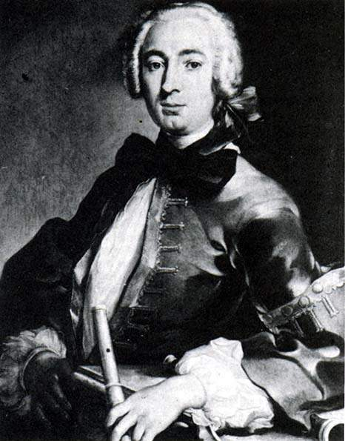
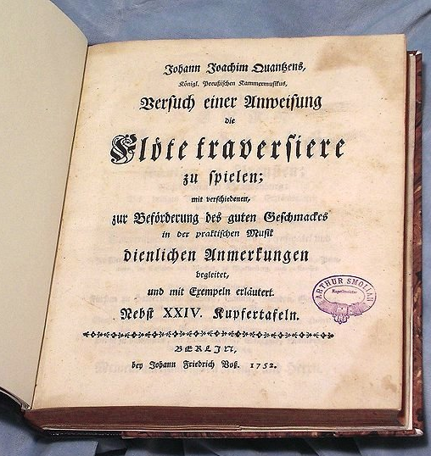
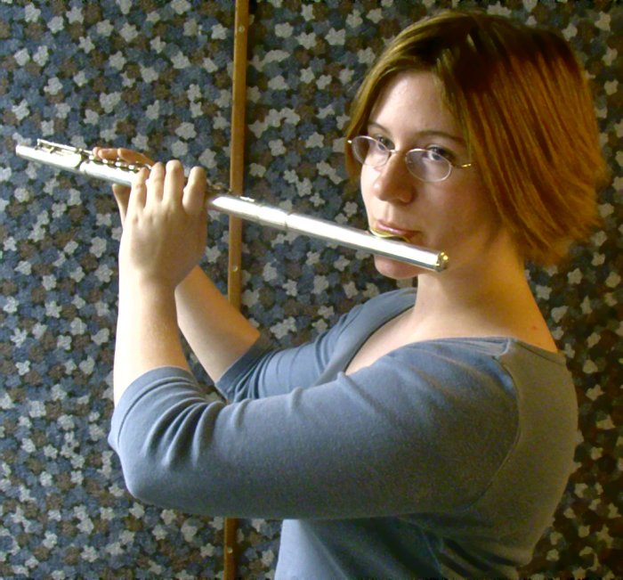
Play Flute?

Slide 19
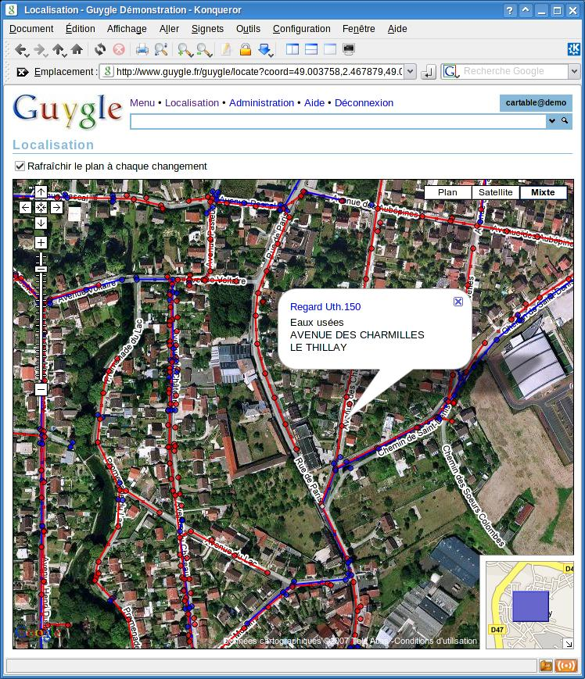
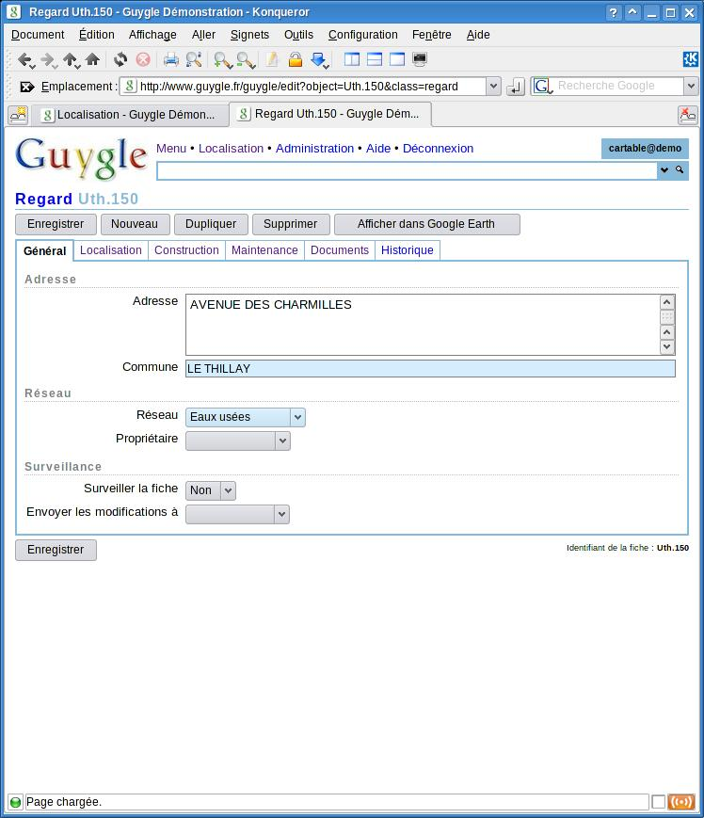
A Little Gambas Story

Slide 20
Morality
You do not have to be modern.
You do not have to do modern.
You should do simple.
You should be simple.
You will have more time for your social life!

Slide 21
Future is not predictable
  Positronic::Variables
  Quantum::Superposition

Slide 22
What Next?
64 bit support.
DBus support.
The merging of the database manager into the development environment.
A report designer in the IDE.
QT4 & Cairo support.
Some KDE4 support.
OpenOffice document generation helper.

Slide 23
Thank You!
  http://gambasdoc.org
  http://gambasrad.org
  http://gambas.sourceforge.net
"When you are doing something, you have against you every people doing the same thing, every people doing the opposite thing, and the very large majority of people doing nothing."

