Slide 1
ENSE 477 Project Scrum
SoundByte
Brandon Clarke, Mason Lane, Jiwoun Kim
04/03/2020

Slide 2
What We’re Doing
Our team will provide creators & hobbyists with a tool that prescribes audio files to complement a given song when mixing. The goal is to improve the workflow of artists while being a utility for DJs in the future.

Slide 3
Roles and Responsibilities
Brandon Clarke:
ML/Suggestion component. Science, Research
ML/Suggestion development
Jiwoun Kim:
frontend design & development
backend development
Mason Lane
Scrum Master
backend/frontend architecture
backend development, feature extraction

Slide 4
What Have We Been Up To?
Feb9 - Feb22 (Last Sprint)
Feb23 - March 8(Current Sprint)

Slide 5
Initialization & Essentia.JS
Essentia now working as a web worker.
Able to import node modules for electron workers.
We can now send relevant data to our python scripts.

Slide 6
Suggestion Menu
We have a song library initially :
From the initialized directory configuration, a JSON library is to be read
The app send the user to the ‘Suggestion Menu’, and it lists up the song library lists based on the JSON library.
Suggestion List:
If the user select a song and push the submit button,
the app projects the suggestions list by using our suggestion model(back end).

Slide 7
Machine Learning
Refining suggestion algorithm
Error function based on weighted differences
Explore different error functions

Slide 8
Where are we sitting?
Brandon:
Yellow, we have made some good progress as of recent but refactoring and testing could bring unexpected delays
Brian:
Between Yellow and Red, getting url with a proper path for playing the sound still have an error.
Mason:
Yellow, lots of cleanup to do. Lots of tiny additions. Very close to MVP. Hoping to start user testing mid march.

Slide 9
Whats next?
Node module for electron loading bar
Settings Menu - or differ this task.
Exception Handling

Slide 10
Whats next?
Add menu pages (Criteria search and Auto pairing)
Clean up setting page
Follow up with Machine Learning results on criteria search and auto pairing menus)

Slide 11
Whats next?
Refactoring Backend
Updating documentation
Testing
Feature filtering

Slide 12
Group reflection
Do you feel you are on track?
We’ve made significant strides, pieces are now falling into place.
Do you feel there are barriers to your success (if any)?
directory/reading issues have made playback complicated and will consume some of Brian’s resources
Do you need any help going forward?
N/A
Any other questions or concerns?
N/A

Slide 13
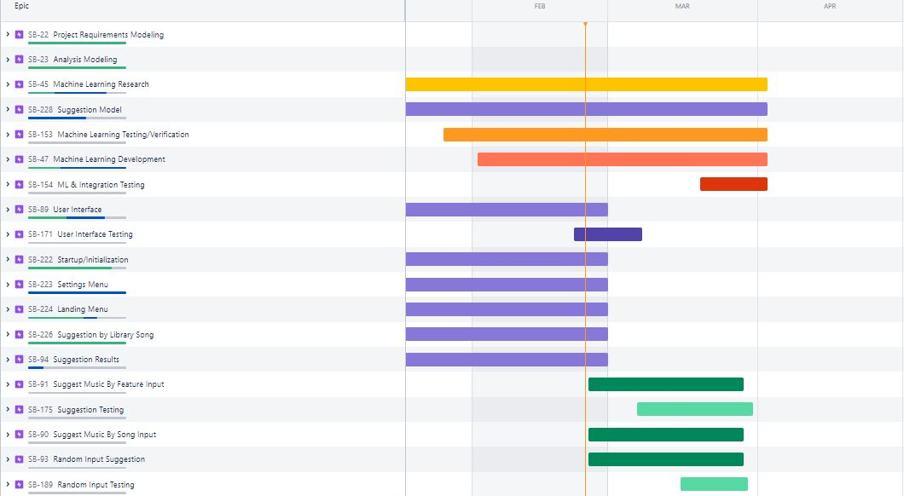
Roadmap

Slide 14
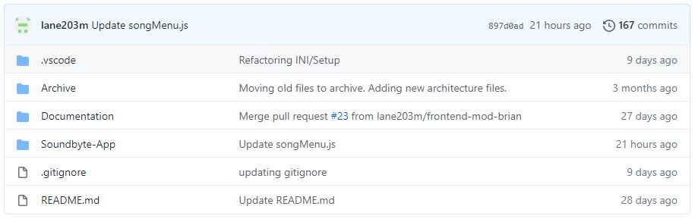
Github
https://github.com/lane203m/SoundByte
https://uofr-capstone.storiesonboard.com/m/guidemap
https://soundbyte.atlassian.net/jira/software/projects/SB/boards/1

