Slide 1
ENSE 400 Vlog 4
SoundByte
Brandon Clarke, Mason Lane, Jiwoun Kim
03/02/2021

Slide 2
What We’re Doing
Our team will provide creators & hobbyists with a tool that prescribes audio files to complement a given song when mixing. The goal is to improve the workflow of artists while being a utility for DJs in the future.

Slide 3
Roles and Responsibilities
Brandon Clarke:
ML component. Science, Research, Development
Jiwoun Kim:
frontend design & development
backend development
Mason Lane
Scrum Master
backend/frontend architecture
backend/ML development

Slide 4
What Have We Been Up To?

Slide 6
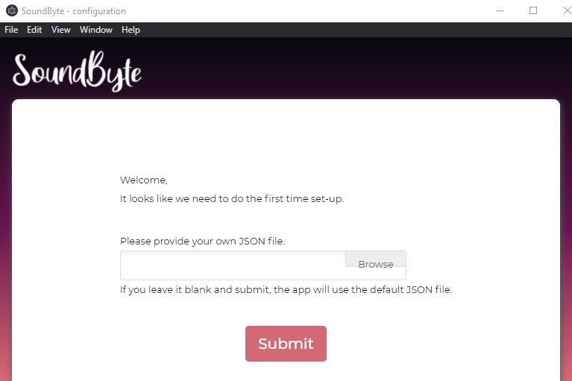
Initialization
Our app initialization starts up automatically.
When there is no the init.JSON file in a designated directory, it sends the user into this page in order to initial setup. After setting, we proceed into the library menu(Suggestion). * There had been a bug due to the path name convention between windows and unix like machines and fixed.

Slide 7
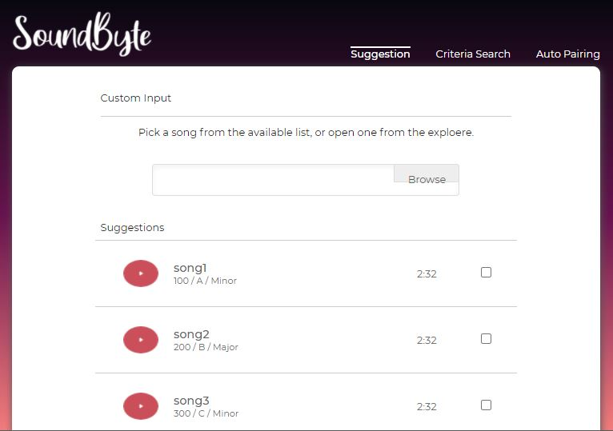
UI
Our UI is close to the final draft of HIFIs.
we have added the components for providing an mp3 as input - but it is currently not functional.

Slide 8
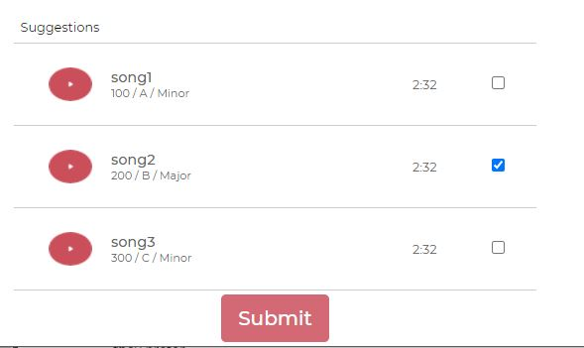

Talking to Python
Currently, a user may select one song & send it to our python model.
We have working intercommunication between python and nodeJS now using python-shell.
This enables us to develop for the results menu & saving functionality.

Slide 9
Some other things
Risk assessment docs are available
Cleaned up file structure
removed unnecessary jupyter files.
Added a github webpage
https://lane203m.github.io/SoundByte/

Slide 10
Machine Learning
Iteratively training model and testing the output
Exploring solutions to increase the size of our training sample library
Researching how to improve key extraction

Slide 11
On the horizon
In the coming weeks, we aim to include the following features:
complete initiation w/validation.
generation of song library JSON upon initialization
results section (displaying our generated output)
Key extraction experiments
After achieving these, we will move on to
features as input
random input
mp3 as input
filtering our list.
Other goals include
saving results for later viewing
playback
error handling

Slide 12
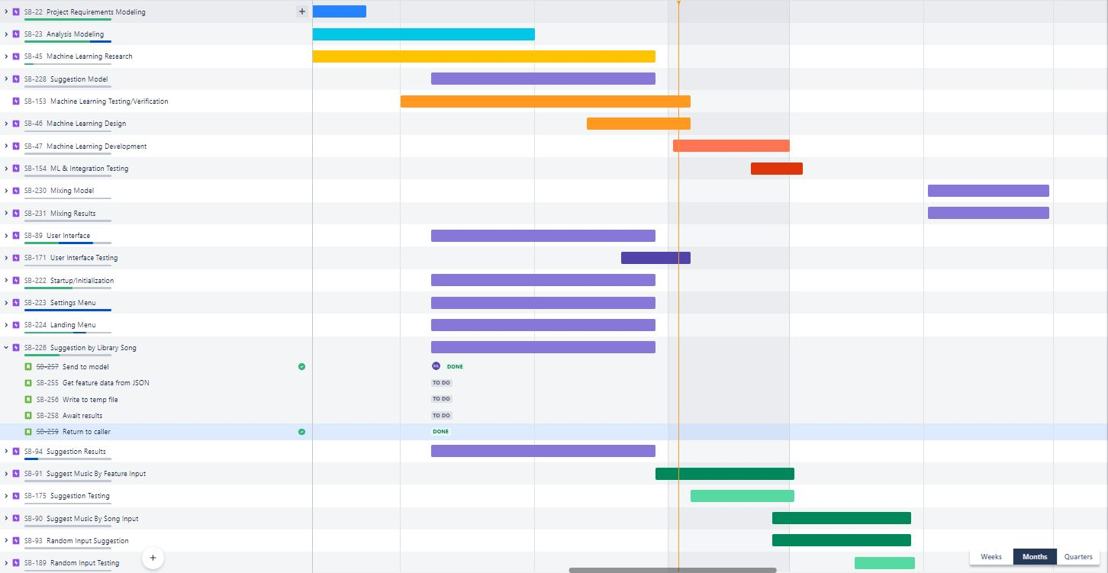

Slide 13
Group reflection
Do you feel you are on track?
We had some delays with MVP1 and don’t feel like we are on track. However, we are catching up.
Do you feel there are barriers to your success (if any)?
There had been an unexpected error(e.g path name conventions). We are also have trouble with key extraction.
Do you need any help going forward?
Plan on speaking with Dr. Yow to gain insight on how to improve feature extraction model.
We would also appreciate help in devising a testing strategy.
Any other questions or concerns?
Would love commentary on our pace

Slide 14

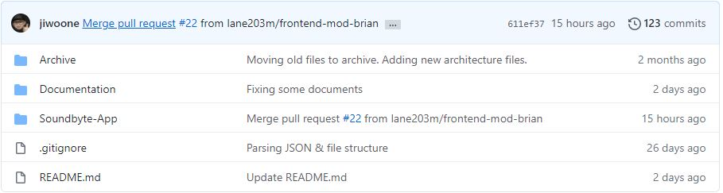
Github
https://github.com/lane203m/SoundByte
https://lane203m.github.io/SoundByte/
https://uofr-capstone.storiesonboard.com/m/guidemap
https://soundbyte.atlassian.net/jira/software/projects/SB/boards/1

