Slide 1
ENSE 477 Project Bazaar Scrum
SoundByte
Brandon Clarke, Mason Lane, Jiwoun Kim
25/02/2020

Slide 2
What We’re Doing
Our team will provide creators & hobbyists with a tool that prescribes audio files to complement a given song when mixing. The goal is to improve the workflow of artists while being a utility for DJs in the future.

Slide 3
Roles and Responsibilities
Brandon Clarke:
ML/Suggestion component. Science, Research
ML/Suggestion development
Jiwoun Kim:
frontend design & development
backend development
Mason Lane
Scrum Master
backend/frontend architecture
backend development, feature extraction

Slide 4
What Have We Been Up To?
Feb9 - Feb22 (Last Sprint)
Feb23 - March 8(Current Sprint)

Slide 5
Initialization & Essentia.JS
Spent the last two weeks investigating Essentia.JS - an alternative we were not aware of.
Successfully decoded wav audio data extracted features using Essentia.JS
Essentia.JS uses a wasm file too large for web apps - we need to introduce a worker for multithreading.
Refactored the libraryBuilder.ts file to call a worker function instead of a python-shell.
LibraryBuilder is currently setup to handle some song. Currently, we save the file name & song length. We then fill the rest with temporary data.
Next iteration plans to include the aforementioned Essentia.JS features & metadata tag reading for authorship & song titles.

Slide 6
Suggestion Menu
We have a song library initially :
From the initialized directory configuration, a JSON library is to be read
The app send the user to the ‘Suggestion Menu’, and it lists up the song library lists based on the JSON library.
Suggestion List:
If the user select a song and push the submit button,
the app projects the suggestions list by using our suggestion model(back end).

Slide 7
Machine Learning
Created a python environment to evaluate song suggestion similarity
Error function based on weighted differences
Input from features
Explore different error functions

Slide 8
Where are we sitting?
Brandon:
Yellow, we have made some good progress as of recent but refactoring and testing could bring unexpected delays
Brian:
Between Green and Yellow, some delay still exist on interface implementation(playback function).
Mason:
Yellow, red if problems persist. Essentia with multithreading scares me.
May need to default to python alternatives (much harder than using essentia)

Slide 9
Whats next?
As previously mentioned; getting workers to return Essentia.JS results.
I have some concerns with this. Awaiting a worker defeats the purpose of multithreading. Given adequate time, it may be more effective to generate song data *after* moving to the song menu page.
Reading wav tags
Several node modules answer this problem, and will make implementation trivial.
Random suggestion input could also be easily implemented.

Slide 10
Whats next?
Proper Input Handling. User should be able to get from initialization to results without problems.
Returning model JSON to results page.
settings menu to re-initialize CFG & JSON

Slide 11
Whats next?
Refactoring Backend
Updating documentation
More extracted features

Slide 12
Other Plans
Filter options on the song/results menu for viewing efficiency
Playback working

Slide 13
Group reflection
Do you feel you are on track?
Trouble with wasm file delayed essentia implementation
However, seeing it run successfully in tests was quite a relief
Were catching up but not fast enough. We need time to test
Do you feel there are barriers to your success (if any)?
Key extraction is successful, but multithreading may cause issues that impair our usage of Essentia. We have not done this before.
Do you need any help going forward?
How do we handle web workers?
Any other questions or concerns?
Not at the moment

Slide 14
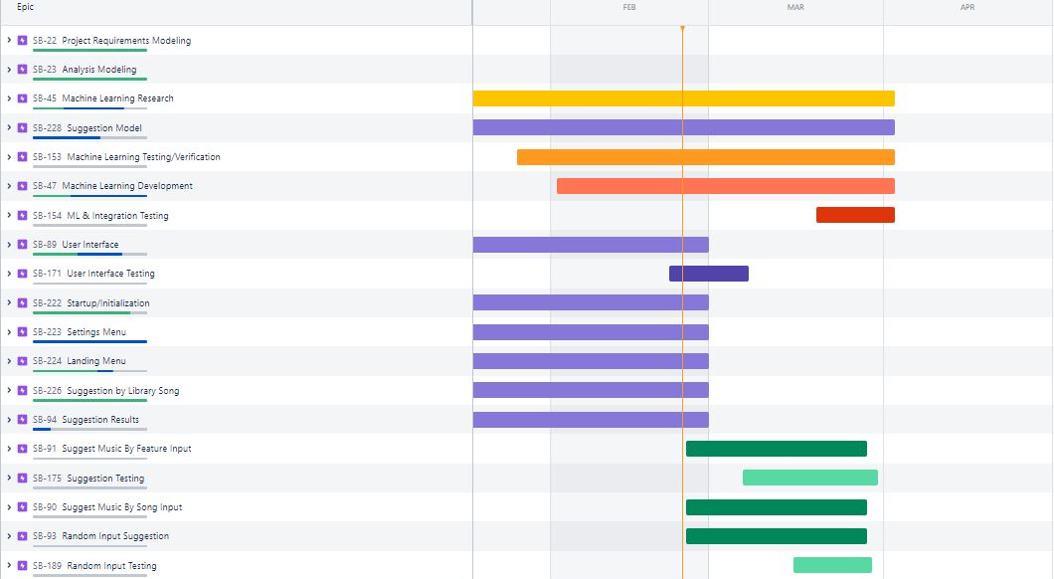
Roadmap

Slide 15
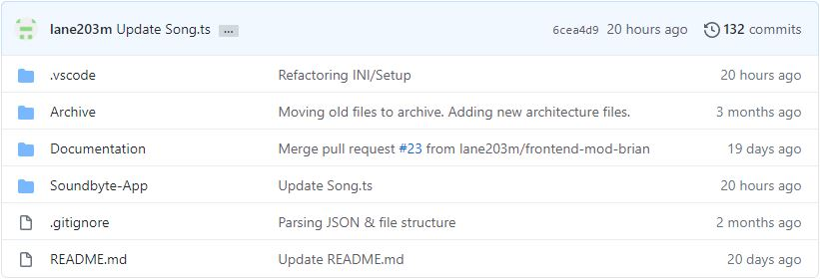
Github
https://github.com/lane203m/SoundByte
https://uofr-capstone.storiesonboard.com/m/guidemap
https://soundbyte.atlassian.net/jira/software/projects/SB/boards/1 [Roadmap half-updated]

