Slide 1
ENSE 400 Dec 14 Scrum
SoundByte
Brandon Clarke, Mason Lane, Jiwoun Kim
21/01/2020

Slide 2
What We’re Doing
Our team will provide creators & hobbyists with a tool that prescribes audio files to complement a given song when mixing. The goal is to improve the workflow of artists while being a utility for DJs in the future.

Slide 3
Roles and Responsibilities
Brandon Clarke:
ML component. Science, Research, Development
Jiwoun Kim:
frontend design & development
backend development
Mason Lane
Scrum Master
backend/frontend architecture
backend development
ML advisory

Slide 4
What Have We Been Up To?

Slide 5


Key Changes
Decided AWS would not suit our project. Ran into storage issues considering the typical size of songs
We are now going building our software on Electron.
Redesigned various components to bring more utility to the user.
We hope to manage a user’s library of songs and allow suggestions via ML. The user may select from their library, input a new Mp3, or enter features manually.
These changes will allow us to
make playback possible,
save a user’s recommendations,
Run off a user’s unique library/settings. Aws made this difficult, as we could not handle the traffic of songs.
introduce automatic mixing options (mvp3)

Slide 6
MVPs
MVP1:
Initialization. Create Library JSON. Read ID3 from Mp3
We will depend on the user’s songs having the required ID3 tags
User may instead upload a JSON manually. Will set CFG file to assume there is no associated Mp3 directory (mixing disabled).
Settings. Update & Re-initialize JSON
user may update existing JSON when files have been edited, added, removed.
Landing Menu
Read & Display JSON library. Row by row. Text only, no playback.
Filter options for the library.
Songs may be selected & sent as the suggestion request.
Features may be input manually for a suggestion
Results
Similar layout to the landing menu. Output varies from the type of input used. Filter capable
User may select songs - but there is no further functionality
User may save results for future reference.
Saved Results
User may read a saved results JSON to view past Results objects.
Suggestion
Accept multiple types of input. All forms of input should eventually produce a Features object
Trained initial model. May be dumb/ineffective.
returns a variable Results type

Slide 7
MVPs
MVP2:
Loading/Process/Exception explanation. Inform the user of what's going on in more detail.
Landing Menu
User may open library songs to the directory - if such exists.
Keyword search
Input an Mp3 that is not part of the library.
Offer playback if CFG + JSON have an associated Mp3 directory.
Results
Allow playback & mixing request if CFG has an Mp3 directory.
Able to display input types of unique Mp3s.
Mixing
Introduce new model for mixing two selected songs. Only offered if Mp3 directory exists.
Expect JSON library songs only (with associated Mp3). No unique Mp3s.
Lazily mash-up songs. Dummy model.
generate results page similar to suggestion results.
Allow saving of results.
Saved results
now includes saved mixes. Stores Mp3s of past mixes.
Suggestions
Handle Mp3 as input type. Derive Features object. Remember Mp3 location.
Improved model. Better training introduced.
MVP3:

Slide 8
MVPs
MVP3:
Startup/Initialization
Provide demo JSON to user if needed.
Settings
Backup old JSON/CFG during updates
Landing Menu
Send random input for suggestions
Suggestions
Refined final model.
Mixing
Handle mixing requests for Mp3 inputs that have no place on the JSON
Improved mixing method
Save mix result Mp3 to our JSON. Introduce to existing library. Retrain

Slide 9
Other Ideas/Issues
Should we worry about modifications made to the Mp3? Do we rely on the user to re-initialize our app - or make an attempt to detect changed, added or missing files automatically.
Re-introduce AWS components. Use to manage an account system. Allow users to save/download JSON libraries. Enables users to go mobile in the future without needing a usb to transfer song/JSON files
Risk assessment so far includes questions like JSON size & time to read individual MP3’s metadata.

Slide 10
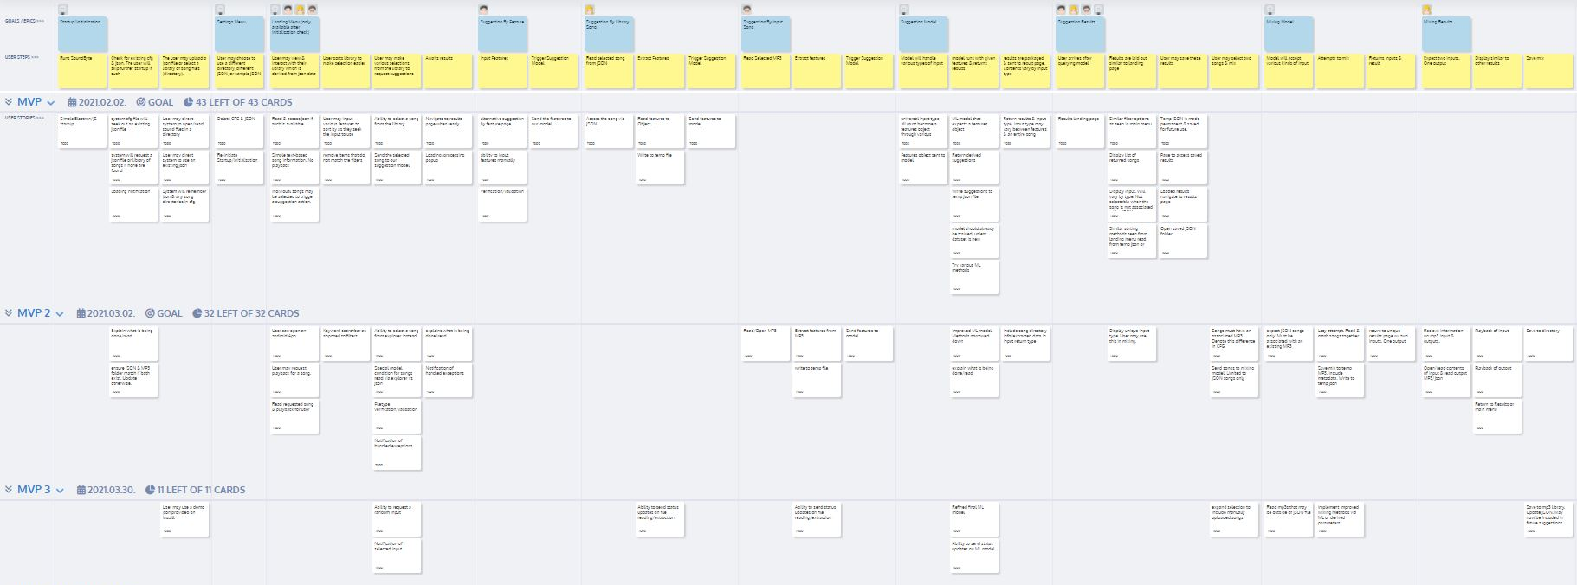
MVP & Storyboard Changes
https://uofr-capstone.storiesonboard.com/m/guidemap

Slide 11
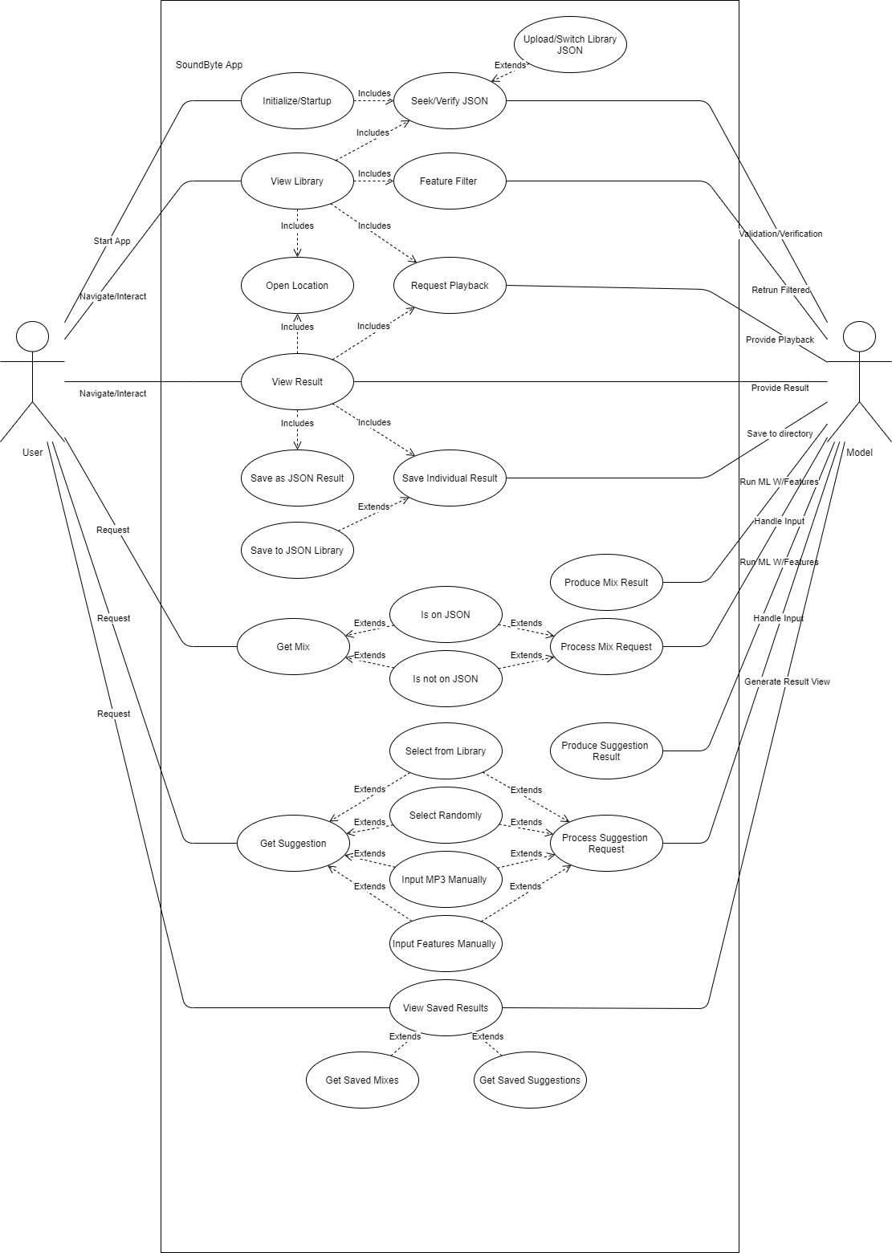
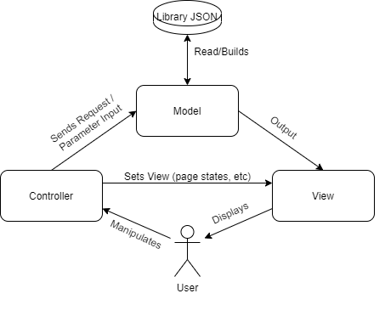
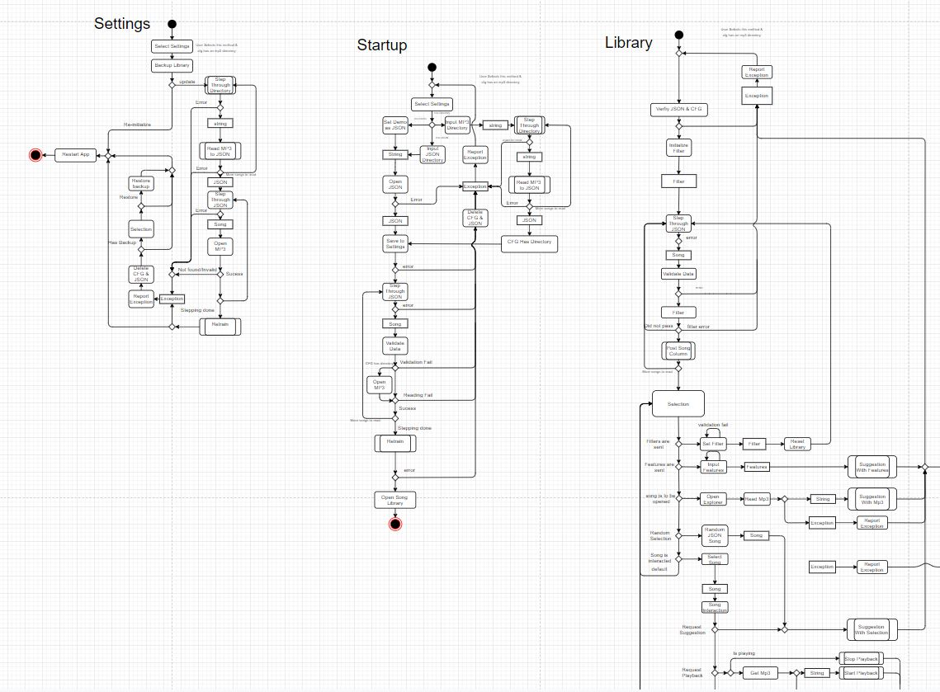
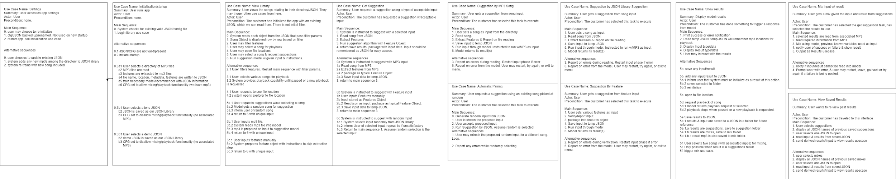
New Architecture in The Works

Slide 12

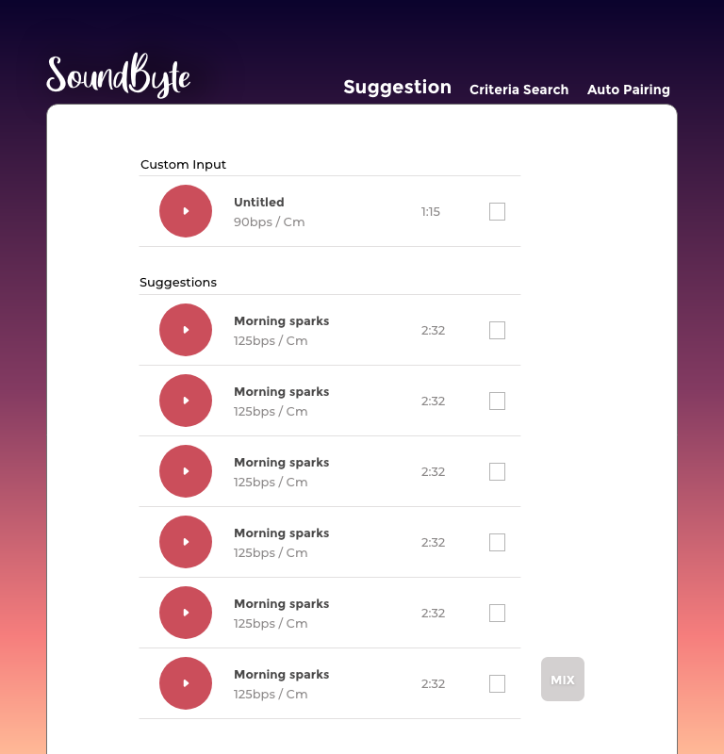
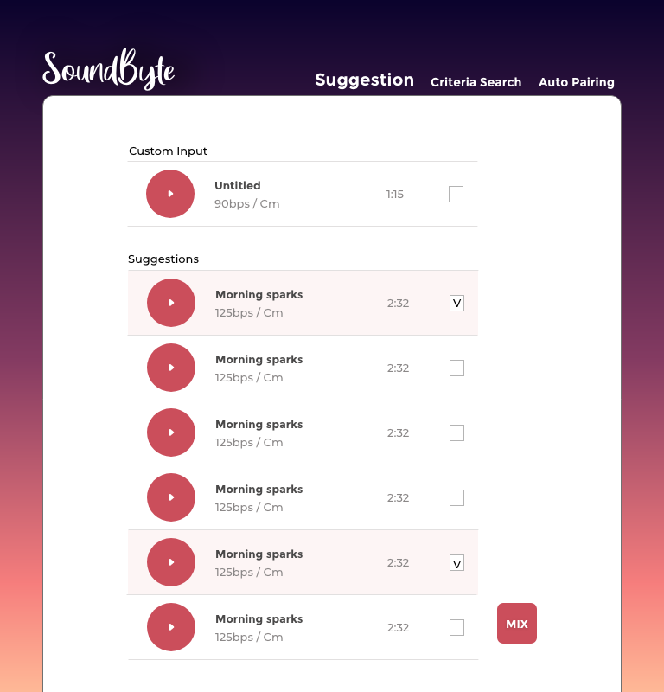
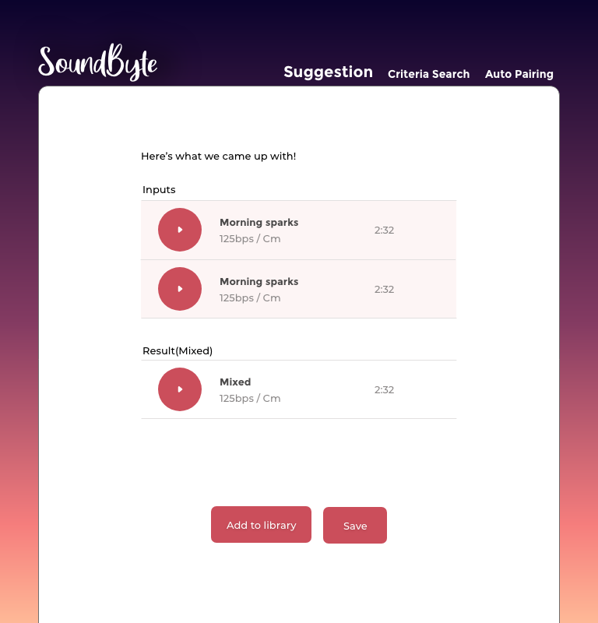
New HIFIs

Slide 13

Machine Learning
Researching LSTM (Long Short Term Memory) model for music feature extraction
Using Tensorflow to implement LSTM

Slide 14
Whats next?
Brandon:
Extracting features,
training a model,
manipulating our dataset & deriving new features
Brian:
Implementing the Interface of the app using electron(front-end) [In progress]
Keep the designs updated(HiFis) [In progress]
Mason:
Electron/Python Work. Building Foundation
Redesign Class Diagrams [In progress]
Redesign Activity Diagrams [In progress]
Redesign Data Dictionary [In progress]
Risk assessment & mitigation docs. QA docs. [In progress]
New Roadmap [In progress]

Slide 15
What’s Missing/Behind?
Things To Remember
We need to write more code & set a proper foundation.
Changes from previous weeks have made us re-do some steps.
We still hope to meet MVP1 by the end of January
Had Projects due on the week of the 7th - as well as finals. These delayed progress during this sprint.
MVP1 is our largest initial release, but we believe it is justified considering the time we can leverage throughout December.

Slide 16
Group reflection
Do you feel you are on track?
Yes and no. Again, we’d have liked to start development earlier. However, it's good that we discovered these issues. It's evident we did not gather requirements effectively.
Do you feel there are barriers to your success (if any)?
Not at the moment
Do you need any help going forward?
Not immediately
Any other questions or concerns?
Would love commentary on architecture. How are we doing?
Are we keeping a healthy pace?

Slide 17

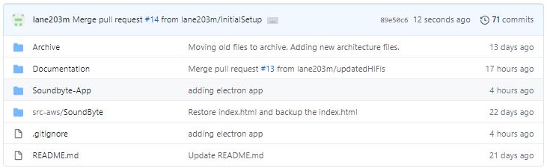
Github
https://github.com/lane203m/SoundByte
https://uofr-capstone.storiesonboard.com/m/guidemap
https://soundbyte.atlassian.net/jira/software/projects/SB/boards/1 [Roadmap half-updated]

