Slide 1
ENSE 477 Jan 21 Scrum
SoundByte
Brandon Clarke, Mason Lane, Jiwoun Kim
21/01/2020

Slide 2
What We’re Doing
Our team will provide creators & hobbyists with a tool that prescribes audio files to complement a given song when mixing. The goal is to improve the workflow of artists while being a utility for DJs in the future.

Slide 3
Roles and Responsibilities
Brandon Clarke:
ML component. Science, Research
ML development
Jiwoun Kim:
frontend design & development
backend development
Mason Lane
Scrum Master
backend/frontend architecture
backend development
ML advisory

Slide 4
What Have We Been Up To?

Slide 5
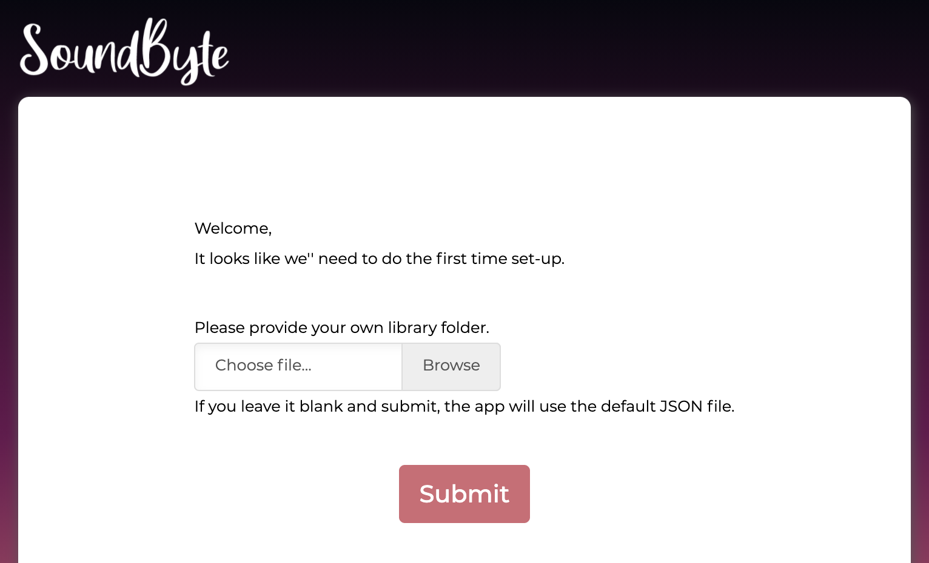
Initialization
When a user installs the app, the app asks where the library file exists. The user can choose automatically generated one or the one that the user prefers on the local machine. It is mandatory sequence, so the user can not navigate to other menus unless the library file has been chosen.

Slide 6
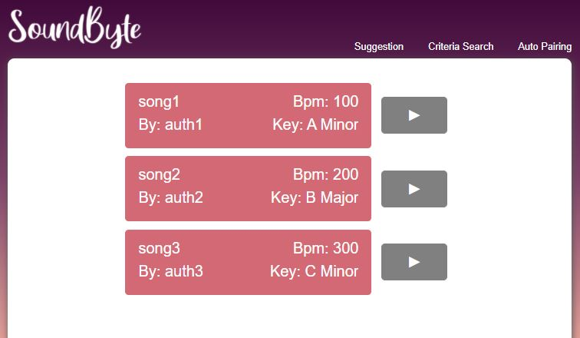
Library Menu
We have a semi-functional library menu which displays important song information, derived from the JSON we create. In the next iteration, the library will get the JSON directory from the cfg file.
Missing a ‘Go’ button

Slide 7
Machine Learning
Writing methods to interface machine learning model to the rest of the backend
Playing around with tensorflow to ensure smooth integration with the rest of our tech-stack

Slide 8
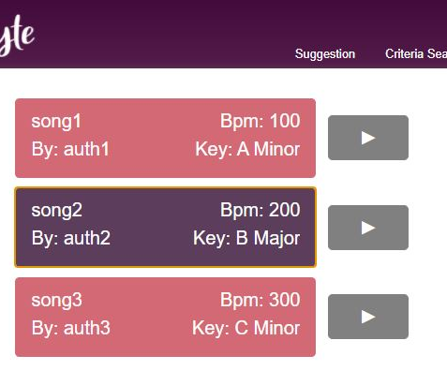
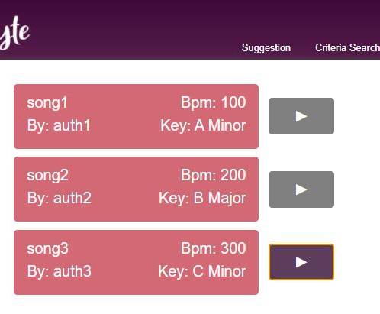
Refactoring
The library menu needs to be a radio button instead; this ensures one selection is made - while also allowing the user to select play buttons. Currently, pressing play deselects a song.

Slide 9
Whats next?
Proper Input Handling. User should be able to get from initialization to results without problems.
Returning model JSON to results page.
settings menu to re-initialize CFG & JSON
ML key extraction demo.

Slide 10
What’s Missing/Behind?
Things To Remember
Electron/Python Work. Building Foundation
Redesign Class Diagrams [Iterative]
Redesign Activity Diagrams [Iterative]
Redesign Data Dictionary [Iterative]
Risk assessment & mitigation docs. QA docs. [In progress]
Sending data to python model.
CFG file saves library directory. Sets initialized state.
startup properly checks CFG file before entering library
Mixing may not be reachable with our current delays

Slide 11
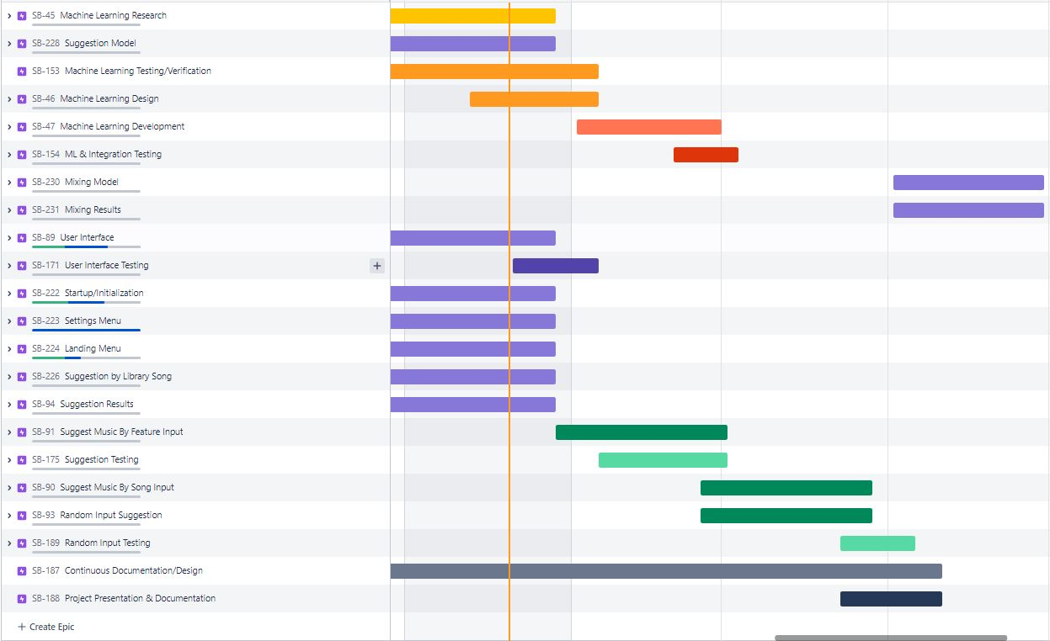

Slide 12
Other Ideas/Issues
Should we worry about modifications made to the Mp3? Do we rely on the user to re-initialize our app - or make an attempt to detect changed, added or missing files automatically.
If key extraction is not reliable, should we simply expect key values in the ID3 tags, or perhaps query using an existing api search (if we can find the song online).

Slide 13
Group reflection
Do you feel you are on track?
We had some delays with MVP1 and don’t feel like we are on track - however, MVP2/3 are smaller.
Do you feel there are barriers to your success (if any)?
Key extraction will continue to cause problems & we may need to face alternatives later
Do you need any help going forward?
Plan on speaking with Dr. Yow to gain insight on how to improve feature extraction model
Any other questions or concerns?
Would love commentary on our pace

Slide 14

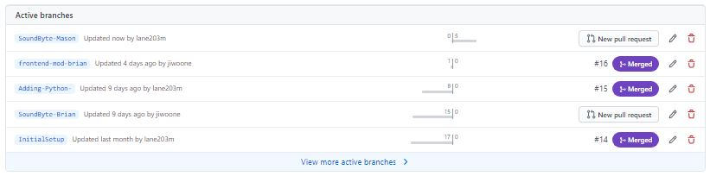
Github
https://github.com/lane203m/SoundByte
https://uofr-capstone.storiesonboard.com/m/guidemap
https://soundbyte.atlassian.net/jira/software/projects/SB/boards/1 [Roadmap half-updated]

