Slide 1
ENSE 477 Vlog 6
SoundByte
Brandon Clarke, Mason Lane, Jiwoun Kim
07/04/2021

Slide 2
What We’re Doing
SoundByte aims to organize a user’s music library in a fresh light to provoke new creative ideas. We suggest songs that might make for a good music sample, mix, mashup, or fade out.

Slide 3
Roles and Responsibilities
Brandon Clarke:
ML/Suggestion component. Science, Research
ML/Suggestion development
Jiwoun Kim:
frontend design & development
backend development
Mason Lane
Scrum Master
backend/frontend architecture
backend development, feature extraction

Slide 4
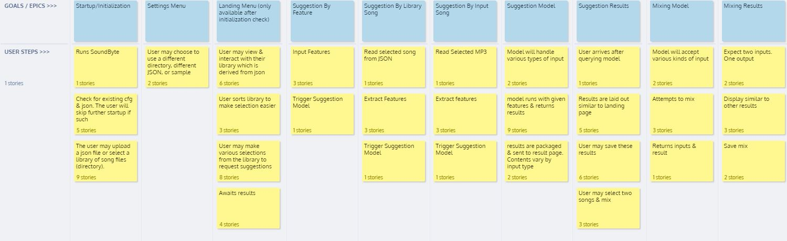

Requirements Gathering
Started with Empathy Mapping
Affinity Diagramming & User Stories
Requirements document
Derived Storyboards & eventually roadmap on Jira
Compiled risk assessment & response documents
Experimenting on AWS
Redesign & finalized Storyboard
Exploring machine learning/feature extraction/suggestion methods & solutions
Other documentation including business case
Notes:
We began with some empathy mapping to get an idea for our project’s scope - and the general need present
Of course, this was followed up by more thorough affinity diagramming & user stories.
This established epics which would later be used in the creation of our storyboards
Our initial designs planned for AWS - but as we experimented we discovered that is was not viable. Storage of songs & request times would bring us over budget.
machine learning options. Early investigation of essentia - though we did not initially adopt it. It was held as a possibility

Slide 5
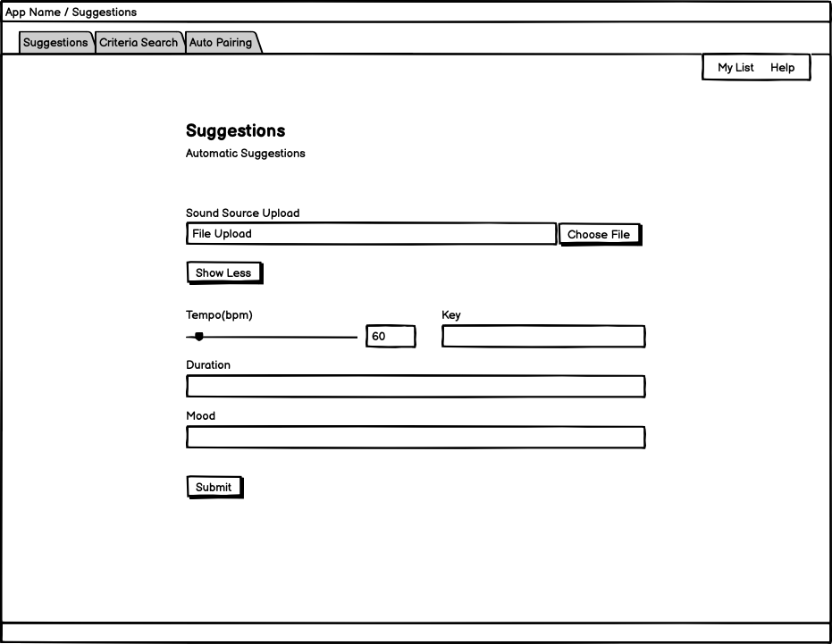
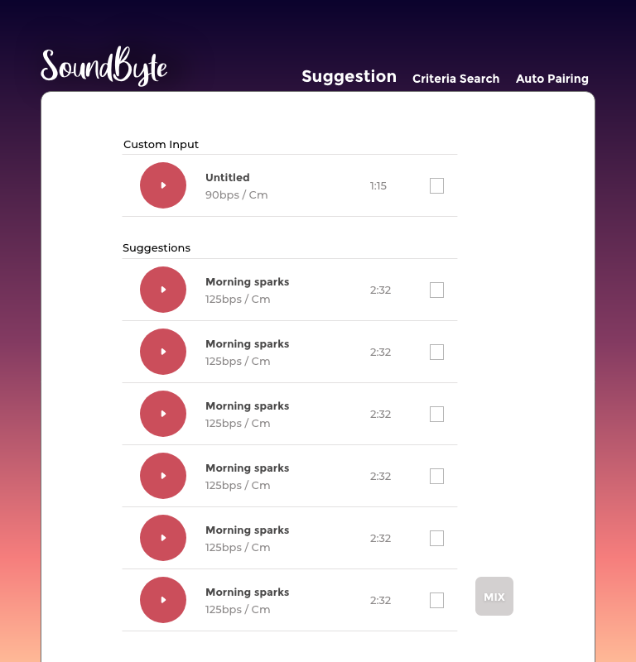
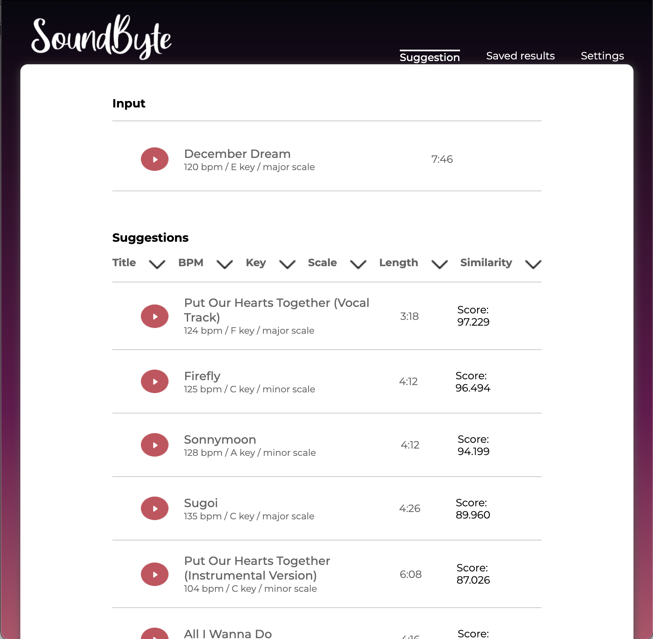
UI Design
LoFi design stack: Web application design pattern
(Responsive and Progressive design pattern, Accordance with using AWS as backend)
HiFi design stack: Javascript(Native), DOM, Typescript, CSS, and HTML (Changed to use python frameworks for our backend)
Fig. LoFi design : Criteria Suggestion
Fig. HiFai design : Suggestion by a song
Fig. working application : Suggestion by a song
Notes:
Our LoFi design more focuses on web application stack, such as responsive and progressive pattern. However, after we decide to use electron as our front end stack, we don’t need to consider the patterns anymore. And the HiFi design have had fixed design components.

Slide 6
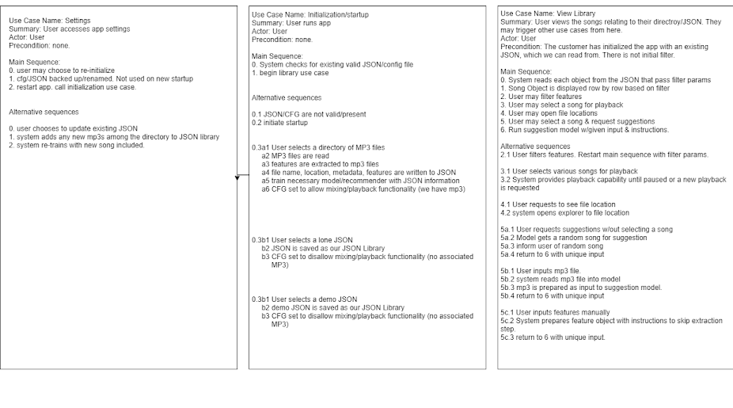
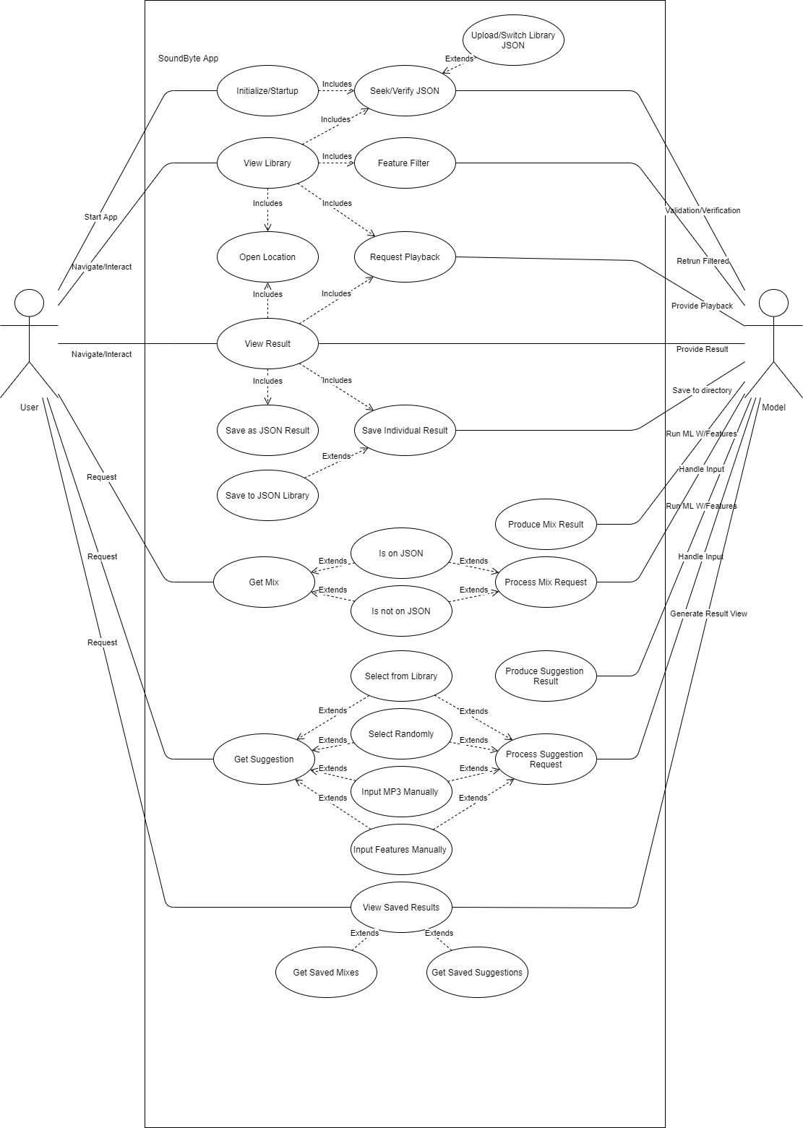
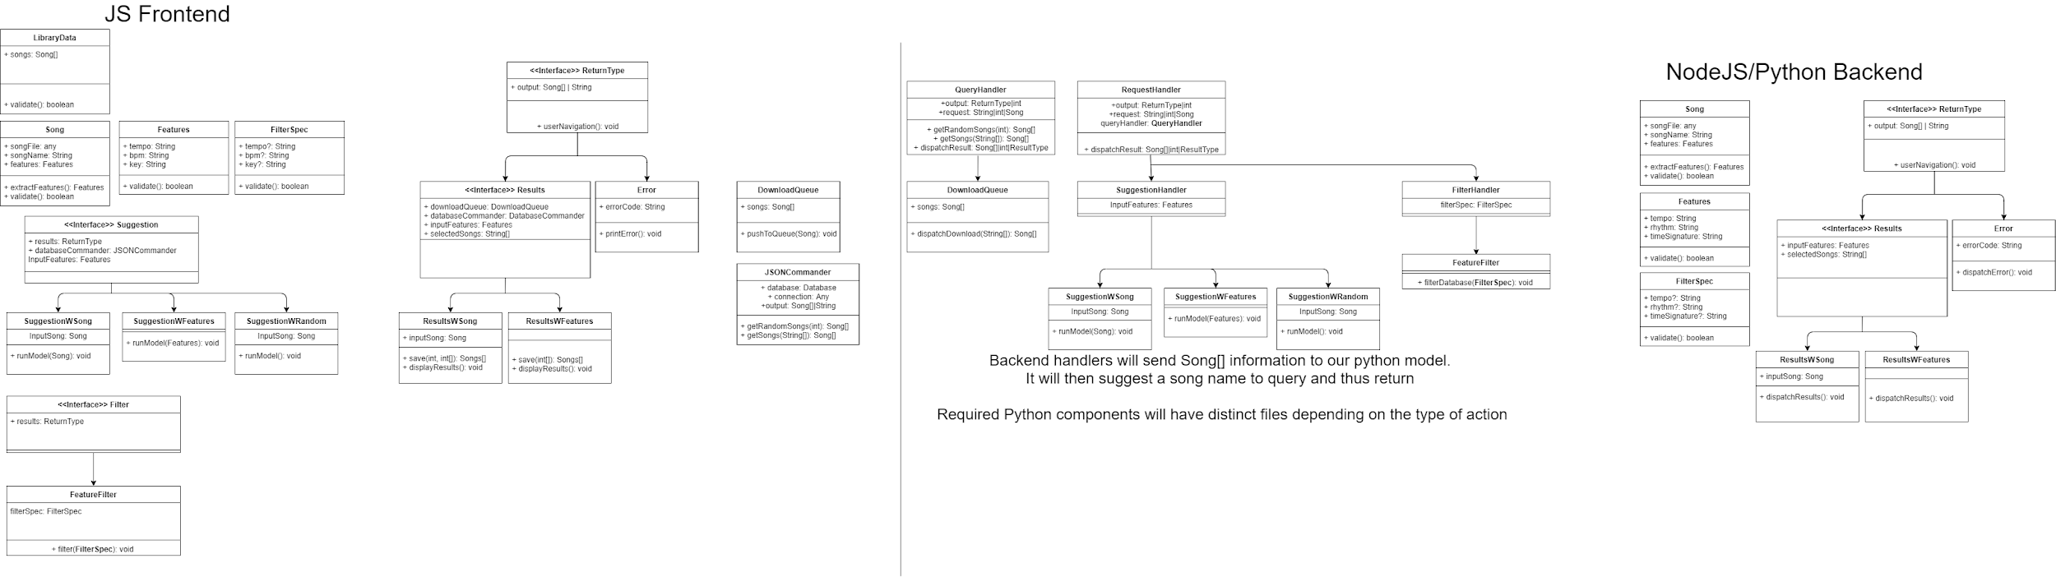
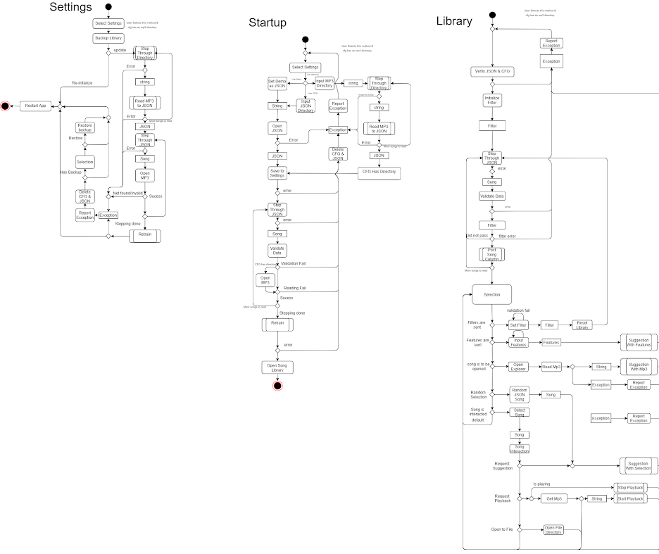
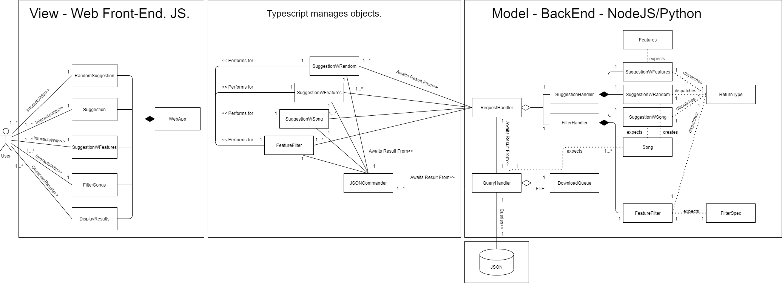
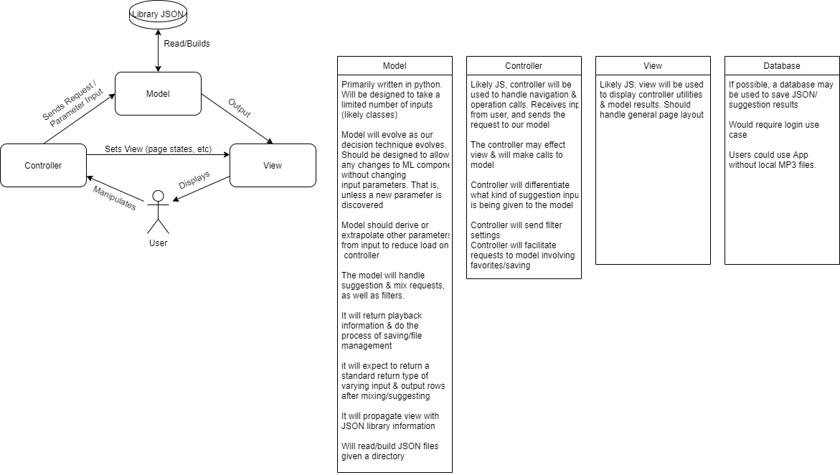
Architecture
Use case diagrams
MVC pattern
Deriving further
Class Model
Data Dictionary
Activity Diagrams
Notes:
We began with some use case diagrams and a general idea for the MVC pattern
Which we then derived for the class model, data dictionary and activity diagrams. These can be found on github

Slide 7
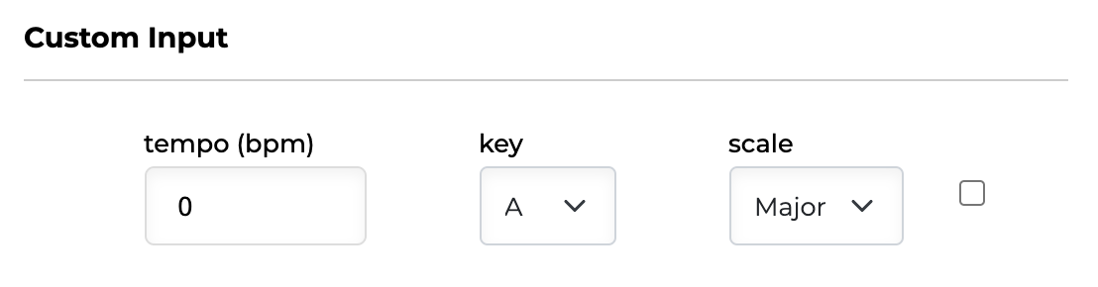
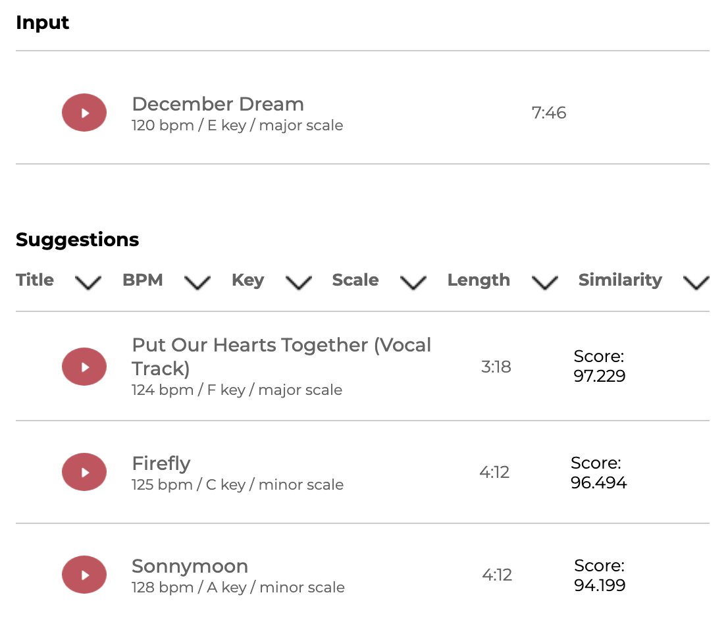
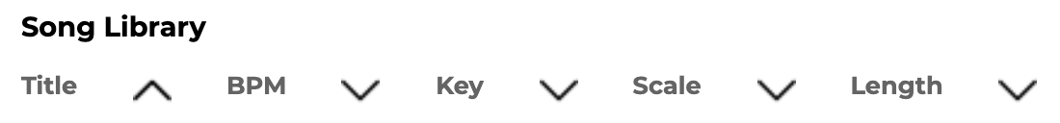



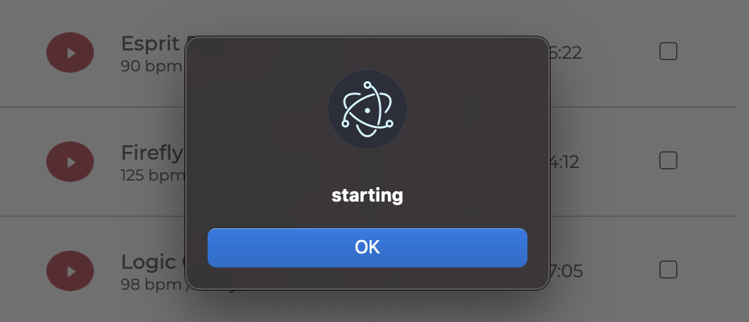
Development : Frontend
We call a Library Data Object from JSON, which is generated by our middleware and back end.
Input may be sent through the selection of various checkboxes, which send either a Song or Feature Object. This is sent to the backend to process the results.
They may also select a random input
Once the results(suggestion) generated as JSON, it gets presented on the screen by using DOM and javascript.
Users are allowed to filter their library/results - and have limited input options to avoid errors.
Users can play each song by pushing the play button they want.

Slide 8

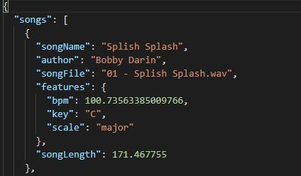
Development : Middleware
Established generic types for important objects & purposes
Used to extend further meaningful types
Eg: Song/Feature Objects. Suggestion, SuggestionWSong, SuggestionWFeature
Use of TypeScript (TS) assisted with the frequent use of specific Objects - our Types. Allowed us to follow the architecture laid out more faithfully.
Backbone for communication between Python and NodeJS
Passes requests made on the frontend
Extendable
Notes:
We established our types to maintain faithfulness to our architecture.
Generic types extend into other types with greater meaning & purpose
Handles the majority of data - its logic/format
TS was a good choice for maintaining an object oriented middleware
We call elements of our python backend from a python-shell

Slide 9
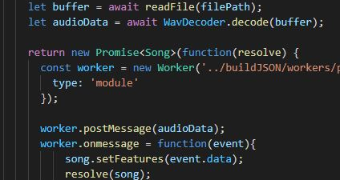
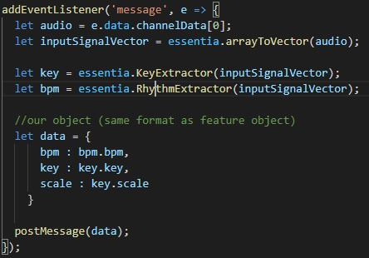
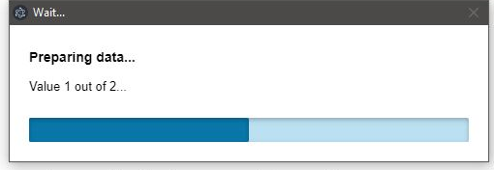
Development: Backend Extraction
Use of EssentiaJS
WASM trouble
Introduction of web-workers
Reads tag metadata
Measures song length
Decodes audio stream
Extract important features with EssentiaJS + web-worker
Save extracted songs to JSON
Loading times
Notes:
Initially we did not include essentia in our designs - this was until we decided to use EssentiaJS. This is different form of Essentia, which is a C++ library with python bindings for linux.
Essentia did not work well as a nodeModule in our chromium application
WASM files may not exceed 4kb on web apps. While electron is for desktop applications, it is technically a web app
Using webworkers, or multithreading, we were able to fix this issue
Ultimately we read tag metadata, measure song length and decode an audio stream. After doing so, we extract important features using essentiaJS within the web-worker
We will discuss loading times in further detail

Slide 10

Development : Backend Suggestion
Python scripts to evaluate song similarity
Input: song library plus one
Song Object
Feature Object
Random Song Object
Weighted sum of difference in features
Returns a Suggestion object, which contains the input song and an array of scored Song results.

Slide 11
Other Design Changes
All backend to be in python
Million Songs Dataset
Lack of dataset access
Limited number of owned songs
Pivot to EssentiaJS
From AWS to desktop
Using WAV instead of MP3
Removal of features
feature creep
new direction
Notes:
Originally set to extract and suggest features within python using a tensorflow model of LSTM
Million songs dataset helped to shape what was possible and what we hoped to achieve. It included over 40 features for most songs making the possibilities endless. Unfortunately the dataset is nearing 10 years old and all of the distribution links were broken. This in combination with the lack of music to train on bought us to a screeching halt.
Then came the pivot to EssentiaJS. A js library that did everything that we hoped to accomplish with a machine learning model. Unfortunately in order to make this work the input files had to be changed to WAV files.
Originally we wanted to make this application as a web app such that it would be very easy to use on any platform. We quickly realised the logistics of uploading an analyzing a users entire library was not feasible and incurred legal concerns. This prompted the change to a desktop app
Removed features:
No longer allowing the input of individual songs for unique suggestion (cant drag and drop a fresh mp3/wav). Not included given our plans for input/feature extraction overhaul (we will discuss this in later slides)
No longer attempting automatic mixing (given our plans for future iterations - this idea, while novel, might demand too much attention for now). Focus on suggestions first.

Slide 12
Code Reviews & After Action Report
Code has standard naming conventions and is highly readable
Standard software engineering principles followed throughout development
Code lacks formal testing such as automated tests
Scalability limited by performance
After Action Report has revealed new avenues for future improvement & ambitions
Notes:
Determining the function of code blocks with fresh eyes is an easy task due to the use of standard naming conventions. Code does not extend off the screen or overwhelm the viewer
Throughout development we tried to take an object oriented approach to our application. Every block of code has a single defined responsibility and a standard set of inputs such that it easy to swap and rearrange blocks of code
Code lacks formal automated testing but manual testing and user testing were performed.
Currently the amount of songs that can be loaded at once is a bit of a burden to the application. At around 200 concurrent songs the application will crash. This could be solved by implementing a queue of some sort or processing songs as they are requested
Our after action report revealed that we feel very good about the usability and functionality of our application. Our app suggests songs with parameters that can be varied by the user and this process is very intuitive. We feel as if the main area for improvement is the performance of the feature extraction.

Slide 13
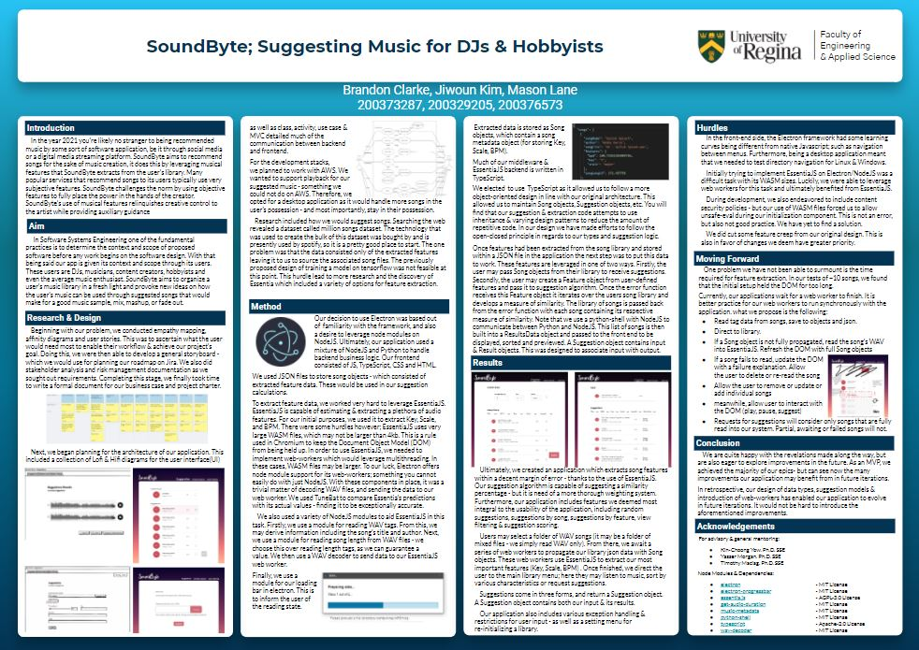
Poster

Slide 14
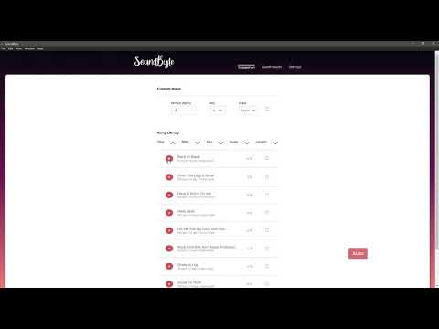
Commercial

Slide 15

Demo

Slide 16
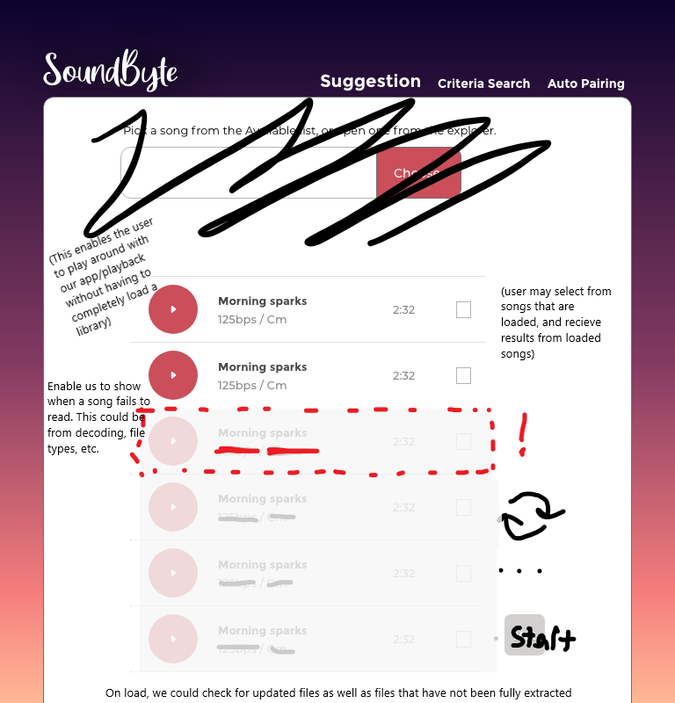
Beyond our MVP
Given that our time to extract features is long, blocking the dom during extraction is unwieldy. In future iterations it would be to leverage our multithreading solution further. Best practice for web-workers is for synchronous activities. Doing so would extract features *as* the user browsed a library.
Might also open opportunities for automated tests
Encourages a greater object-oriented design that may still use much of our existing middleware/backend

Slide 17
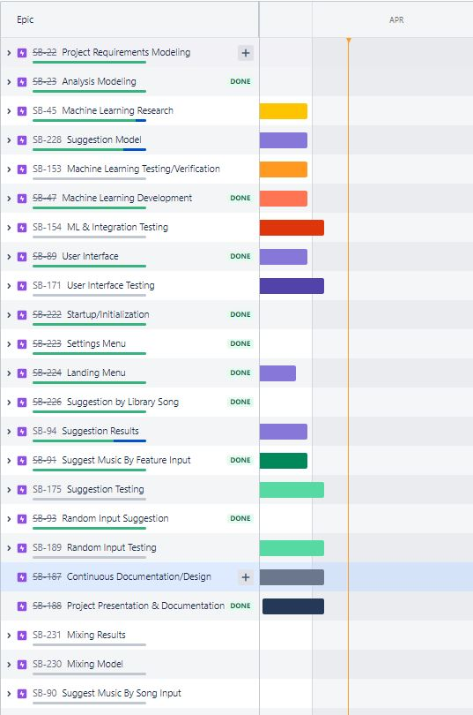
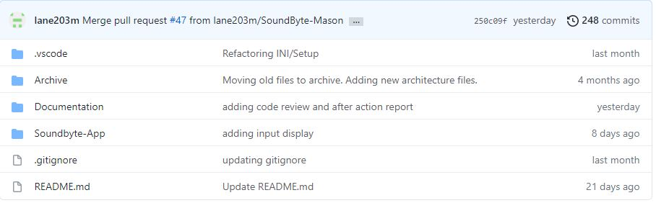
Github
https://github.com/lane203m/SoundByte
https://uofr-capstone.storiesonboard.com/m/guidemap
https://soundbyte.atlassian.net/jira/software/projects/SB/boards/1

