Slide 1
ENSE 477 Vlog 5
SoundByte
Brandon Clarke, Mason Lane, Jiwoun Kim
18/03/2020

Slide 2
What We’re Doing
Our team will provide creators & hobbyists with a tool that prescribes audio files to complement a given song when mixing. The goal is to improve the workflow of artists while being a utility for DJs in the future.

Slide 3
Roles and Responsibilities
Brandon Clarke:
ML/Suggestion component. Science, Research
ML/Suggestion development
Jiwoun Kim:
frontend design & development
backend development
Mason Lane
Scrum Master
backend/frontend architecture
backend development, feature extraction

Slide 4
What Have We Been Up To?
Feb23 - March 8 (Last Sprint)
March 9 - March 22(Current Sprint)

Slide 5
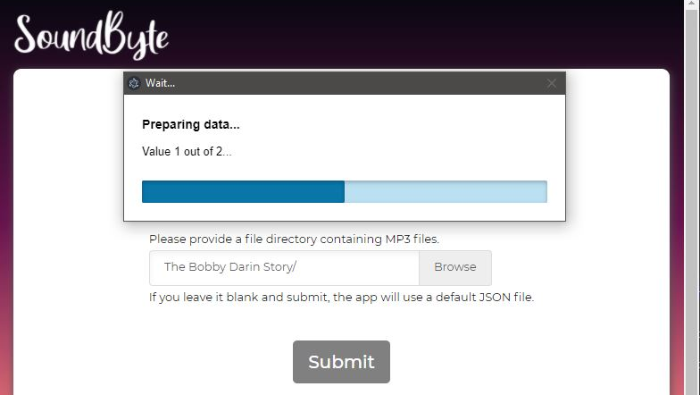
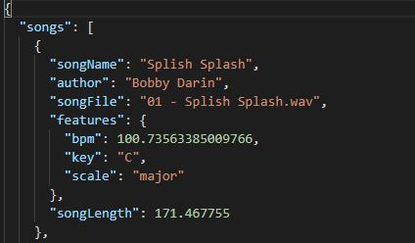
Ini & Essentia.JS
Successful feature extraction with Essentia JS through a multi-threading web worker.
Added a loading bar for essentia
Disabled button elements on loading
We can now send relevant data to our python scripts.
Adding Content Security Policies & Unsafe-Eval

Slide 6
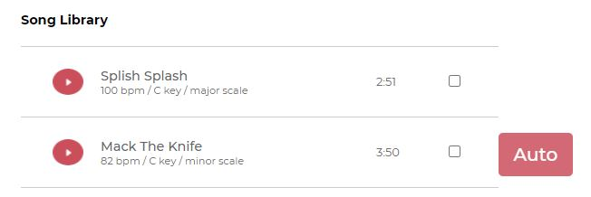
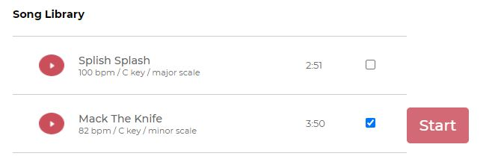
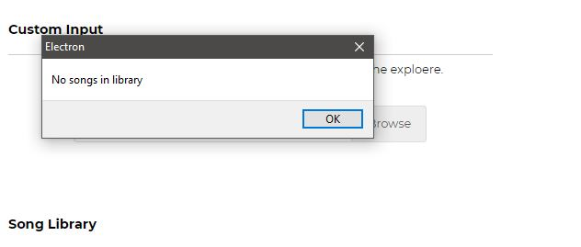
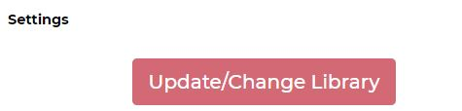
Other Additions
Working random-input selection
Settings Menu
Various exception handling
Minor UI improvements
Fixed bug with the LibraryData type

Slide 7
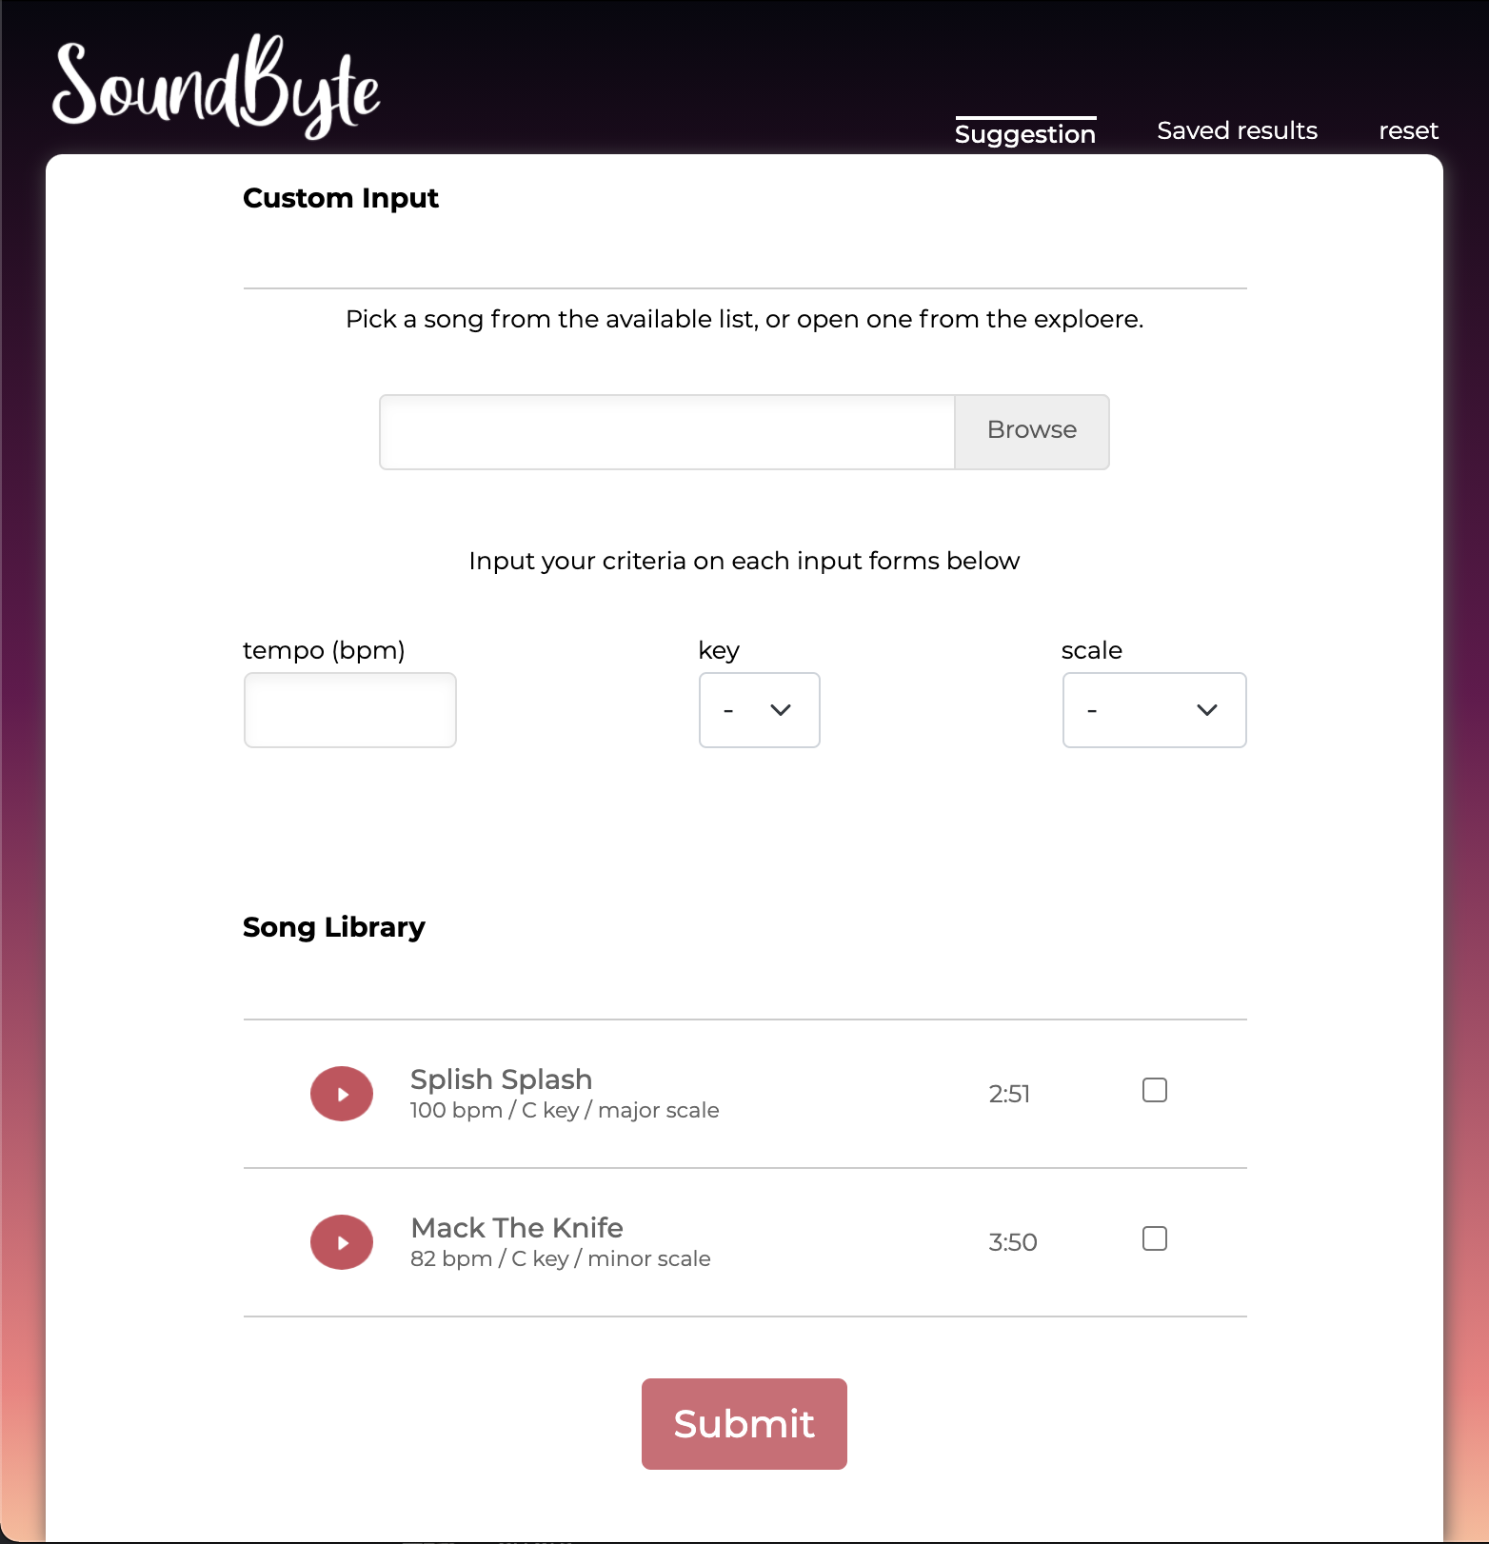
Front End Stack
Add criteria options for the search condition
Add Saved results menu
Autopairing menu changed to Reset: Users can change their initial song library
Playback function works fine but need to test sufficiently.

Slide 8
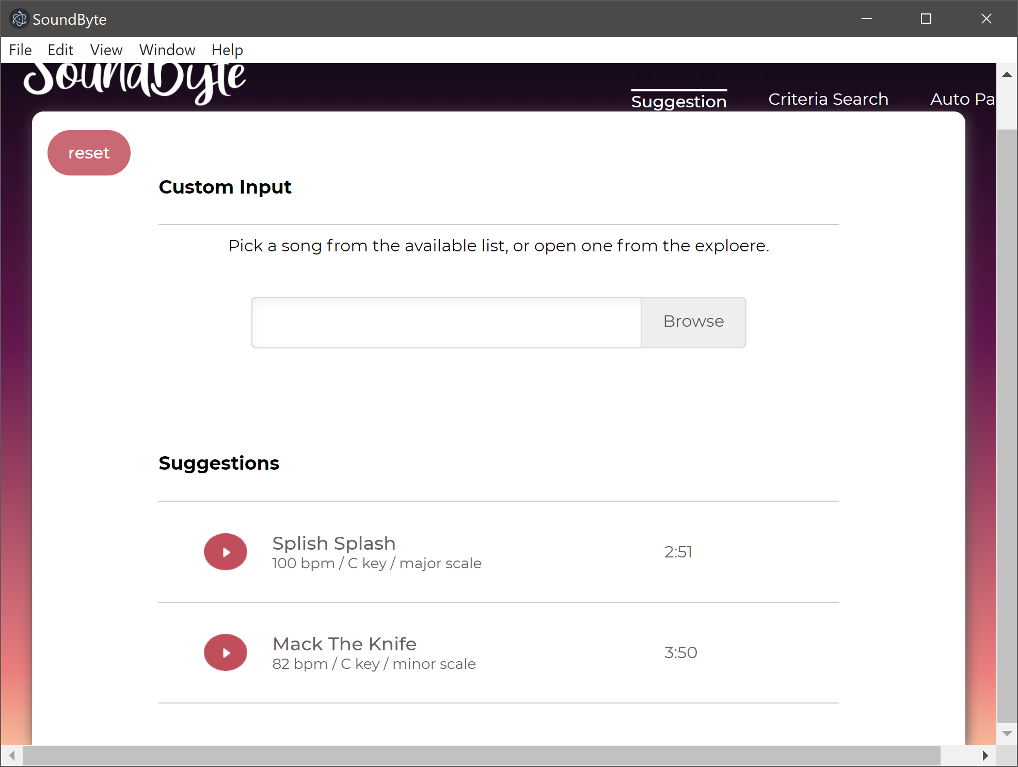
Machine Learning
Refining weights vs differences in key
Sorting by features

Slide 9
Where are we sitting?
Brandon:
Yellow, mid march and still lots of polishing to do
Brian:
Yellow, feels like behind the track somehow.
Mason:
Yellow, lots of cleanup to do. Lots of tiny additions. Very close to MVP. Sad to delay user testing

Slide 10
Whats next?
More exception handling
Sending features as input exclusively
Help with existing tickets like filter & result saving
User testing & evaluation

Slide 11
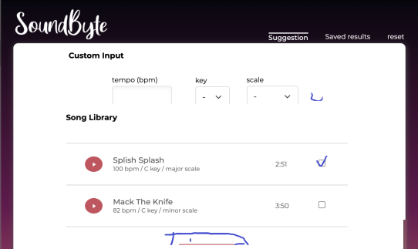
Whats next?
Clean up setting page
Follow up for save results menu
Fixing design errors
Testing front end functions following to the backend functions

Slide 12
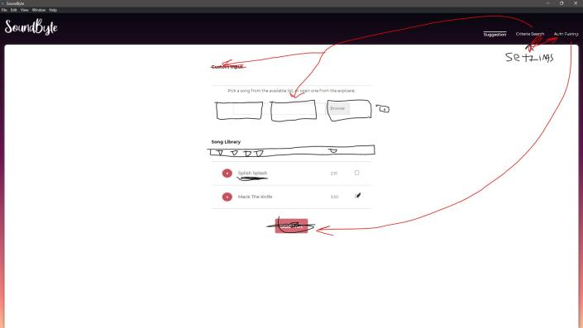
Whats next?
Refactoring Backend
Updating documentation
Testing
Feature filtering

Slide 13
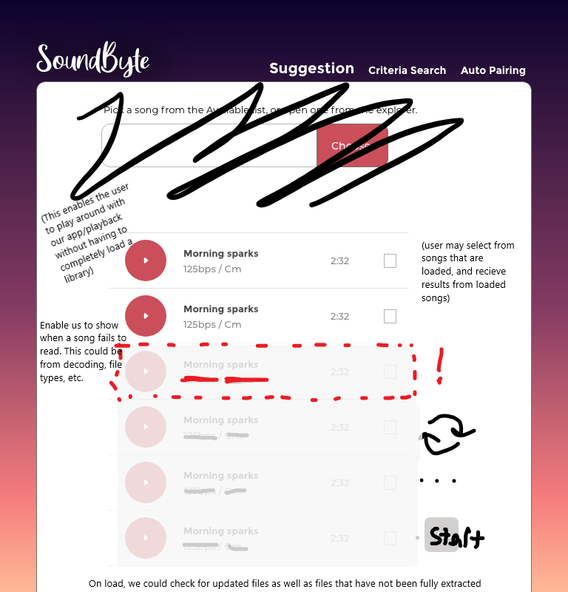
Beyond our MVP
Given that our time to extract features is long, blocking the dom during extraction is unwieldy. In future iterations it would be better to leverage our multithreading solution to load features as the user browses.

Slide 14
Group reflection
Do you feel you are on track?
We’ve made significant strides, pieces are now falling into place.
Do you feel there are barriers to your success (if any)?
Testing will be minimal
Do you need any help going forward?
N/A
Any other questions or concerns?
N/A

Slide 15
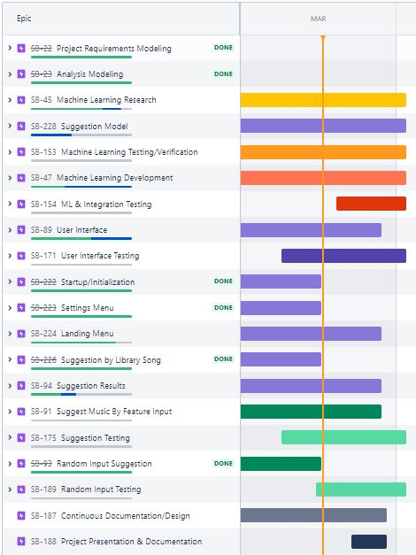
Roadmap

Slide 16
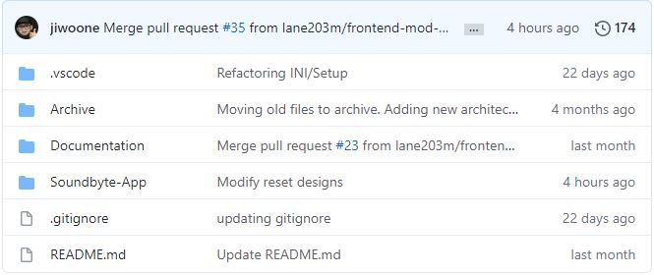
Github
https://github.com/lane203m/SoundByte
https://uofr-capstone.storiesonboard.com/m/guidemap
https://soundbyte.atlassian.net/jira/software/projects/SB/boards/1

