Slide 1
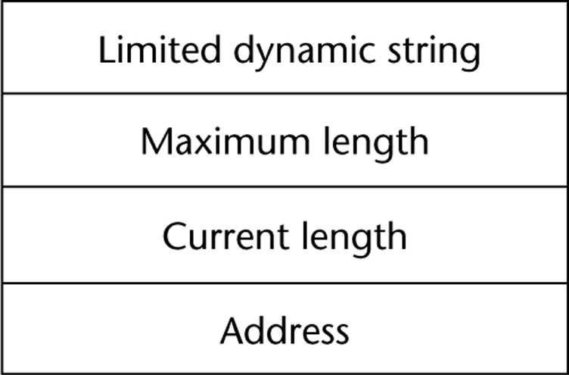
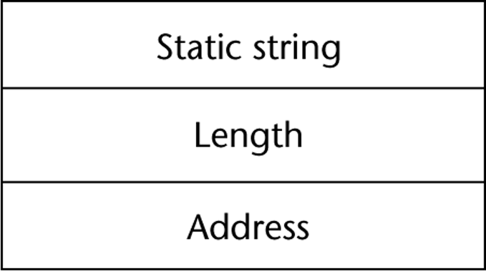
 | Primitive? | Operations
C/C++ | No (char arrays) | Ops provided thru libs
SNOBOL4 | Yes | Many, incl elaborate pattern matching
FORTRAN/Python | Yes | Assignment and several ops
Java | Yes (String class) | Ops via String class methods
Perl, JavaScript, Ruby, PHP | Built-in Support | Built-in pattern matching (RegEx)
 | String Length Type | Notes
COBOL, Java (String) | Static
C/C++ | Limited Dynamic Length | Null terminated rather than maintaining length
SNOBOL4, Perl, JavaScript | Dynamic | No Max Length
Ada | Supports all three

