Slide 1

Willson Financial Case Study
Kaden Lizama
Gerald Oden
CSD-310

Slide 2
Group Introduction
Kaden Lizama lives in Hawaii and is currently pursuing a BS degree in Software Development from Bellevue University.
Gerald Oden is a Cybersecurity Manager living in Birmingham, Alabama and is currently pursuing a BS degree in Software Development from Bellevue University.

Slide 3
Background
Ned and Jake Willson have long shared an interest in Finance and Investing.
The brothers each pursued finance degrees. Ned continued to complete his MBA.
Ned and Jake founded Willson Financial after each passing their Chartered Financial Analyst license.
Willson Financial targets successful ranchers, farmers and retirees in the local community.
Willson Financial elected to register with the Securities and Exchange Commission and must ensure compliance with SEC Regulations.
After hiring a full time office employee and a part time compliance manager, Willson Financial is examining their company data to analyze their business growth and perform a strategic review of their business.

Slide 4
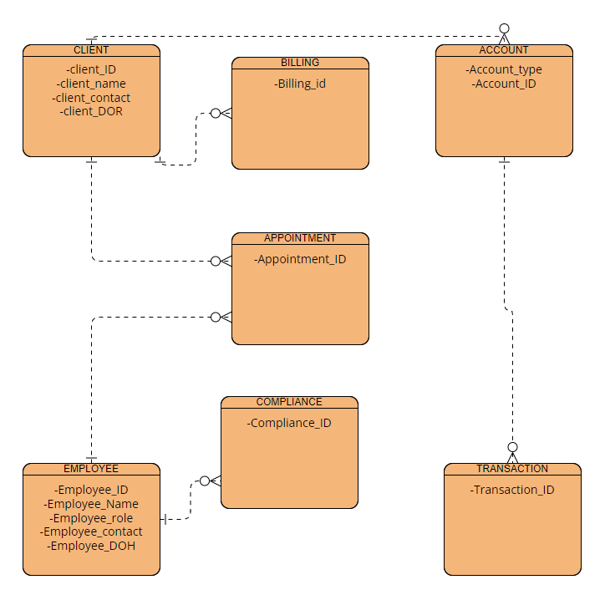
Entity Relationships
The following diagram represents the Willson Financial Database and its entity relationships:

Slide 5
Business Questions?
How many clients have been added for each of the last six months?
1
What is the average amount of assets for the entire client list?
2
How many clients have a high number (>10) of transactions each month?
3

Slide 6
Reports Overview
Monthly New Clients
Average Assets
High Value Clients

Slide 7
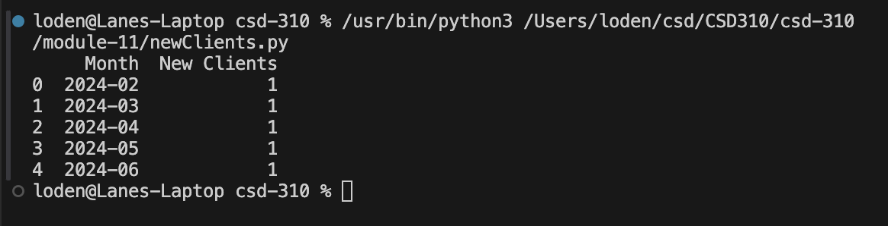
Monthly New Clients Report
This report will show how many clients have been added for each of the past six months.
This helps to understand the growth of the client base over time.
In order to ensure that the resulting data is displayed cleanly, we installed the pandas Python module.
Sample report output:

Slide 8
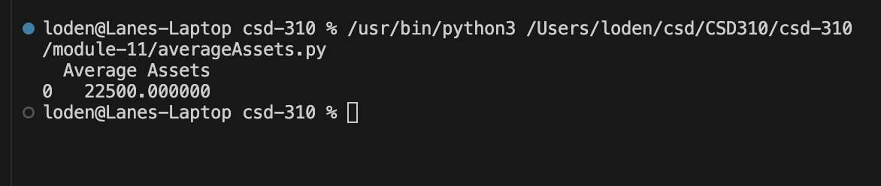
Average Assets Report
This report will provide the average amount of assets for the entire client lists.
As our business grows, we should expect the average assets to grow with us.
In order to ensure that the resulting data is displayed cleanly, we installed the pandas Python module.
Sample report output:

Slide 9
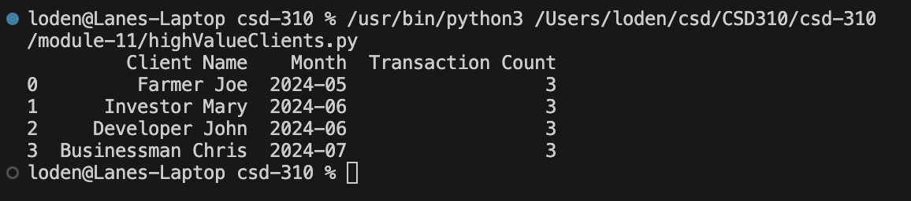
High Value Clients Report
This report will help us identify and understand our clients with more than 10 transactions per month.
Currently, our most active clients only have 3 transactions per month, so we have scaled the report to identify our most active clients today.
In the future, we can extend this report to identify clients with more than 10 transactions per month.
In order to ensure that the resulting data is displayed cleanly, we installed the pandas Python module.
Sample report output:

Slide 10

The End!

