Slide 1
Barriers to Implementing a Just Culture
Gerald Oden
CSD 380
Module 8

Slide 2
Introduction to Just Culture
What is a Just Culture?
A just culture emphasizes accountability and a focus on learning from errors rather than assigning blame.
Objective:
To create an environment where employees feel safe reporting mistakes, leading to continuous improvement and enhanced safety.

Slide 3
Fear of Blame and Punishment
Employees often fear punitive actions, leading to underreporting of errors.
This fear stems from a natural tendency to blame individuals involved in incidents (Just Culture HQCA, 2023).

Slide 4
Lack of Trust in Leadership
A deficit of trust in management can deter open communication.
Employees may doubt that reporting errors will lead to constructive outcomes, especially if previous reports were mishandled (PubMed, 2022).

Slide 5
Resistance to Change
Organizations may resist adopting a just culture due to entrenched traditional practices.
Shifting from a blame-oriented culture to one focused on learning requires significant changes in mindset and processes.

Slide 6
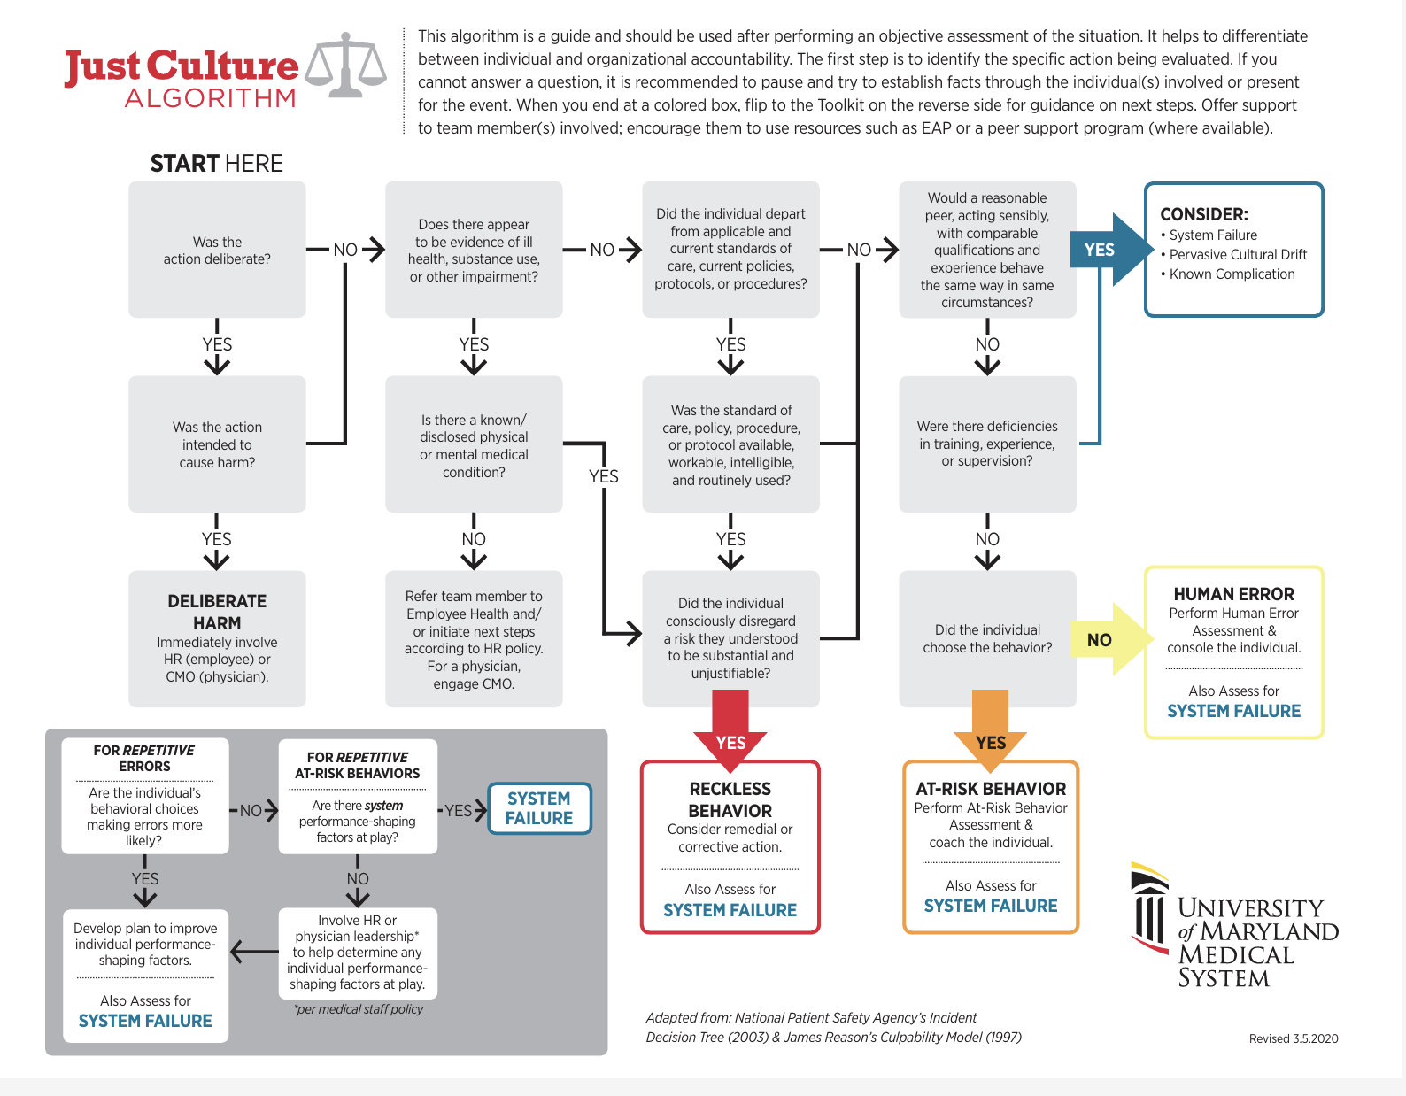
What does a just culture look like?
The University of Maryland has provided this flowchart as a visual representation of the steps to assess actions and determine appropriate responses within a just culture framework (University of Maryland Medical System)

Slide 7
Conclusion
Implementing a just culture necessitates addressing fears, building trust, and embracing change.
Organizations should commit to transparent practices, provide leadership support, and foster an environment conducive to open dialogue.

Slide 8
Works Cited
Bayern, S. (2003). JSTL in action. Manning Publications.
Dekker, S. (2018). The field guide to understanding 'human error' (3rd ed.). CRC Press.
Edmondson, A. C. (2019). The fearless organization: Creating psychological safety in the workplace for learning, innovation, and growth. Wiley.
PubMed. (2022). The barriers and enhancers to trust in a just culture in hospital services. National Library of Medicine. https://pubmed.ncbi.nlm.nih.gov/35588066/
Just Culture HQCA. (2023). Overcoming barriers to a just culture. https://justculture.hqca.ca/overcoming-barriers-to-a-just-culture/
University of Maryland Medical System. (n.d.). Just Culture Algorithm. University of Maryland Upper Chesapeake Health. Retrieved from https://www.umms.org/uch/-/media/files/um-uch/for-health-professionals/justculturealgorithm.pdf

