Slide 1
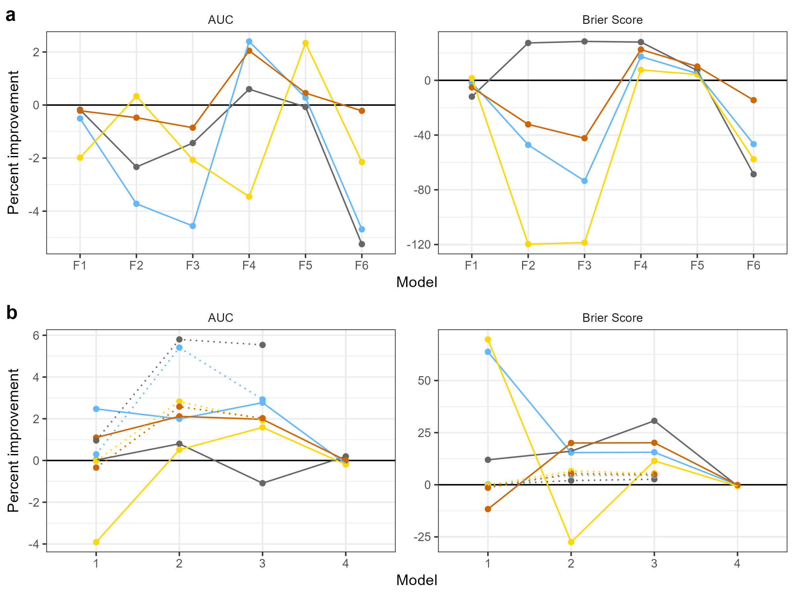
Golden-winged Warbler
Wood Thrush
Cerulean Warbler
Canada Warbler
eBird data (E models)
Outdated data (O models)

