Slide 1


BIS Pipeline Bank for International Settlements Analytics Enabling Advanced Insight into Global Financial Stability through Data Pipeline Automation
Lane Whitmore
Dave Friesen

Slide 2
Overview
Opportunity – background and problem
Solution – purpose and approach
Architecture – ecosystem and data flow
BIS Database Design – Entity Relationship Diagram (ERD)
Non-Functionals – security, data integrity, monitoring/logging, and scalability
Demo
Wrap-up – gaps and extensibility
BIS Pipeline walkthrough

Slide 3
Opportunity
The Bank for International Settlements (BIS)
● international “bank for central banks” supporting worldwide monetary and financial cooperation
BIS publishes a “gold mine” of data
● statistics, rates, and metrics informing analysis of global financial stability and liquidity
● “domains” include banking, currency, debt, derivatives, credit, property, consumers, markets
Automation and data structure can accelerate analytical leverage of BIS information
Background and problem statement

Slide 4
Solution
BIS Pipeline provides a production-ready, automated data pipeline to extract, load, transform, and persist select BIS datasets to a relational database for analytical “consumption”
Data surfaced through baseline BIS Pipeline includes US dollar exchange rates (monthly, quarterly and annual), consumer prices, and policy rates (monthly)
BIS Pipeline is built on Python and MySQL and automated through Windows (by default)
Purpose and
approach

Slide 5
Architecture Ecosystem and data flow
e.g.,
Service
Endpoints
“Cron-triggered” and Automated Functional Process
1
2
3
4
5
6
7
Archived
Data
(.zip)
Source
Data
(dataframe(s))
Relational
Data
(MySQL)
8
bis.org
e.g.,
Analytics
download
(Python)
extract
+ load
transform
consume
Security; Data Integrity Controls; Logging
Scalability and Extensibility
leveraging relational data and “cloud-compatible” tooling
e.g.,
Data Science

Slide 6
Architecture Sourcing data
e.g.,
Service
Endpoints
“Cron-triggered” and Automated Functional Process
1
2
3
4
5
6
7
Archived
Data
(.zip)
Source
Data
(dataframe(s))
Relational
Data
(MySQL)
8
bis.org
e.g.,
Analytics
download
(Python)
extract
+ load
transform
consume
Security; Data Integrity Controls; Logging
e.g.,
Data Science

Slide 7
Architecture Extraction and load
e.g.,
Service
Endpoints
“Cron-triggered” and Automated Functional Process
1
2
3
4
5
6
7
Archived
Data
(.zip)
Source
Data
(dataframe(s))
Relational
Data
(MySQL)
8
bis.org
e.g.,
Analytics
download
(Python)
extract
+ load
transform
consume
Security; Data Integrity Controls; Logging
e.g.,
Data Science

Slide 8
Architecture Transformation
e.g.,
Service
Endpoints
“Cron-triggered” and Automated Functional Process
1
2
3
4
5
6
7
Archived
Data
(.zip)
Source
Data
(dataframe(s))
Relational
Data
(MySQL)
8
bis.org
e.g.,
Analytics
download
(Python)
extract
+ load
transform
consume
Security; Data Integrity Controls; Logging
e.g.,
Data Science

Slide 9
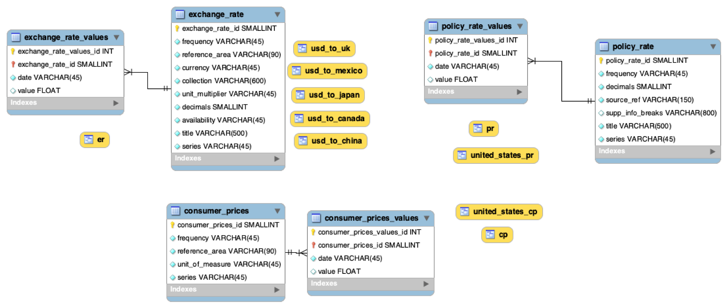
BIS Database Design Entity Relationship Diagram (ERD)

Slide 10
Architecture Consumption (example)
e.g.,
Service
Endpoints
“Cron-triggered” and Automated Functional Process
1
2
3
4
5
6
7
Archived
Data
(.zip)
Source
Data
(dataframe(s))
Relational
Data
(MySQL)
8
bis.org
e.g.,
Analytics
download
(Python)
extract
+ load
transform
consume
Security; Data Integrity Controls; Logging
e.g.,
Data Science

Slide 11
Non-Functionals
Ensuring data integrity is focus (given no PII) → best practices include least privilege, secured credentials; extensible to finer-grained security
Data integrity further supported through completeness controls and logging
Scalability is inherently supported through architecture, relational data, and “cloud-compatible” tooling
Security, Data Integrity, Monitoring/Logging, and Scalability

Slide 12
Demo

Slide 13
Wrap-up
Automated pipeline framework for BIS (and other) data → extensible by design and implementation
Limitations include baseline scope and potentially environmental (e.g., “local” execution)
Net: BIS Pipeline provides a framework to enable and extend global financial analytics; possibilities range from descriptive analytics to advanced predictive models and more
Gaps and
extensibility

Slide 14
Thank you!

