Slide 1

BIS Pipeline Bank for International Settlements Analytics Enabling Advanced Insight into Global Financial Stability through Data Pipeline Automation
Lane Whitmore
Dave Friesen

Slide 2
Overview
Opportunity – background and problem
Solution – purpose and approach
Architecture – ecosystem and data flow
BIS Database Design – Entity Relationship Diagram (ERD)
Non-Functionals – security, data integrity, monitoring/logging, and scalability
Demo
Wrap-up – gaps and extensibility
BIS Pipeline walkthrough

Slide 3
Opportunity
The Bank for International Settlements (BIS)
● international “bank for central banks” supporting worldwide monetary and financial cooperation
BIS publishes a “gold mine” of data
● statistics, rates, and metrics informing analysis of global financial stability and liquidity
● “domains” include banking, currency, debt, derivatives, credit, property, consumers, markets
Automation and data structure can accelerate analytical leverage of BIS information
Background and problem statement

Slide 4
Solution
BIS Pipeline provides a production-ready, automated data pipeline to extract, load, transform, and persist select BIS datasets to a relational database for analytical “consumption”
Data surfaced through baseline BIS Pipeline includes US dollar exchange rates (monthly, quarterly and annual), consumer prices, and policy rates (monthly)
BIS Pipeline is built on Python and MySQL and automated through Windows (by default)
Purpose and
approach

Slide 5
Architecture Ecosystem and data flow
e.g.,
Service
Endpoints
“Cron-triggered” and Automated Functional Process
1
2
3
4
5
6
7
Archived
Data
(.zip)
Source
Data
(dataframe(s))
Relational
Data
(MySQL)
8
bis.org
e.g.,
Analytics
download
(Python)
extract
+ load
transform
consume
Security; Data Integrity Controls; Logging
Scalability and Extensibility
leveraging relational data and “cloud-compatible” tooling
e.g.,
Data Science

Slide 6
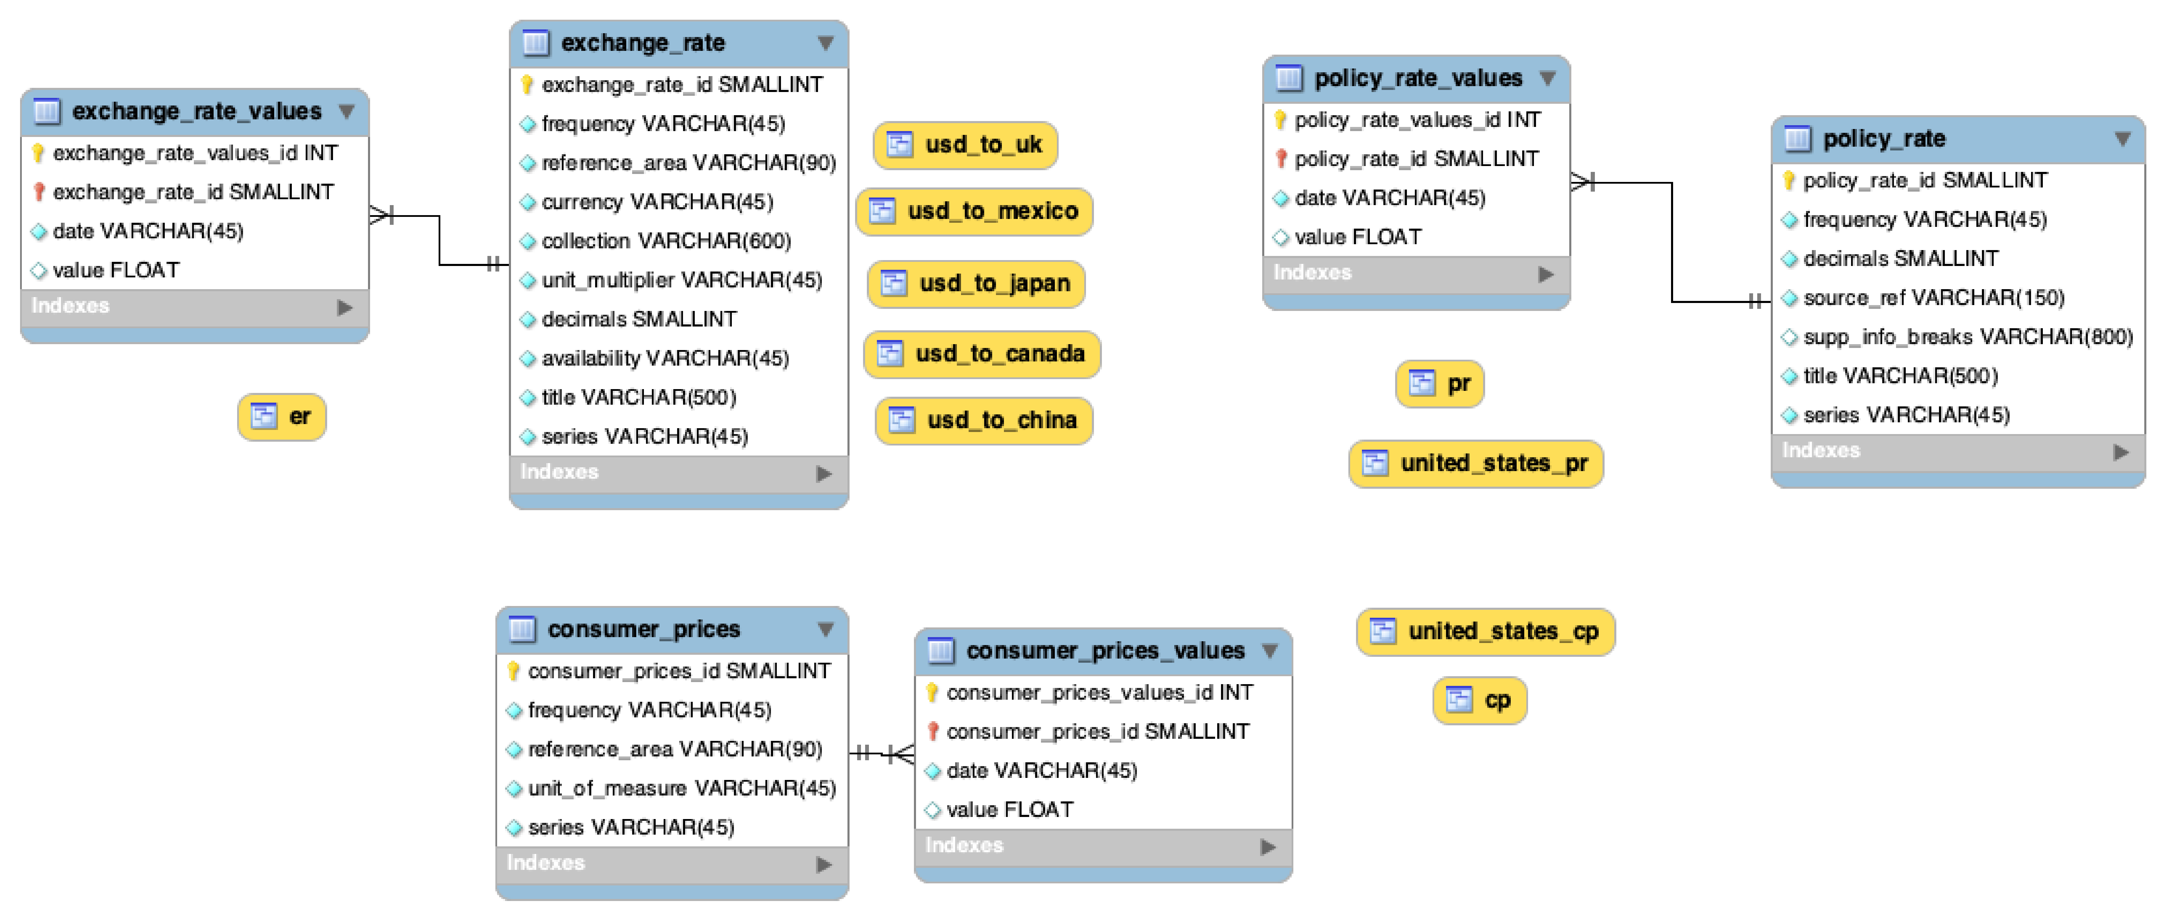
BIS Database Design Entity Relationship Diagram (ERD)

Slide 7
Non-Functionals
Ensuring data integrity is focus (given no PII) → best practices include least privilege, secured credentials; extensible to finer-grained security
Data integrity further supported through completeness controls and logging
Scalability is inherently supported through architecture, relational data, and “cloud-compatible” tooling
Security, Data Integrity, Monitoring/Logging, and Scalability

Slide 8
Demo

Slide 9
Wrap-up
As highlighted above, __*BIS Pipeline*__ was created as an automated pipline framework for BIS - and, prospectively, complementary - data. Considering this, output examples are limited to *baseline* data and analytical visualizations. That said, pipeline extensibility was considered in design and implementation, and is encouraged.
Regarding potential environment limitations, executing the pipeline on a local (e.g., vs. scalable cloud) environment may limit options when expanding the scope of the database to include most or all the datasets housed on BIS’s website. For instance, that substantial increase in data will result in more space to house the data which may lead to further investment in hardware. So, while the pipeline itself will be highly scalable moving forward, the limitations of on-site hardware could potentially put hold on materially expanding the database.
In conclusion, __*BIS Pipline*__ was developed as a *base* framework to enable and extend analytics and other usage of global financial data provided by the Bank of International Settlements. As noted above under *Opportunity and Solution*, possibilities range from descriptive analytics and visualization to advanced predictive models and others. The pipeline's architecture, implementation approach, and automation support data and consumption pattern extensions limited only by user interest and ambition.
Gaps and
extensibility

Slide 10
Thank you!

