Slide 1
Assignment 1
Add FoodType Model to Database
It should have the following properties
Id
Name

Slide 2
Assignment 2
Add FoodTypeRepository and IFoodTypeRepository
Create Interface for IFoodTypeRepository
It should have two custom methods like category
Update()
GetFoodTypeListForDropDown()
Identify the return type for both and the parameters. It is similar to Category.
Create Class FoodTypeRepository and extend IFoodTypeRepository in that.
Implement both the methods defined in interface inside the FoodTypeRepository.
HINT: This is exactly same as category repository.

Slide 3
Assignment 3
Add FoodTypeRepository to Unit Of Work
Add FoodType Repository and its interface in all the required spots inside
IUnitOfWork
UnitOfWork

Slide 4
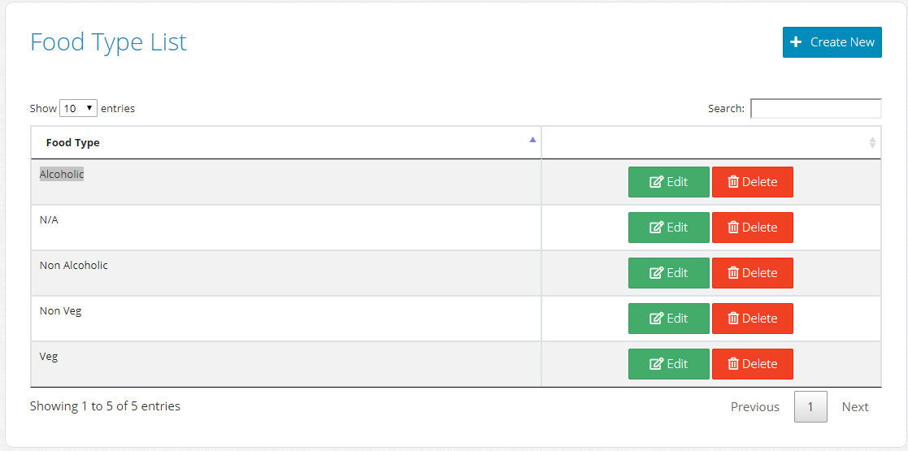
Assignment 4
Display all Food Type’s
Add FoodType API Controller with the following actions
Get
Add Index Razor Page FoodType Controller
HINT: Create a new folder inside Pages as “FoodType”
Add foodType.js file for loading data tables in FoodType Index Razor Page
NOTE: You will not have any food types to display yet!

Slide 5
Assignment 5
FoodType Upsert
Add Upsert Razor Page inside “FoodType” folder.
Implement View for Upsert.
Implement GET and POST Handler for Upsert.
HINT: This should be same as “Category”
Create Few FoodType for our project.
Veg
Non Veg
Alcoholic
Non Alcoholic
N/A

Slide 6
Assignment 6
Delete FoodType
Add API to delete FoodType inside the FoodType Controller (API Call)
Add JavaScript inside the foodType.js to call API on click of Delete button

