Slide 1
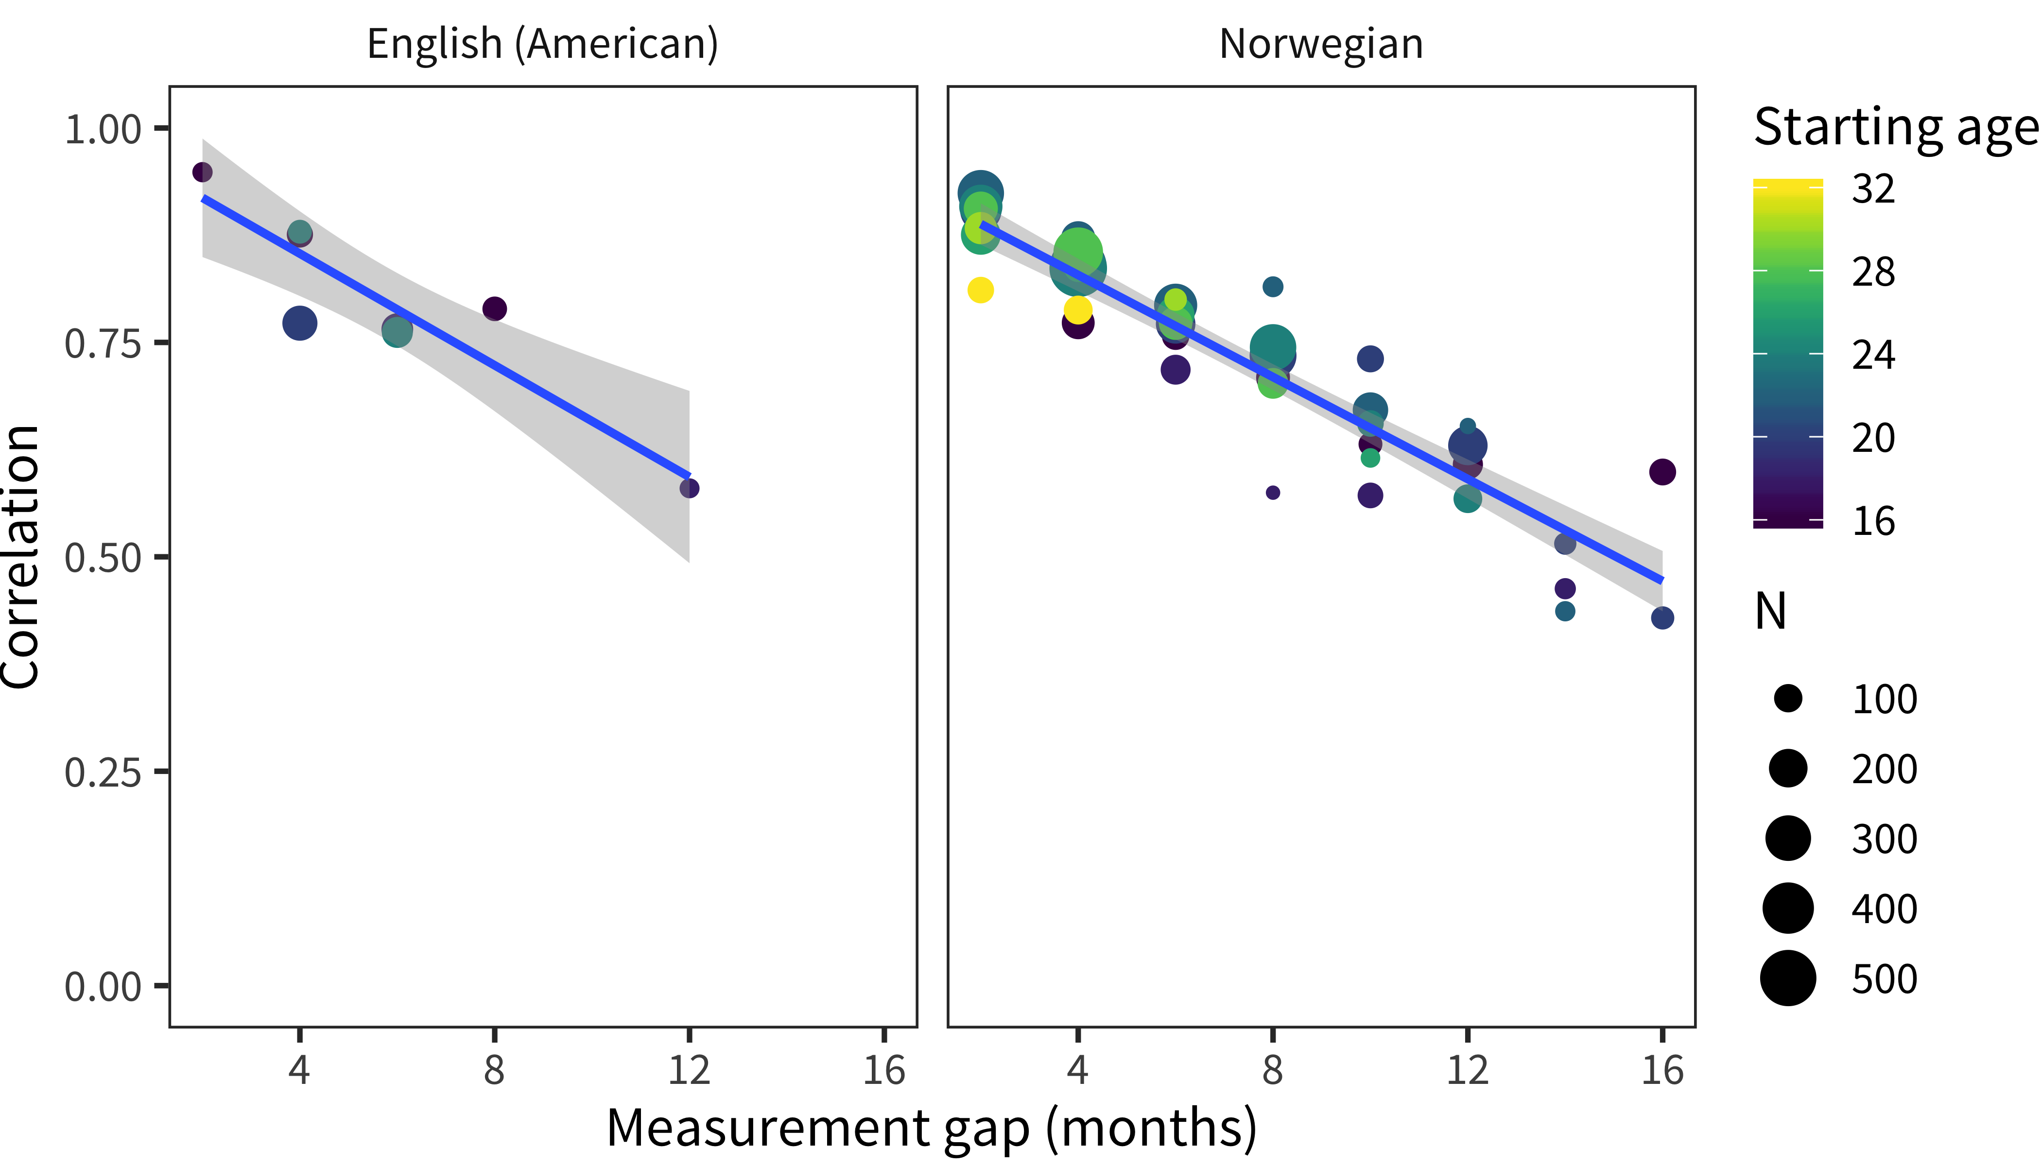
(months)

Slide 2
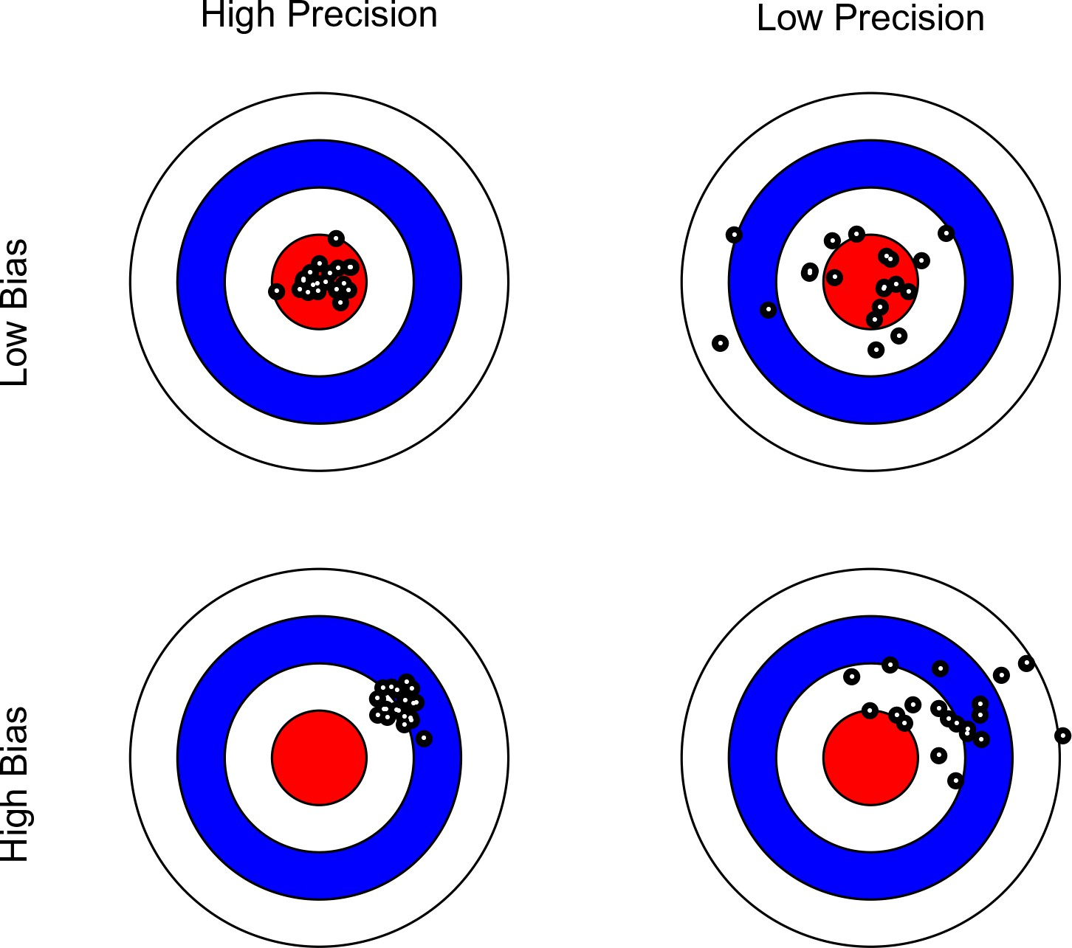

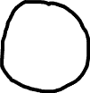

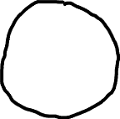
High Precision
Low Precision
High Validity
Low Validity

Slide 3
Neither good nor bad
Extremely bad
Moderately bad
Slightly good
Moderately good
Extremely good
Slightly bad
About half the time
Most of the time
Never
Sometimes
Always

Slide 4


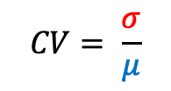

Measuring reliability with a true zero
Standard deviation of individual measures (including measurement error)
Measuring reliability without a true zero
o₁
o₂
Parallel tests
Individual measures (including measurement error)
True height
$$CV= \frac{σ}{μ}$$
Test-retest reliability: $ρ_{o_{1},o_{2}}$
Zero point

Slide 5
Body movements or gestures
2 alternative forced choice
Short answer question
Interview, long-form written response
Multi-AFC
Speeded button press
Likert scale
Approximate measure complexity
More constrained, fewer alternatives
Less information content
Easier to analyze
Easier to use with children, animals, etc.
More open-ended
Greater information content
Harder to analyze using quantitative methods
More affected by other factors, e.g., task, language skill, etc.

