Slide 1

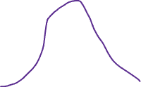
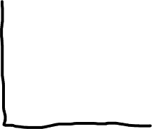





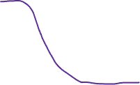


Homogeneous distribution of effects in the population
Heterogeneous distribution of effects in the population
Representative sample
Sample mean
Population mean
Distribution
Effect size
Convenience sample
Bias

