Slide 1
Longitudinal First Words Study: Setup and Brainstorming
Rose Schneider
April 7, 2015

Slide 2
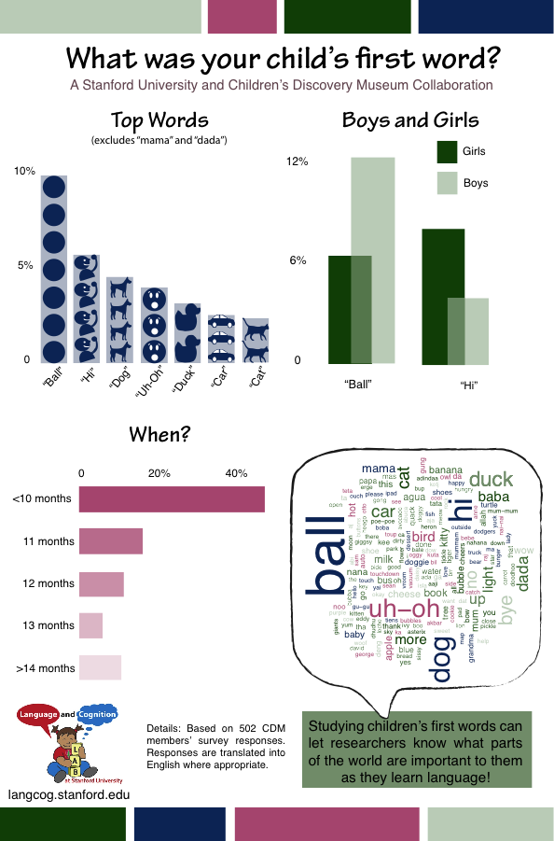
Most Previously…
FW_CDM
~500 CDM responses
Interesting results, including:
Consistency in first words
Individual differences
Early age of production
Notes:
Previously, we ran a study at the CDM asking parents to report on their children’s first words. We received about 500 responses, and made an adorable infographic.
However, we also saw some interesting things in this data, including:
A high degree of consistency in what words were being chosen as first words. Given that the set of potential first words is theoretically boundless, it’s interesting that we saw many of the same words being produced as first words across many children.
We observed some individual differences that seem to echo some developmental trends (e.g., girls are more likely to say “hi” as a first word and boys are more likely to say “ball”.)
Finally, we observed a significantly earlier than expected age of first production – 40% of parents reported a child saying a first word before 10 months. However, how much earlier, we don’t know (we were working under the assumption that children start to speak at 12months, and so 10 months seemed reasonable as a lower bound).

Slide 3
Less previously…
FW_Turk
1000 HITs (1671 children)
More support for:
Consistency in first words
Individual differences
Early age of production
Notes:
After the CDM data, we ran an extended study on Mechanical Turk, which allowed for parents to answer for multiple children. We received data for 1671 children, and saw more support for:
Consistency in first words. With a larger sample size, we not only saw that the same words were being selected by many children, but also that these words were consistent with the words reported in the CDM survey.
We again saw some gender differences in individual items as well as support for some conceptual development claims. For example, although “No” was a very frequent first word, it was usually produced as either a refusal, or as a repetition, but never as denial, which is a concept reportedly developed later.
Again, we saw a very early emergence of first words. While some of these can be dismissed as implausibly early, we still see words occurring before 12 months.

Slide 4
Minimally previously…
FW_Cogsci
CDM, Turk, Wordbank, Psycholinguist data (N=2,279)
3 Analyses:
2. Independence of age & word
3. Predicting first words
1. Age of first words
Notes:
We took this data, along with data from a modified survey sent to the Psycholinguist community, as well as Wordbank data. Wordbank data was selected for children who were reported to produce exactly one word (potentially their first word, although we can’t be sure).
For our cogsci paper, we did 3 analyses over these data:
We looked at age of production for all 4 datasets, and see that 75% of children produce a word before their first birthday
Grouping words by their MB-CDI categories (a rough proxy for their conceptual categories), and splitting the data by age (before and after 12 months), we did not see differences in the distributions of CDI categories in first words. This suggests that early and later speakers are speaking about the same kinds of things, and oftentimes the same things.
Again looking within CDI categories, we attempted to predict what makes a word more likely to be spoken first. We used number of syllables (an imprecise but suitable) measure of phonological complexity, and the frequency of the word in parental speech from the CHILDES corpus. We found that first words that are phonologically simpler and more frequent in parental speech are more likely to be first words.

Slide 5
So far:
First word production prior to 12 months
Later speakers do not have conceptually different first words – some independence between conceptual and linguistic development
Data collected consistent with development (e.g., “No” being used as refusal in first word, but not as denial or nonexistence)
First word strongly predicted by phonological complexity and frequency in parental utterances (grouped within CDI categories)
Notes:
So far, we have observed:
First word production often occurs earlier than expected – in 75% of children, a first word occurs before 12 months
We don’t observe a difference in the distributions of conceptual categories represented in earlier vs. later speakers (before and after 12 months). This is suggestive of a degree of independence between conceptual and linguistic development.
While we did not report on individual words and trends, we did observe some data consistent with various developmental claims
“No”, while a frequent first word, was used exclusively as refusal. This usage of “no” is acquired conceptually before its use as denial or assertion of nonexistence
We also observed some gender differences (e.g., males are much more likely to produce “car” as a first word)
Looking into the consistency that we observed in first words, we found that phonological complexity and frequency are strong predictors of what word will be produced as a first word.

Slide 6
Lots of questions
Retrospective biases – datasets relied on parent recall
Interpretation of a rich interpretation?
Definition of a “word”
Time-course of words
Sampling biases?
Notes:
However, with this data come questions.
Retrospective biases – for ¾ of the data sets, we relied on parent memory (Wordbank data was presumably collected closer in time to when a word was uttered, but still can be subject to bias and inaccuracy on behalf of parents).
Going off of that, are we making a rich interpretation of a potentially rich interpretation? E.g., when we standardized words, we relied on parental descriptions of what a child was doing or referring to when the word was said. We have one data point about what the parent thought that utterance meant, and it’s possible that recall of this utterance may be affected by memories of the situation, perhaps shaping the parent’s interpretation of the word.
This spills over into what parents are remembering as a word. Despite us stressing our definition of a word (“consistent production of a sound or a set of sounds that consistently refer to the same referent across multiple situations – does not have to match the adult target”) it’s possible that later parental recall of words is causing us to miss some of the development of phonology and meaning.
Which follows – what is the time-course of a word, in terms of meaning, form, and tokens in speech? Looking at the development of first words over the course of the first few years of language production could potentially reveal a great deal about the relationship between conceptual and linguistic development.
Because asked about children who had already said a first word, is it possible that we missed many later producers who are still young? We did see some young children who had not yet produced a “word” in the Turk data; however, it’s possible that because we are asking about this first word, we’re missing many later speakers.

Slide 7
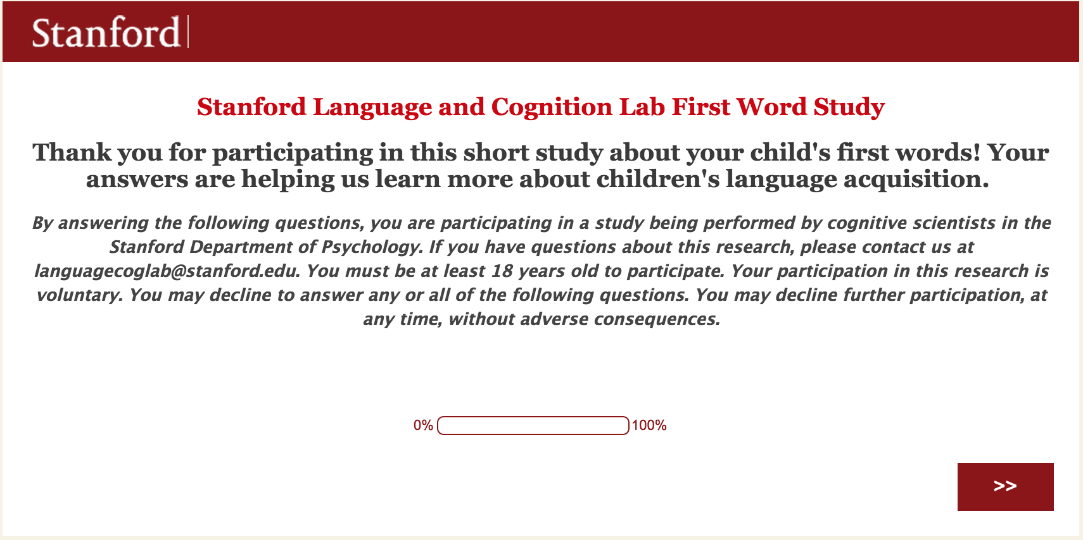
Enter FW_long
Longitudinal, web-survey study
Recruiting children from 5-6 months from Santa Clara & San Mateo counties
Send a reminder every 3 weeks asking if child has said anything “word-like” yet
Follow-up surveys asking about changes in meaning, form, appearance, or other developmental milestones reaches
Easy, fun, minimal time required
Notes:
To address some of these questions, we decided to launch a longitudinal study of infants’ first words. This is a web-based study through Qualtrics, and will be just as easy for parents to fill out as the CDM and Mturk studies
We are recruiting children from the general population, and will start them in the study at 5-6 months.
Parents will receive a quick reminder email every 3 weeks asking if children have said anything “word-like” yet. We will stress that this does not have to match the adult target, but does have to refer to the same object, action, or idea.
Follow-up surveys (every 3-4 weeks) will ask about parents’ previous responses, as well as if the parent has noticed any changes in meaning, form, or appearance. We ask parents if the word is still being said, if it’s still being used to refer to the same referent, or if it’s developed any changes in form. Additionally, we ask if the child has achieved any other developmental milestones (walking, etc.)
These surveys are designed to last only about 5-10 minutes, and will be easy and fun to parents to complete. They will contain all the items from our previous studies.

Slide 8
Goals
Less demand on parent recall
Potentially more representative sample
More detailed time-course of first word development
Early language production in context
Notes:
So what do we hope to accomplish with the first word study?
By frequently reminding parents to report about word-like utterances, we are hopefully reducing the amount of time between when a parent hears a word and reports it. This can potentially reduce any rich interpretations of utterances, giving us a more accurate idea of what a word sounded like and what it referred to.
By including children in a study before they have spoken a first word, we will be able to observe both later and early speakers as they produce words, and will not be missing out on young children who may be later producers
As a parental recall of a first word may have already been standardized and matched to the adult form by the parent, having a report of how a word sounded potentially days after it was uttered will be much more informative about linguistic development. Additionally, any changes in form, meaning, or usage can let tell us much more about the relationship between early linguistic development and conceptual development.
Having reports of language production in context – and not as an isolated recollection potentially years later – can also be informative in what affects early linguistic development and language productions (e.g., motor development resulting in conceptually different words)

Slide 9
Boring stuff (if you want to run a longitudinal study)
Recruiting through REDcap
Stanford email address linked with Gmail
Canned responses scheduled with Boomerang
Workflow managed through Trello.com
Surveys created with Qualtrics

