Slide 1
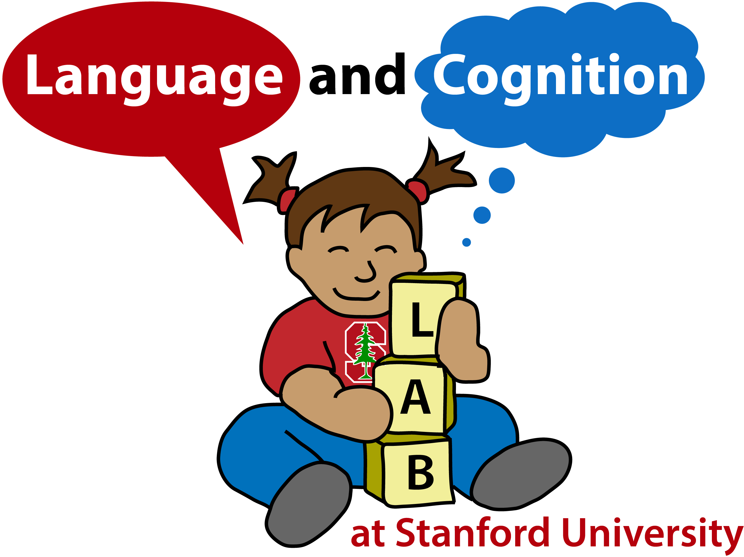

Large-scale investigations of variability in children’s first words
Rose M. Schneider, Daniel Yurovsky, and Michael C. Frank
Stanford University
Background
Analysis 1: When does a first word emerge?
What are the most common first words?
First words can reveal much about early cognitive and linguistic development, marking what a child is both able and willing to talk about.
However, because first words are often difficult for an external observer to record or measure, parental reports are a potential method for studying early language development
We use 4 parent-report datasets to explore both the time-course of first words and the relationship between conceptual and linguistic development in early language production
MTurk | Museum | Psycholinguists | Wordbank
Dog | Ball | Up | Baa Baa
No | Hi | More | Uh-Oh
Ball | Dog | Hi | Yum Yum
Bottle | Uh-Oh | Cat | Woof Woof
Hi | Duck | Bye | Hi
Table 1: The top 5 first words from all datasets, collapsed across ages
First words highly consistent across datasets
Datasets
Analysis 3: What linguistic factors predict a first word?
Children’s first words (N= 2,279) drawn from 4 parent reports:
Amazon Mechanical Turk Survey
1650 children’s first words
803 female, 847 male
M age = 10 mo., median age = 10 mo.
Figure 1: Cumulative probability of a child having a produced a first word across development
Early first words: 75% produced prior to 12 months
Analysis 2: How are age and first word related?
Museum Member Web Survey
501 children’s first words
214 female, 285 male, 2 sex unreported
M age = 11 mo., median age = 10 mo.
Psycholinguist Web Survey
52 children’s first words
26 female, 26 male
M age = 11.16 mo., median age = 11 mo.
Figure 3: Parameter estimates for hurdle models predicting children’s first words
First words phonologically simpler, more frequent in input
Wordbank Database
76 children producing exactly one word
31 female, 45 male
M age = 10.63 mo., median age = 11 mo.
Discussion
Observed first words that were both early and displayed a degree of independence between age and conceptual category, indicating linguistic factors, specifically phonological complexity and frequency in parental speech, likely drive first word production.
While disadvantages, parent report yielded data consistent both within and across datasets
Future work includes longitudinal tracking of children’s very early language development
“Mama” and “Dada” excluded from analyses
Responses standardized across datasets when possible (e.g., “Doggy”, “Doggie” = “Dog”)
21 responses excluded
Figure 2: Proportion of children’s first words by CDI category, split by earlier (<12 mo.) vs. later (>12 mo.) speakers; grey line is baseline CDI distribution
Independence between first word age and conceptual category

