Slide 1
Acceleration and variability in vocabulary growth for young children (and language models)
Michael C. Frank

Slide 2

AI disclosure
First project I’ve collaborated completely with AI (Claude Code)
~6 weeks of constant iteration
Being careful about requesting cleanup, documentation, best practices throughout
Question about how to establish trust?
Key plots to diagnose model performance
Annotated Stan code
Provenance and reproducibility traces for all figures/table

Slide 3
Two views of early word learning
Slow and incremental
Statistical learning (Saffran et al., 1996)
Cross-situational learning (Yu & Smith, 2007)
Input-uptake relationships (Weisleder & Fernald, 2012)
Quick and inferential
Mutual exclusivity (Markman et al., 1988)
Shape bias (Smith et al., 2002)
Pragmatic word learning (Tomasello, 2000)

Slide 4
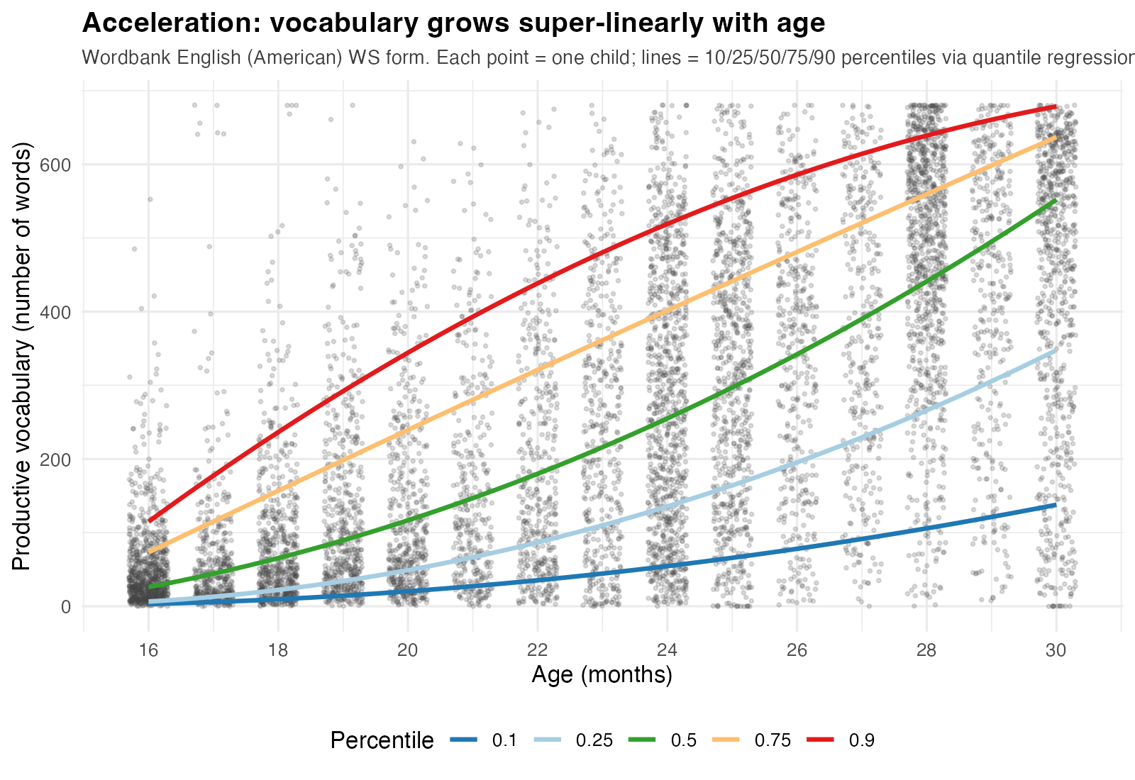
Exploring signatures of vocabulary growth
Acceleration + variability are ubiquitous
Can they help us reconcile these two views?
Terminology note: Efficiency: what’s changing in the child; Acceleration: what’s happening in the data

Slide 5
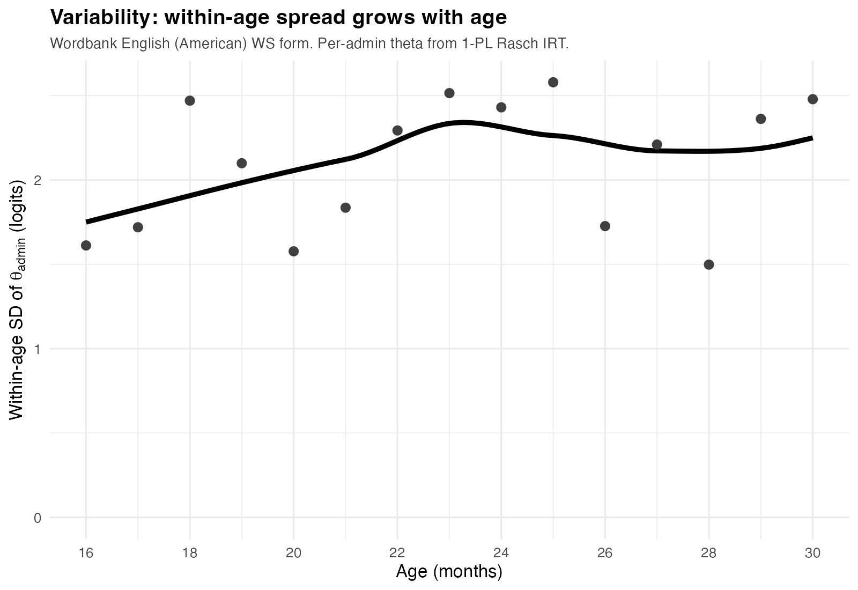
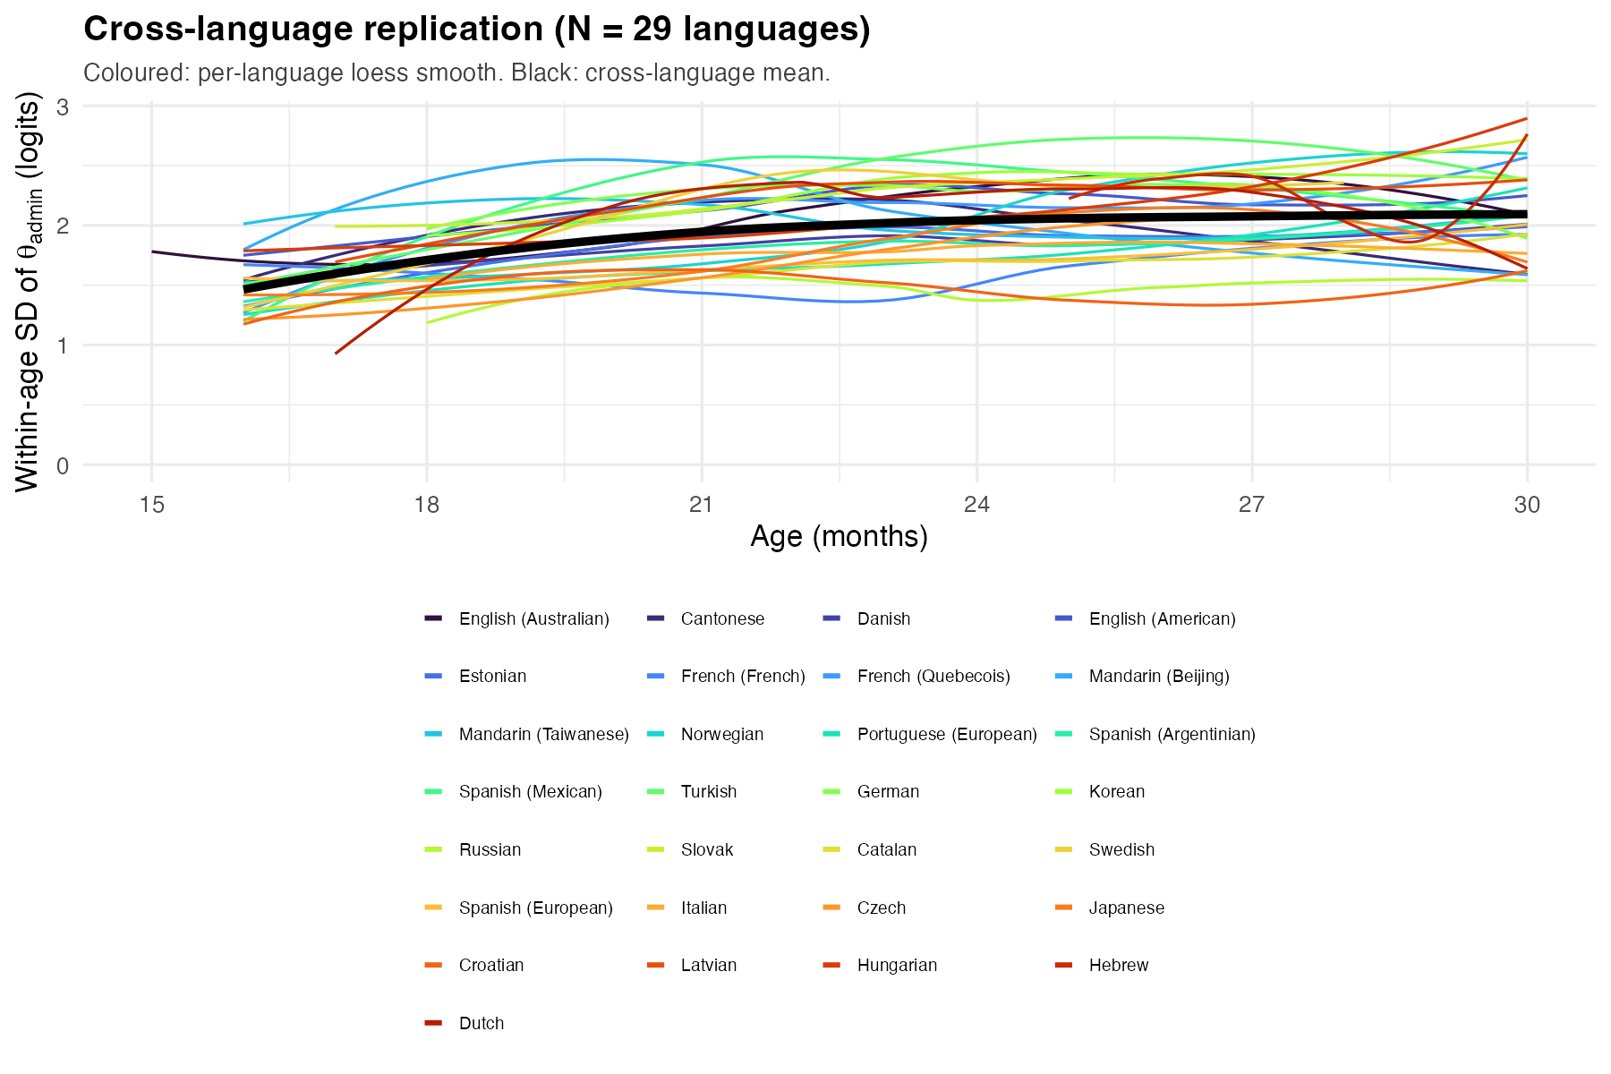
Two signatures of vocabulary growth

Slide 6

Picking up where George left off…

Slide 7
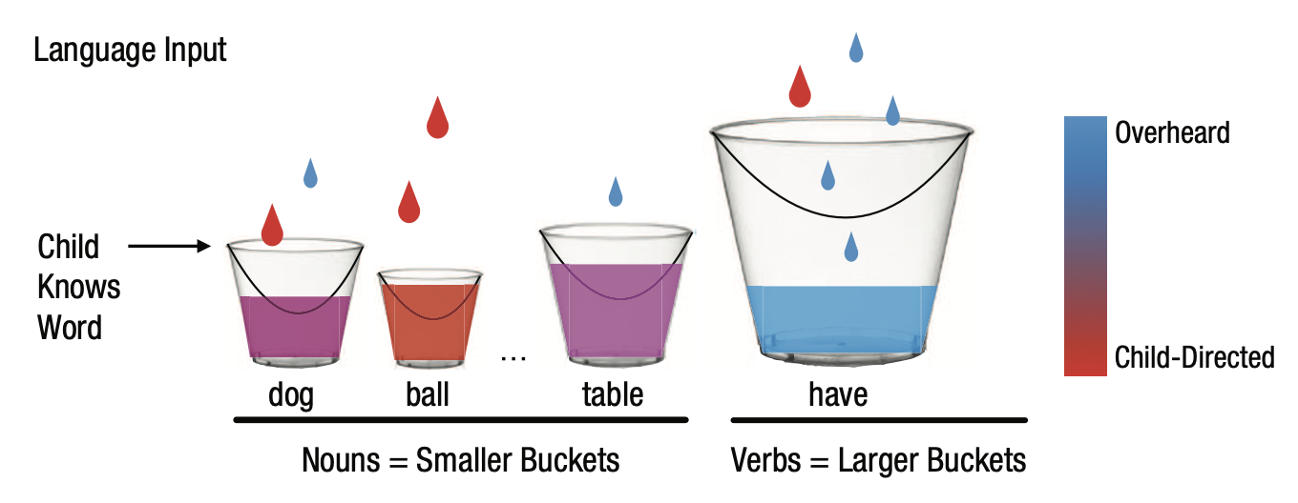
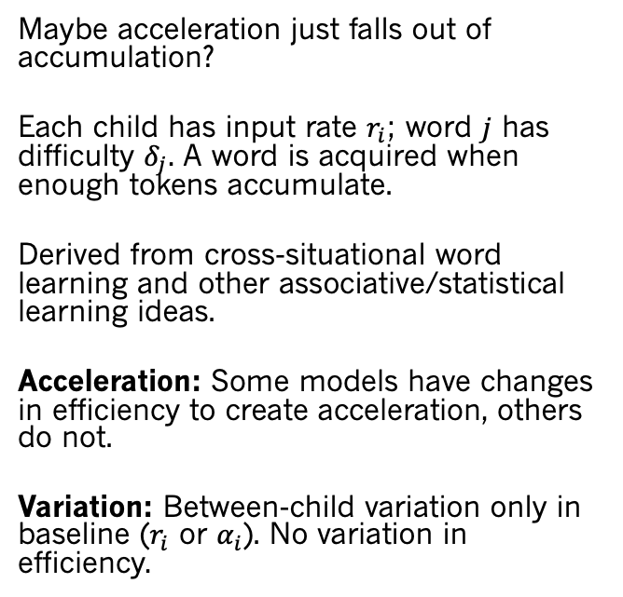
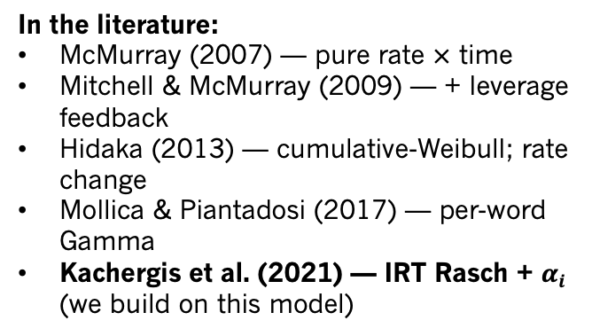
Is growth pure accumulation?
Maybe acceleration just falls out of accumulation?
Each child has input rate $r_{i}$; word $j$ has difficulty $δ_{j}$. A word is acquired when enough tokens accumulate.
Derived from cross-situational word learning and other associative/statistical learning ideas.
Acceleration: Some models have changes in efficiency to create acceleration, others do not.
Variation: Between-child variation only in baseline ($r_{i}$ or $α_{i}$). No variation in efficiency.
In the literature:
McMurray (2007) — pure rate $×$ time
Mitchell & McMurray (2009) — + leverage feedback
Hidaka (2013) — cumulative-Weibull; rate change
Mollica & Piantadosi (2017) — per-word Gamma
Kachergis et al. (2021) — IRT Rasch + $α_{i}$ (we build on this model)

Slide 8
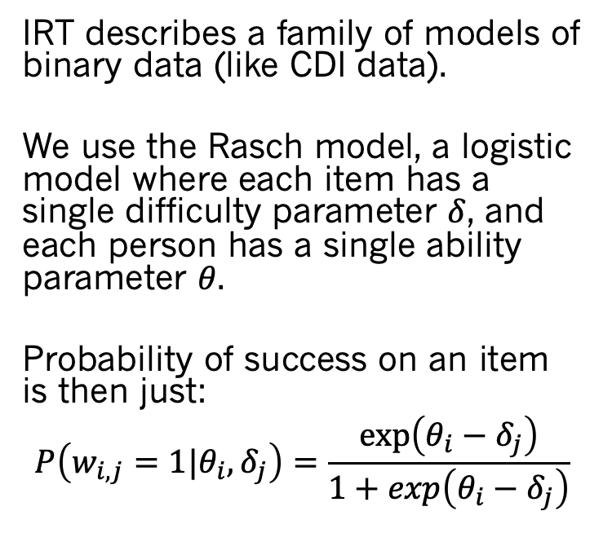
Item response theory (IRT)
A test taker with θ=0 has a 50% chance
IRT describes a family of models of binary data (like CDI data).
We use the Rasch model, a logistic model where each item has a single difficulty parameter $δ$, and each person has a single ability parameter $θ$.
Probability of success on an item is then just:
$$P\left(w_{i,j}=1|θ_{i},δ_{j}\right)=\frac{exp\left(θ_{i}−δ_{j}\right)}{1+exp\left(θ_{i}−δ_{j}\right)}$$
(difficulty)
ICC = item characteristic curve

Slide 9
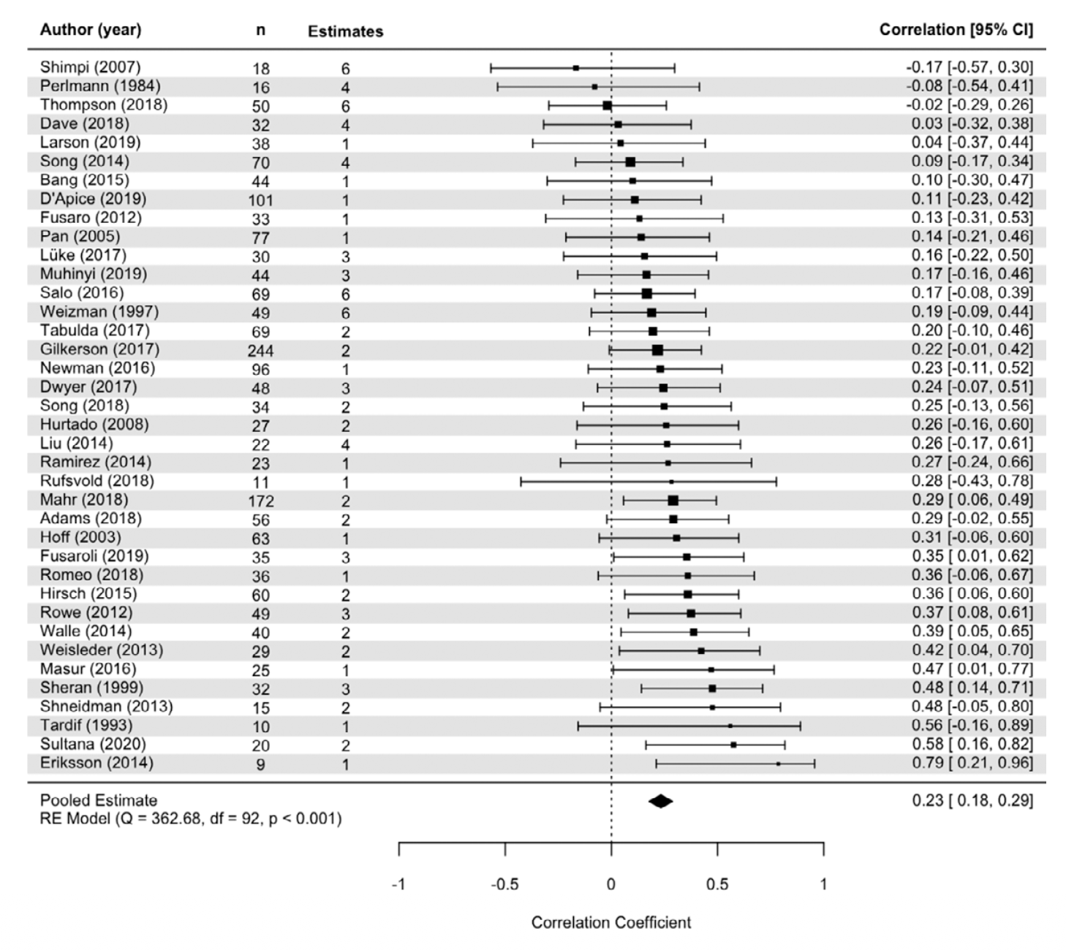
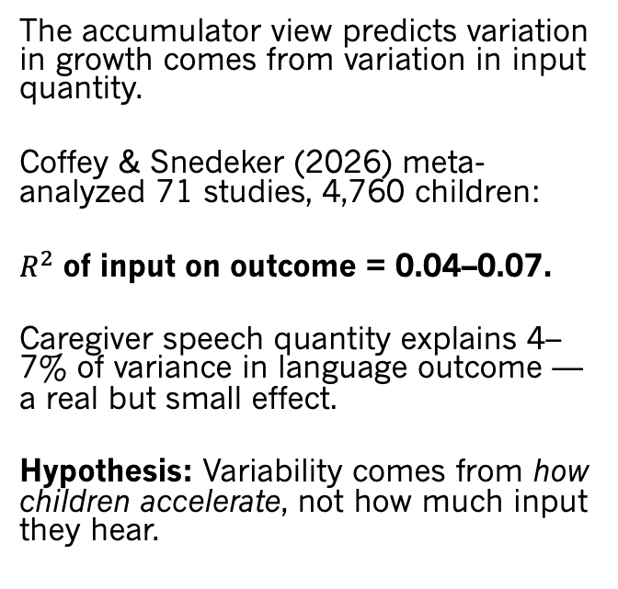
Puzzle: input matters less than supposed
The accumulator view predicts variation in growth comes from variation in input quantity.
Coffey & Snedeker (2026) meta-analyzed 71 studies, 4,760 children:
$R^{2}$ of input on outcome = 0.04–0.07.
Caregiver speech quantity explains 4–7% of variance in language outcome — a real but small effect.
Hypothesis: Variability comes from how children accelerate, not how much input they hear.

Slide 10
This work: modeling individual variability
We build a Bayesian model based on Kachergis et al. (2021) “standard model” to estimate:
Efficiency change. Does acceleration result from changes in learning efficiency?
Input share. How much of the between-child variance is attributable to input rate vs. to internal factors like variation in efficiency?
Does the same machinery applied to large language models yield the same answers?

Slide 11
Building the model

Slide 12
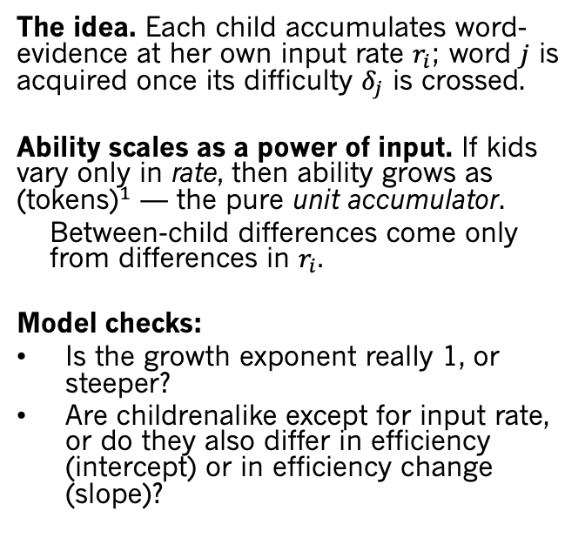
The accumulator hypothesis
The idea. Each child accumulates word-evidence at her own input rate $r_{i}$; word $j$ is acquired once its difficulty $δ_{j}$ is crossed.
Ability scales as a power of input. If kids vary only in rate, then ability grows as ${\text{(}\text{tokens}\text{)}}^{1}$ — the pure unit accumulator.
Between-child differences come only from differences in $r_{i}$.
Model checks:
Is the growth exponent really 1, or steeper?
Are childrenalike except for input rate, or do they also differ in efficiency (intercept) or in efficiency change (slope)?
Kachergis et al. (2021)

Slide 13
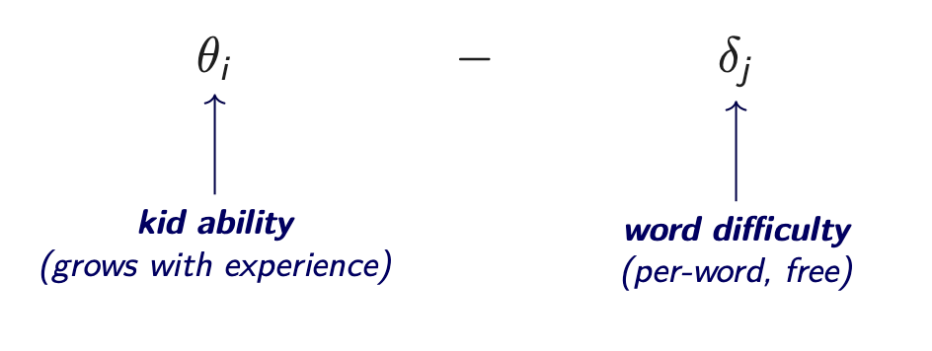
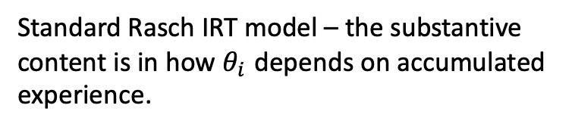

Rasch model
$P\left(w_{i,j}=1|θ_{i},δ_{j}\right)=\frac{exp\left(θ_{i}−δ_{j}\right)}{1+exp\left(θ_{i}−δ_{j}\right)}$:
Standard Rasch IRT model – the substantive content is in how $θ_{i}$ depends on accumulated experience.

Slide 14

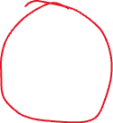
Rasch model
$P\left(w_{i,j}=1|θ_{i},δ_{j}\right)=\frac{exp\left(θ_{i}−δ_{j}\right)}{1+exp\left(θ_{i}−δ_{j}\right)}$:
Focus of most prior work (e.g., Kachergis et al., 2021; various AOA prediction work) – we leave this free here and don’t predict individual word difficulties

Slide 15
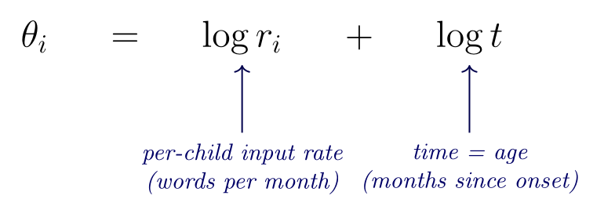


Rasch + accumulator dynamics
Different from Kachergis; matches Peekbank & Hidaka (2013). Power law, not exponential!
$P\left(w_{i,j}=1|θ_{i},δ_{j}\right)=\frac{exp\left(θ_{i}−δ_{j}\right)}{1+exp\left(θ_{i}−δ_{j}\right)}$, where:
Ability = rate × time. The only thing that changes across development is more accumulated input. The only source of variation between children is variation in the input rate

Slide 16
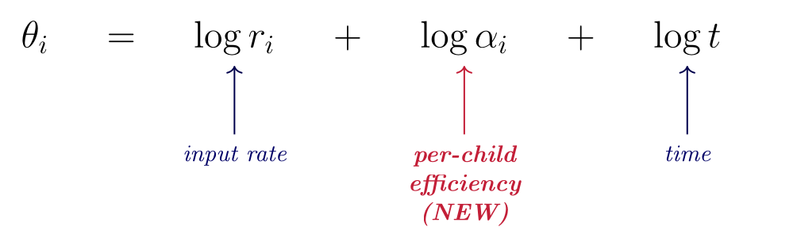
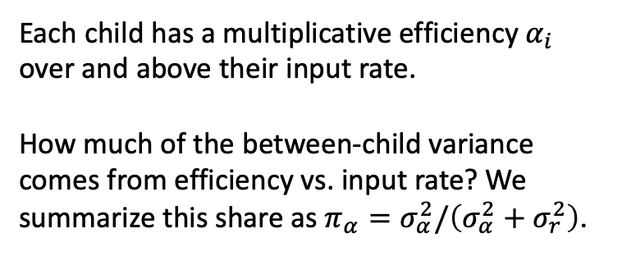
Rasch accumulator + per-child efficiency
$P\left(w_{i,j}=1|θ_{i},δ_{j}\right)=\frac{exp\left(θ_{i}−δ_{j}\right)}{1+exp\left(θ_{i}−δ_{j}\right)}$, where:
Each child has a multiplicative efficiency $α_{i}$ over and above their input rate.
How much of the between-child variance comes from efficiency vs. input rate? We summarize this share as $π_{α}=σ_{α}^{2}/\left(σ_{α}^{2}+σ_{r}^{2}\right)$.

Slide 17
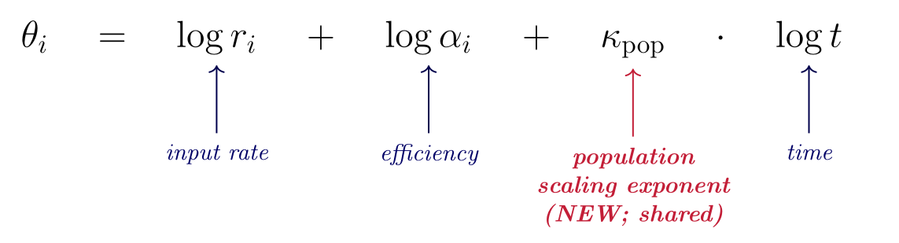
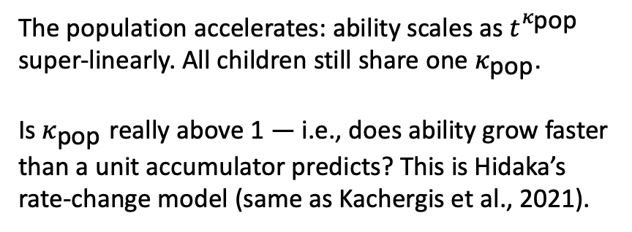
Rasch accumulator + efficiency slope
$P\left(w_{i,j}=1|θ_{i},δ_{j}\right)=\frac{exp\left(θ_{i}−δ_{j}\right)}{1+exp\left(θ_{i}−δ_{j}\right)}$, where:
The population accelerates: ability scales as $t^{κ_{\text{pop}}}$ super-linearly. All children still share one $κ_{\text{pop}}$.
Is $κ_{\text{pop}}$ really above 1 — i.e., does ability grow faster than a unit accumulator predicts? This is Hidaka’s rate-change model (same as Kachergis et al., 2021).

Slide 18
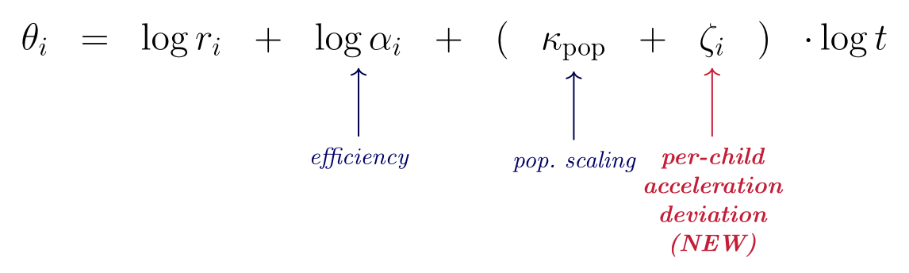
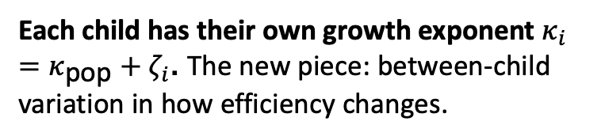
Rasch accumulator + per-child efficiency slope
$P\left(w_{i,j}=1|θ_{i},δ_{j}\right)=\frac{exp\left(θ_{i}−δ_{j}\right)}{1+exp\left(θ_{i}−δ_{j}\right)}$, where:
Each child has their own growth exponent $κ_{i}=κ_{\text{pop}}+ζ_{i}$. The new piece: between-child variation in how efficiency changes.

Slide 19
Rasch – glmer equivalency
This model is also a GLMER with:
produces ~ = 1 + log_age
+ (1 + log_age | child)
+ (1 | word)
modulo some significant (but not huge) differences…
Can pin input rate externally
Bayesian/extensible
(We never examined fit to variance in prior work!)

Slide 20
Results: English and Norwegian longitudinal fits

Slide 21
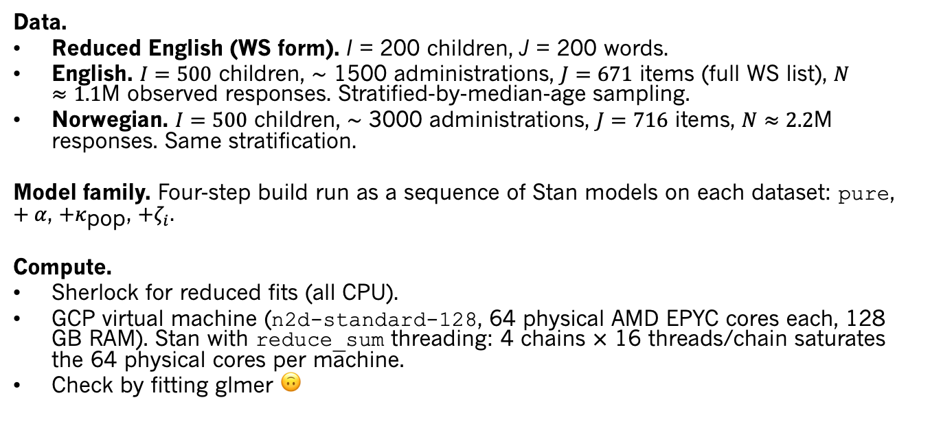
Data and compute for the longitudinal fits
Data.
Reduced English (WS form). I = 200 children, J = 200 words.
English. $I=500$ children, $∼$ 1500 administrations, $J=671$ items (full WS list), $N≈1.1$M observed responses. Stratified-by-median-age sampling.
Norwegian. $I=500$ children, $∼$ 3000 administrations, $J=716$ items, $N≈2.2$M responses. Same stratification.
Model family. Four-step build run as a sequence of Stan models on each dataset: pure, $+α$, $+κ_{\text{pop}}$, $+ζ_{i}$.
Compute.
Sherlock for reduced fits (all CPU).
GCP virtual machine (n2d-standard-128, 64 physical AMD EPYC cores each, 128 GB RAM). Stan with reduce_sum threading: 4 chains $×$ 16 threads/chain saturates the 64 physical cores per machine.
Check by fitting glmer 🙃

Slide 22
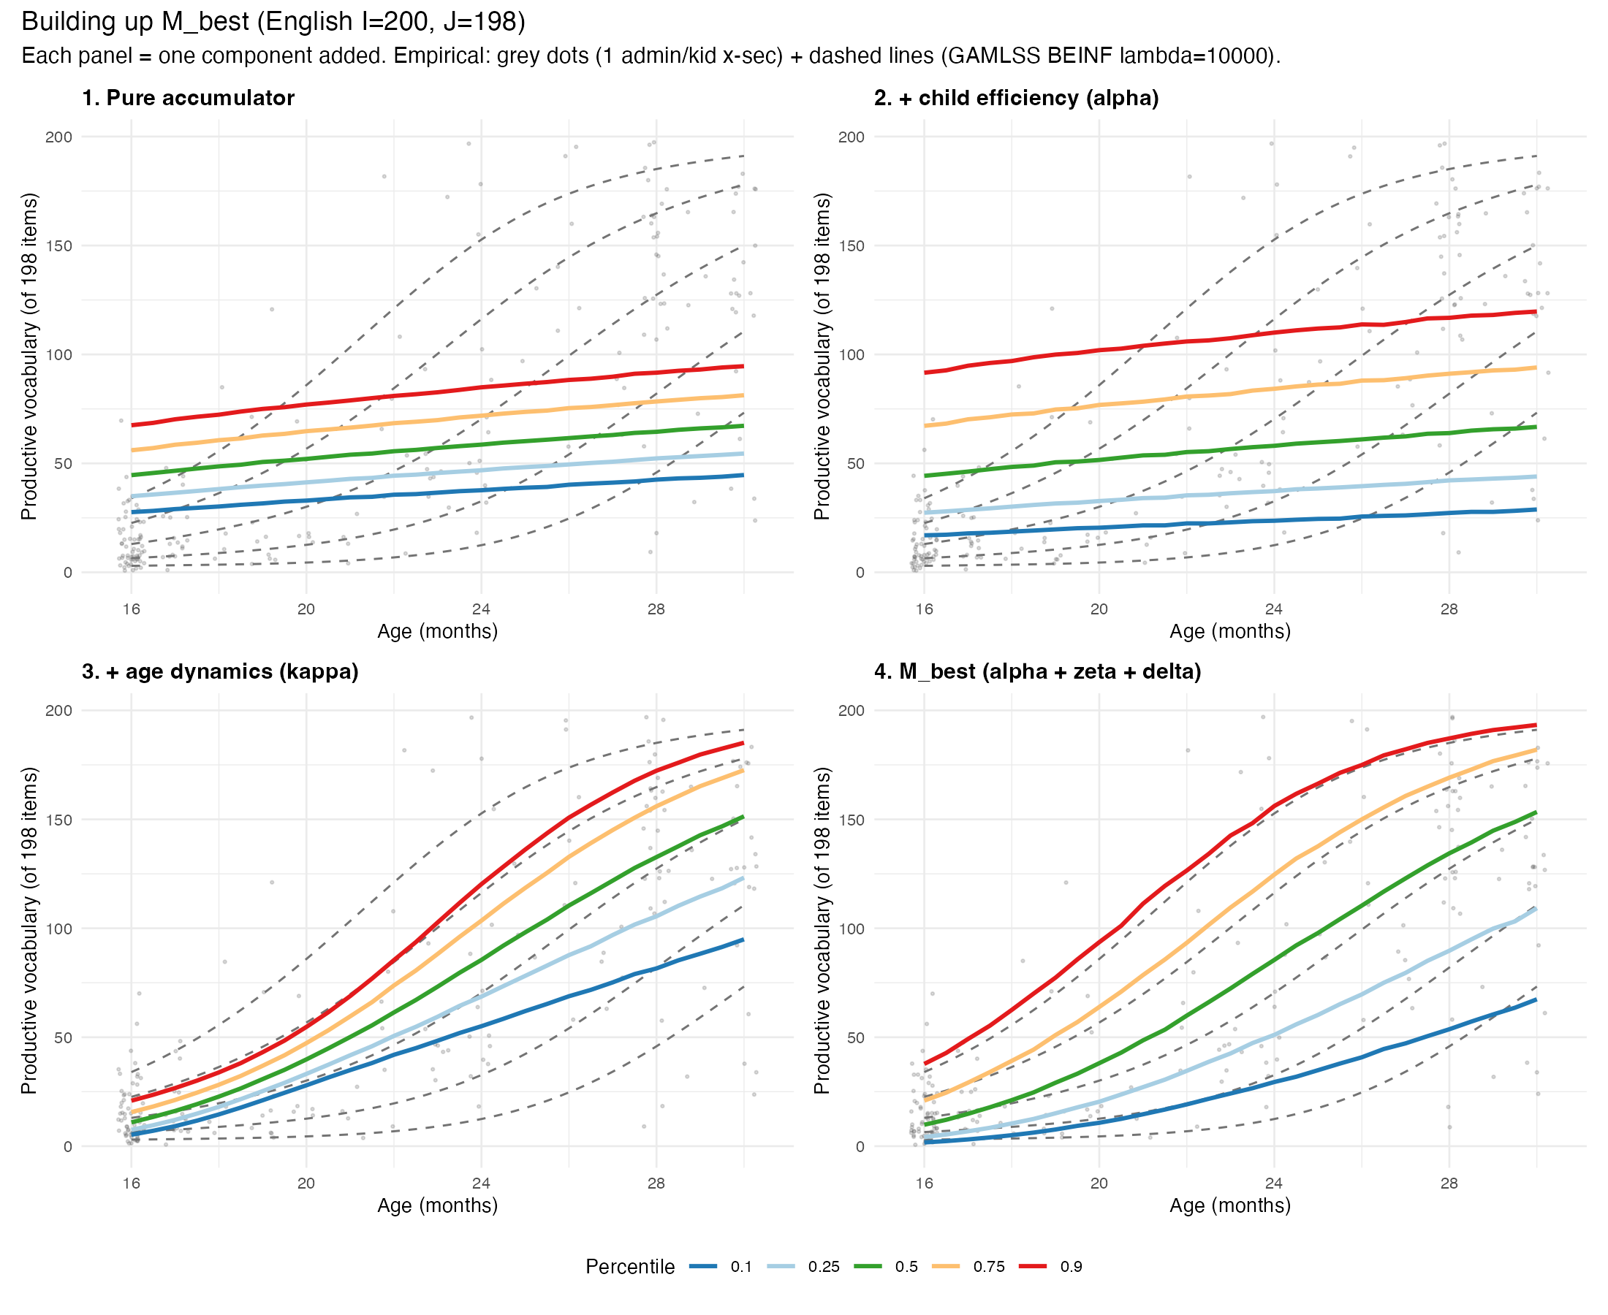

Slide 23
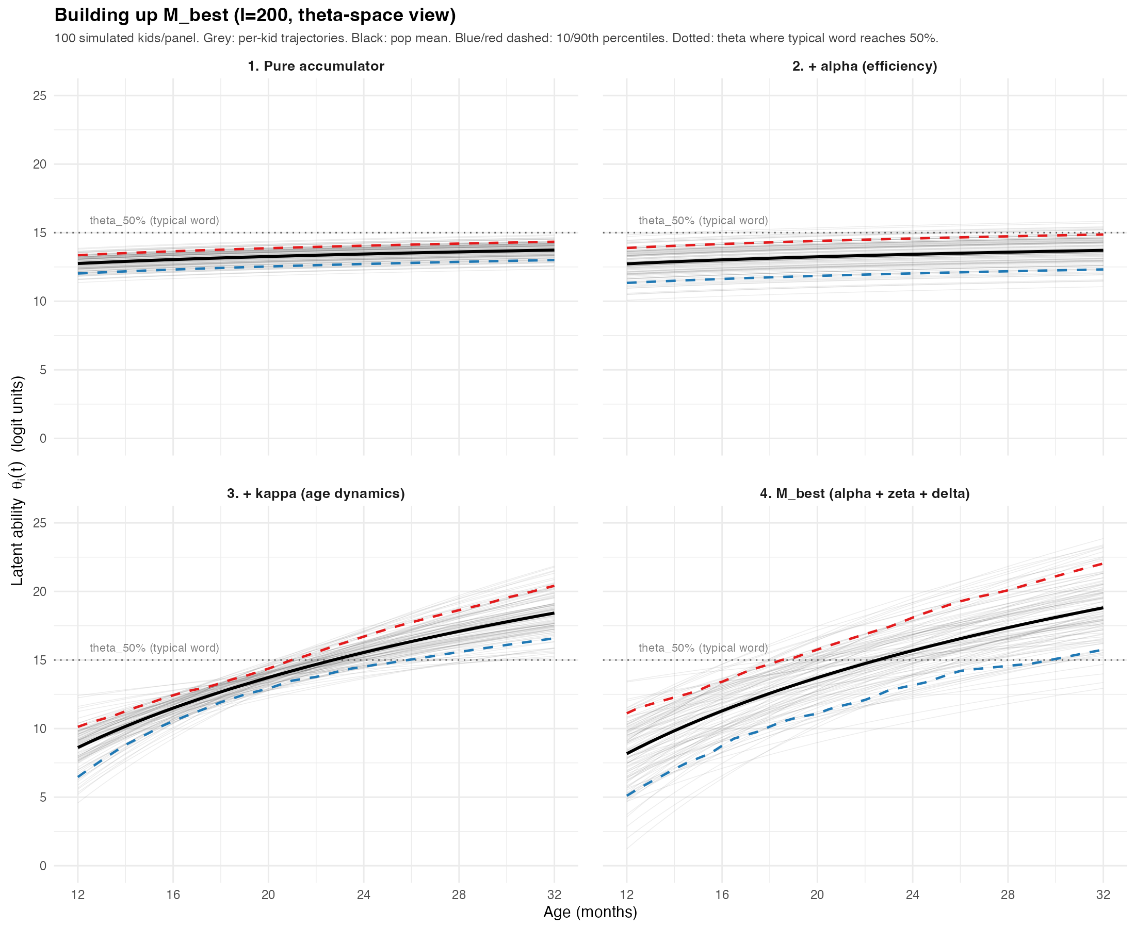
Latent ability changes
Note power law not exponential – hard to think about – fastest acceleration early on, not later

Slide 24
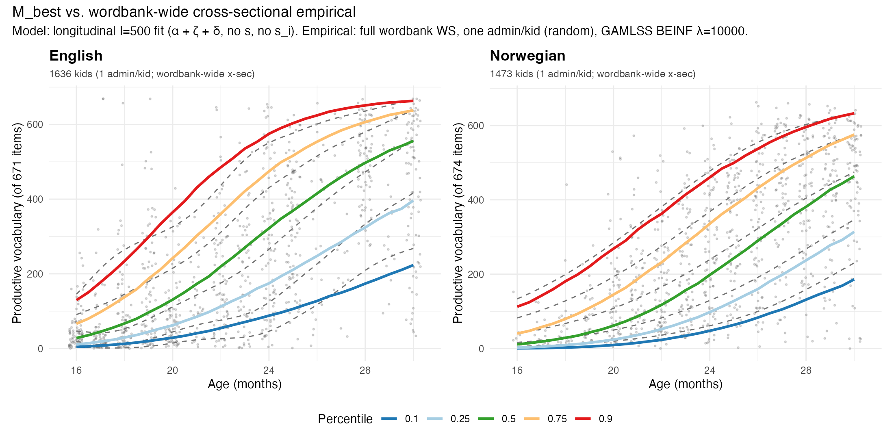
N=500 longitudinal data

Slide 25
Best-fitting model: parameter posteriors
Parameter | EN M_best (I=500) | NO M_best (I=500)
I (kids) | 500 | 500
J (items) | 671 | 674
N (obs) | 1106805 | 2056872
kappa | 10.31 [10.25, 10.37] | 11.47 [11.40, 11.53]
sigma_alpha | 1.81 [1.69, 1.94] | 2.05 [1.93, 2.18]
sigma_zeta | 3.81 [3.58, 4.07] | 4.79 [4.49, 5.13]
pi_alpha | 0.92 [0.91, 0.93] | 0.94 [0.93, 0.94]
rho(xi, zeta) | -0.09 [-0.18, -0.01] | -0.13 [-0.21, -0.04]
Increasing efficiency!
Efficiency variation >> rate variation

Slide 26
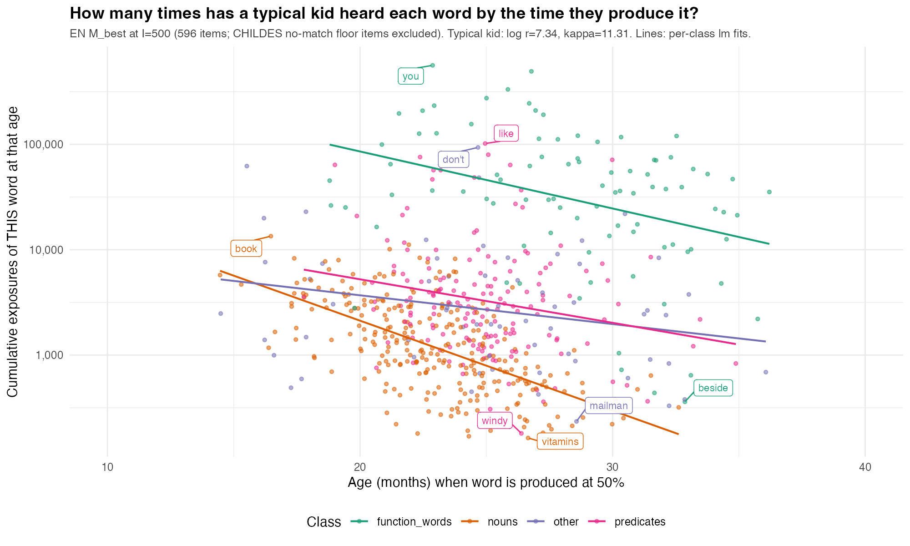
Exponentially fewer exposures before learning
Notes:
Step 1 — Predict the age of 50%
The model's linear predictor for kid $i$, word $j$, age $t$:
$$η_{ij}\left(t\right) = ξ_{i}+κ_{i}⋅log⁡\left(t/a_{0}\right)+\log{H}−δ_{j}$$
where:
$ξ_{i}=\log{r_{i}}+\log{α_{i}}$ — kid's intercept (log input rate + log efficiency)
$κ_{i}=1+δ+ζ_{i}$ — kid's effective age-growth exponent (population δ + per-kid deviation)
$\log{H}$, $a_{0}$ — fixed constants (log-hours-per-month, reference age)
$δ_{j}$ — fitted item difficulty
At 50% production, $η=0$, so:
$$t_{j} = a_{0}⋅\exp{ \text{⁣}}\left(\frac{δ_{j}−\log{H}−ξ_{i}}{κ_{i}}\right)$$
For a typical kid, I set $ξ_{i}=μ_{r}$ (mean log rate; equivalent to log α = 0) and $κ_{i}=1+δ$ (population κ with no per-kid slope deviation). Posterior medians from the EN M_best fit: $μ_{r}=7.34$, $δ=10.3$, so $κ=11.3$.
Step 2 — Cumulative exposures of word *j* by age $t_{j}$
A typical kid hears $r=e^{μ_{r}}$ tokens per hour ≈ 1,540 tokens/hour. Over a month, that's $r⋅H$ tokens where $H=e^{\log{H}}=365$ (waking hours per month ≈ 12 hr/day × 30.4 days). The fraction of those tokens that ARE word $j$ is its empirical CHILDES frequency $p_{j}$. So by age $t_{j}$ months:
$$\boxed{ N_{j} = r⋅H⋅t_{j}⋅p_{j} }$$
— total cumulative count of times the kid has heard this specific word.
Step 3 — Plot
$\left(t_{j} , N_{j}\right)$ as one dot per word. y-axis on log scale because $N_{j}$ spans ~10⁰ to 10⁵.
What the per-class regression lines show
For a single typical kid, $r$ and $H$ are constants. Taking logs:
$$\log{N_{j}} = \underset{\text{constant}}{\underbrace{log⁡\left(rH\right)}} + \log{t_{j}} + \log{p_{j}}$$
And $\log{t_{j}}=\log{a_{0}}+\left(δ_{j}−\log{H}−ξ\right)/κ$, so for a fixed kid:
$$\log{N_{j}} = \text{const} + \frac{1}{κ} δ_{j} + \log{p_{j}}$$
So $\log{N_{j}}$ depends linearly on (a) word difficulty $δ_{j}$ (with slope 1/κ ≈ 0.09 — the *efficiency-gain term*) and (b) word frequency $\log{p_{j}}$. The plot's $x$-axis ($t_{j}$) is monotone in $δ_{j}$, so what you see across age is the combined effect of *the model's difficulty estimate getting harder AND the typical word getting more or less frequent*.

Slide 27
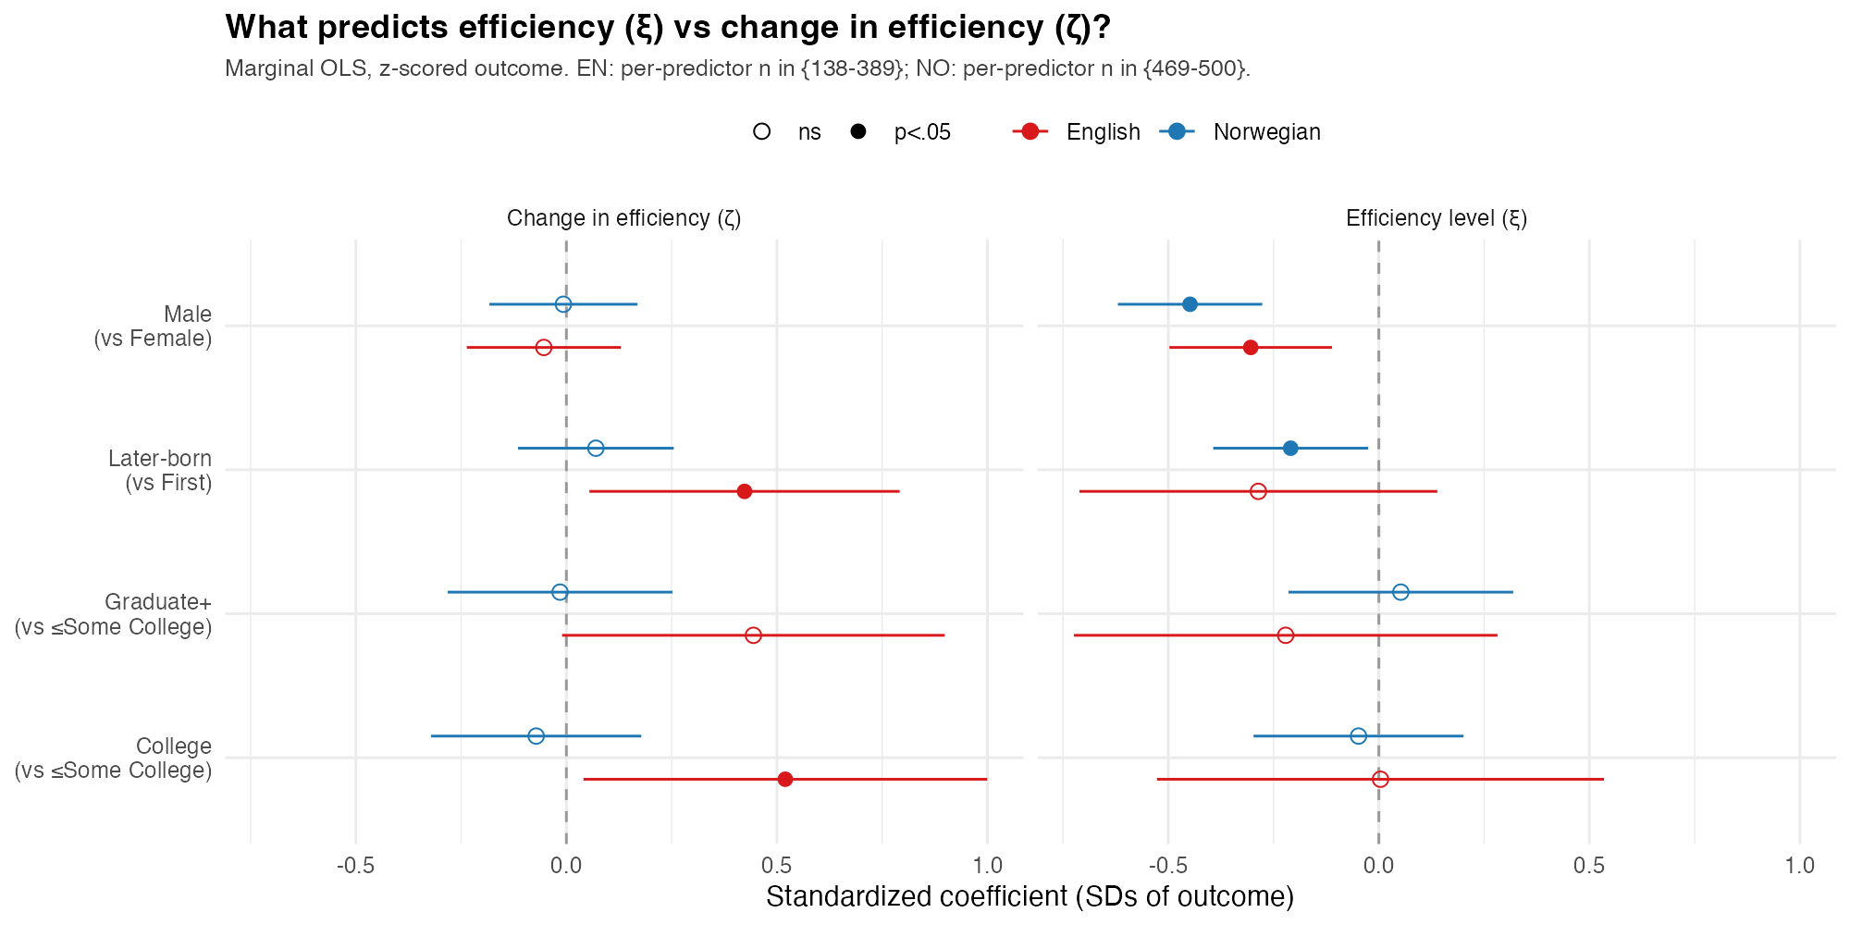
Demographic variation across two parameters
Intrinsic differences??
Input-driven??

Slide 28
Input quantity

Slide 29
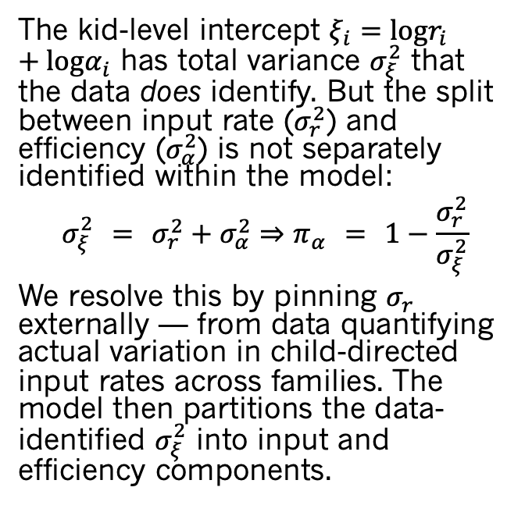
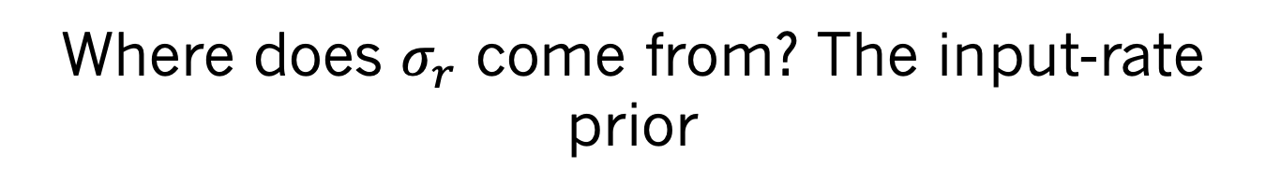
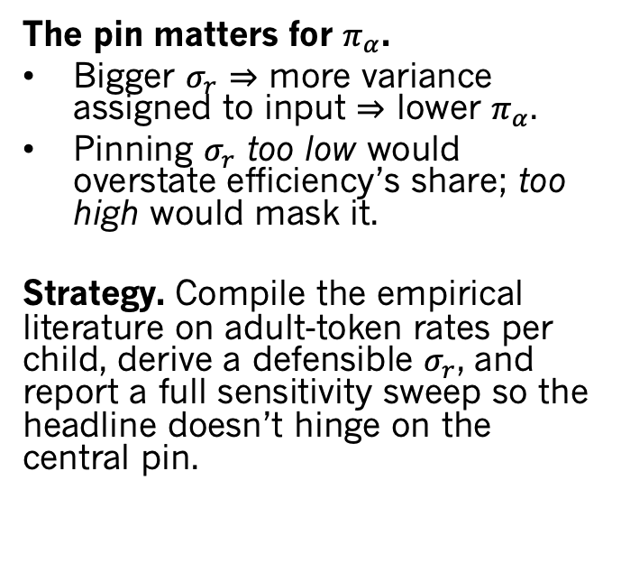
Where does $σ_{r}$ come from? The input-rate prior
The kid-level intercept $ξ_{i}=logr_{i}+logα_{i}$ has total variance $σ_{ξ}^{2}$ that the data does identify. But the split between input rate ($σ_{r}^{2}$) and efficiency ($σ_{α}^{2}$) is not separately identified within the model:
$$σ_{ξ}^{2} = σ_{r}^{2}+σ_{α}^{2}⇒π_{α} = 1−\frac{σ_{r}^{2}}{σ_{ξ}^{2}}$$
We resolve this by pinning $σ_{r}$ externally — from data quantifying actual variation in child-directed input rates across families. The model then partitions the data-identified $σ_{ξ}^{2}$ into input and efficiency components.
The pin matters for $π_{α}$.
Bigger $σ_{r}$ $⇒$ more variance assigned to input $⇒$ lower $π_{α}$.
Pinning $σ_{r}$ too low would overstate efficiency’s share; too high would mask it.
Strategy. Compile the empirical literature on adult-token rates per child, derive a defensible $σ_{r}$, and report a full sensitivity sweep so the headline doesn’t hinge on the central pin.

Slide 30
Estimating input variation
Source | Sample | Channel | n | tok/hr (mean) | tok/hr (±1 SD) | tok/mo (mean) | tok/mo (±1 SD) | σ_r (log) | 1-SD factor
Hart & Risley | all pooled | mother CDS | 42 | 1,148 | 546 – 2,410 | 419K | 199K – 880K | 0.74 | 2.10×
Hart & Risley | within-stratum | mother CDS | 42 | 1,148 | 631 – 2,086 | 419K | 230K – 761K | 0.6 | 1.82×
Soderstrom & Wittebolle | all pooled | all speech | 12 | 967 | 622 – 1,502 | 353K | 227K – 548K | 0.44 | 1.55×
Sperry (PIN) | all pooled | adult-to-child | 42 | 1,537 | 901 – 2,622 | 561K | 329K – 957K | 0.53 | 1.71×
Sperry | within-stratum | adult-to-child | 42 | 1,537 | 974 – 2,425 | 561K | 356K – 885K | 0.46 | 1.58×
Weisleder & Fernald | all pooled | mother CDS | 29 | 458 | 197 – 1,065 | 167K | 72K – 389K | 0.84 | 2.33×
Bergelson (SEEDLingS LENA)* | US 13–18 mo daylong | LENA AWC | 44 | 1,100 | 650 – 1,850 | 400K | 240K – 675K | 0.52 | 1.68×
Casillas (Tseltal Mayan)* | Chiapas daylong | adult-to-child | 10 | 500 | 170 – 1,500 | 180K | 62K – 550K | 1.09 | 2.97×
Bunce et al. 2024 (meta)* | 11 communities | adult-to-child | 82 | 900 | 280 – 2,900 | 330K | 100K – 1,060K | 1.18 | 3.25×
Notes:
σ_r is the SD of log(tokens/hr) across kids. Multiplying by exp(·) converts it to the multiplicative factor for a 1-SD shift in input rate. The central pin σ_r = 0.534 (Sperry within-pool, adult-to-child) means a kid at the 84th percentile of input hears 1.71× more than the median, and the spread from 16th to 84th percentile (one full ±1 SD) is 1.71² ≈ 2.91×. Cross-cultural variation reaches σ_r ≈ 1.2 (Bunce, Casillas), an 11× spread between 16th and 84th — but that's mostly population-level differences (Tseltal, Yélî, Pirahã vs. Western-CDS), not within-population family-to-family variability.

Slide 31
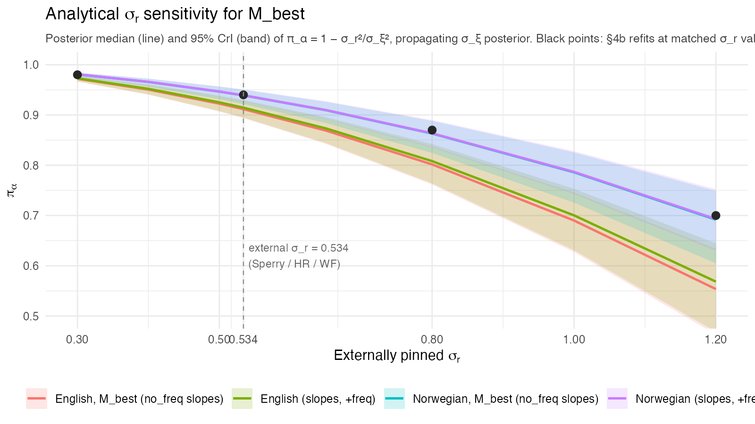
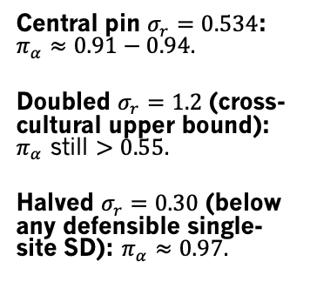
Sensitivity: $π_{α}$ across plausible $σ_{r}$
Central pin $σ_{r}=0.534$: $π_{α}≈0.91​−​0.94$.
Doubled $σ_{r}=1.2$ (cross-cultural upper bound): $π_{α}$ still $>0.55$.
Halved $σ_{r}=0.30$ (below any defensible single-site SD): $π_{α}≈0.97$.

Slide 32
Caveat: input quantity, not quality
Haven't modeled variation in input quality — diversity, contingency, conversational structure, child-directed register. Two distinct effects:
1. Constant per-child quality — refines what σ_α is
Fixed multiplier on input: q_i constant in age - indistinguishable from σ_α. So part of the σ_α we report could be hidden quality variance:
target π_α σ_q needed per-SD factor on quality
0.90 0.27 1.31×
0.70 0.88 2.42×
0.50 1.22 3.40×
For π_α to drop below 0.5, kid-to-kid quality variation would need σ_q ≈ 1.22 — more than 2× as much as measured input-rate variation (σ_r ≈ 0.53).
2. Age-varying quality — competes with κ (acceleration)
A quality multiplier that grows with age is equivalent to a steeper κ_i. To absorb the observed acceleration into a quality story, "quality" would have to grow ~3,000× for the median kid,
Quality might explain part of σ_α but cannot explain acceleration.

Slide 33
Extensions: directly observed input and processing

Slide 34
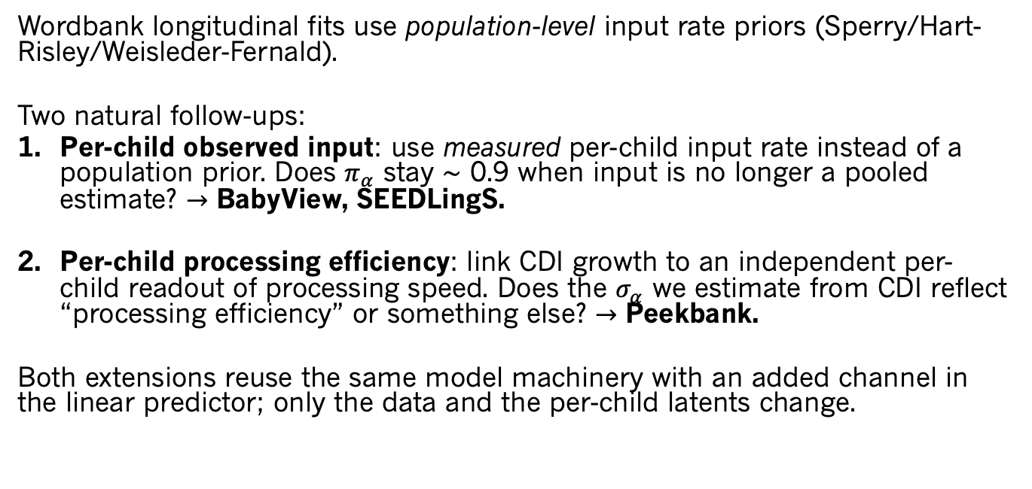
Model extensions: testing $π_{α}$ with richer data
Wordbank longitudinal fits use population-level input rate priors (Sperry/Hart-Risley/Weisleder-Fernald).
Two natural follow-ups:
Per-child observed input: use measured per-child input rate instead of a population prior. Does $π_{α}$ stay $∼$ 0.9 when input is no longer a pooled estimate? $→$ BabyView, SEEDLingS.
Per-child processing efficiency: link CDI growth to an independent per-child readout of processing speed. Does the $σ_{α}$ we estimate from CDI reflect “processing efficiency” or something else? $→$ Peekbank.
Both extensions reuse the same model machinery with an added channel in the linear predictor; only the data and the per-child latents change.

Slide 35
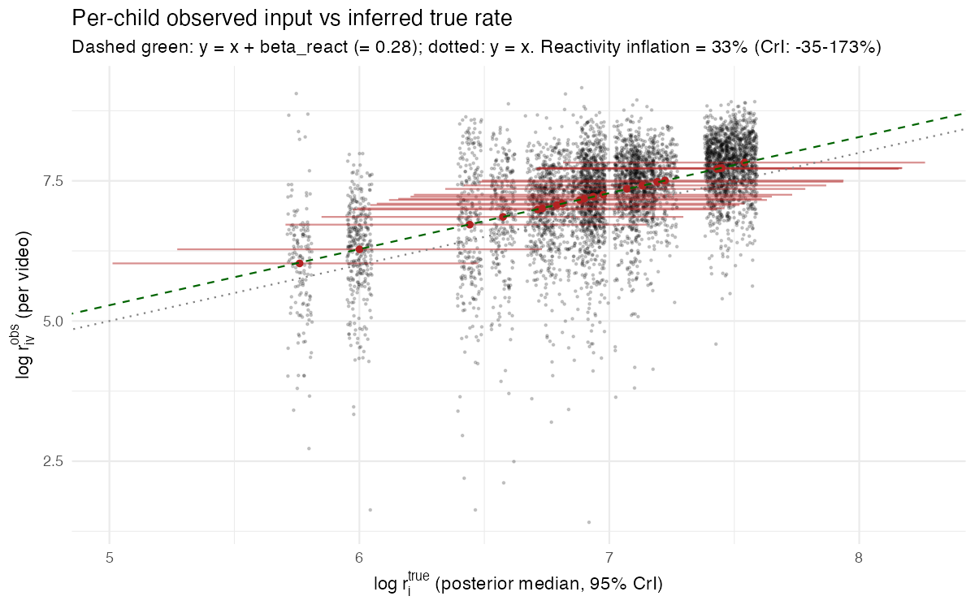
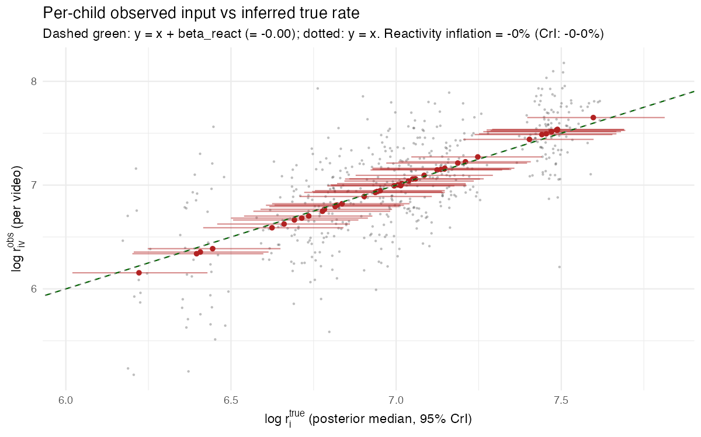




Replicating with directly observed input
BabyView, $N=20$
SEEDLingS, $N=44$ (comp corrected)
$π_{α}=0.84$, [0.68, 0.93]
$π_{α}=0.94$, [0.89, 0.97]

Slide 36
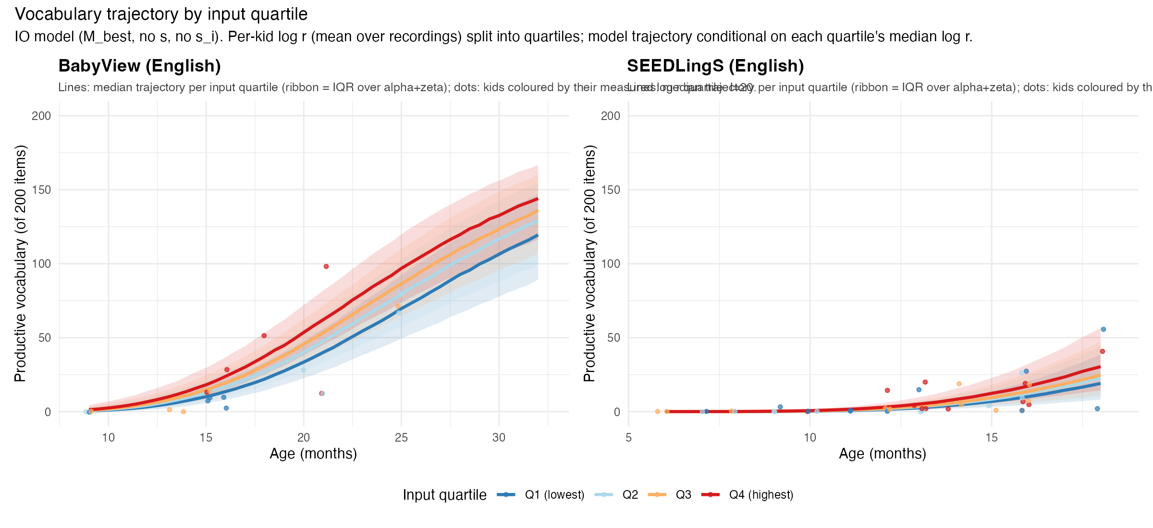
Minimal input effects

Slide 37
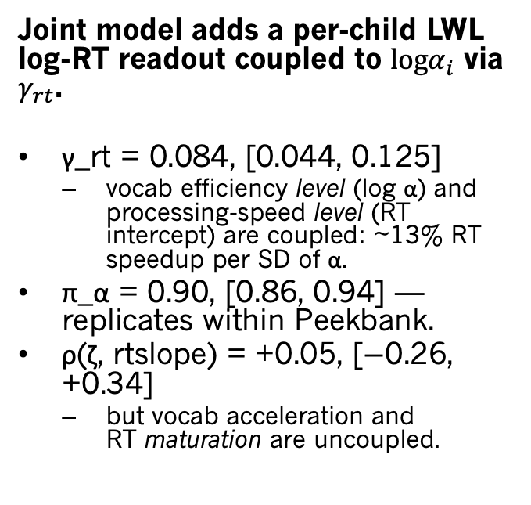
Processing speed readout: Peekbank LWL
Joint model adds a per-child LWL log-RT readout coupled to $logα_{i}$ via $γ_{rt}$.
γ_rt = 0.084, [0.044, 0.125]
vocab efficiency level (log α) and processing-speed level (RT intercept) are coupled: ~13% RT speedup per SD of α.
π_α = 0.90, [0.86, 0.94] — replicates within Peekbank.
ρ(ζ, rtslope) = +0.05, [−0.26, +0.34]
but vocab acceleration and RT maturation are uncoupled.
Shared efficiency (intercept), distinct efficiency change (slopes)
Replicates Peekbank paper (Frank et al., 2026, eLife): higher RT = bigger vocab per age, but not faster growth

Slide 38
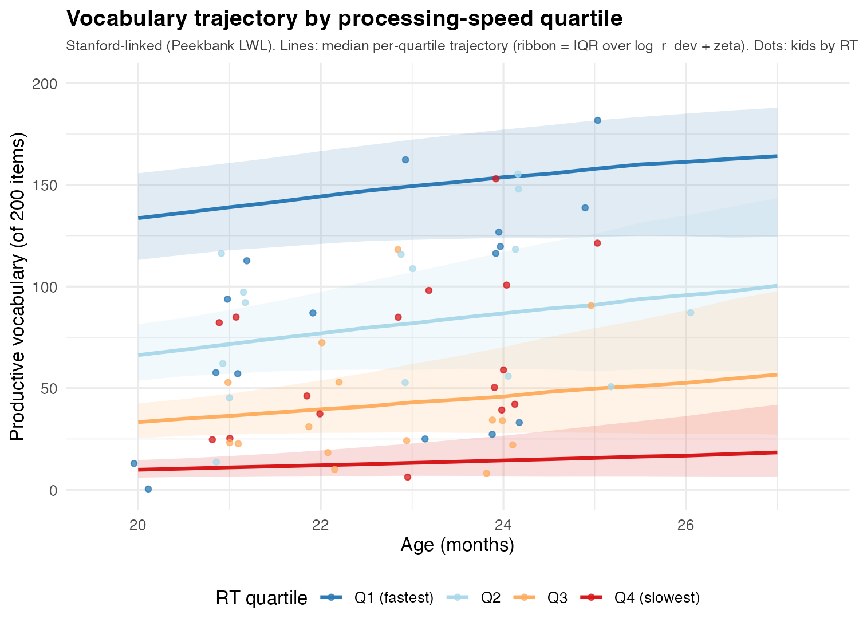
Peekbank RT results

Slide 39
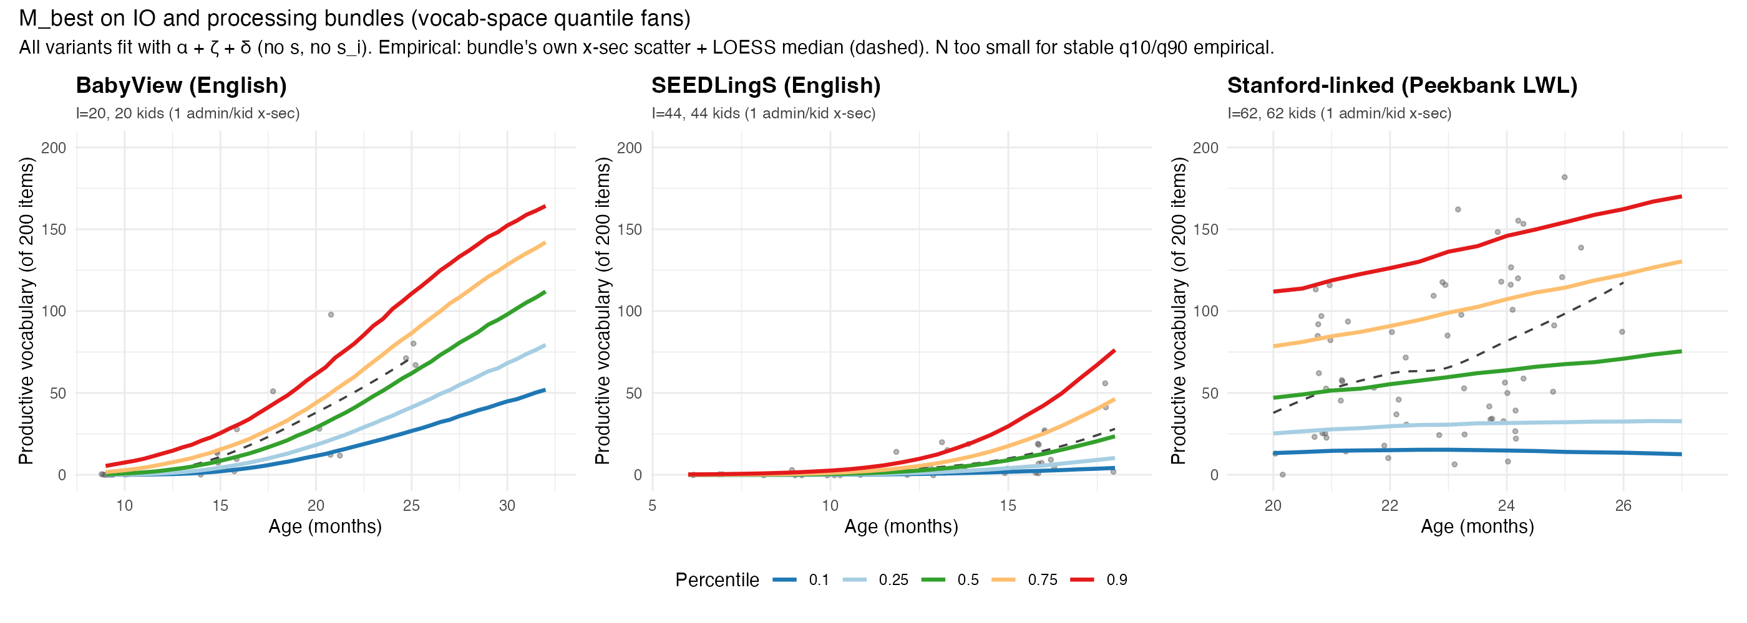
Good fits

Slide 40
$π_{α}$ across five samples
Parameter | EN M_best (I=500) | NO M_best (I=500) | BabyView (IO) | SEEDLingS (IO) | Peekbank (proc)
I (kids) | 500 | 500 | 20 | 44 | 62
J (items) | 671 | 674 | 200 | 200 | 200
N (obs) | 1106805 | 2056872 | 16459 | 102800 | 20600
kappa | 10.31 [10.25, 10.37] | 11.47 [11.40, 11.53] | 6.42 [5.98, 6.87] | 8.19 [7.82, 8.57] | 2.51 [1.60, 3.38]
sigma_alpha | 1.81 [1.69, 1.94] | 2.05 [1.93, 2.18] | 1.13 [0.82, 1.56] | 1.39 [1.12, 1.74] | 1.67 [1.35, 2.03]
sigma_zeta | 3.81 [3.58, 4.07] | 4.79 [4.49, 5.13] | 2.57 [1.92, 3.39] | 3.97 [3.32, 4.70] | 6.42 [5.34, 7.54]
pi_alpha | 0.92 [0.91, 0.93] | 0.94 [0.93, 0.94] | 0.83 [0.66, 0.93] | 0.94 [0.89, 0.97] | 0.90 [0.86, 0.94]

Slide 41
Connecting to LLMs

Slide 42
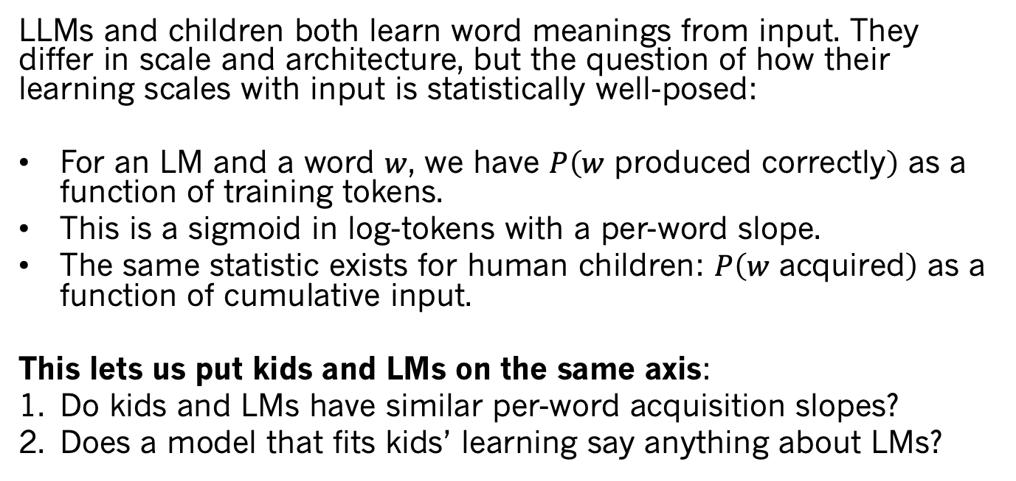
Why look at LLMs?
LLMs and children both learn word meanings from input. They differ in scale and architecture, but the question of how their learning scales with input is statistically well-posed:
For an LM and a word $w$, we have $P\left(w \text{produced} \text{correctly}\right)$ as a function of training tokens.
This is a sigmoid in log-tokens with a per-word slope.
The same statistic exists for human children: $P\left(w \text{acquired}\right)$ as a function of cumulative input.
This lets us put kids and LMs on the same axis:
Do kids and LMs have similar per-word acquisition slopes?
Does a model that fits kids’ learning say anything about LMs?

Slide 43
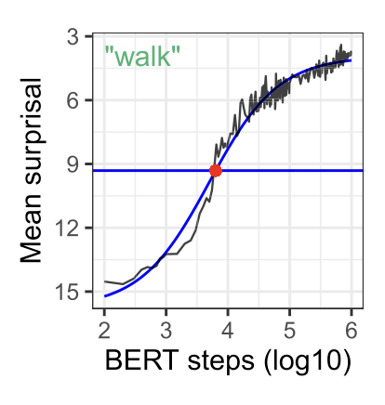
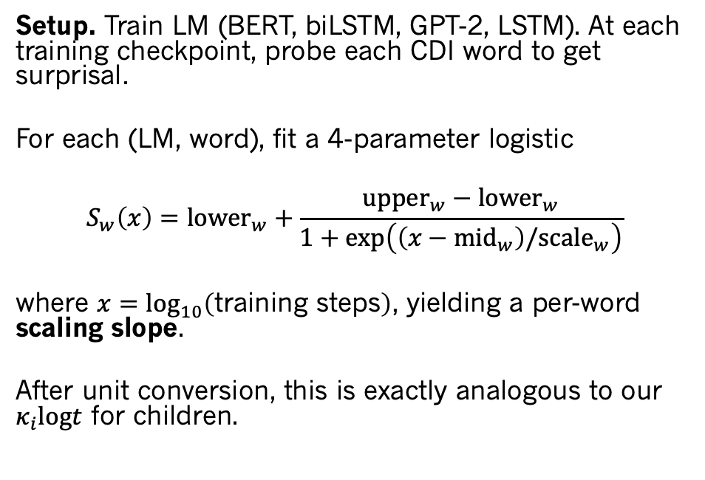
Chang & Bergen: Per-word sigmoids in LMs
Setup. Train LM (BERT, biLSTM, GPT-2, LSTM). At each training checkpoint, probe each CDI word to get surprisal.
For each (LM, word), fit a 4-parameter logistic
$$S_{w}\left(x\right)={lower}_{w}+\frac{{upper}_{w}−{lower}_{w}}{1+exp\left(\left(x−{mid}_{w}\right)/{scale}_{w}\right)}$$
where $x=\log_{10}\left(\text{training} \text{steps}\right)$, yielding a per-word scaling slope.
After unit conversion, this is exactly analogous to our $κ_{i}logt$ for children.
Chang & Bergen (2022)

Slide 44
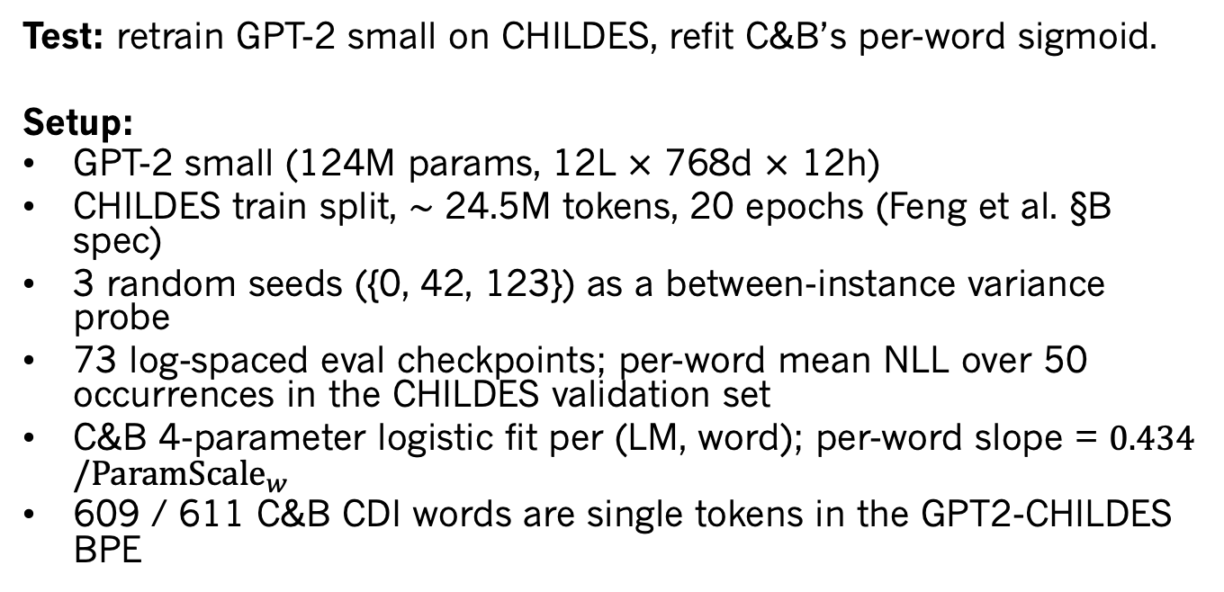
Apples-to-apples comparison
Test: retrain GPT-2 small on CHILDES, refit C&B’s per-word sigmoid.
Setup:
GPT-2 small (124M params, 12L $×$ 768d $×$ 12h)
CHILDES train split, $∼$ 24.5M tokens, 20 epochs (Feng et al. §B spec)
3 random seeds ({0, 42, 123}) as a between-instance variance probe
73 log-spaced eval checkpoints; per-word mean NLL over 50 occurrences in the CHILDES validation set
C&B 4-parameter logistic fit per (LM, word); per-word slope = $0.434/{ParamScale}_{w}$
609 / 611 C&B CDI words are single tokens in the GPT2-CHILDES BPE

Slide 45
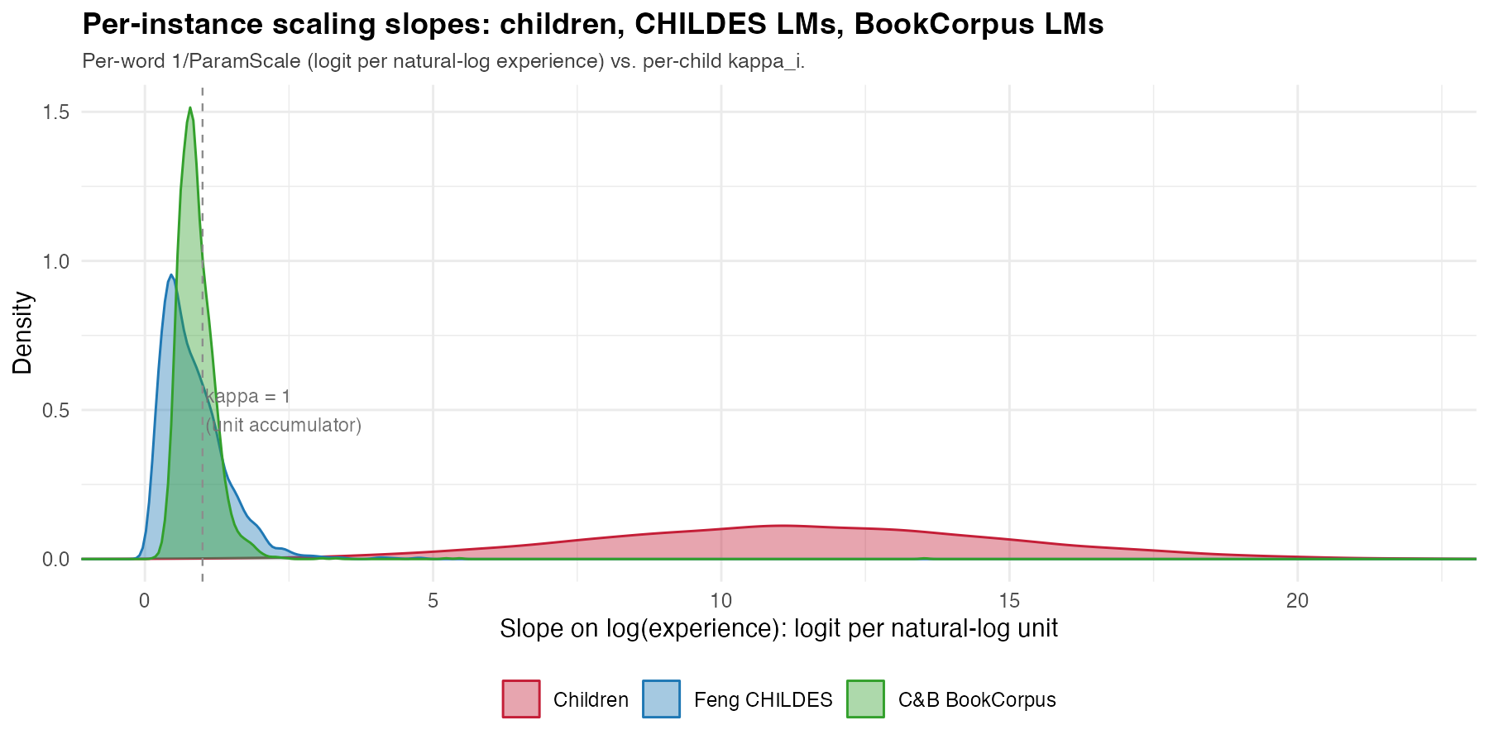
No increases in efficiency for LLMs

Slide 46
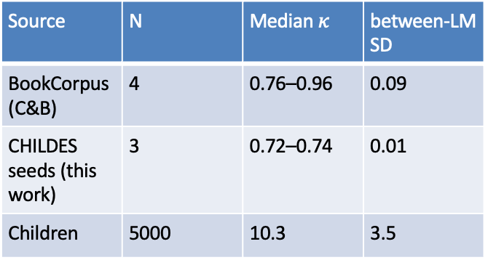
Minimal variance for LLMs (preliminary!)
Between architectures (Chang & Bergen 2022, BookCorpus). Four LMs — BERT, GPT-2, biLSTM, LSTM — give median per-word slopes of 0.76, 0.81, 0.87, 0.96. Between-architecture SD ≈ 0.09.
Between seeds (CHILDES-trained GPT-2 small). Three seeds on the same CHILDES data give median per-word slopes of 0.72, 0.74, 0.74. Between-seed SD ≈ 0.01.
Source | N | Median $κ$ | between-LM SD
BookCorpus (C&B) | 4 | 0.76–0.96 | 0.09
CHILDES seeds (this work) | 3 | 0.72–0.74 | 0.01
Children | 5000 | 10.3 | 3.5

Slide 47
Future work?
Pilot to test for data-related variation. Train GPT-2 small on the two disjoint 10M-token chunks extractable from CHILDES, fix everything else.
Main study. Three sources of between-LM variability, measured independently:
Seed variability.
Data variability — varied subsamples (CHILDES or TinyDialogues per pilot outcome), fixed seed and architecture.
Architecture variability — within-GPT-2 sweep over learning rate, width, depth.

Slide 48
Synthesis

Slide 49
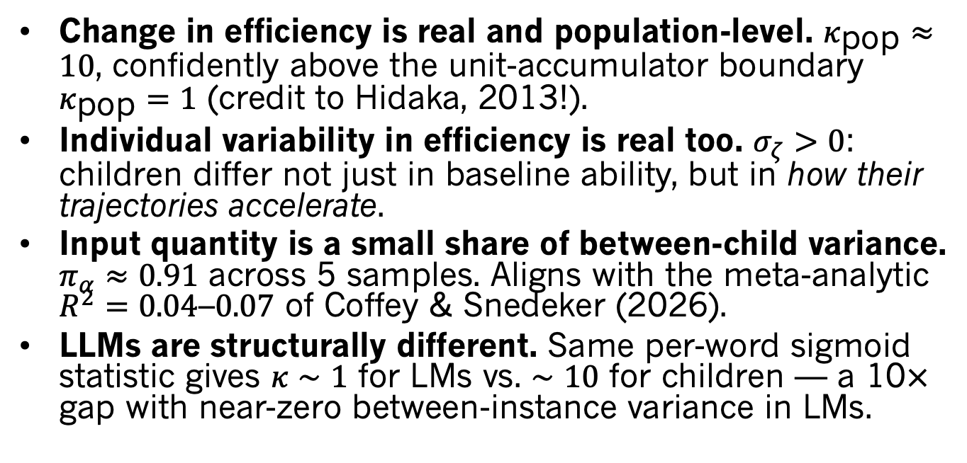
Technical summary
Change in efficiency is real and population-level. $κ_{\text{pop}}≈10$, confidently above the unit-accumulator boundary $κ_{\text{pop}}=1$ (credit to Hidaka, 2013!).
Individual variability in efficiency is real too. $σ_{ζ}>0$: children differ not just in baseline ability, but in how their trajectories accelerate.
Input quantity is a small share of between-child variance. $π_{α}≈0.91$ across 5 samples. Aligns with the meta-analytic $R^{2}=0.04$–$0.07$ of Coffey & Snedeker (2026).
LLMs are structurally different. Same per-word sigmoid statistic gives $κ∼1$ for LMs vs. $∼10$ for children — a 10$×$ gap with near-zero between-instance variance in LMs.

Slide 50
Two signatures, twin constraints on theory

Slide 51
Thanks!

Slide 52
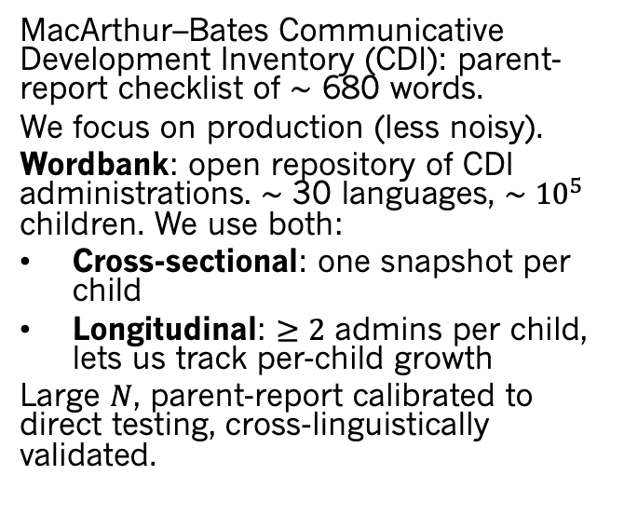
Wordbank Data
MacArthur–Bates Communicative Development Inventory (CDI): parent-report checklist of $∼$ 680 words.
We focus on production (less noisy).
Wordbank: open repository of CDI administrations. $∼$ 30 languages, $∼​{10}^{5}$ children. We use both:
Cross-sectional: one snapshot per child
Longitudinal: $≥2$ admins per child, lets us track per-child growth
Large $N$, parent-report calibrated to direct testing, cross-linguistically validated.

Slide 53


Cross-language acceleration
$κ_{\text{pop}}∼10​−​12$ in both languages, with $P\left(κ_{i}>1\right)>0.997$.
$δ$ vs. $ζ_{i}$ decomposition is identifiability-dependent. In Norwegian (8 admins/kid), per-child slopes are well-identified — dropping $ζ_{i}$ hurts fit by 235 ELPD. In English (3 admins/kid), $δ$ pools what Norwegian’s data lets fall into $ζ_{i}$.
Reading. The acceleration signature is universal. Its internal parameterization is identifiability-dependent on data density.
In any dense longitudinal sample, between-child $κ_{i}$ spans roughly $5​−​15$.

Slide 54
Vocabulary growth
Theoretical: Vocabulary is a key nexus of language, social cognition, and conceptual development.
Practical: Variation in vocabulary growth is a key precursor of academic outcomes.
Methodological: Vocabulary count has a property nearly no other psychological metric has: a true zero, so we can explore the psychometrics of learning.
Comparative: We can explore how LLMs relate to children using dense data about child outcomes.

Slide 55

Appendix: per-child trajectories from the best fit

Slide 56

120 kids sampled from the best-fitting model’s posterior. Left: latent ability $θ$ (logit). Right: predicted vocabulary. Concave-up shape = super-linear signature; fan width = between-child variability.

Slide 57



Appendix: $σ_{r}$ sensitivity from earlier cross-sectional fits
Reviewer reflex. “Maybe kids’ tokens differ in quality, and that’s what looks like acceleration.”
Structural answer. Per-child age-varying quality $q_{i}\left(t\right)={\left(t/a_{0}\right)}^{γ_{i}}$ on input is observationally equivalent to $γ_{i}=κ_{i}−1$.
Implication. Quality cannot escape acceleration — it relabels it. For the median kid, “quality” would have to grow $∼3,000​×$ from age 12 to 30 mo. For the 95th percentile kid, $∼{10}^{6}×$. Implausible as a substantive quality story.

Slide 58

Appendix: McMurray (2007) in our notation
Original. Each word $w$ has threshold $τ_{w}∼g\left(τ\right)$; deterministic step at $t≥τ_{w}$. Vocabulary $L\left(t\right)=G\left(t\right)$ (CDF of $g$). Acceleration requires $g′\left(τ\right)>0$ over the productive window.
In our notation:
$$η_{ij}\left(t\right) = logt−logτ_{j} = κlogt−δ_{j}\text{with}κ≡1,δ_{j}=logτ_{j}.$$

Slide 59

Appendix: Hidaka (2013) in our notation
Original. Three families: cumulative ($N$-accumulator at constant rate, AoA $∼Γ$), rate-change (1-accumulator at rate $δ⋅t^{D}$, AoA $∼$ Weibull), and both. Rate-change: ability $∝t^{D+1}$; $D>0$ produces super-linear scaling.
In our notation (rate-change form):
$$η_{ij}\left(t\right) = \left(D+1\right)logt−δ_{j}\text{with}κ_{i}≡D+1.$$
Hidaka’s $D=κ_{\text{pop}}−1$ in our notation. His $D>0$ is our $κ_{\text{pop}}>1$.

Slide 60

Appendix: Mollica & Piantadosi (2017) in our notation
Original. Per-word: $k_{w}$ effective learning instances arrive as Poisson at rate $λ_{w}$; word acquired after $k_{w}$ events. ${AoA}_{w}∼Γ\left(k_{w},λ_{w}\right)$. For large $k_{w}$, Gamma CDF approximates Gaussian (mean $k_{w}/λ_{w}$) and then a $∼$ 1.7-scale logistic.
In our notation:
$$η_{ij}\left(t\right) = logt−δ_{j}\text{with}κ_{i}≡1, δ_{j}≈log\left(k_{j}/λ_{j}\right).$$

Slide 61

Appendix: Kachergis et al. (2021) in our notation
Original. 1-PL Rasch IRT with per-child latent ability: $logit P\left(y_{ij}=1\right)=θ_{i}+d_{j}+β_{a}a_{i}+β_{t}log\left(p_{j}Ha_{i}\right)$. Per-child $θ_{i}$ free; $d_{j}$ per-word free; shared age slope $β_{a}$ across all kids.
In our notation:
$$η_{ij} = \left(logr_{i}+logα_{i}\right)+κloga_{i}−δ_{j}\text{with}κ≡\text{shared} \text{population} \text{slope}.$$
First prior model to free $σ_{α}$. But $σ_{κ}$ is still zero — every kid has the same scaling slope.

Slide 62
Appendix: glmer
Quantity glmer Stan mean Stan 95% CI
Fixed log_age slope (κ_pop = 1+δ) 11.292 11.308 [11.25, 11.37]
sd(Intercept | child) (σ_ξ) 1.907 1.891 [1.78, 2.01]
sd(log_age | child) (σ_ζ) 3.877 3.811 [3.58, 4.07]
cor((Int, log_age) | child) (ρ_ξζ) -0.099 -0.094 [-0.18, -0.01]
sd(Intercept | word) 1.911 (not in scalar summary) —
All four glmer estimates fall inside the Stan 95% credible intervals. Implied π_α from glmer + external σ_r=0.534 pin = 0.922 vs Stan posterior 0.920.
M_best is exactly glmer(produces ~ 1 + log_age + (1 + log_age | child) + (1 | word), family = binomial).
The Bayesian wrapper adds the external σ_r pin (which decomposes σ_ξ into σ_r and σ_α) and posterior uncertainty, but the random-effects skeleton is identical.

