Slide 1
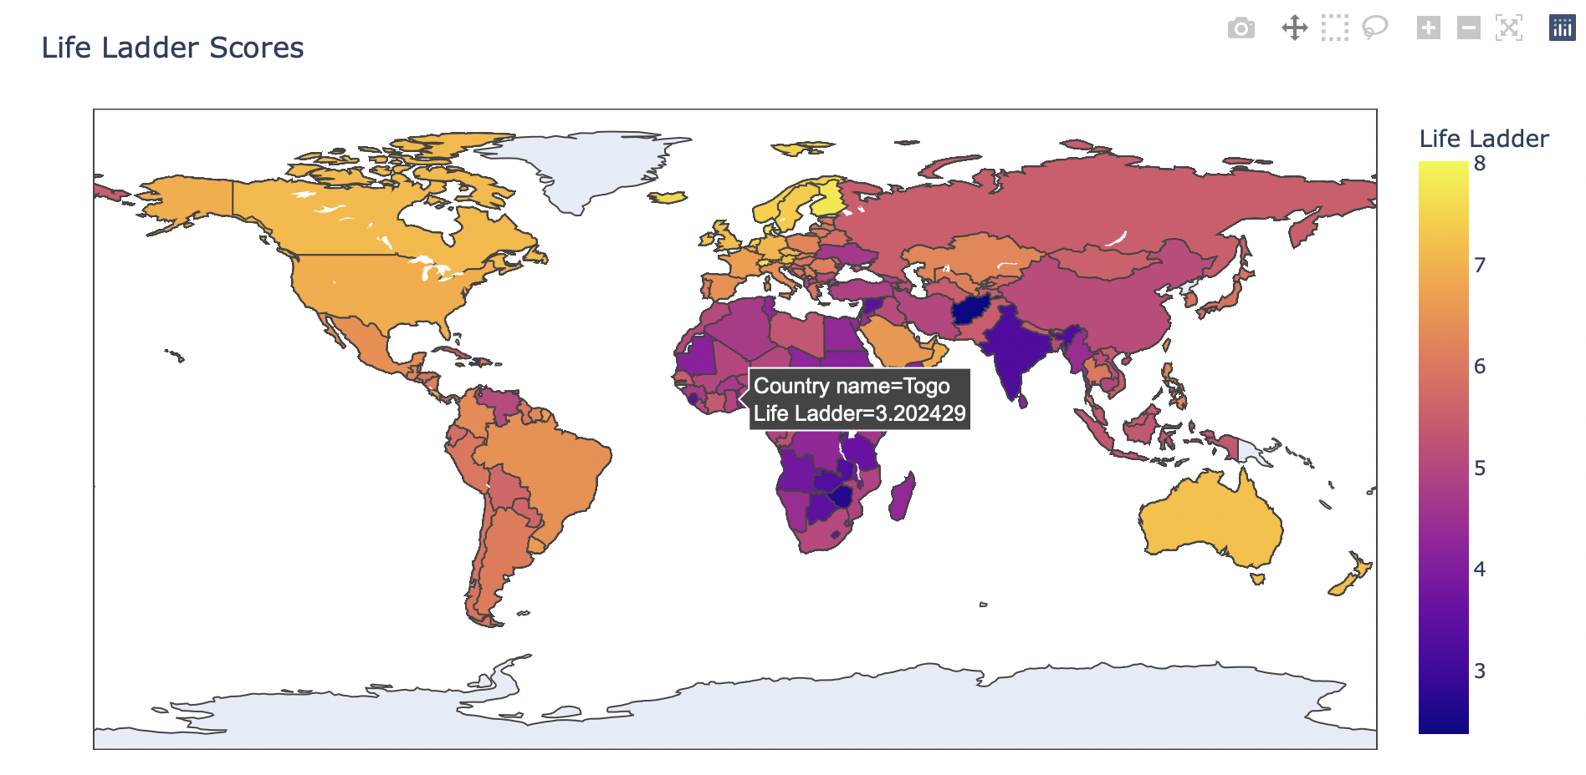
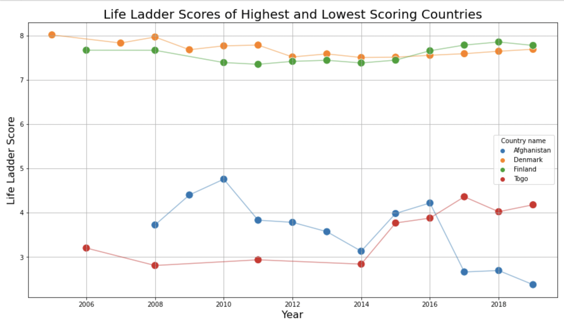
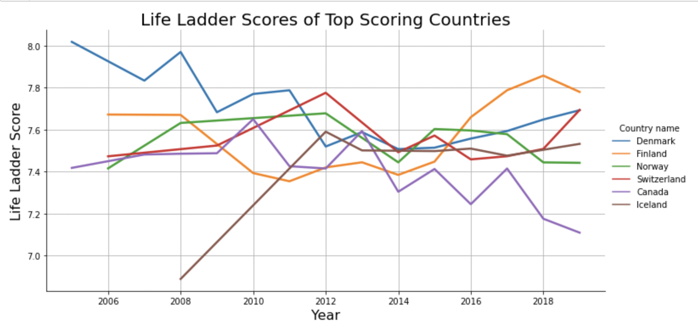
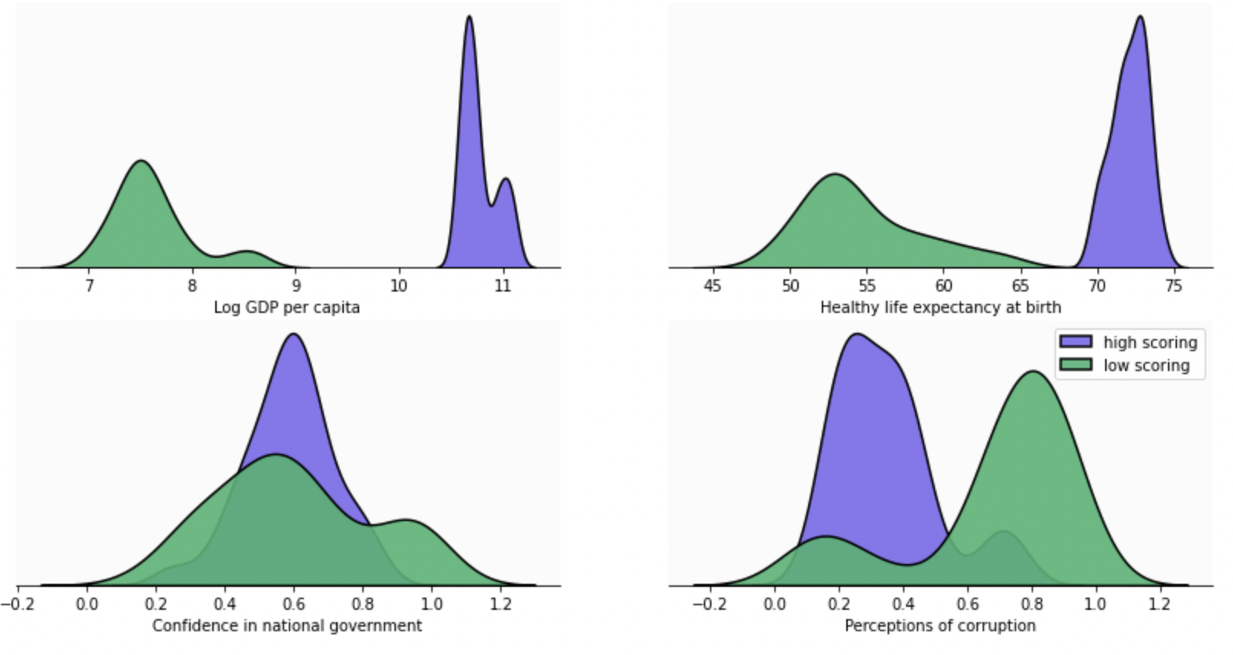
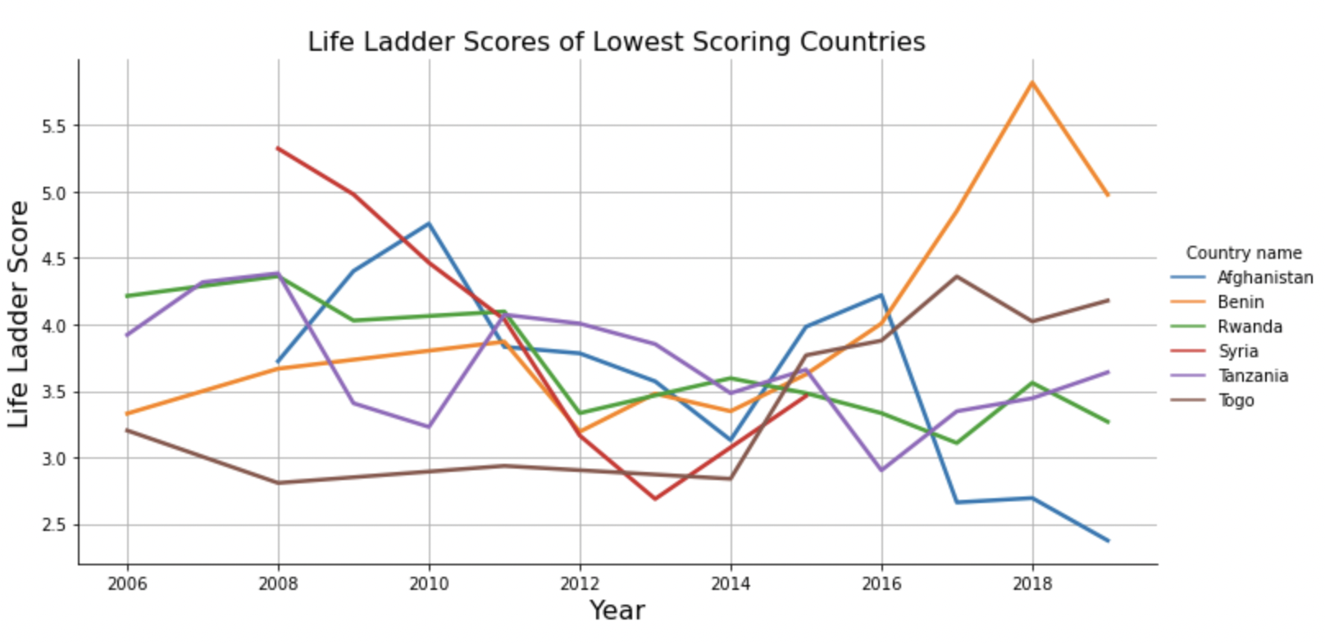
World Happiness Index
Emily Lang
CMSE 402
Introduction:
Results:
The life ladder score of a country is the average value of how citizens would rate their quality of life from 0-10. The goal of this project was to explore which countries most consistently have the highest and lowest life ladder scores, and which features most strongly affect the scores of these countries.
Methodology:
The scores of countries through the years was examined first, to get an idea of how countries usually scored
The countries were then narrowed to a subset of the top and bottom scoring 6 countries
From this subset, the most consistently highest and lowest 2 countries were selected
The features were examined through linear regression to determine the top features effecting score
The features found through linear regression were then compared for the top and bottom sets of countries
Overall Scores
Figure 1: The life ladder scores from 2019 for each country.
Which countries are the consistently highest and lowest scoring?
Figure 3: A closer look at the consistently highest and lowest 2 countries from figure 2.
Conclusions:
Finland and Denmark are the countries with the consistently happiest citizens.
To increase the happiness score of citizens, other countries should focus on improving GDP per capita, life expectancy/healthcare, perceptions of corruption and overall confidence in their national government, as these are the most important factors to increase scoring.
References:
Which features have the strongest impact on a countries score?
Figure 4: The top 4 features, found through linear regression, and how the compare within the top 6 and bottom 6 countries.
Dataset: https://www.kaggle.com/datasets/priyanka841/2019-world-happiness-report-csv-file
Information on life ladder scores and features: https://worldhappiness.report/faq/
Top and bottom scoring countries
Figure 2: The scores of the top 6 and bottom 6 countries through the years.

