Slide 1
Introduction to Groundwater Modeling with MODFLOW 6
MODFLOW and More Workshop, Golden, Colorado
June 6, 2019

Slide 2
Class Agenda
Morning
Afternoon
8:30 AM -- Part 1: Introductions
8:45 AM -- Part 2: Building, Running, and Post-Processing MODFLOW 6 Models
10:00 AM -- Break
10:15 AM -- Part 3: Advanced Package Capabilities
11:15 AM -- Part 4: Newton Raphson
12:00 PM -- Lunch
1:00 PM -- Part 5: XT3D
2:30 PM -- Part 6: Alternative Discretization Approaches
3:00 PM -- Break
3:15 PM -- Part 7: Real-World MODFLOW 6 Example
4:15 PM -- Part 8: Future Directions:
(1) CSUB Package
(2) Transport
(3) Linear Network Flow (LNF) Model
(4) MODPATH
5:00 PM -- Class Adjourn

Slide 3



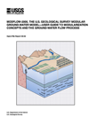
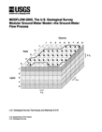
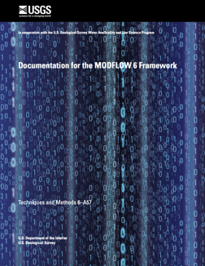
MODFLOW 6 Development
Consolidate popular capabilities from MODFLOW versions (2005, NWT, USG, LGR, …)
Improve solution technique
Modernize code and input structure
Support multi-model simulations
Extend MODFLOW into a hydrologic simulator
New core version
1984
1988
1996
2000
2005
2017
Notes:
MODFLOW 6 will combine the best features of existing versions of MODFLOW and get rid of outdated functionality. Highly coupled and complex systems will be solved with one system of equations making this MODFLOW version much faster than with previous versions of MODFLOW that iteratively solved the flow part, then the other parts, like transport or local grid refinement. This effort intends to modernize MODFLOW’s design to account for 20+ years of improvements in software design and essentially making MODFLOW a more of a hydrologic simulator.

Slide 4
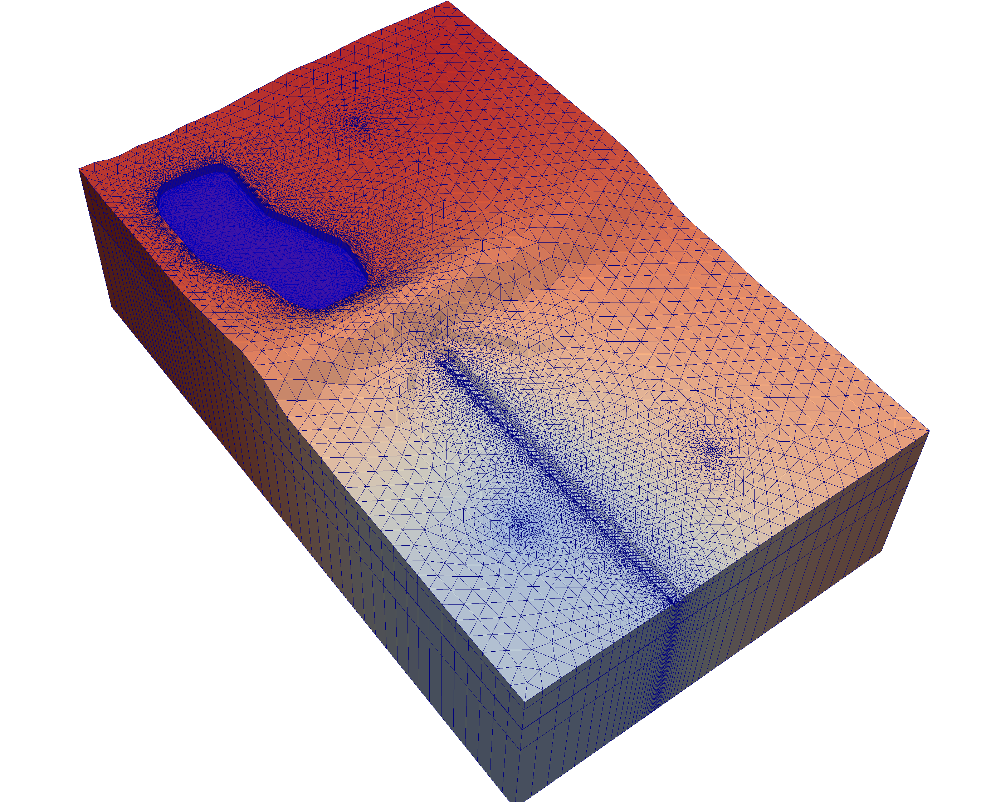
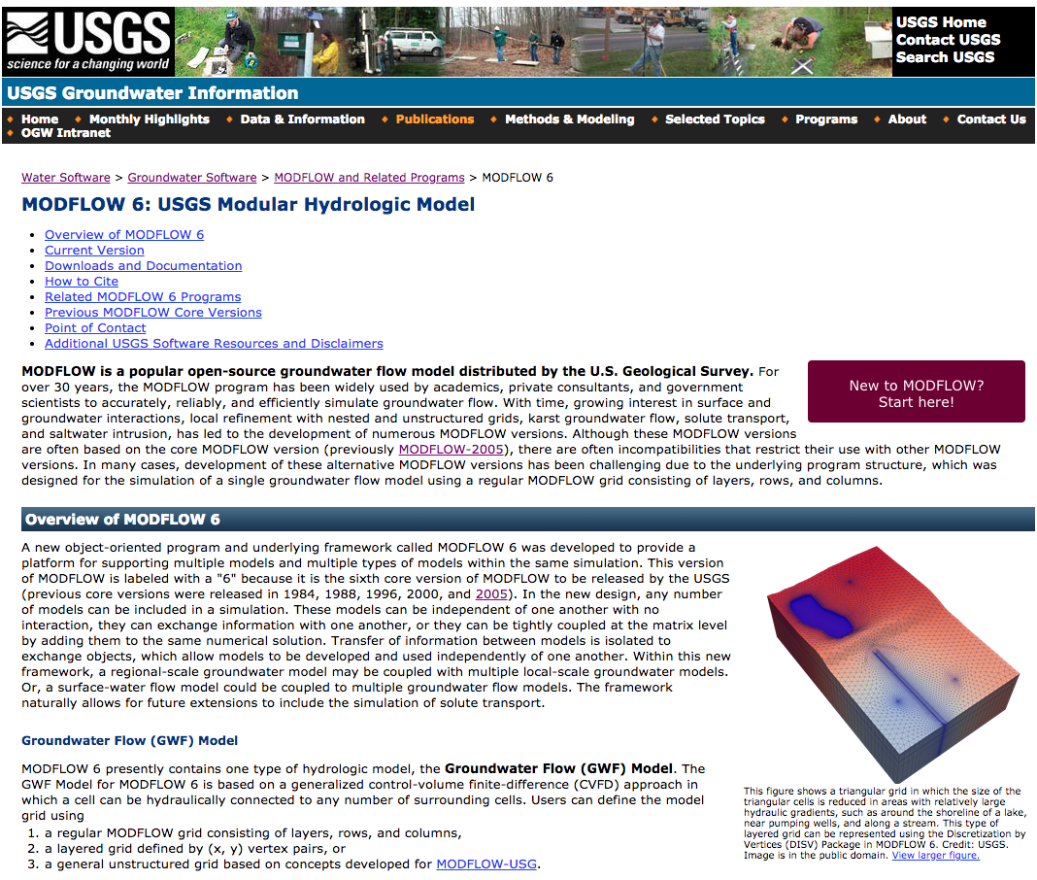
MODFLOW 6
Object oriented
Multiple models
Multiple packages
Control volume finite difference formulation
Regular grids or unstructured grids
Traditional or Newton Raphson formulation
New look and feel
Available now (6.0.4)

Slide 5

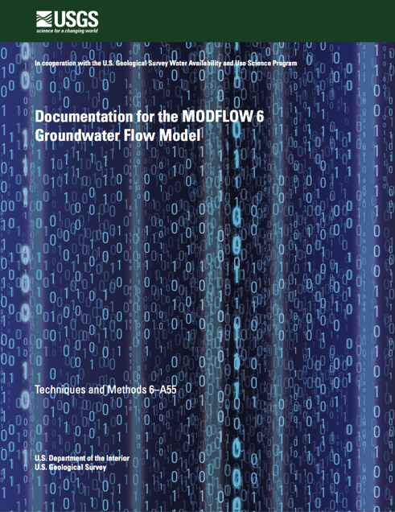
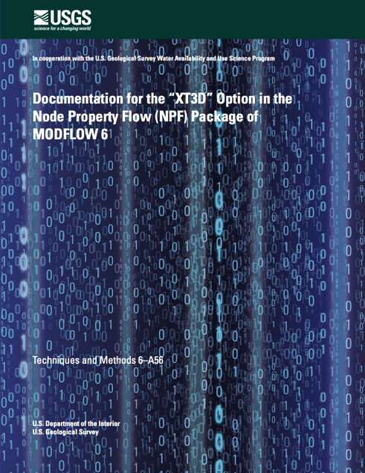
MODFLOW 6 Publications
Hughes, J.D., Langevin, C.D., and Banta, E.R., 2017, Documentation for the MODFLOW 6 framework: U.S. Geological Survey Techniques and Methods, book 6, chap. A57, 40 p., https://doi.org/10.3133/tm6A57.
Langevin, C.D., Hughes, J.D., Banta, E.R., Niswonger, R.G., Panday, Sorab, and Provost, A.M., 2017, Documentation for the MODFLOW 6 Groundwater Flow Model: U.S. Geological Survey Techniques and Methods, book 6, chap. A55, 197 p., https://doi.org/10.3133/tm6A55.
Provost, A.M., Langevin, C.D., and Hughes, J.D., 2017, Documentation for the "XT3D" option in the Node Property Flow (NPF) Package of MODFLOW 6: U.S. Geological Survey Techniques and Methods, book 6, chap. A56, 40 p., https://doi.org/10.3133/tm6A56.

Slide 6
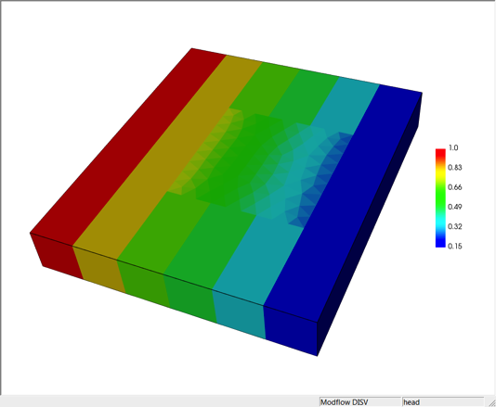
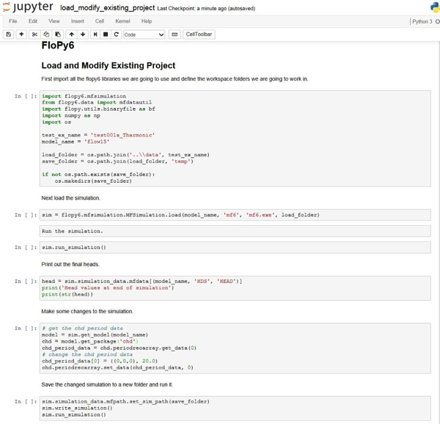
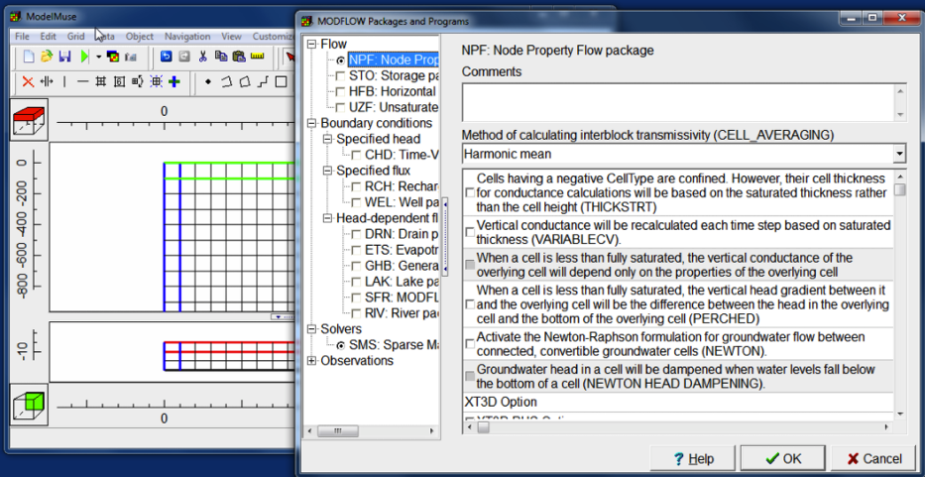
USGS Support Software
MF5TO6
Included with MODFLOW 6
ZONEBUDGET
Included with MODFLOW 6
FLOPY for MODFLOW 6
Available now
MODPATH 7
Available for certain types of grids
MODELVIEWER
Beta available
MODELMUSE (Winston)
Beta version available
Notes:
Chris

