Slide 1
Part 5: XT3D
Introduction to Groundwater Modeling with MODFLOW 6
MODFLOW & More, June 6, 2019

Slide 2
Challenge
Allow MODFLOW 6 to simulate groundwater flow with fully 3D anisotropy
Unstructured, cell-centered, finite-volume grids

Slide 3
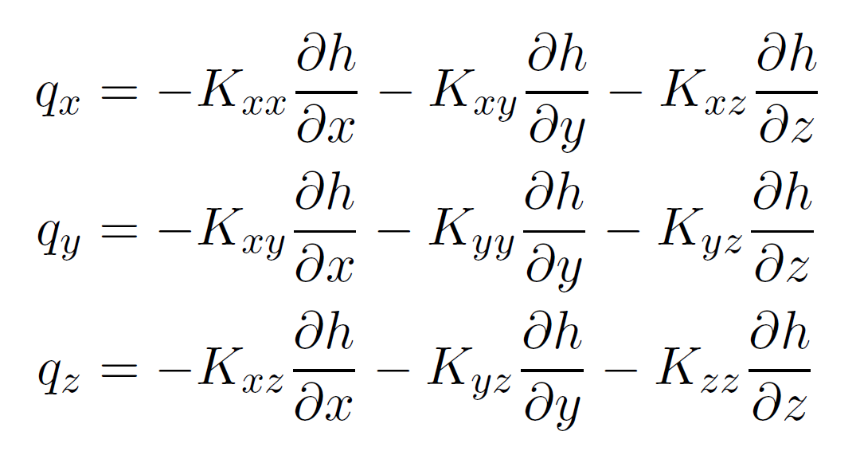
Darcy’s Law with full 3D anisotropy

Slide 4
Darcy’s Law with full 3D anisotropy
x component
need all three components of head gradient

Slide 5
Gradient estimation - rectangular grid
y
x

Slide 6
Gradient estimation - rectangular grid
y
x

Slide 7
Gradient estimation - rectangular grid
spatial interpolation
y
x

Slide 8

Gradient estimation - rectangular grid
x component
y
x

Slide 9

Gradient estimation - rectangular grid
y component
y
x

Slide 10
Gradient estimation - rectangular grid
average of two estimates
y
x

Slide 11
Gradient estimation - rectangular grid
y component, other side
y
x

Slide 12
Gradient estimation - rectangular grid
combine
estimates
y
x

Slide 13
Gradient estimation - rectangular grid
weight by
distance
y
x

Slide 14
Gradient estimation - rectangular grid
weight by
orientation
x
x
y
x

Slide 15
Gradient estimation - rectangular grid
y
x

Slide 16
Main ideas
Use weighted averaging to incorporate gradient information from neighboring connections

Slide 17
Main ideas
Use weighted averaging to incorporate gradient information from neighboring connections
Weight depends on distance

Slide 18
Main ideas
Use weighted averaging to incorporate gradient information from neighboring connections
Weight depends on distance
Weight depends on orientation

Slide 19
Main ideas
Use weighted averaging to incorporate gradient information from neighboring connections
Weight depends on distance
Weight depends on orientation
Combine estimates from both sides of the interface

Slide 20
XT3D – regular and irregular grids

Slide 21
XT3D – regular and irregular grids
spatial interpolation

Slide 22
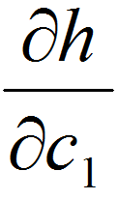
XT3D – regular and irregular grids
component along primary connection

Slide 23
XT3D – regular and irregular grids
“unknown” head
component along primary connection

Slide 24
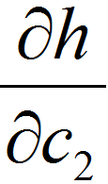
XT3D – regular and irregular grids
component ⊥ to primary connection
= weighted average

Slide 25
XT3D – regular and irregular grids
component ⊥ to primary connection
= weighted average
indirect information:
spatially removed from primary interface
components along neighboring connections (not ⊥)
need to do some math

Slide 26
XT3D – regular and irregular grids
component ⊥ to primary connection
= weighted average
indirect information:
spatially removed from primary interface
components along neighboring connections (not ⊥)
need to do some math
weight by:
distance: closer = more weight

Slide 27
XT3D – regular and irregular grids
component ⊥ to primary connection
= weighted average
indirect information:
spatially removed from primary interface
components along neighboring connections (not ⊥)
need to do some math
x
weight by:
distance: closer = more weight
orientation: more ⊥ = more weight

Slide 28
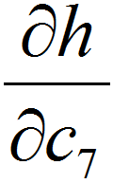
XT3D – regular and irregular grids
component ⊥ to primary connection, other side

Slide 29
XT3D – regular and irregular grids
combine estimates
(continuity of normal flux)

Slide 30
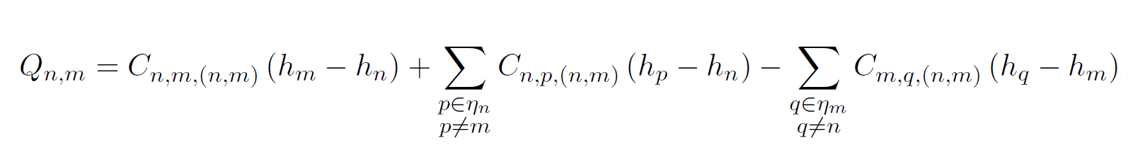
XT3D flow expression
Flow between two cells expressed in terms of conductance-like coefficients that can involve all neighbors of the two cells

Slide 31
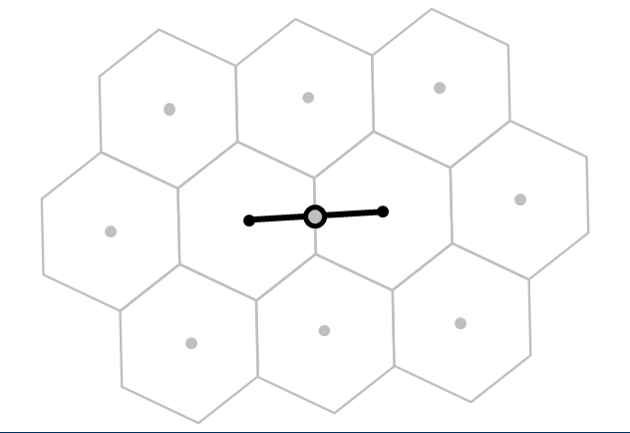
XT3D flow expression
Flow between two cells expressed in terms of conductance-like coefficients that can involve all neighbors of the two cells

Slide 32
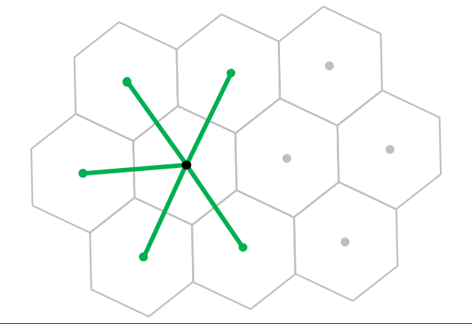
XT3D flow expression
Flow between two cells expressed in terms of conductance-like coefficients that can involve all neighbors of the two cells

Slide 33
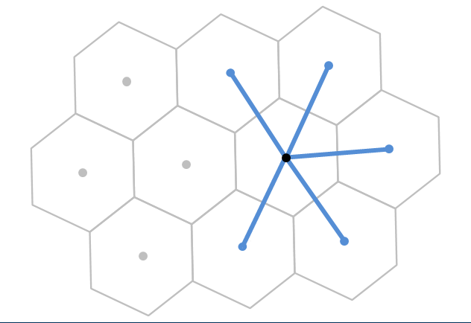
XT3D flow expression
Flow between two cells expressed in terms of conductance-like coefficients that can involve all neighbors of the two cells

Slide 34
XT3D flow expression
Flow between two cells expressed in terms of conductance-like coefficients that can involve all neighbors of the two cells
Larger stencil than in standard conductance-based MODFLOW formulation

Slide 35
XT3D performance
Longer run times than standard MODFLOW formulation
Requires more memory than standard MODFLOW formulation
“RHS” suboption makes memory requirement comparable to default formulation (same stencil)

Slide 36
Usage notes
To use XT3D, “flip a switch” in Node Property Flow (NPF) Package input
Matrix not necessarily symmetric → use BICGSTAB for linear acceleration
Don’t use ghost nodes (GNC) at the same time
Works with horizontal flow barriers (HFB)
Has a Newton-Raphson formulation
Vertical contribution to “conductances” currently based on fully saturated cell thickness

Slide 37
Conclusions
XT3D handles arbitrarily oriented 3D anisotropy on structured and unstructured grids
“Ghost-node-like” correction on unstructured grids
Also applicable to dispersion

Slide 38
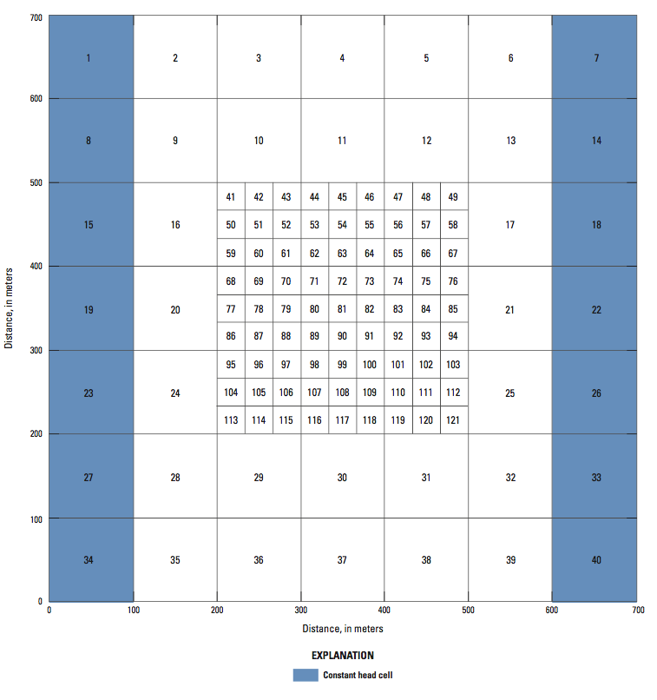
Exercises 5-1 and 5-2
Use XT3D instead of ghost nodes
Introduce (2D) anisotropy
“extra credit”
blew thru exercises
love math
excess brainpower

Slide 39
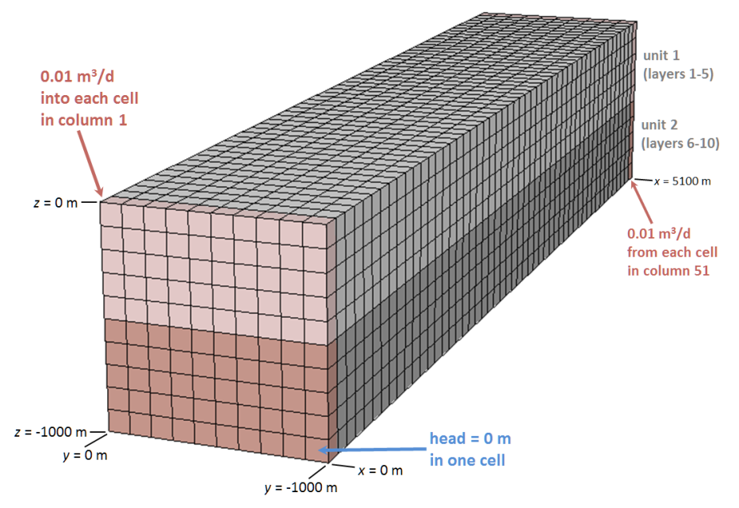
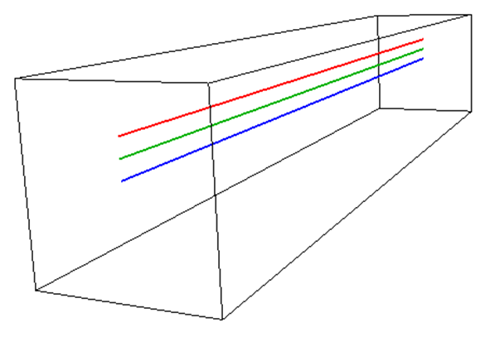
Exercise 5-3
3D anisotropy
Particle tracking of groundwater “whirls”

