Slide 1
MODFLOW & More
2019
The LNF Model for MODFLOW 6
Sorab Panday, Christian D. Langevin, Joseph D. Hughes, Richard G. Niswonger, and Alden Provost

Slide 2
Presentation Outline
The MODFLOW 6 framework
The LNF Model
The Exchanges – LNF-LNF & GWF-LNF
Implementation
Applications Example

Slide 3
The MODFLOW 6 framework

Slide 4
Drivers
MODFLOW is not just for groundwater anymore
Processes abound – CFP, MNW, SWR, SFR, UZF, OBS – need unified framework
To provide a plug-and-play capability for linking or coupling new or existing models of various processes, formulations, and scales to MODFLOW and to each other
Provide a unified solution framework for holistic water modeling
Complexity of models
Help simplify inputs, outputs and analyses by making separate models of the complex intersections of otherwise simpler models
For example, LGRs (and sub-layering) can be separate models, differently nested layers can be separate models
Keeping different process models and input/output files independent
Simplify post-processing for calibration or documentation
Modernize
Upgrade program design and steady-state/transient input/output
Discard outdated functionality
Consolidate boundaries and increase flexibility

Slide 5
Framework salient features
Plug-and-play capability for different models
Different models can be integrated simply by supplying the appropriate local-level matrix for each model well as the appropriate exchange terms, to the object-oriented framework
Different models, model formulations, or linearization schemes can integrate and operate within a single cohesive modeling environment
Entire matrix of flow equations for all models and exchanges solved simultaneously
Each model solved separately with iteration on the exchange terms

Slide 6
The LNF Model

Slide 7
LNF model salient features
Flow through network of one-dimensional features
Horizontal; vertical; angled
Flow formulations
Laminar
Hazen-Williams
Manning
Darcy-Weisbach
Solution Options
Saturated or Unconfined
Flow to Dry Cell
Picard or Newton linearization
Section Geometries
Circular
Rectangular
x
x
x
x
x
x
x
x
x
x
x
x
x
x
x
x
x
x
x
x
x
x
x
x

Slide 8
The Exchanges – LNF-LNF & GWF-LNF

Slide 9

GWF-LNF Exchange salient features
Exchange of flux between cells of different models
Exchange formulations
Leakance
Flow across skin of specified hydraulic conductivity and thickness
Modified Thiem solution to include skin resistance/well efficiency
Solution Options
Saturated or Unconfined
Flow to Dry Cell
Picard or Newton linearization

Slide 10
Implementation

Slide 11
Coding Narrative
LNF is a new model
MODFLOW 6 formulation flow features/options adopted
MODFLOW 6 input/output structure adopted
Coding was at the local (LNF model) level for cell numbering and matrix assembly (framework puts it all together)
Needed to extend the numerical model base type
Adds new model into framework
Methods/subroutines of new model called in correct places
Slight learning curve for object-oriented Fortran
Some debugger obstacles, but…
Efforts were mostly to develop and debug the new LNF model with little effort required to drop it in to the framework

Slide 12
Application Example

Slide 13
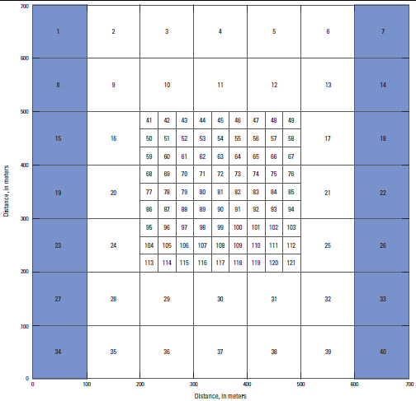
3 Models: Gwf1; Gwf2; Lnf1
First example problem from MODFLOW-USG document
0 to -100 m depth
K = 1 m/d
BUT with semi-circular canal as shown
Gwf1: 7x7; 100 m side
Gwf2: 9x9; 33.3 m side
Lnf1: 4 cells
1 = 50 m long
2, 3, 4 = 100 m long
Lnf1
Gwf2
Gwf1
h = 1
h = 0

Slide 14
BEGIN OPTIONS
END OPTIONS
BEGIN TIMING
TDIS simulation.tdis
END TIMING
BEGIN MODELS
#modeltype namefile modelname
GWF model1.nam GWF_Model_1
GWF model2.nam GWF_Model_2
LNF model3.nam LNF_Model_1
END MODELS
BEGIN EXCHANGES
GWF-GWF gwf1-gwf2.exg GWF_Model_1 GWF_Model_2
GWF-LNF gwf1-lnf1.exg GWF_Model_1 LNF_Model_1
GWF-LNF gwf2-lnf1.exg GWF_Model_2 LNF_Model_1
END EXCHANGES
BEGIN SOLUTION_GROUP 1
#implicit exchange
MXITER 1
NUMERICAL simulation.ims GWF_Model_1 GWF_Model_2 LNF_Model_1
#
#explicit exchange
#MXITER 10
#NUMERICAL simulation.ims GWF_Model_1
#NUMERICAL simulation.ims GWF_Model_2
#NUMERICAL simulation.ims LNF_Model_1
END SOLUTION_GROUP
Integrating the models: mf6.nam
Define all Models
Define all Exchanges
Define Solution

Slide 15
LNF Model: NAME File
BEGIN OPTIONS
END OPTIONS
BEGIN INPUT_FILES
DIS8 model3.dis
GEO8 model3.geo
IC8 model3.ic
NPF8 model3.npf
OC8 model3.oc
STO8 model3.sto
data model3.disu.dat
END INPUT_FILES
BEGIN OUTPUT_FILES
LIST model3.list
DATA(BINARY) model3.hds
DATA(BINARY) model3.ddn
DATA(BINARY) model3.cbc
END OUTPUT_FILES
Open Input Files
Open Output Files

Slide 16
# Unstructured discretization file
begin options
LENGTH_UNITS meters
end options
begin dimensions
nodes 4
nja 10
end dimensions
begin disdata
fleng
internal 1.0 (free) 1 fleng
50.0 100.0 100.0 100.0
felev
constant -10.0
fangle
constant 0.0000
end disdata
begin connectiondata
iac
external 'model3.disu.dat' 1 (free)
ja
external 'model3.disu.dat' 1 (free)
end connectiondata
LNF Discretization File
Options
Dimensions
Discretization Data
2 3 3 2
Define Connectivity
1 2
2 1 3
3 2 4
4 3

Slide 17
LNF Model: Geometry File
BEGIN OPTIONS
PRINT_INPUT
END OPTIONS
BEGIN DIMENSIONS
GEOMETRY_LIST 1
END DIMENSIONS
BEGIN GEOMETRY_LIST
CIRCULAR 1 NAME 'semi-circle section'
CIRCULAR 1 RADIUS 10.0
END GEOMETRY_LIST
BEGIN CELL_GEOMETRY_TYPES
IGEOTYPE
CONSTANT 1
END CELL_GEOMETRY_TYPES
Define Options
List Sections
Define geometry for each section
Allocate Sections to all LNF cells

Slide 18
begin options
SAVE_FLOWS
HNOFLO -1E5 hnoflo
#VISCOSITY 1.0e-6
#GRAVITY 9.81
end options
#
begin npfdata
#
#icelltype(nodes) is 0:confined, 1:convertible
icelltype
constant 1
#
#ifdc(nodes) flow to dry cell correction option 0: no, 1: yes correct
ifdc
constant 0
#
#iflowtype(nodes) is the flag for flow equation for this cylinder
iflowtype
constant 4 Manning's equation
#
#chk(nodes) Manning's constant 0.013 s/m^1/3 converted to d/m^1/3
chk
constant 1.505e-7
end npfdata
LNF Model: NPF Data
Define Options
Read NPF data

Slide 19
GWF1-LNF1 Exchange
begin options
PRINT_INPUT
PRINT_FLOWS
SAVE_FLOWS
NEWTON
# AUX testaux
end options
begin dimensions
NEXG 1
end dimensions
# GWnode LNFnode ifdc Icelltype Iflowtype FlenGW Kv Thick
begin exchangedata
#
20 1 0 1 3 50.0 1.0 1.0
end exchangedata
Define Options
Number of exchanges
List of exchange data
Similar file for GWF2-LNF1 Exchange

Slide 20
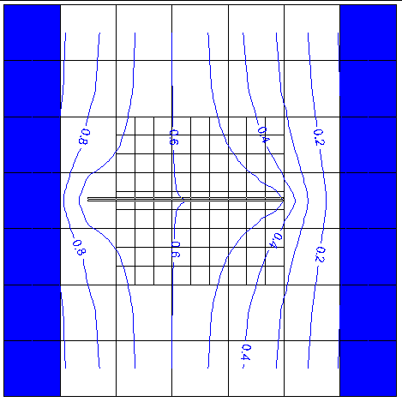
Simulation Results
Flux through Domain = 150 m^{3/}day
Results compare with USG
Simulation Narrative
Input readily constructed
Outputs readily evaluated
I think you will be quite excited to use the code or customize other processes/codes into it
Head Distribution

Slide 21
Questions
??
spanday@gsienv.com

