Slide 1
Water Levels, Canal Stage, and Saltwater Intrusion in Broward County, Florida
By
Alyssa Dausman & Christian Langevin
USGS SEAWAT Training Class
Feb. 26 – March 2, 2007
Ft. Lauderdale, Florida

Slide 2
Objective
To quantify the relationship between water-level, well-field withdrawal, and canal stage fluctuations on movement of the saltwater interface for Broward County

Slide 3
Steps taken to reach OBJECTIVE:
Field data
  Continuous monitoring
  Statistical analysis-ANN
Variable-density modeling
  Representative model
  Broward County model

Slide 4
Steps taken to reach OBJECTIVE:
Field data
  Continuous monitoring
  Statistical analysis-ANN
Variable-density modeling
  Representative model
  Broward County model

Slide 5
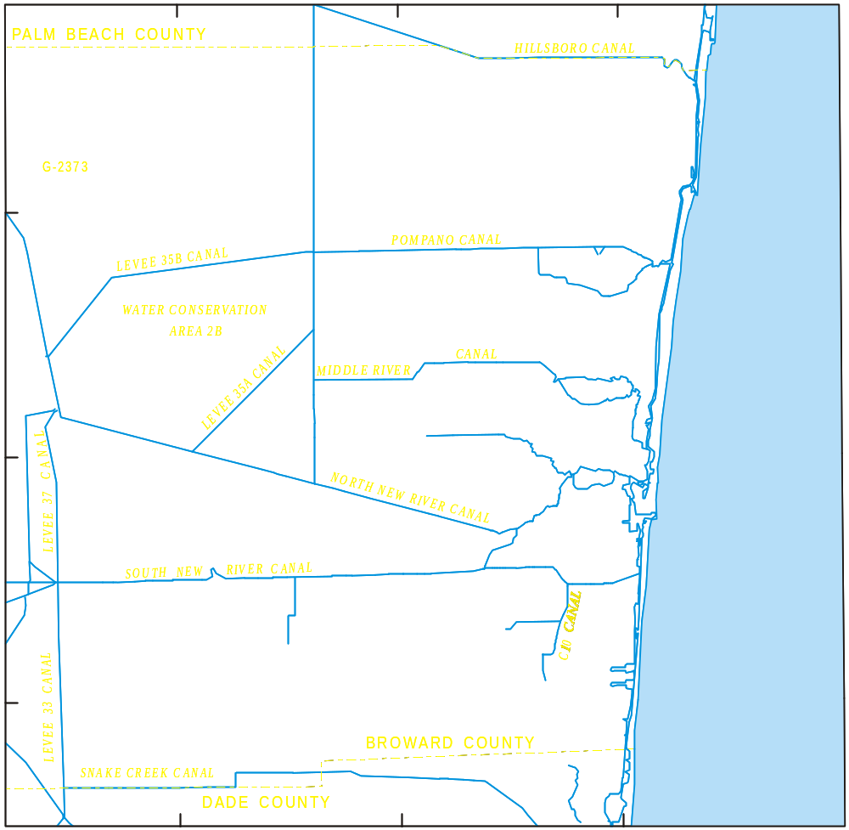
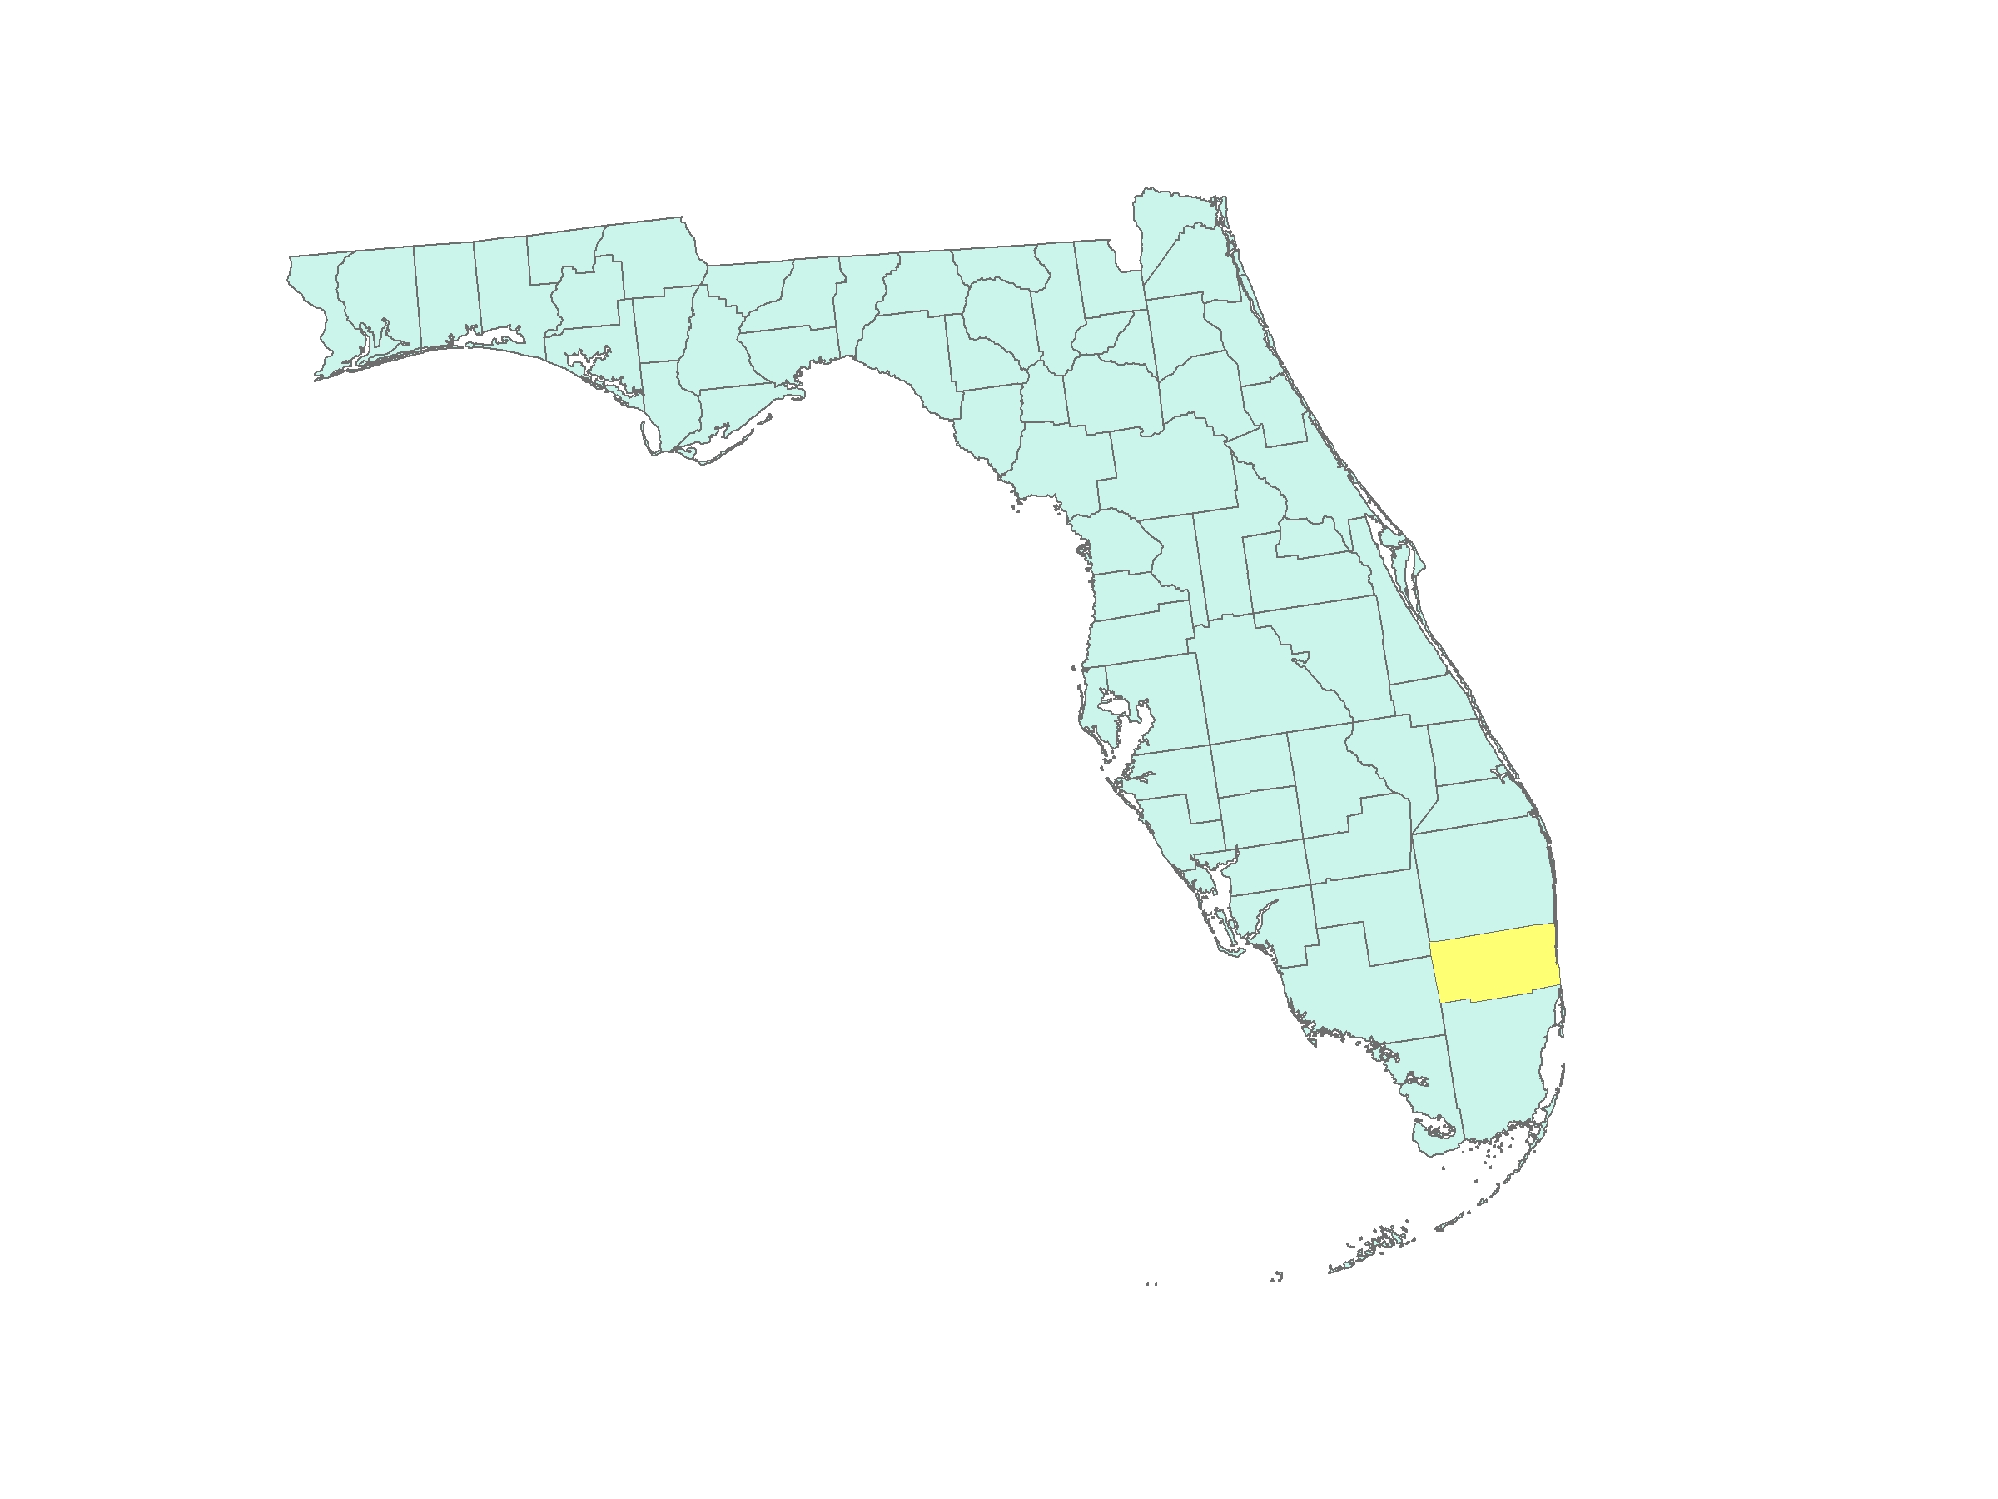
Atlantic
Ocean
Florida
Gulf of Mexico
0
2
4
6 MILES
0
2
4
6 KILOMETERS

Slide 6
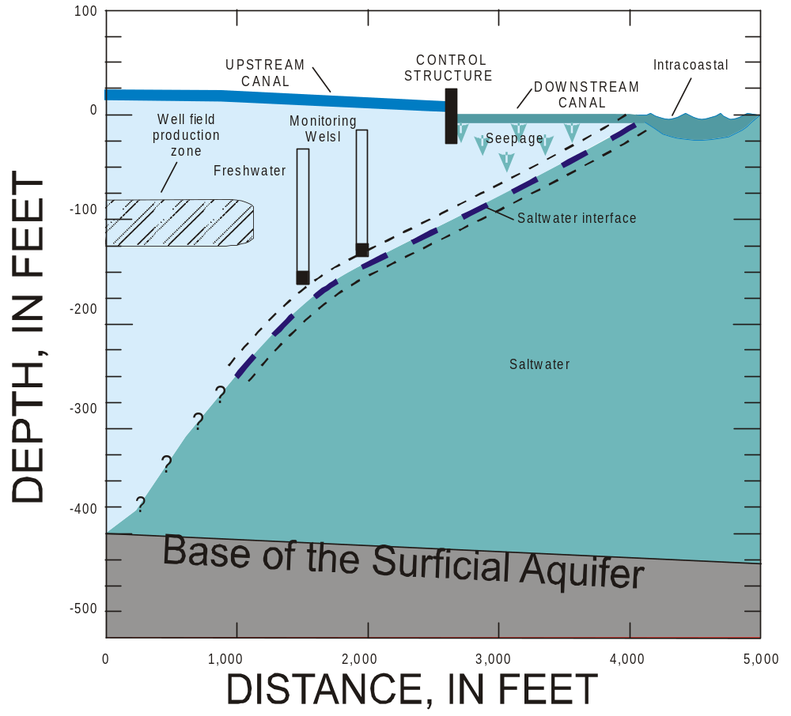

Slide 7
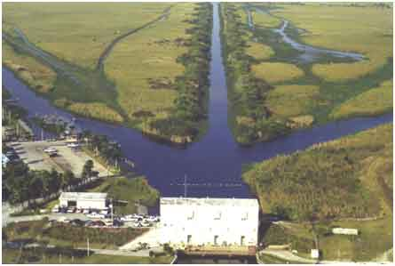
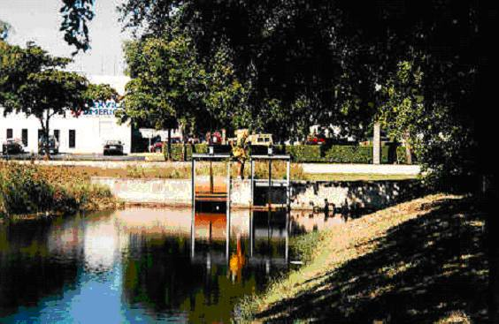

Slide 8
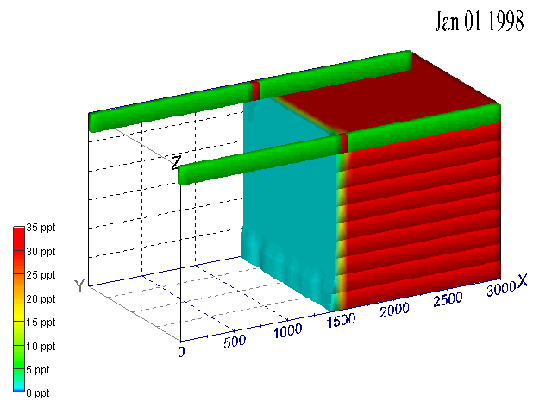
Control Structure Example

Slide 9
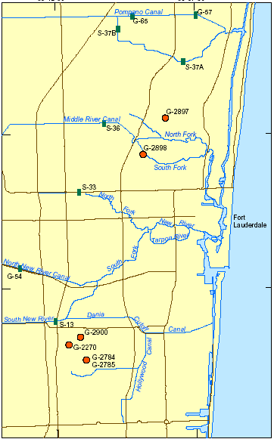
Data Collection
G-2897
G-2898
G-2900
G-2270
G-2784/5
Monitoring Well
~100 feet
surficial aquifer
Biscayne aquifer
lower surficial

Slide 10
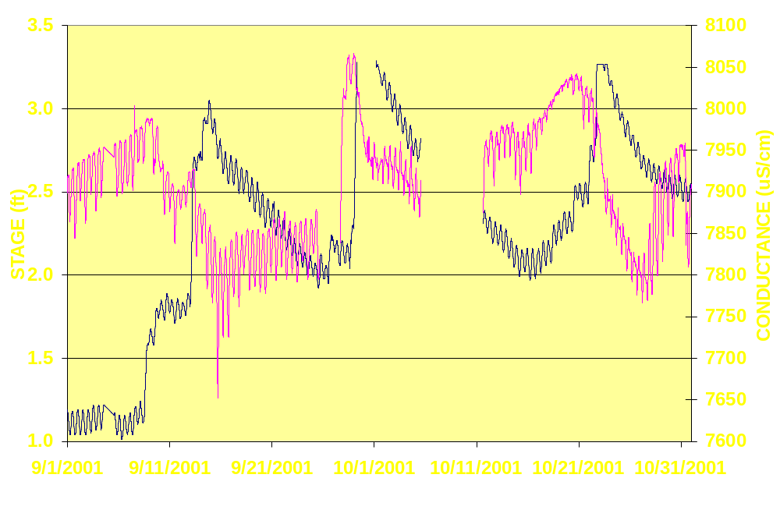
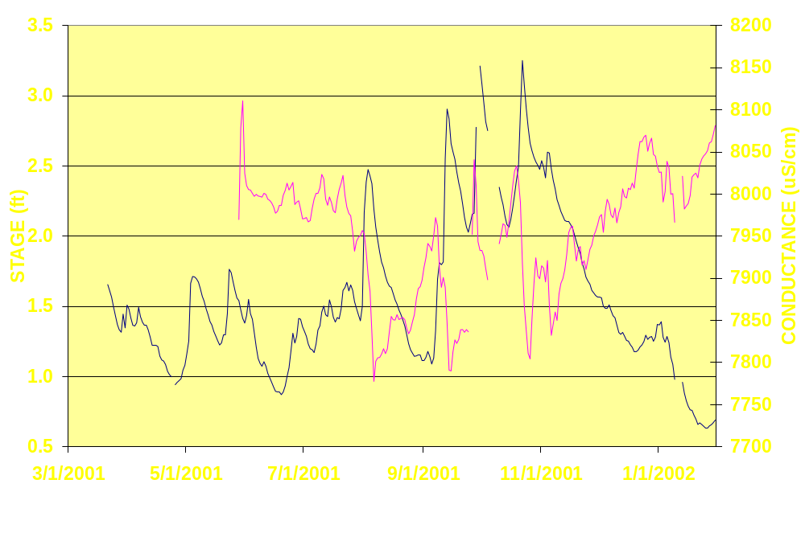
G-2900
Water Level
Conductance
Daily Average
15-min data
Conductance
Water Level

Slide 11
Steps taken to reach OBJECTIVE:
Field data
  Continuous monitoring
  Statistical analysis-ANN
Variable-density modeling
  Representative model
  Broward County model

Slide 12
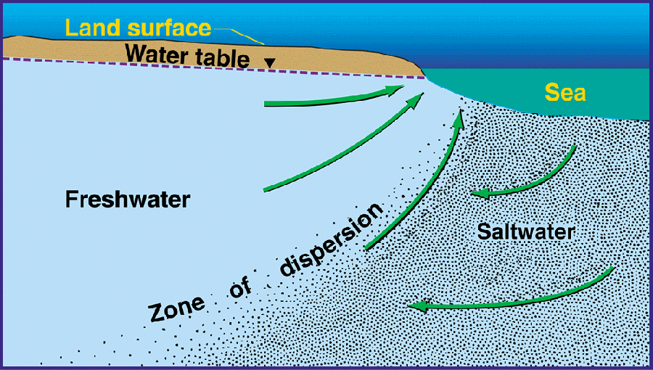
Conceptual Model
Seawater is 2.5% more dense than freshwater

Slide 13


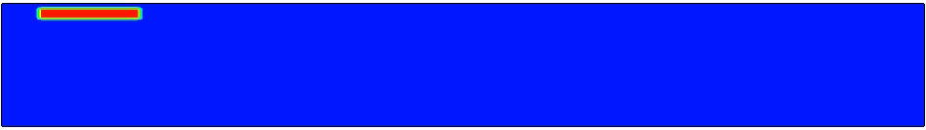

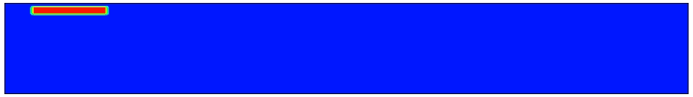
FLOW
Constant density
TRANSPORT
FLOW
Variable density
TRANSPORT

Slide 14
Modeling Goals
Explain field data
Determine aquifer parameters
Perform evaluation scenarios
  Canal stage changes
  Sea-level rise
  Drought/increased pumpage

Slide 15
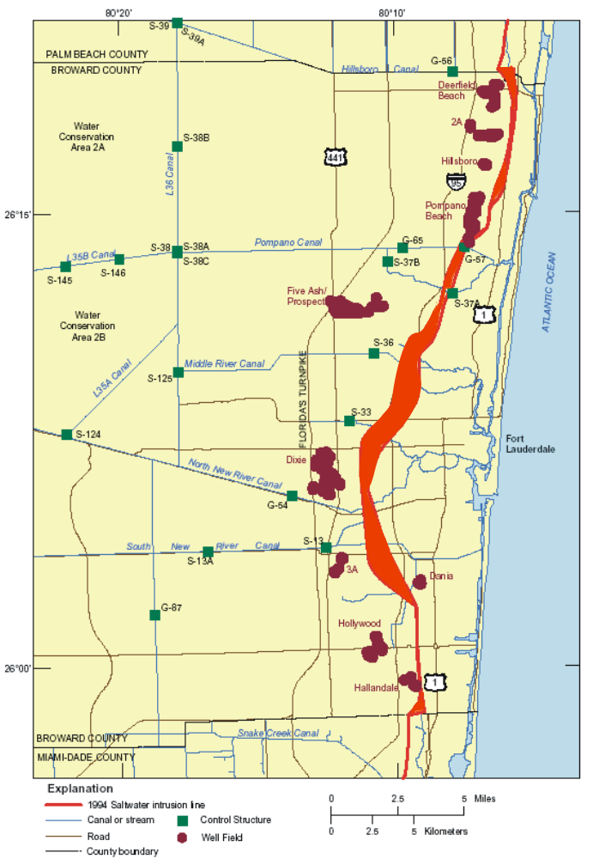

Slide 16
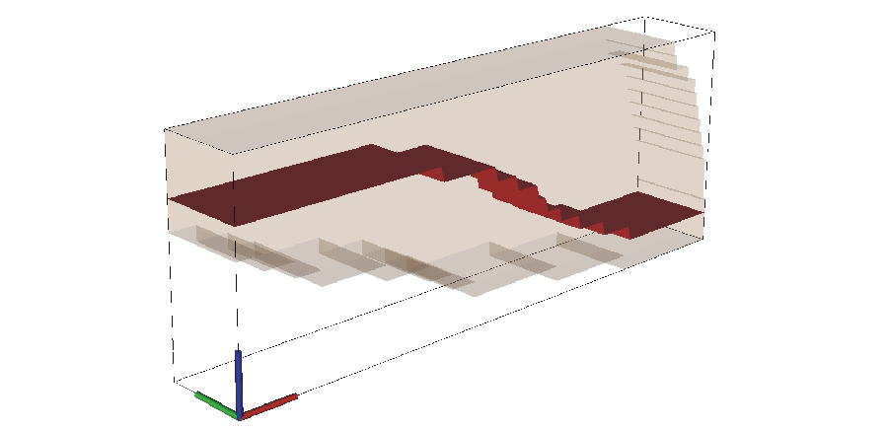
Data going in Model
Pumping
Water-levels
N
Rainfall
I
n
t
e
r
c
i
d
a
l
o
a
s
t
a
l
T
a
l
ET
F
i
e
l
d
C
a
n
W
e
l
l
Control
O
c
e
a
a
l
n
C
a
n
Structure
Biscayne
Aquifer
C
o
n
n
e
c
t
i
o
n
t
o
E
v
e
r
g
l
a
d
e
s
Lower Surficial
Aquifer
112.5m
k
m
2
.
8
2
Hydraulic Conductivity
3
.
4
5
k
m

Slide 17
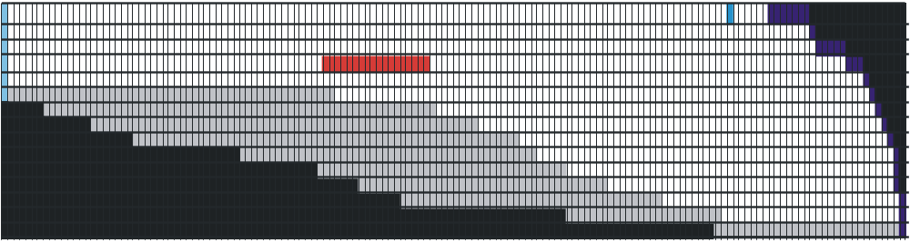
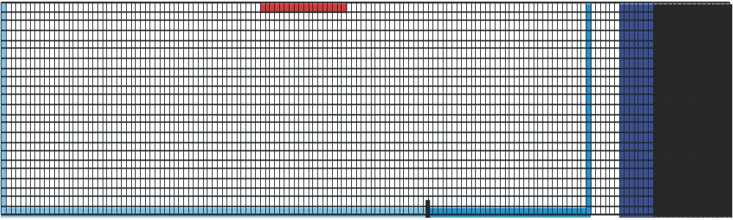
Cross Sectional View
Connection to
Everglades
Ocean
Well Field
Biscayne
Aquifer
Lower Surficial
Aquifer System
Map View
Well Field
Intracoastal
Ocean
Connection to
Everglades
Upstream Stage
Downstream Stage

Slide 18
Calibrating Model to Data
Attempt to match
N
I
n
t
e
r
c
o
i
d
a
l
a
s
t
a
l
l
d
T
a
n
a
l
W
e
l
l
F
i
e
Control
C
O
c
e
C
a
n
a
l
Structure
a
n
Biscayne
C
o
n
n
e
c
t
i
o
n
Aquifer
t
o
Lower Surficial
E
v
e
r
g
l
a
d
e
s
Aquifer
112.5m
.
8
k
m
2
2
3
.
4
5
k
m

Slide 19
Evaluation Scenarios
Simulation 1: 10-Year Representative Model
Simulation 2: Canal Stage Changes
Simulation 3: Sea Level Rise
Simulation 4: Drought/Increase Pumpage

Slide 20
Simulation 1: 10-Year Representative Model
120 monthly stress periods
Data from years 1990-1999 Prospect well-field area

Slide 21
Simulation 1: Representative Model
Results

Slide 22
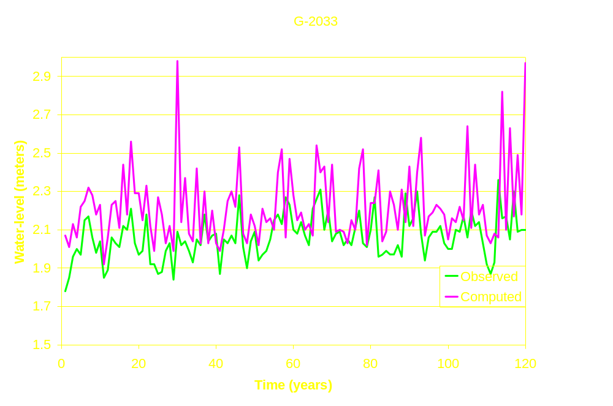
Water Levels

Slide 23
Upstream Flows
Observed ~31MGD
Simulated Constant Ocean ~121,127m3/day or 32MGD

Slide 24
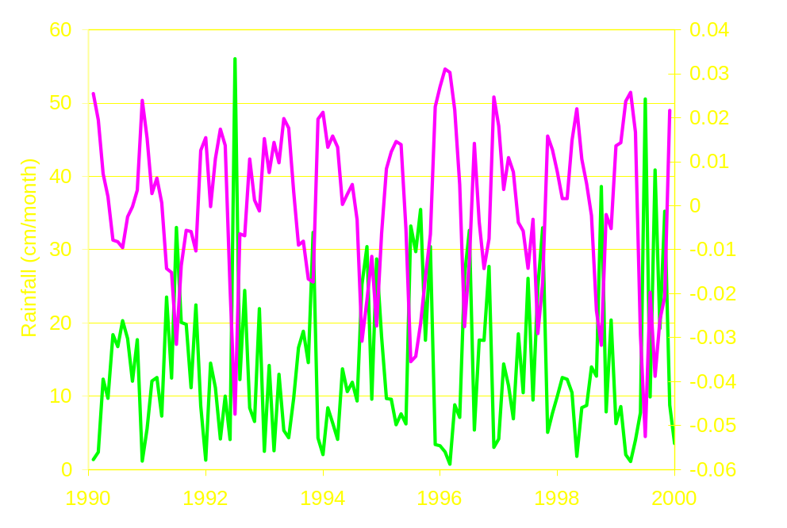
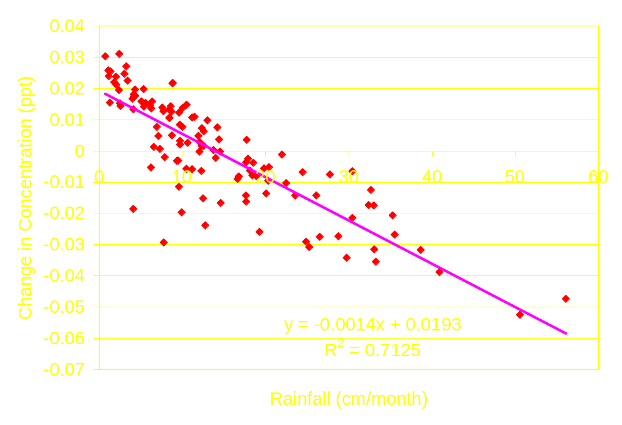
Observation well near well field
Rainfall
Rainfall vs Change
In Concentrations
Change in
Trend Line
Concentrations

Slide 25
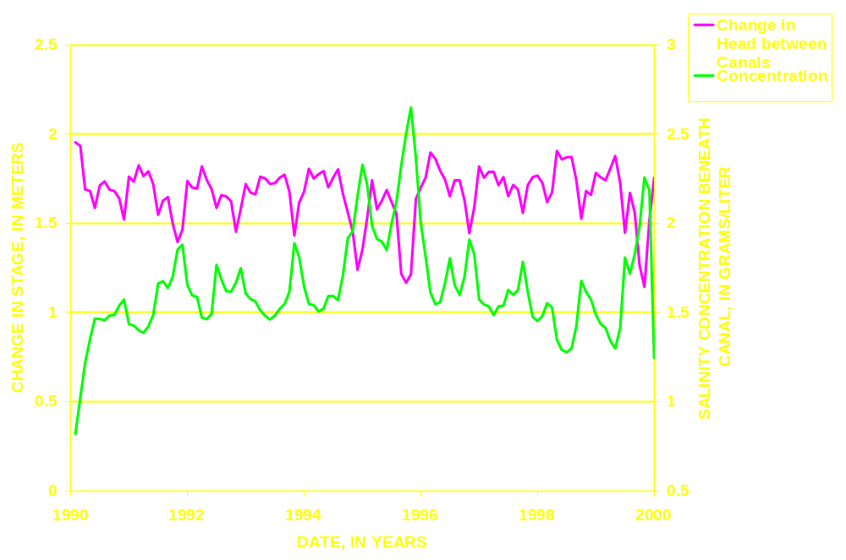
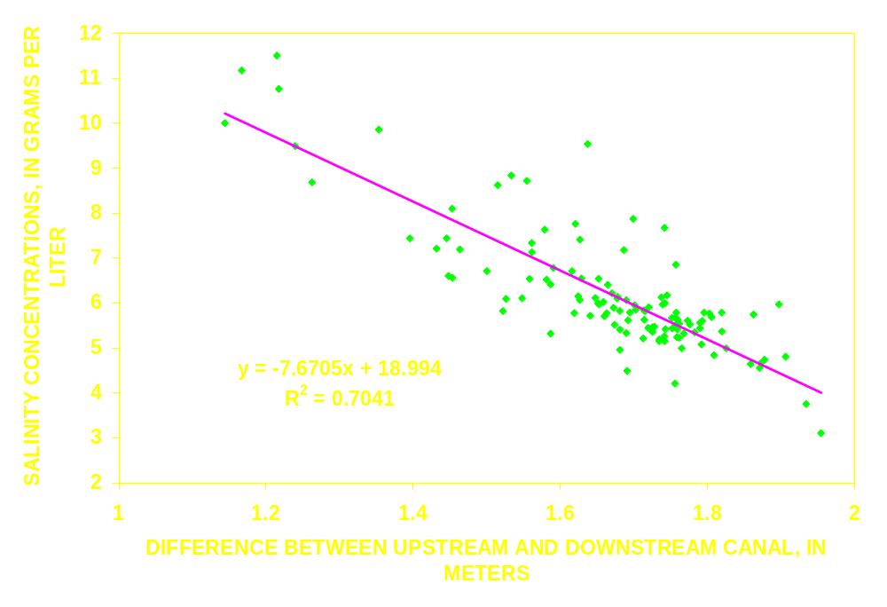
Observation point beneath canal

Slide 26
Results from Simulation 1
Rainfall appears to have greatest effect on saltwater intrusion near well field
Upstream canal stage appears to have greatest effect on saltwater intrusion near canal

Slide 27
Evaluation Scenarios
Simulation 1: 10-Year Representative Model
Simulation 2: Canal Stage Change
Simulation 3: Sea Level Rise
Simulation 4: Drought/Increase Pumpage

Slide 28
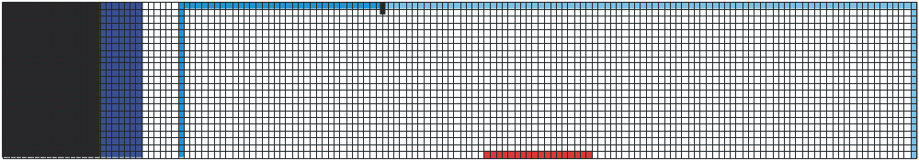
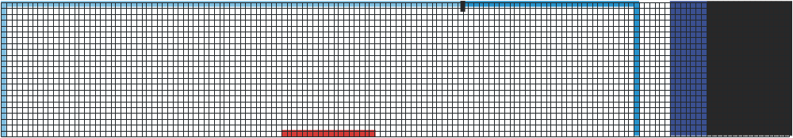
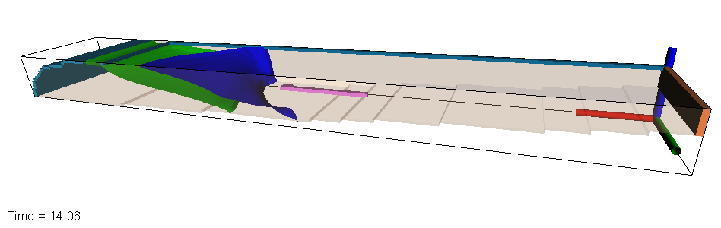
7
Equilibrium
Average Upstream Canal Stage
6
5
4
Canal Stage
Drop 1-foot
Canal Stage
Raised 1-foot
3
2
Average Downstream Canal Stage
1
0
Time in Years
-50
-40
-30
-20
-10
0
10
20
30
40
50
60
70
80
90
100
110
120
130
140
N
Control Structure
N
N
Ocean
Well Field
Salt Water
Interface

Slide 29
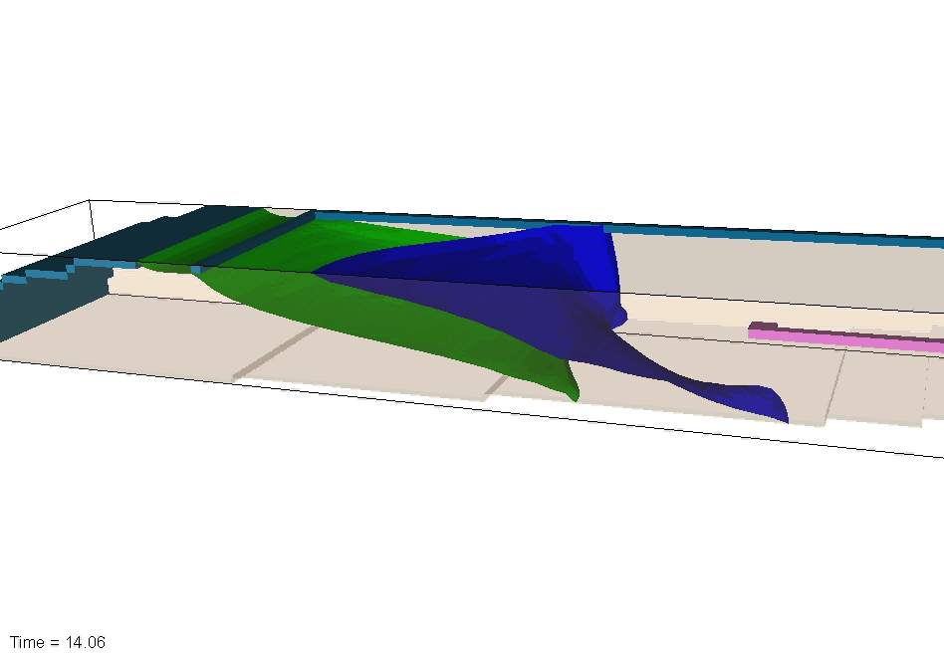

Slide 30
Results
It takes 50 years after 1-foot decrease in upstream stage for interface to reach equilibrium
It takes 90 years after 1-foot increase in upstream stage for interface to reach equilibrium

Slide 31
Evaluation Scenarios
Simulation 1: 10-Year Representative Model
Simulation 2: Canal Stage Change
Simulation 3: Sea Level Rise
Simulation 4: Drought/Increase Pumpage

Slide 32
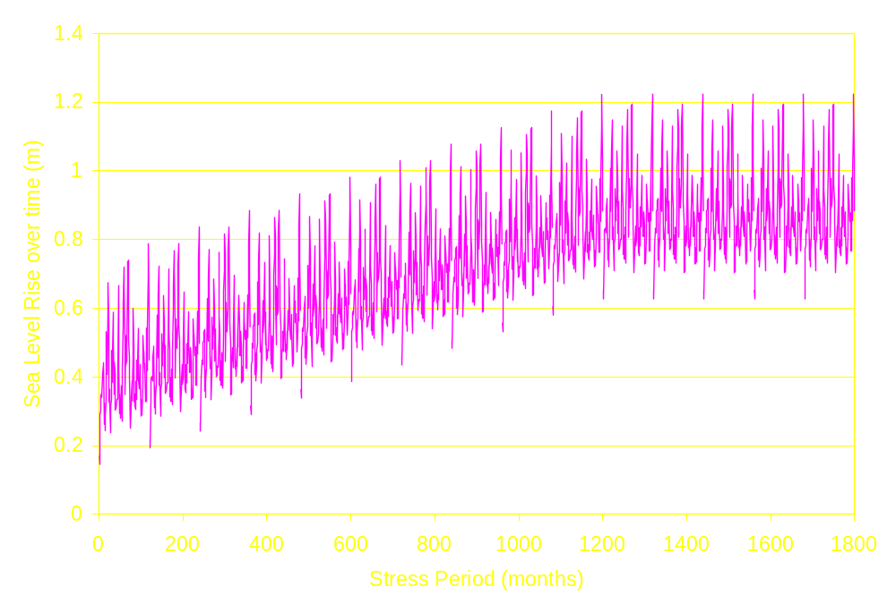
Simulation 3: Sea Level Rise
Gradually increase sea level 19 inches over 100 years
Keep sea level stable for remaining 60 years (to equilibrium)
100 years
60 years

Slide 33
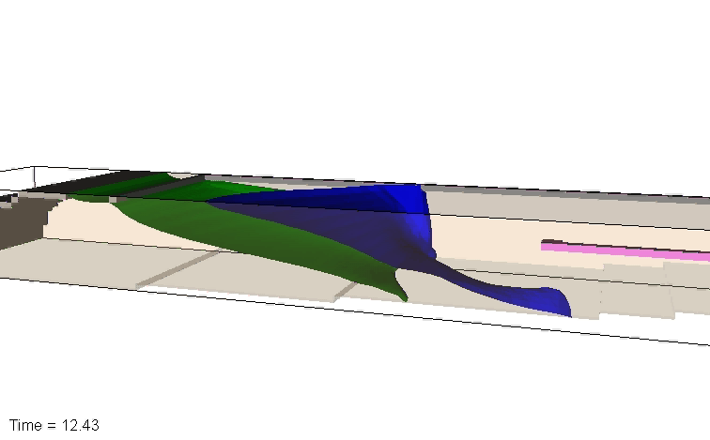

Slide 34
Results from sea-level rise
Well-field is contaminated after a 19 inches of sea-level rise

Slide 35
Evaluation Scenarios
Simulation 1: 10-Year Representative Model
Simulation 2: Canal Stage Change
Simulation 3: Sea Level Rise
Simulation 4: Drought/Increase Pumpage

Slide 36
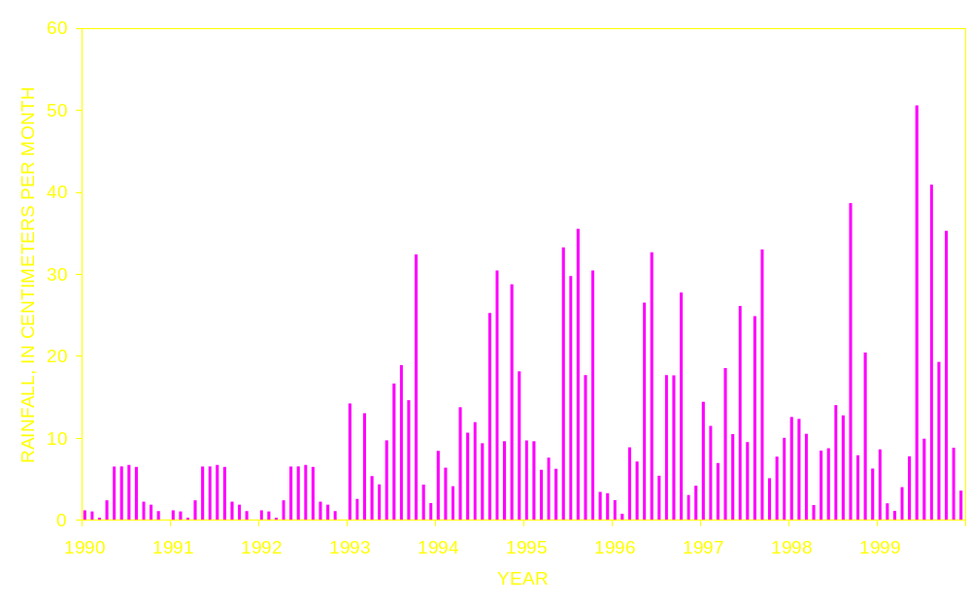
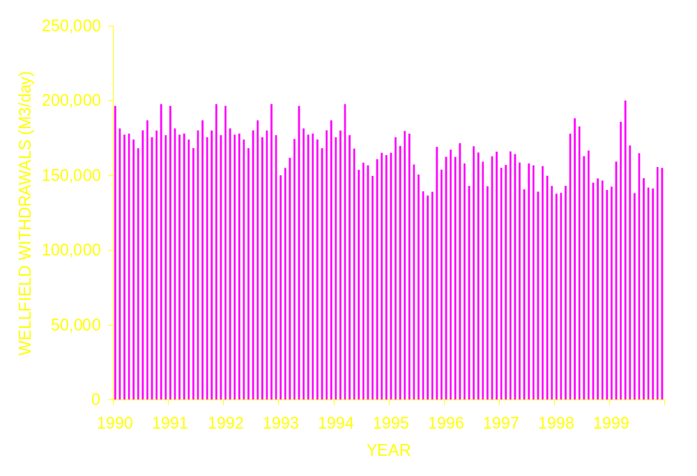
Simulation 4:
Drought/
Increased
Pumpage
Rainfall
Pumpage

Slide 37

Results- little interface movement
Map view
Well field
250 mg/l Chloride
concentration contour
N
Lines at t=1, 3, 5, 8, 10 years
Upstream Canal
Downstream Canal

Slide 38
Broward County Model

Slide 39
Goals with Broward County Model
Convert existing FLOW model to a variable-density model
Outline steps for the conversion
Observe equilibrium saltwater interface position based on water levels

Slide 40
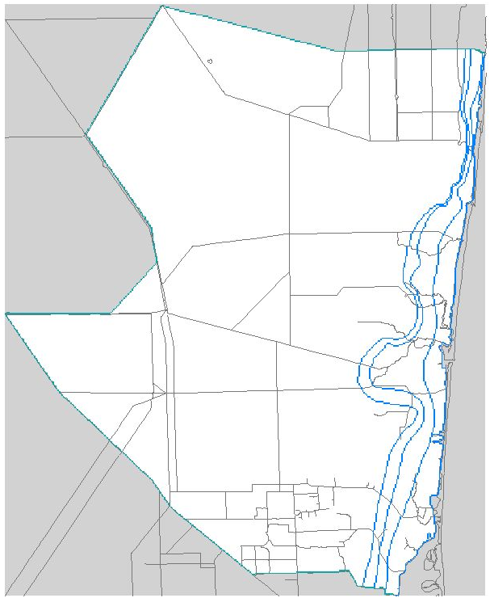
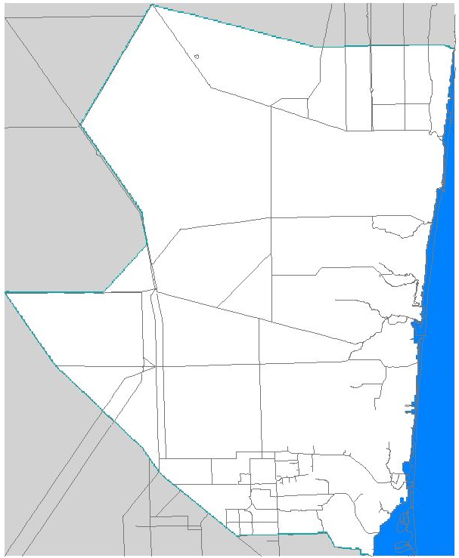
Broward County Model
Boundaries in the SFWMD Modflow model.
Boundaries in the USGS SEAWAT model.
Wetlands
Wetlands
ACTIVE
ACTIVE
Inactive
INACTIVE
INACTIVE
OCEAN

Slide 41
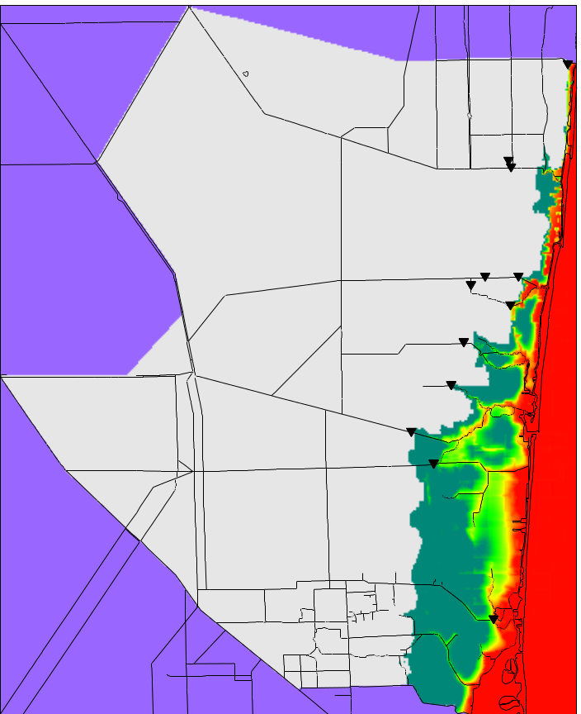
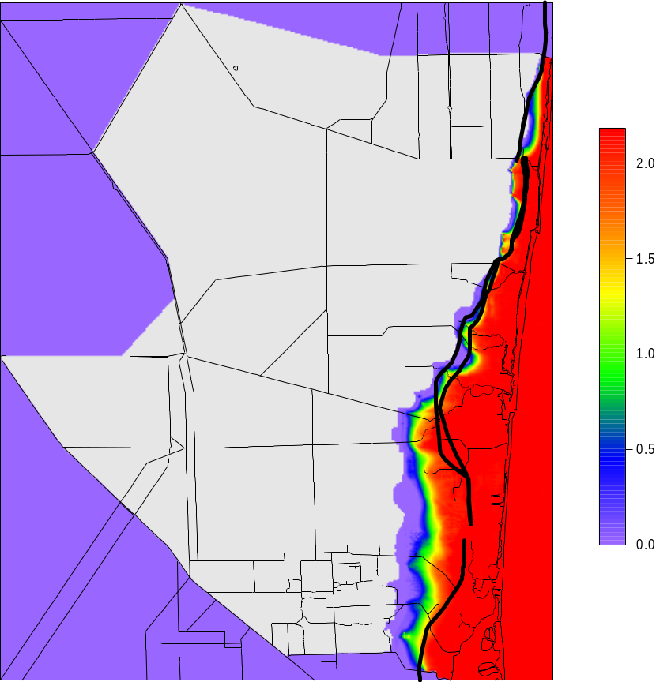
Model Results
Layer 2
Layer 4
35
17.5
0

Slide 42
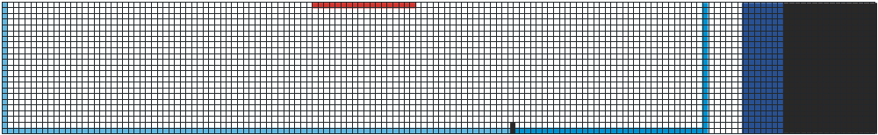
Conclusions…
For periods of less than 10 years:
Rainfall appears to have greatest effect on saltwater intrusion near well field
Upstream canal stage appears to have greatest effect on saltwater intrusion near canal

Slide 43
Conclusions… (Cont.)
Upstream canal stage has greatest effect on long-term (>10years) movement of the saltwater interface
“Permanent damage” to the Biscayne aquifer is a threat—it takes longer to move interface out than it does for it to intrude
Sea-level rise will likely contaminate well fields if it rises around 19 inches in the next 100 years
A short-term drought (<3 years) with increased pumpage will likely not have a long-term affect on saltwater intrusion in the Biscayne aquifer

Slide 44
?

Slide 45
7
Equilibrium
Average Upstream Canal Stage
6
5
4
Canal Stage
Drop 1-foot
Canal Stage
Raised 1-foot
3
2
Average Downstream Canal Stage
1
0
Time in Years
-50
-40
-30
-20
-10
0
10
20
30
40
50
60
70
80
90
100
110
120
130
140
N

