Slide 1
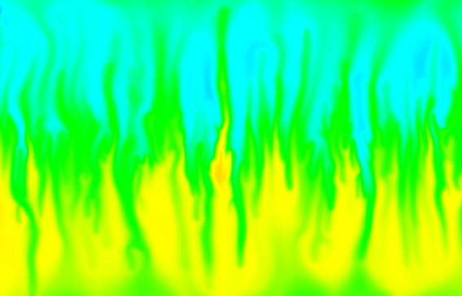
Modeling Solute and Heat Transport with SEAWAT: Henry-Hilleke
SEAWAT workshop for SWIM21
June 16-20, 2010
Azores

Slide 2
Henry-Hilleke Problem
Temperature and salinity variation of the Henry (1964)
Laboratory Problem-never (before) been numerically simulated
Numerical Problem
Hughes and Sanford (2004)
Dausman et al. (2009)

Slide 3
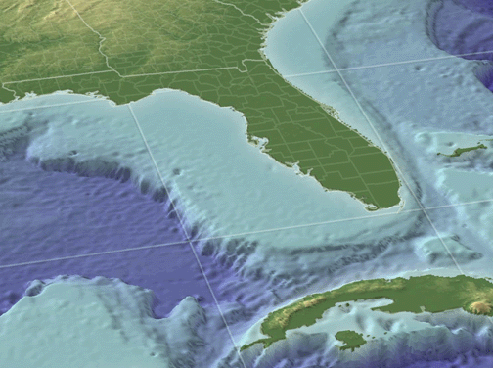
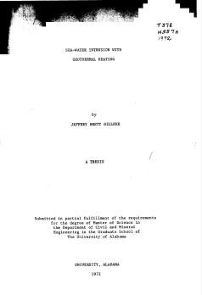
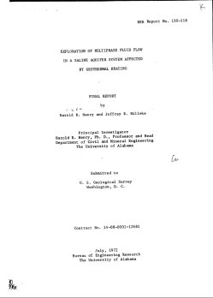
Henry-Hilleke Laboratory Problem
Only laboratory experiment that includes
Heat transport
Solute transport
Variable-density flow
Density is a function of T and C
Motivation
Floridan Aquifer System
Reported in
Henry and Hilleke (1972)
Hilleke (1972)

Slide 4
Laboratory Experiment
366 cm
15 cm wide
122
cm
SEAWAT
representation

Slide 5
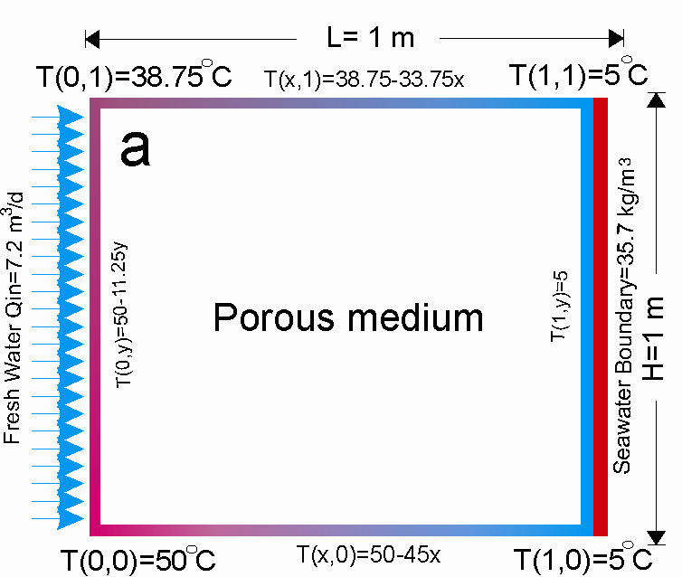
Henry-Hilleke Numerical Model
Generalization of the Laboratory Experiment
2-D cross sectional model representing half of a carbonate platform
41 col, 41 lay, 1 row
1 meter by 1 meter

Slide 6
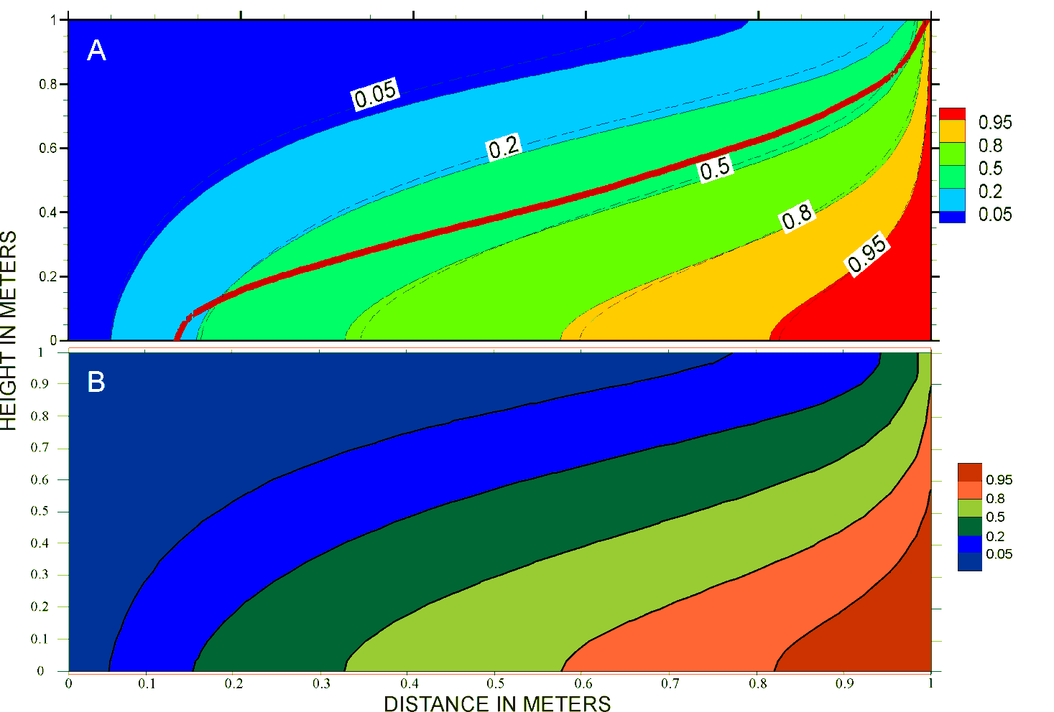
Numerical Salinity results

Slide 7
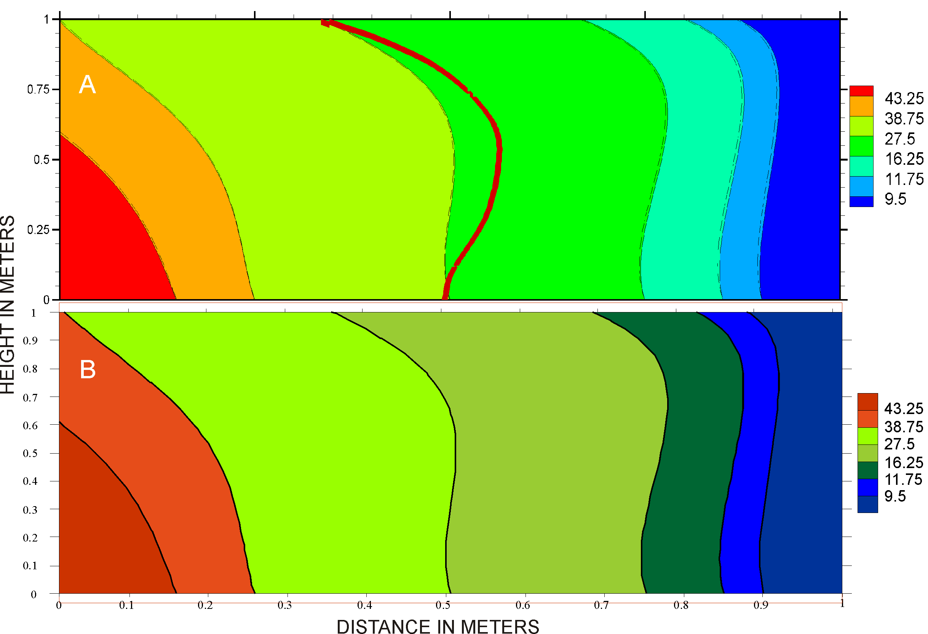
Numerical Temperature results

Slide 8
SEAWAT simulation of laboratory experiment
2-D SEAWAT model for laboratory 130 col, 49 layers, 1 row

Slide 9
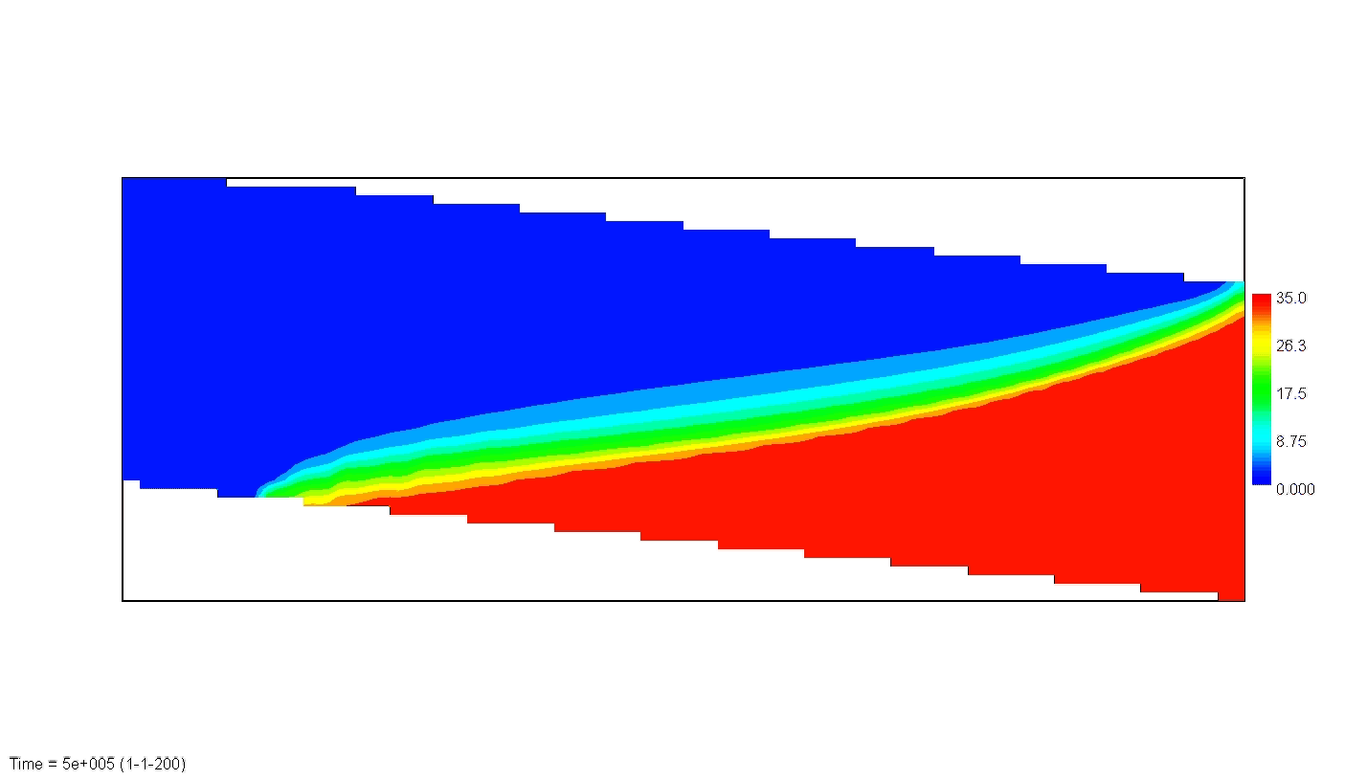
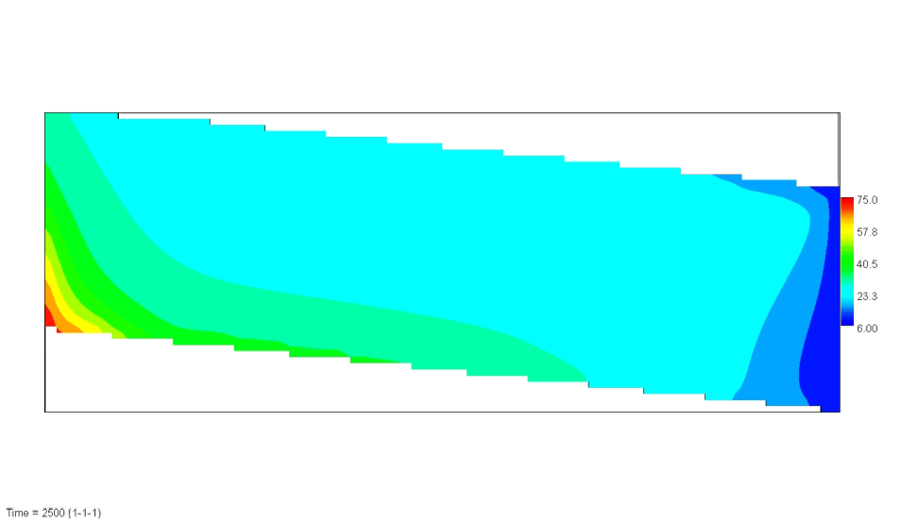
salinity
2-D SEAWAT results simulating
laboratory experiment
temperature

Slide 10
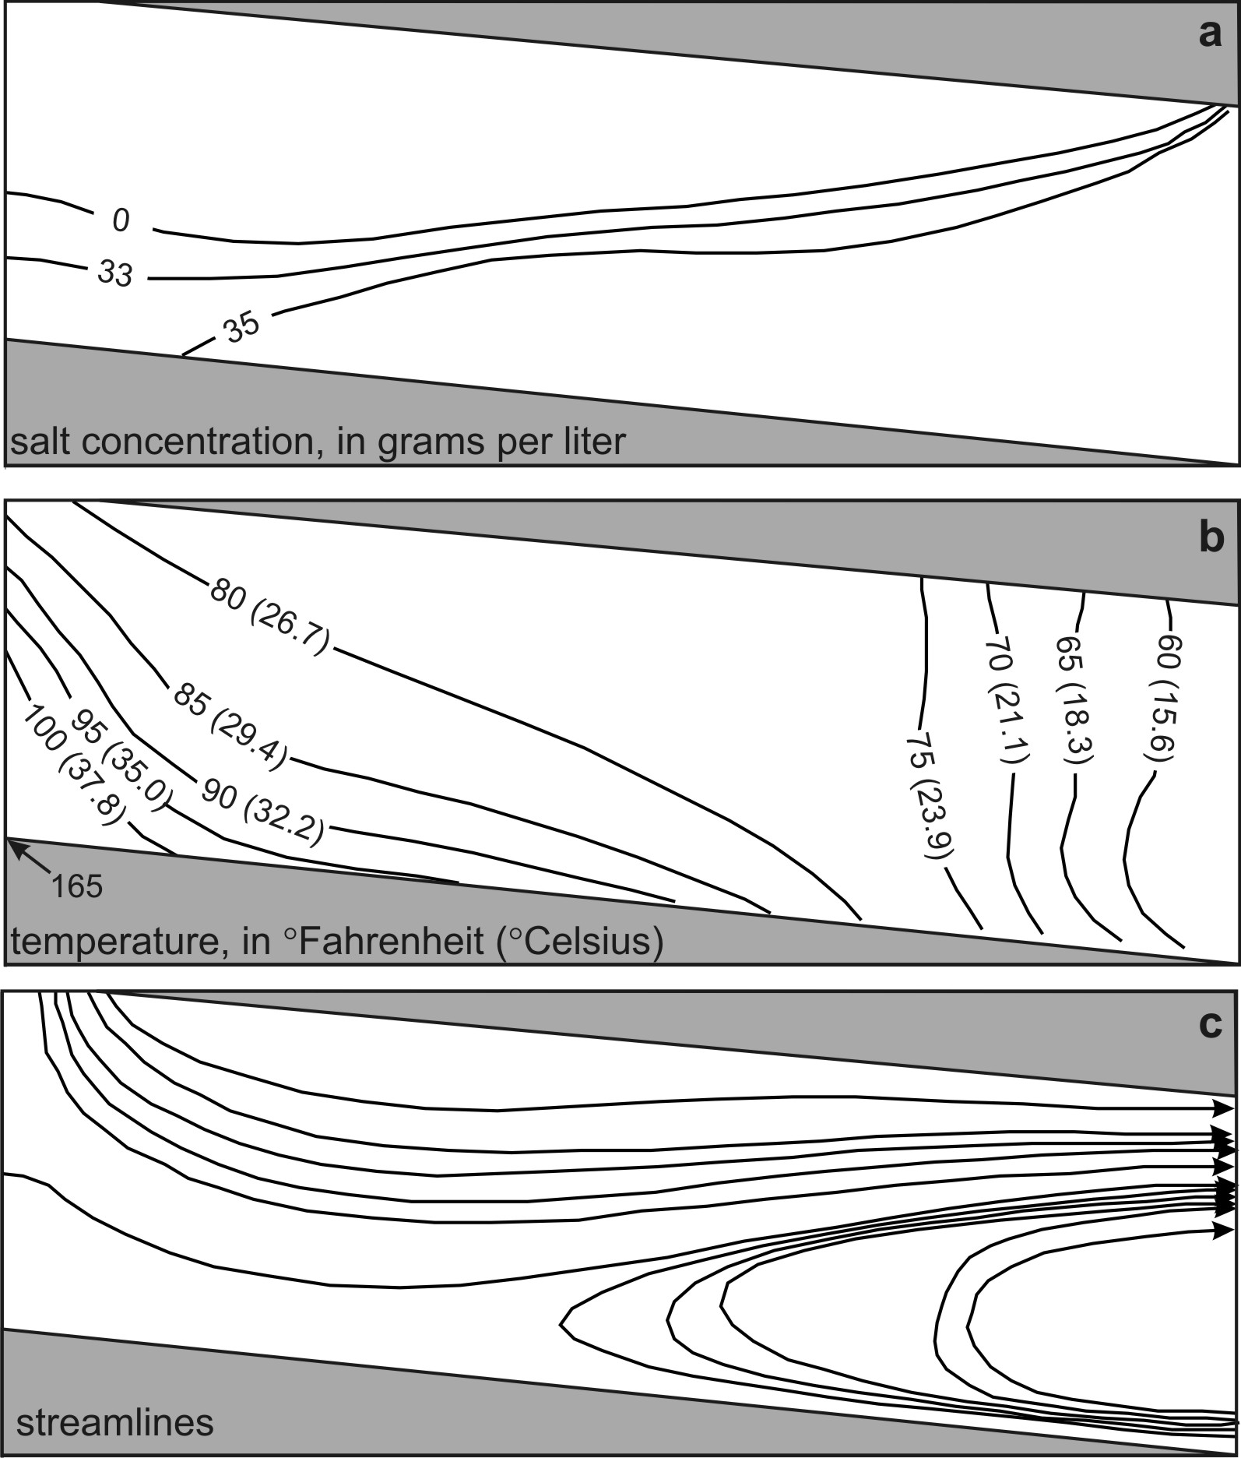
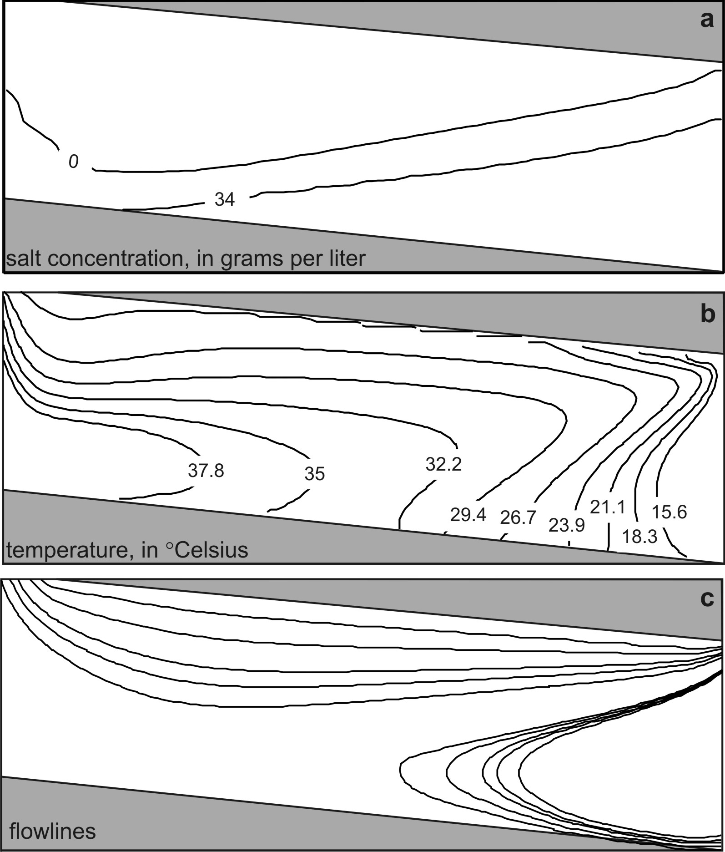
Comparison with 2-D SEAWAT model
laboratory experiment
SEAWAT

Slide 11
What’s wrong?
2-D SEAWAT model for the Henry-Hilleke numerical model benchmarks well, however…
2-D SEAWAT model for laboratory experiment does not match
Could it be because of the third dimension?
Could heat be lost to the room?

Slide 12
3-D SEAWAT Model
Add a third dimension to simulate heat loss to the room from the tank (5 rows )
Recorded room temperature assigned to row 5 as constant temperature boundary
This allows simulation of “heat loss” to the room

Slide 13
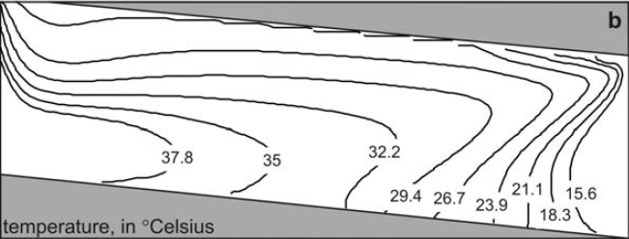
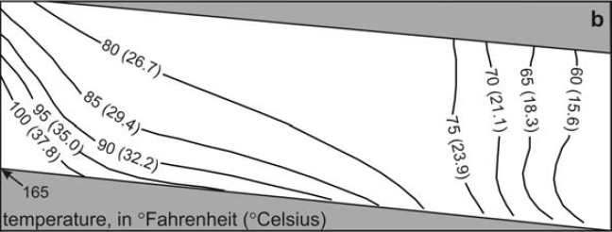
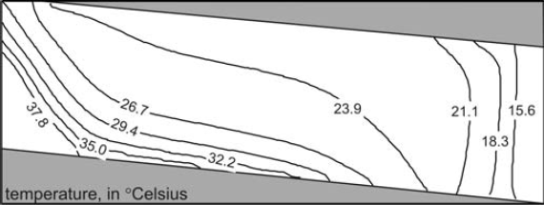
Temperature Discrepancy
2D SEAWAT Model
laboratory experiment
3D SEAWAT Model

Slide 14
Results
This is the first numerical simulation of a laboratory experiment that includes solute and heat transport
Simulating a heat transport laboratory experiment is more complicated because (unlike solute) heat can be lost to the surroundings

