Slide 1
Parameterization of an Initial Concentration Field for SEWAT
Alyssa Dausman

Slide 2

Initial concentrations
We typically develop steady-state model run to get initial concentrations
Can take a long time to get initial conditions
How accurate are they?
If you don’t include a tidal signal and then add one for a transient model, initial interface location may be incorrect
Dispersion of salts across interface can be incorrect (too thick) after long run
Case 1
Base Case - Case 1
S
R
0
0
E
T
a
b
E
M
N
-
5
0
-
5
0
I
,
N
O
I
T
A
-
1
0
0
-
1
0
0
V
Contours of concentration (ppt)
E
L
10000
12000
14000
16000
18000
20000
22000
10000
12000
14000
16000
18000
20000
22000
E
X-DISTANCE, IN METERS
X-DISTANCE, IN METERS

Slide 3

PEST utility designed to quickly create initial concentrations: ELEV2CONC
Groundwater Data Utilities: Part B
ELEV2CONC:
Computes a sequence of initial concentration arrays (one for each model layer) based on a user-supplied freshwater/saltwater interface elevation array, and (spatially varying) thickness of the interface.

Slide 4
What needs to be provided to ELEV2CONC
Grid specification file: File providing information about the grid
# Model layers
Active cells in each model layer (for example IBOUND for each layer)
Base of layer bottom elevations (from DIS file)
Interface elevation array file: file that provides the elevation of the “center” of the interface in model area. One elevation value for every cell in the model. This can be estimated from data collected in the field
Can use PPK2FAC and FAC2REAL from PEST

Slide 5
For Example:
Estimate:
Depth to interface at site
Take all these field values and use PPK2FAC and FAC2REAL to get interface elevation array file
Might need to use “dummy points”
It can be part of the calibration process or provided by your

Slide 6
What needs to be provided to ELEV2CONC cont…
Freshwater concentration
Seawater concentration
Width of interface (can be estimated as part of the calibration process or provided by you)
Nature of concentration variation across interface

Slide 7
ELEV2CONC
Example
response file
Explanation
grid.spc
17
4,17
ibound
bottom
elev_wells.ref
3
1.85E+02
0
35
conc
uconc.ucn
conc
Grid specification file
Number of layers in model
Upper and lower layers for present analysis
Filename base for activity arrays in “integer array file” (ibound4.inf, ibound5.inf, ibound6.inf, etc..)
Filename base for layer bottom elevations “real array file” (bottom0.ref, bottom1.ref, etc…)
Real array file with elevation of interface (50% freshwater, 50% seawater)
Nature of interface: Enter nature of concentration variation across interface:-
if linear - enter 1
if sigmoidal - enter 2
if exponential - enter 3
Width of interface
Freshwater Concentration
Seawater Concentration
Filename for formatted output files (ELEV2CONC will write concentrations into conc4.ref, conc5.ref, conc6.ref, etc…)
Filename for unformatted output file (*.UCN)
Existing conc array filenam for unanalyzed layers (conc1.inf, conc2.inf, conc3.inf)

Slide 8
EXAMPLE Model:
SEAWAT Batch
PEST.EXE
Create Interface
Elevation Array from DATA
FAC2REAL
Create initial
concentration field
ELEV2CONC
Input concentrations
to model through
BTN package in
SEAWAT.NAM file
Process model output
MOD2OBS
SWT_V4.exe

Slide 9
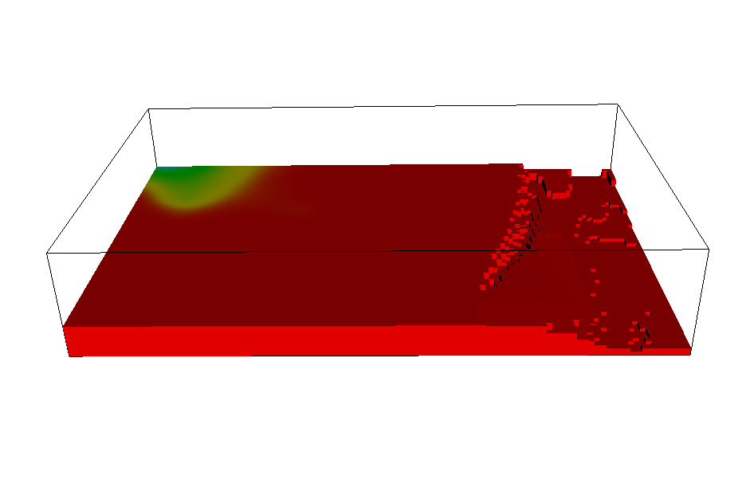
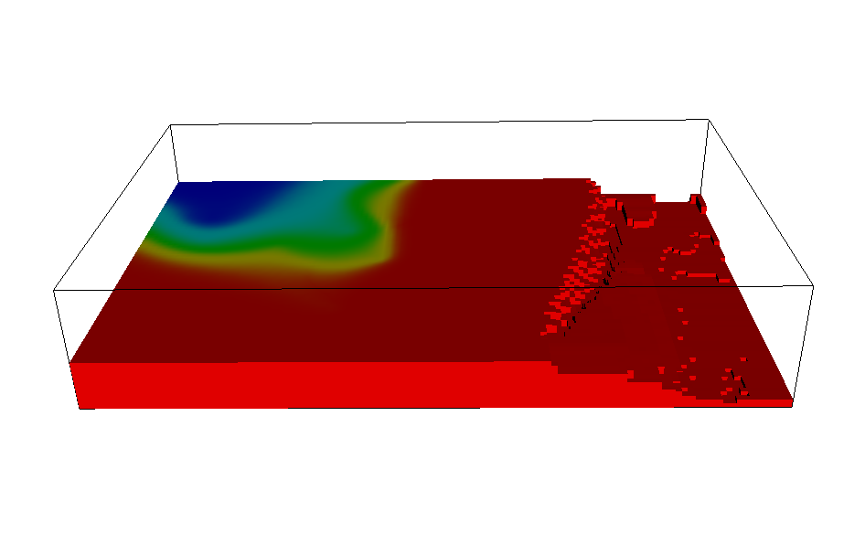
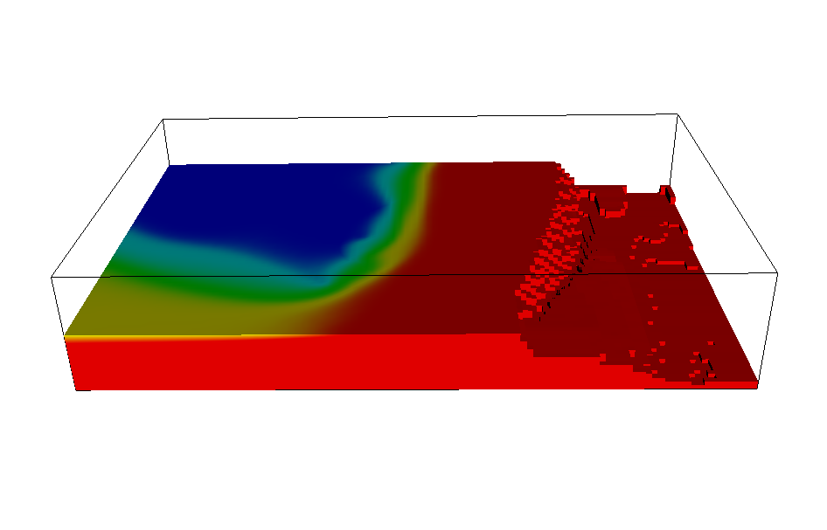
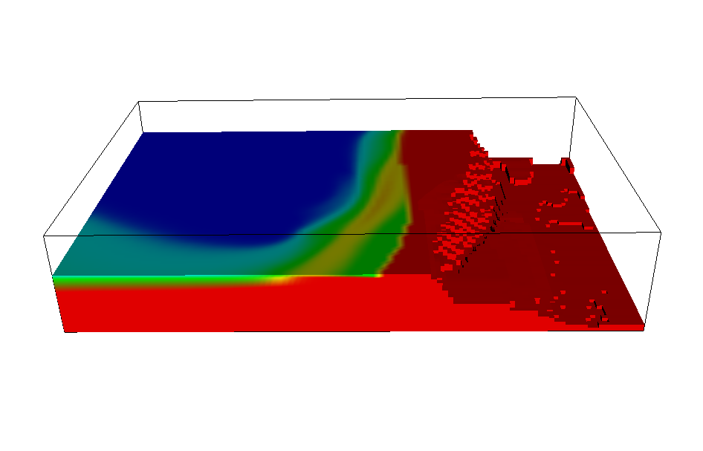
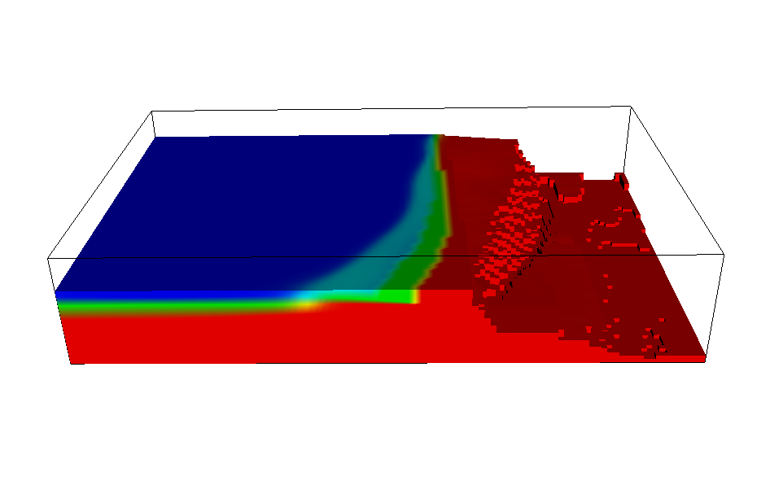
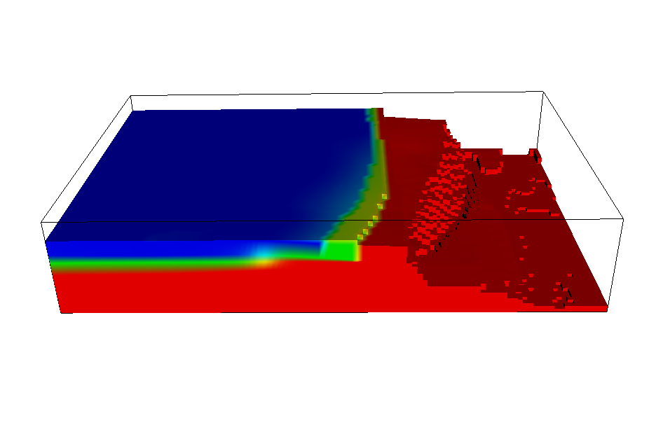
Example of Results:

Slide 10
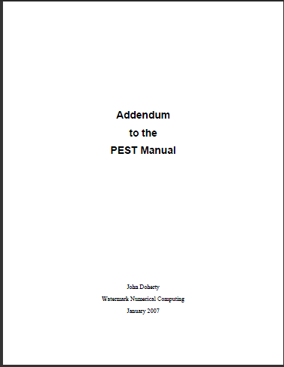
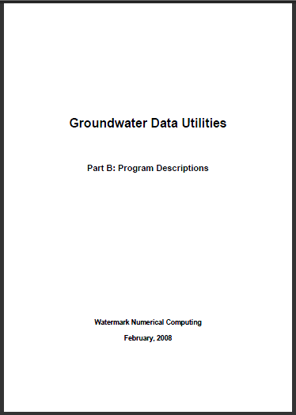
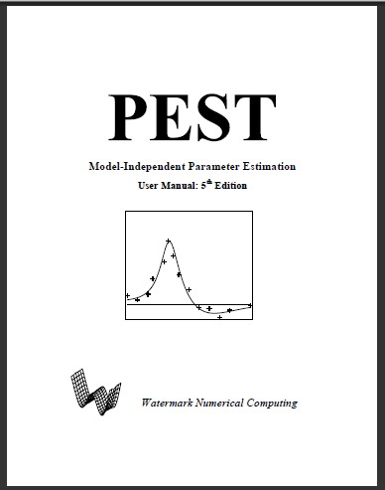

All instructions in four PEST manuals
Directions for using parameters estimation (optional): PEST manual and Addendum to PEST manual
Format of input files: Groundwater Utilities A
For example: Grid Specification File
ELEV2CONC: Groundwater Utilities B

Slide 11
Advantages
Disadvantages
Quick initial conditions
Coordinated with field data
Can be part of the estimation process
May not be accurate for long-term transient runs
Interface may move after model “begins” running if parameterization doesn’t support initial concentration field

