Slide 1

Application of Null Space Monte Carlo to a salt water intrusion model
PEST-conference, Bethesda 2009
Daan Herckenrath, Christian Langevin, John Doherty

Slide 2

Background
Salt water intrusion models require many input parameters, which can contain large uncertainties
Many different parameter sets often calibrate the model
Efforts to quantify prediction errors of such models are scarce

Slide 3
Objectives
Prediction uncertainty assessment of a salt water intrusion model using Null Space Monte Carlo (NSMC)
Test different implementations of the NSMC method for its effectiveness/efficiency

Slide 4
Null Space Monte Carlo
Developed by (Tonkin and Doherty, 2009) in order to decrease the numerical burden of a calibration-constrained MC to quantify predictive uncertainty for highly parameterized models

Slide 5
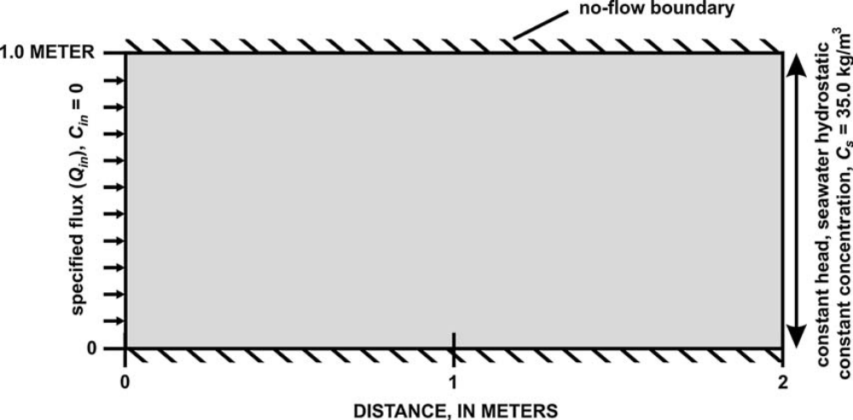
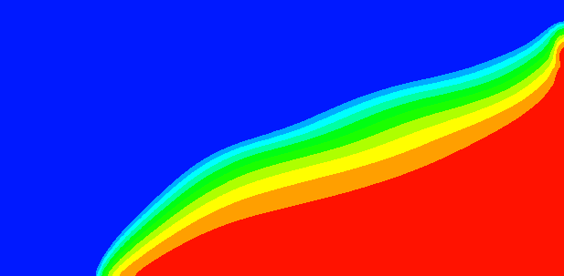
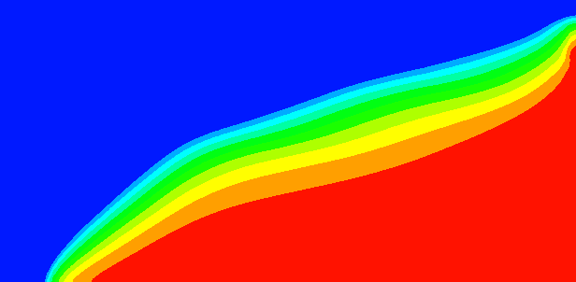

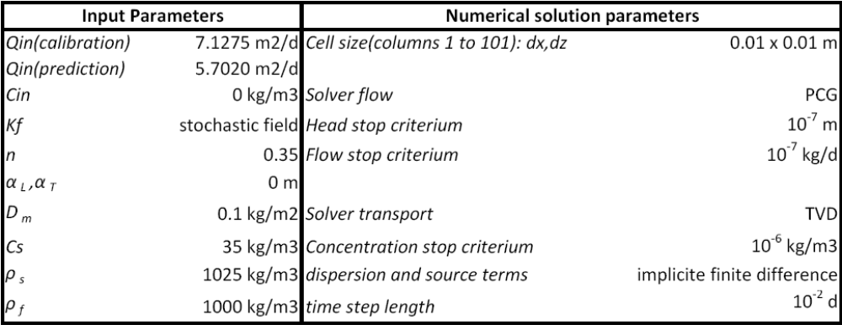
Salt water intrusion model
Based on Henry problem
Simulations performed with SEAWAT (Langevin et al., 2008)
Prediction: position 10% seawater line after reducing the freshwater flux Qin
Stress-period 1
Stress-period 2
2 stress-periods
Figure: Langevin et al., 2006
Notes:
For testing the Null space MC for a saltwater intrusion model I selected the Henry-problem, which well-known within the community of variable density flow modelers for benchmarking and the application of new concepts

Slide 6
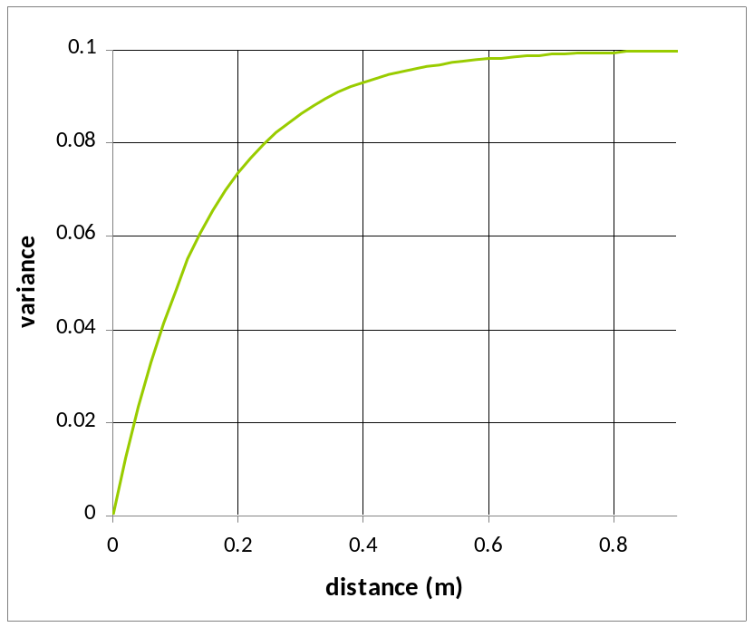
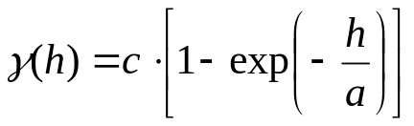
Unconstrained Monte Carlo analysis
1000 stochastic realizations for the hydraulic conductivity
Based on an exponential variogram and a specified mean of 824 m2/d
a=0.15m
c=0.1

Slide 7
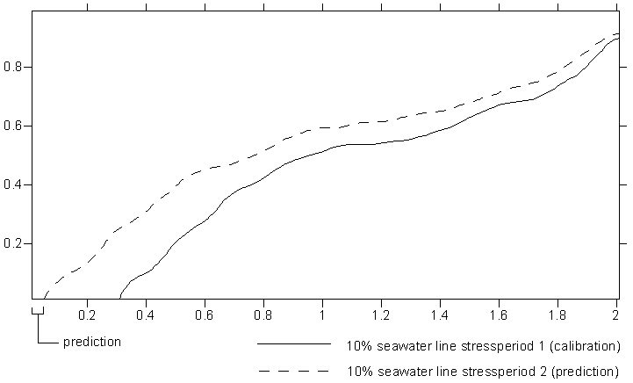
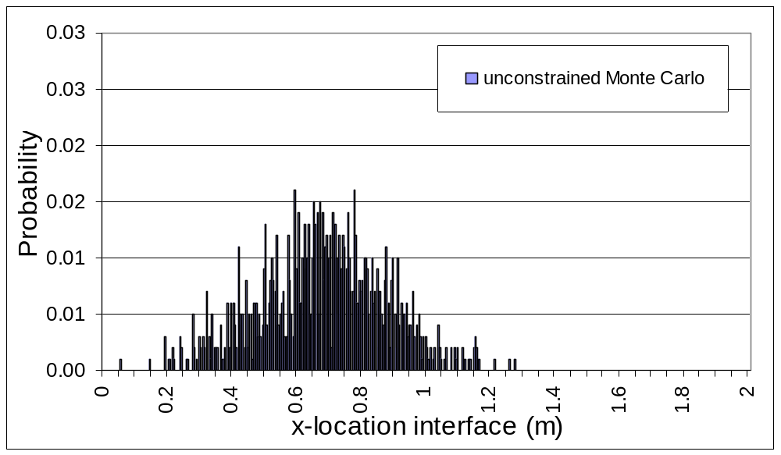
Unconstrained Monte Carlo analysis
Result unconstrained MC:
  1000 predictions with regards to the position of the 10% seawater line after reducing Qin with 20%
= 0.05 m
Notes:
Since this case of salt water intrusion has such a low likelihood, this would be very difficult to approximate in a real-world modeling context. For that purpose we selected the stochastic hydraulic conductivity field giving rise to this extreme case of salt water intrusion as the true hydraulic conductivity in order to test the NSMC methodology for quantifying predictive uncertainty in a challenging way.

Slide 8
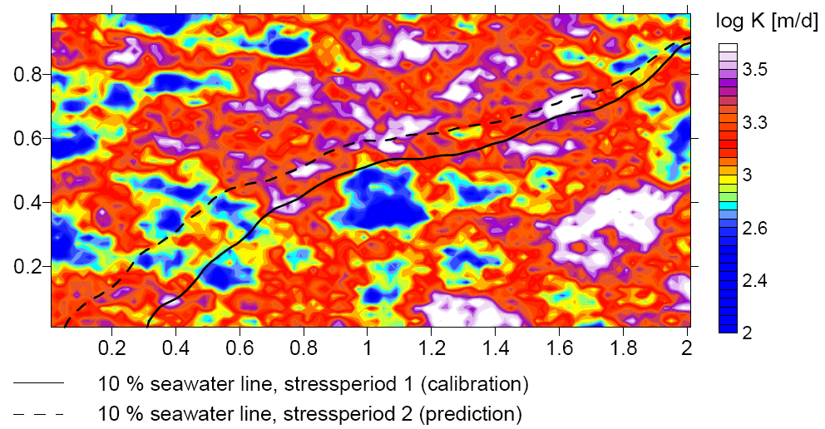
Selection of a synthetic truth
From the results of the unconstrained MC, one realization is selected as our truth, this being the hydraulic conductivity field resulting in the farthest inward movement of the 10% seawater line
Notes:
Observations calculated on the basis of this hydraulic conductivity field comprised the calibration dataset.

Slide 9
Application & testing Null Space Monte Carlo
Can NSMC method capture the true prediction value of 0.05 m within its calculated uncertainty bounds?
Procedure:
  Model calibration
  Generation of random parameter sets and difference fields
  Divide parameter space in solution space and null space components
  Null space-projection of random parameter sets
  Recalibration of null space-projected sets

Slide 10
1. Model calibration
Parameters:
  Pilot points at 50 locations
  Initial parameter values (mean stochastic fields)
  Preferred value regularization
Observation data:
  Heads and concentrations at 12 locations based on simulation results with the “true hydraulic conductivity field”
  Noise added
  Observation weights: 1/(standard deviation noise)
Notes:
For the model calibration pilot points at 50 locations were employed and 12 observation points. At each observation point a head and concentration value was available, based on the simulation results using the depicted truth. Subsequently noise was added to these observations

Slide 11
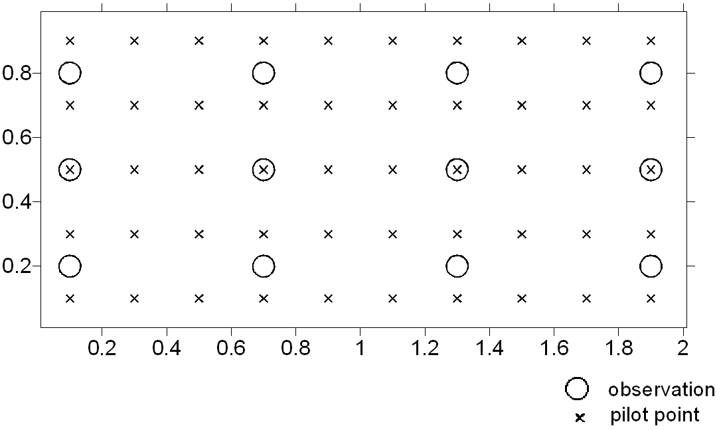
Model calibration

Slide 12
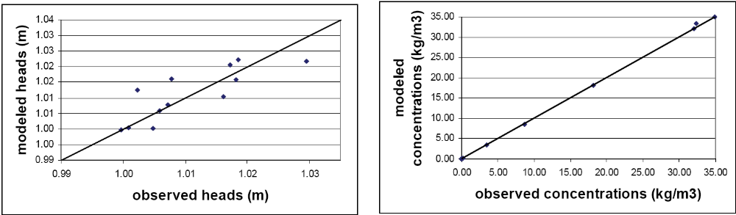
Model calibration
Modeled vs. observed heads and concentrations:

Slide 13
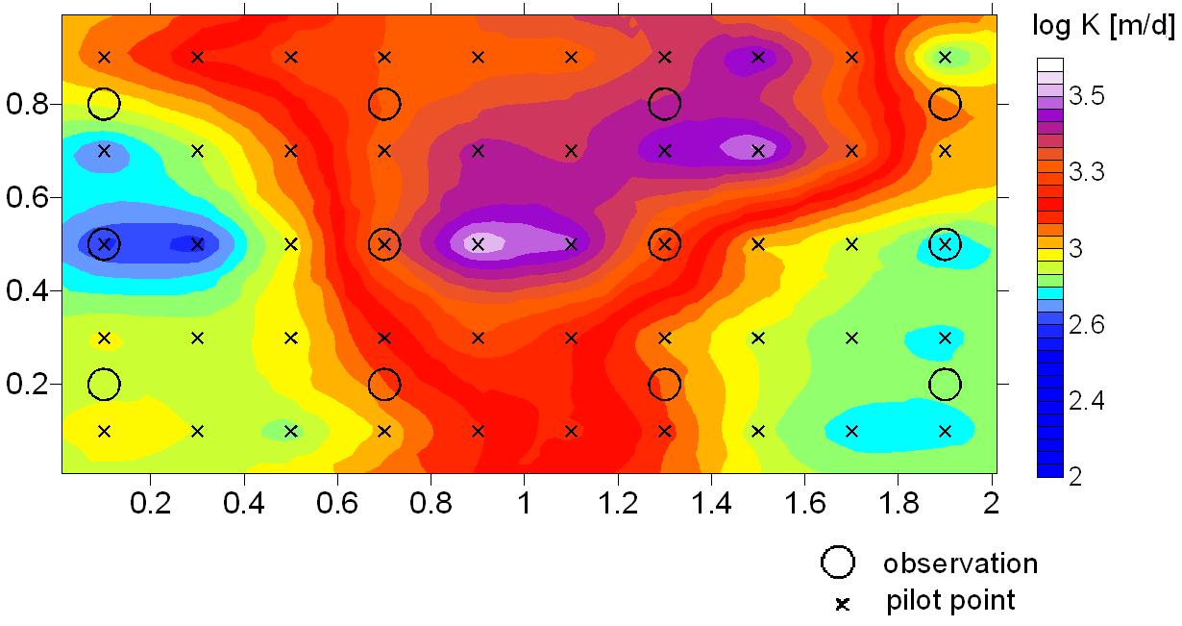
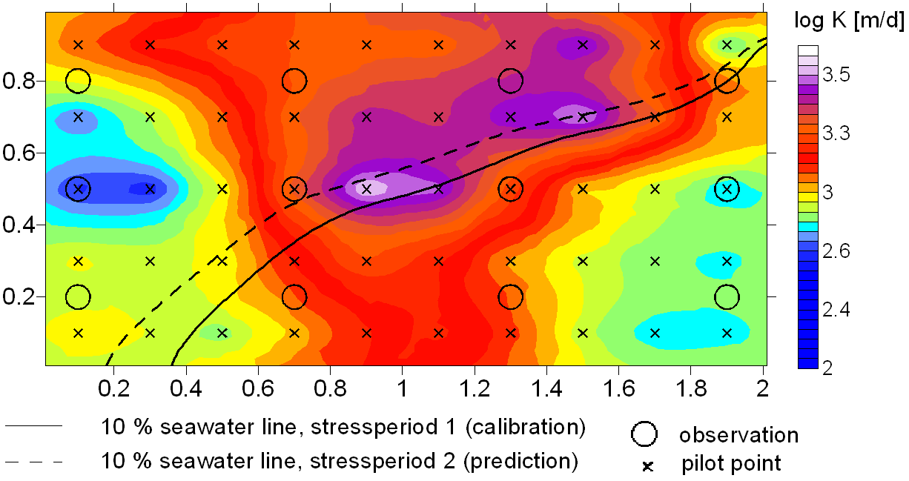
Model calibration
Prediction based on calibrated model: 0.18 m (truth 0.05 m)

Slide 14
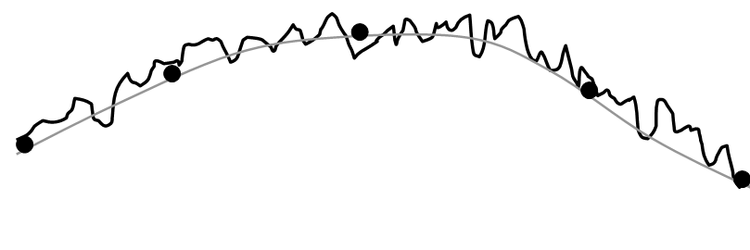
2. Generation of parameter realizations and associated difference fields
Generation of 1000 random parameter sets:
  Sampling at pilot point locations of 1000 stochastic fields
Generation of difference fields:
  Purpose: Add intra-pilot point scale heterogeneity
Stochastic field
Fitted smooth curve
Pilot points
Notes:
Smooth curve is the result of an interpolation at all pilot point locations, in order to get the closest match between the smooth curve and the stochastic field. Then differences between the smooth and stochastic field are recorded to add intra-pilot point heterogeneity within the recalibration process of the nullspace projected parameter sets. Direct sampling can also be applied, however, the difference field seems to be rather located within the null space of your calibrated model.

Slide 15
3. Division of parameter space into solution space and null space components
Parameter space:
  Calibration sensitive + calibration insensitive parameter-combinations (calibration solution space +calibration null space)
PEST’s utility SUPCALC applied:
  Determine which parameter combinations are associated with the calibration solution space
  Result: 5 calibration-sensitive parameter-combinations
Notes:
SUPCALC separates solution and null spaces according to the pre- and post-calibration error variance of each orthogonal parameter combination spanning parameter space as calculated through singular value decomposition. Where the post-calibration error variance exceeds its pre-calibration error variance, the pertinent parameter combination is assigned to the null space

Slide 16
4. Null space projection of random parameter sets
PEST’s utility PNULPAR applied:
  Create parameter sets, from which null space components are retained and solution space components are replaced with that of the calibrated parameter field
Solution space dimensionality has to be defined during this operation:
  Roughly equal to number of calibration sensitive parameter combinations
  Maximum dimensionality = number of observations
Notes:
Dimensionality of the solution space is roughly equal to the number of super parameters, calculated based on the. random parameter sets are generated, from which null space projections will be retained and solution space projections will be replaced with that of the calibrated parameter field

Slide 17
5. Recalibration of null space projected parameter sets
Only parameter combinations within the calibration solution space are adjusted
First optimization iteration involves no model runs
During the recalibration, difference fields are added to the pilot-point interpolated fields

Slide 18
Different implementations of NSMC
Scenario’s:
  Solution space dimensionality (SSD) of 5, no difference fields used
  Solution space dimensionality (SSD) of 5, difference fields used
  Solution space dimensionality (SSD) of 13, no difference fields used
  Solution space dimensionality (SSD) of 13, difference fields used

Slide 19
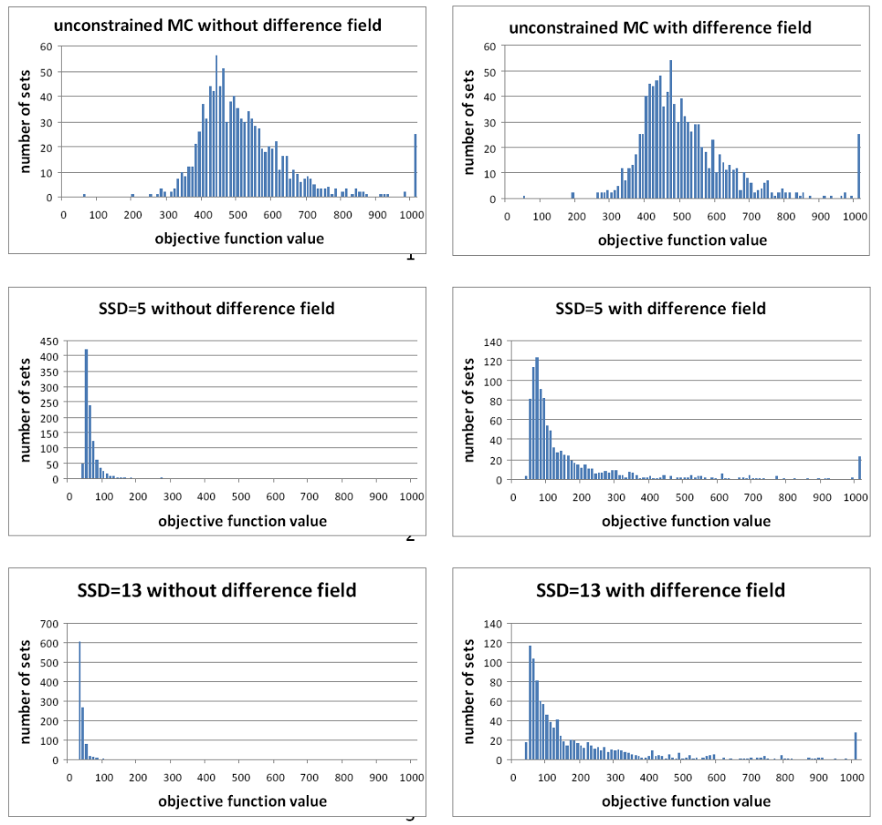
Results
Measurement objective function values before and after nullspace projection of random parameter sets:

Slide 20
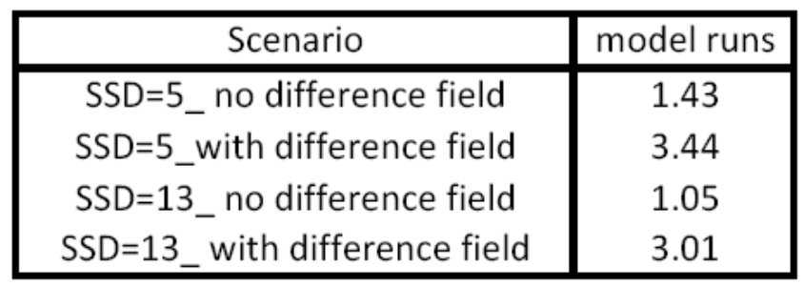
Results
Average amount of model runs needed to recalibrate the null space-projected parameter sets (4 different scenario’s):
Calculation time doubles up
30% gain
18% gain

Slide 21
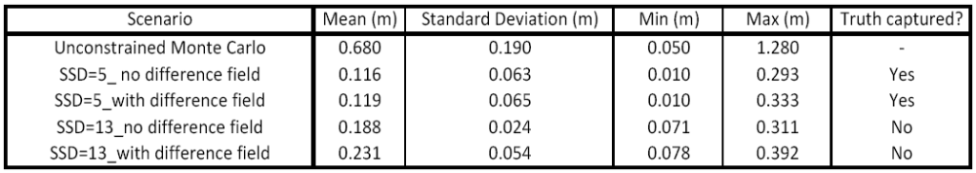
Results
Summary of the statistics associated with the prediction of 1000 calibration-constrained parameter sets obtained with the NSMC method (4 different scenario’s):
TRUTH

Slide 22
Conclusions
Gains in efficiency when dimensionality of solution space is set higher than proposed by PEST’s SUPCALC-utility
However, inability of capturing the “true” prediction value with the increased SSD, because too many random field components are removed during null space-projection
Amount of model calls increased with more than a factor 2 when difference fields are incorporated within the recalibration process of the null space-projected parameter sets
Incorporation of difference field has no significant effect on the computed uncertainty range when the solution space dimensionality is set appropriately

Slide 23
Thank you!!
daah@env.dtu.dk

Slide 24

2. Division of parameter space into solution space and null space
PEST’s SUPCALC utility used to determine number of calibration-sensitive parameter combinations
  Singular value decomposition of (Q weight matrix, X post-calibration Jacobian matrix)
  Separation solution and null space based on pre- and post-calibration error variance of existing parameter combinations
  Result:
    Number of super-parameters (calibration-sensitive parameter combinations) in order to estimate the solution space dimensionality
    5 super parameters
Notes:
SUPCALC separates solution and null spaces according to the pre- and post-calibration error variance of each orthogonal parameter combination spanning parameter space as calculated through singular value decomposition. Where the post-calibration error variance exceeds its pre-calibration error variance, the pertinent parameter combination is assigned to the null space

Slide 25
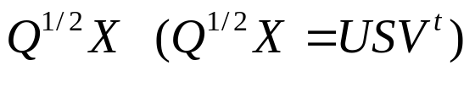

3. Null space projection of random parameter sets
PEST’s utility PNULPAR to create parameter sets, from which null space components will be retained and solution space components will be replaced with that of the calibrated parameter field
  Singular value decomposition of
    V=[V1 V2] in which V2 is an orthogonal matrix, whose columns span the calibration solution space
    Dimensionality of the solution space identifies number of columns in V related to calibration sensitive parameter combinations
    Dimensionality of the solution space approximately equals number of super-parameters determined by SUPCALC (maximum equals number of observations)
  Parameter differences calculated between the calibrated parameter set p and the random one p, which are then projected on the calibration solution space
    Projected parameter differences added to calibrated parameter set p
Notes:
Dimensionality of the solution space is roughly equal to the number of super parameters, calculated based on the. random parameter sets are generated, from which null space projections will be retained and solution space projections will be replaced with that of the calibrated parameter field

