Slide 1
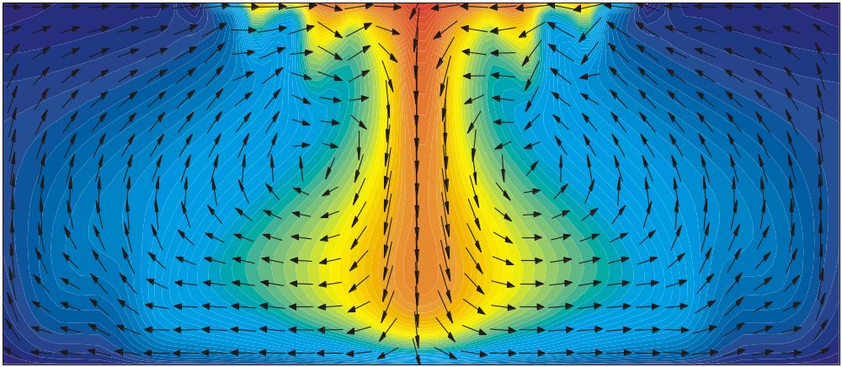
SEAWAT Training Course
2010 Salt Water Intrusion Meeting
June 16 – 25, 2010
Ponta Delgada, Azores, Portugal
Notes:
SEAWAT Training Course
Lecture 1

Slide 2
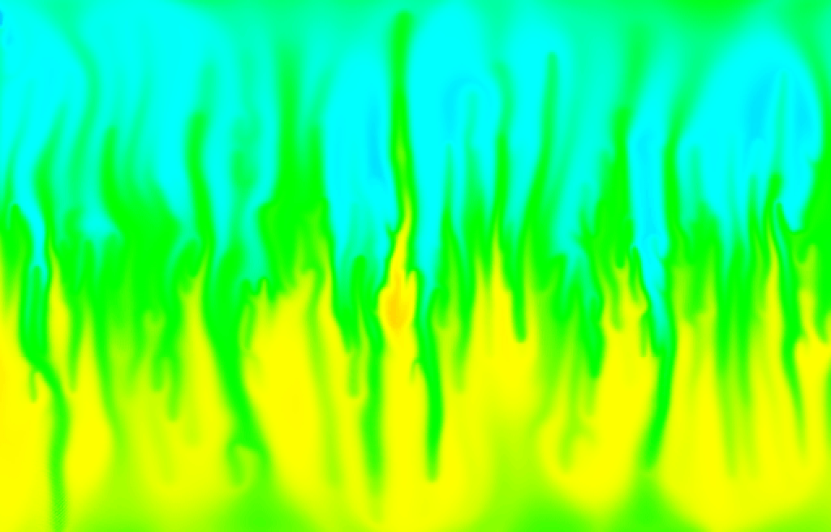
SEAWAT Training Course
2010 Salt Water Intrusion Meeting
June 16 – 25, 2010
Ponta Delgada, Azores, Portugal
Notes:
SEAWAT Training Course
Lecture 1

Slide 3
Presentation 1
Welcome/Introductions

Slide 4
Instructors
Christian Langevin—Research Hydrologist, USGS, Reston, Virginia
Alyssa Dausman—Hydrologist, USGS, Fort Lauderdale, Florida
Joseph Hughes—Research Hydrologist, USGS, Tampa, Florida

Slide 5
Course Purpose
Present the fundamentals of modeling variable-density groundwater flow using the SEAWAT computer program

Slide 6
You!
Participant introductions
Name, employer, experience in groundwater flow and transport modeling
Future projects involving variable-density groundwater flow modeling?

Slide 7
Course Participants

Slide 8
Computer Programs Used in This Course
SEAWAT Version 4
MODFLOW-2000
MT3DMS
Groundwater Vistas
Modelviewer
MODPATH
ZONEBUDGET
PEST
Excel

Slide 9
Course Materials
Class presentations
Class exercises
SEAWAT manuals
  Version 4: Langevin et al. (2007)
  Version 3: SEAWAT-2000 (Langevin et al., 2003)
  Version 2: Guo and Langevin (2002)

Slide 10
Supplemental References
MODFLOW-2000 manual (Harbaugh et al., 2000)
MT3DMS manual (Zheng and Wang, 1999)
MT3DMS v5.2 Supplemental User’s Guide (Zheng, 2006)
Original MODFLOW Documentation (McDonald and Harbaugh, 1988)
Applied Groundwater Modeling (Anderson and Woessner, 1992)
Applied Contaminant Transport Modeling (Zheng and Bennett, 2002)
Seawater Intrusion in Coastal Aquifers—Concepts, Methods, and Practices (Bear et al., 1999)

Slide 11
Graphical User Interfaces (GUI’s) for MODFLOW-2000
Free from USGS:
  MFI2K
Five popular commercial interfaces
  PMWIN
  Groundwater Vistas
  Visual MODFLOW
  Argus
  GMS

Slide 12
Course Schedule
Presentations
  Presentation 1: Welcome/Introductions
  Presentation 2: Variable-Density Groundwater Modeling: Applications and Tools
  Presentation 3: Fluid Properties
  Presentation 4: Concepts and Equations of Variable-Density Groundwater Flow
  Presentation 5: Concepts and Equations of Solute and Heat Transport
  Presentation 6: MODFLOW
  Presentation 7: MT3DMS—Solution Schemes
  Presentation 8: MT3DMS—Packages
  Presentation 9: SEAWAT Concepts
  Presentation 10: Variable-Density Flow (VDF) Process in SEAWAT
  Presentation 11: Instructions for Using SEAWAT
  Presentation 12: Evaluating output from SEAWAT

Slide 13
Course Schedule (cont.)
List of Exercises
  Exercise 1: Using Groundwater Vistas
  Exercise 2: PARTICLEFLOW—Understanding Advection and Dispersion
  Exercise 3: Calculating Hydrostatic Conditions
  Exercise 4: Henry Problem
  Exercise 5: Modified Henry Problem
  Exercise 6: SWI— Part I. Design and run a 2D cross-section model to obtain the steady-state pre-withdrawal distribution of head and salinity
  Exercise 7: SWI— Part II. Design and run a 3D model to determine the effects of groundwater pumping on saltwater interface movement
  Exercise 8: SWI— Part III. Determine wellfield protection area
  Exercise 9: SWI— Part IV. Simulation of multi-species solute transport

Slide 14
Course Schedule (cont.)
Case Studies and Benchmark Problems
  Effect of Heterogeneity on Aquifer Storage and Recovery
  Submarine Groundwater Discharge to Biscayne Bay
  Deep Well Injection in Southern Florida
  Turkey Point Nuclear Cooling Canals
  Henry and Hilleke Physical and Numerical Laboratory Experiment
  SEAWAT Benchmark Problems
  Null Space Monte Carlo Analysis with the Henry Problem
  Effect of Numerical Dispersion on Predictions with a Saltwater Intrusion Model
  Tidal Fluctuations and Transient Dispersion
  Parameterization of an Initial Concentration Field
  Double Diffusive Finger Convection
  SUTRA

