Slide 1
Presentation 6
MODFLOW-2000

Slide 2
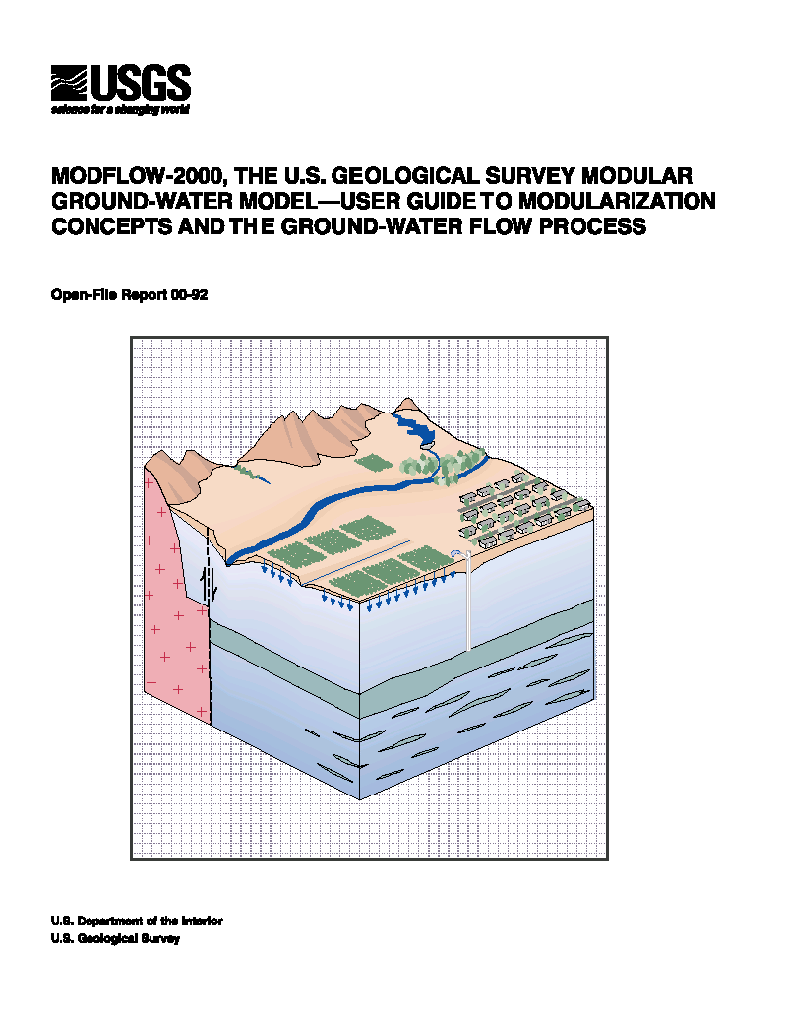
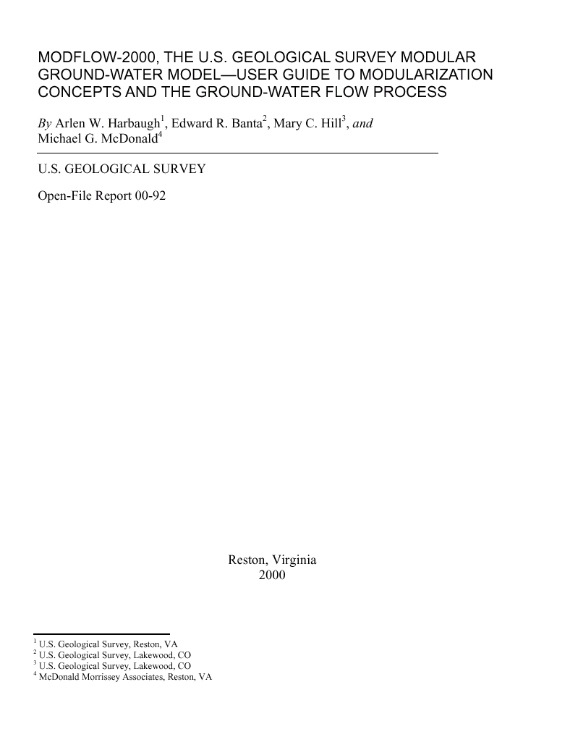
MODFLOW-2000
http://water.usgs.gov/software/modflow.html

Slide 3
History of MODFLOW
1970’s: Trescott and Pinder 3D, transient
1983: modular model, 7,000 lines
1980’s: MODFLOW escapes USGS. Commercial use exceeds use by USGS
1992: MODFLOWP, 17,000 lines
1996: MODFLOW96
2000: MODFLOW2000
1999-2000: 23,000 copies downloaded from USGS

Slide 4
Reasons For MODFLOW-2000
Facilitate solving more than just the flow equation
Parameter estimation
Transport
Courtesy Arlen Harbaugh

Slide 5
Obvious Changes in MODFLOW-2000
New Terminology
Processes
Parameters
Discretization file
Two listing files
Input
Parameter definition
Discretization file
BAS and BCF changes
Layer-Property Flow Package
Courtesy Arlen Harbaugh

Slide 6
Structure of MODFLOW2000
Processes
Packages
Procedures

Slide 7
Processes
MODFLOW2000
Global (GLO)
Ground-Water Flow (GWF)
Observation (OBS)
Sensitivity (SEN)
Parameter Estimation (PES)
Ground-Water Transport (GWT) –Based on MOC3D code (separate distribution)
Variable-Density Flow (VDF)
Integrated MT3DMS (IMT)
SEAWAT2000

Slide 8
Packages
Typically one for each feature
New packages in MODFLOW-2000
Layer Property Flow (LPF)
Hydrogeologic Unit Flow (HUF)
LMG Solver
Etc.

Slide 9
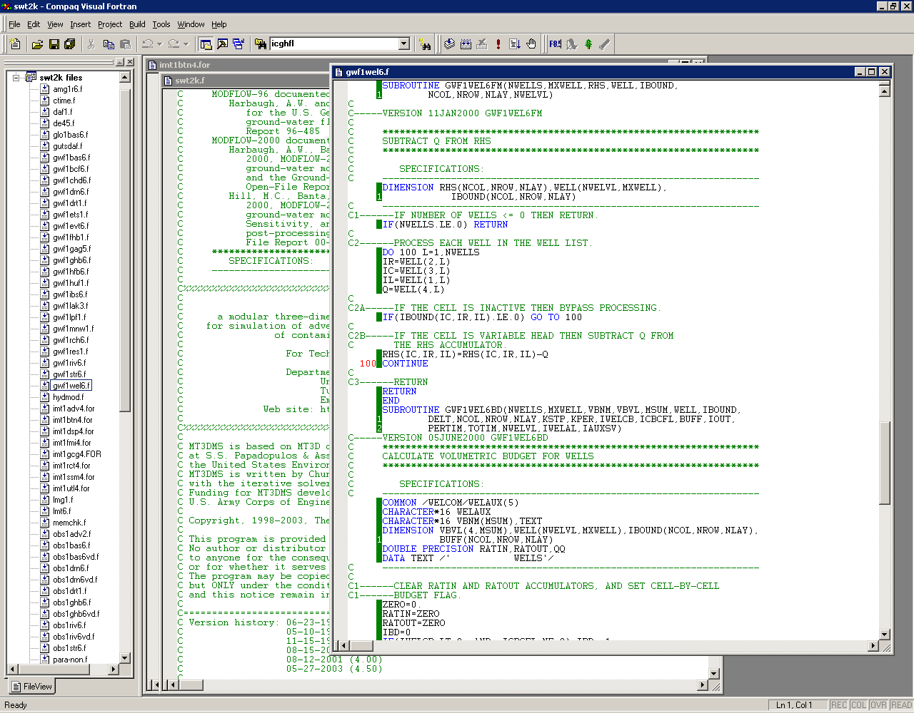
Procedures
One for each type of programming calculation
Read and Prepare (RP)
Formulate (RP)
Etc.
Typical procedure name
GWF1WEL6FM

Slide 10
Temporal Discretization
Stress periods
Time steps
In MODFLOW2000, stress periods may be either steady-state or transient
ts1
ts1
ts2
ts3
ts1
ts2
ts3
ts4
ts5
time
STRESS PERIOD 1
(SS)
STRESS PERIOD 2
(TR)
STRESS PERIOD 3
(TR)

Slide 11
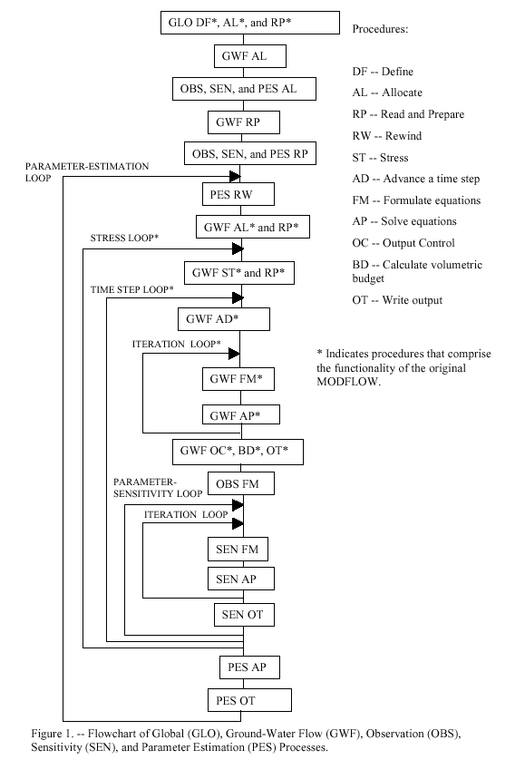
Program Structure
Harbaugh and others (2000)

Slide 12
Flow Equation

Slide 13
Finite-Difference Approximation
CR, CC, and CV are hydraulic conductances in the row, column, and layer directions;
h is head;
m is timestep;
P is the sum of head coefficients;
Q is the sum of discharges;
S is the storativity; and
V is the saturated cell volume

Slide 14
Parameters
Generic meaning of “PARAMETER”
Any input data for a model
Meaning of “PARAMETER” in MODFLOW-2000
A specially designated value that can define many input values for a model
Changing the parameter value changes all of the associated input values
Necessary for parameter estimation because we don’t have enough data to estimate values for all input data
Parameters are a convenient way to specify input data even if not using parameter estimation
Courtesy Arlen Harbaugh

Slide 15
Example of Array Parameters
Zone Array
2 2 2 5 5
2 2 2 5 5
2 2 5 5 5
2 2 5 5 5
Define Parameters HKA and HKB:
Make hydraulic conductivity equal to the value of HKA times the multiplier array at cells where zone array = 2
Make the hydraulic conductivity equal to the value of HKB times the multiplier array at cells where zone array = 5
Multiplier Array
0.7 0.8 0.9 1.0 1.0
0.8 0.9 1.0 1.0 1.0
0.9 1.0 1.0 1.0 1.0
1.0 1.0 1.0 1.0 1.0
7.0 8.0 9.0 30.0 30.0
8.0 9.0 10.0 30.0 30.0
9.0 10.0 30.0 30.0 30.0
10.0 10.0 30.0 30.0 30.0
If HKA=10.0 and HKB=30.0, the resulting hydraulic conductivity is:
Courtesy Arlen Harbaugh

Slide 16
Example of List Parameters
List for Parameter RIVA
Layer Row Col. Factor
1 10 11 14.0
1 11 12 15.0
1 11 13 16.0
Define Parameters RIVA and RIVB:
Make the Riverbed Conductance equal to the value of RIVA times the Factor in the corresponding list of river locations
Make the Riverbed Conductance equal to the value of RIVB times the Factor in the corresponding list of river locations
List for Parameter RIVB
Layer Row Col. Factor
1 12 13 18.0
1 13 14 20.0
Thus, if RIVA=10.0 and RIVB=20.0, the riverbed conductance list is:
Layer Row Col. Conductance
1 10 11 140.0
1 11 12 150.0
1 11 13 160.0
1 12 13 360.0
1 13 14 400.0
Courtesy Arlen Harbaugh

Slide 17
Parameter Definition
Parameters can only be specified for part of the input data:
LPF, CHD, GHB, RIV, DRN, WEL, RCH, EVT, HFB allow parameters
Array parameters
For each layer, specify multiplier and zone arrays
NONE is a special multiplier array
ALL is a special zone array
If an array is defined using parameters, values for all cells in all layers must be defined by the parameters – i.e. cannot define values for some cells using parameters and some without using parameters
Additive parameters
List parameters
Can mix parameters with non-parameter data
Additive parameters
Courtesy Arlen Harbaugh

Slide 18
Global Process
Discretization Data
All discretization data in one place
Elevations always included even if GWF does not need because there is a good chance other processes will need
Not always included originally in order to save memory
Courtesy Arlen Harbaugh

Slide 19
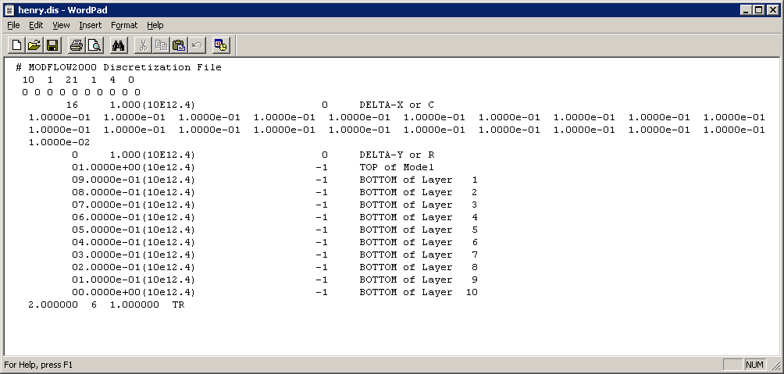
Discretization File
NLAY, NROW, NCOL, NPER, ITMUNI, LENUNI
Existence of Quasi-3D Confining Units
DELR
DELC
TOP elevation of system
Bottom elevation of each model layer and Quasi-3D Confining Unit
PERLEN, NSTP, TSMULT, SS/TR for each stress period
Mixed steady-state and transient simulations
Courtesy Arlen Harbaugh

Slide 20
List of Packages (included with MF2K version 1.17)
BAS6 -- Basic Package
BCF6 -- Block-Centered Flow Package
LPF1 -- Layer-Property Flow Package
RIV6 -- River Package
DRN6 -- Drain Package
WEL6 -- Well Package
GHB6 -- General Head Boundary Package
RCH6 -- Recharge Package
EVT6 -- Evapotranspiration Package
CHD6 -- Time-Variant Specified-Head Package
HFB6 -- Horizontal Flow Barrier Package
SIP5 -- Strongly Implicit Procedure Package
SOR5 -- Slice Successive Over-Relaxation Package
PCG2 -- Version 2 of Preconditioned Conjugate Gradient Package
DE45 -- Direct solver
LMG1 -- Multigrid solver (for USGS use only)
STR6 -- Streamflow-Routing Package
ADV2 -- Advective-Transport Observation Package
RES1 -- Reservoir Package (RES is the file type in the MODFLOW name file)
FHB1 -- Flow and Head Boundary Package (FHB is the file type in the MODFLOW name file)
IBS6 -- Interbed Storage (subsidence) Package (IBS is the file type in the name file)
HUF2 -- Hydrogeologic-Unit Flow Package
LAK3 -- Lake Package
ETS1 -- Evapotranspiration with a Segmented Function Package
DRT1 -- Drains with Return Flow Package
LMT6 -- Link to MT3DMS contaminant-transport model
MNW1 -- Multi-Node Well Package
DAF1 -- Diffusion Analogy Surface-Water Flow Package
SUB1 -- Subsidence and Aquifer-System Compaction Package
SFR2 -- Stream-Flow Routing Package, version 2
GMG1 -- Geometric MultiGrid Solver Package
Bold indicates package not compatible with SEAWAT-2000

Slide 21
Changes to BAS and BCF (MF96 TO MF2K)
BAS
Removed NLAY, NROW, NCOL, NPER, ITMUNI
Removed PERLEN, NSTP, TSMULT
BCF
Removed DELR and DELC
Removed TOP and BOT for convertible and water-table layers
Removed steady-state flag
MF96TO2K can convert MODFLOW-96 data sets

Slide 22
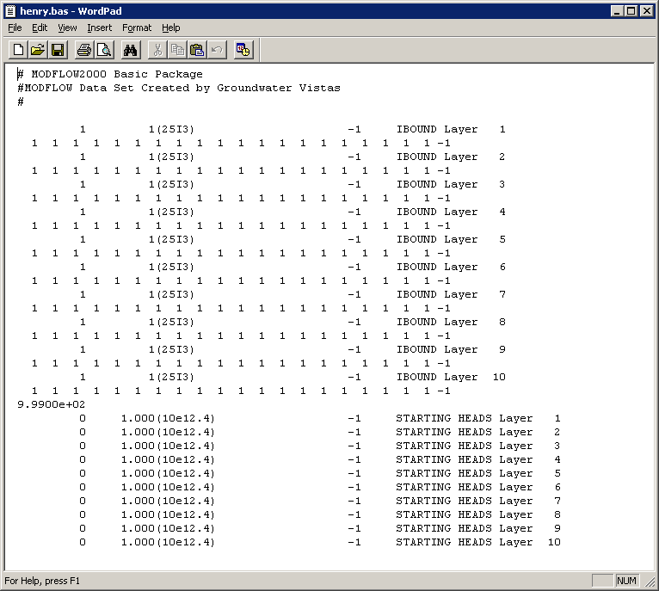
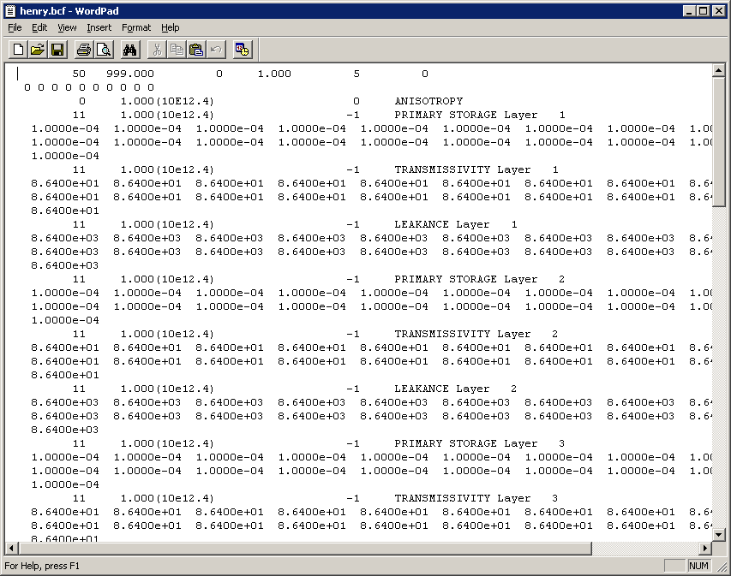

Slide 23
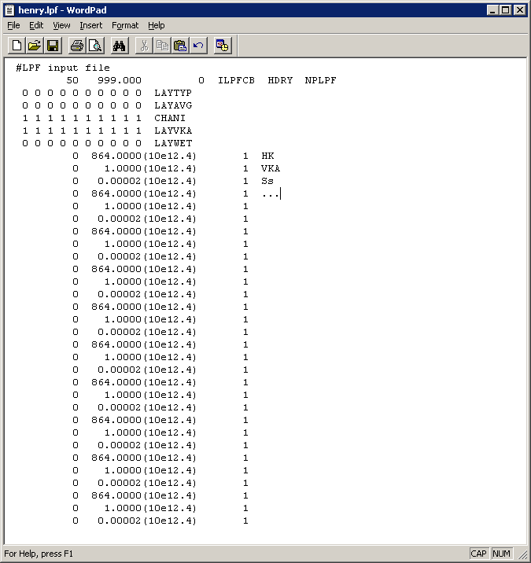
LPF Package
Substitute for Block-Centered Flow (BCF)
Internally LPF works like BCF
Layers are confined or convertible
Transmissivity, storage, and vertical leakage are based on saturation for convertible layers
Wetting and drying
Grid independent hydraulic properties
Specific storage when confined
Horizontal K even for confined layers
Vertical K or horizontal to vertical anisotropy ratio
Vertical K of quasi 3-D confining beds
NO MORE VCONT

Slide 24
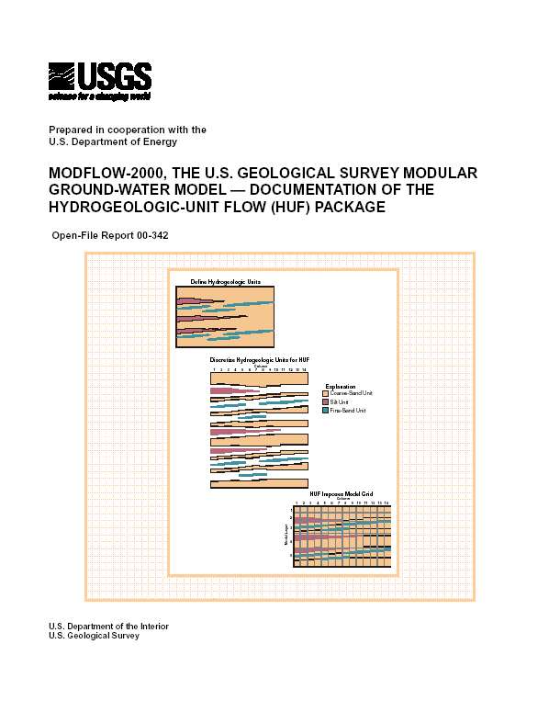
HUF Package
Anderman, E.R., and Hill, M.C., 2000, MODFLOW-2000, the U.S. Geological Survey Modular Ground-Water Model - Documentation of the Hydrogeologic-Unit Flow (HUF) Package: U.S. Geological Survey Open-File Report 00-342, 89 p.

Slide 25
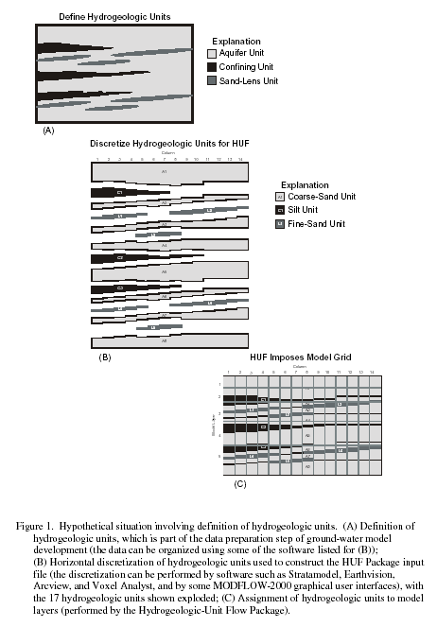
HUF (cont.)
Source: Anderman and Hill (2000)

Slide 26
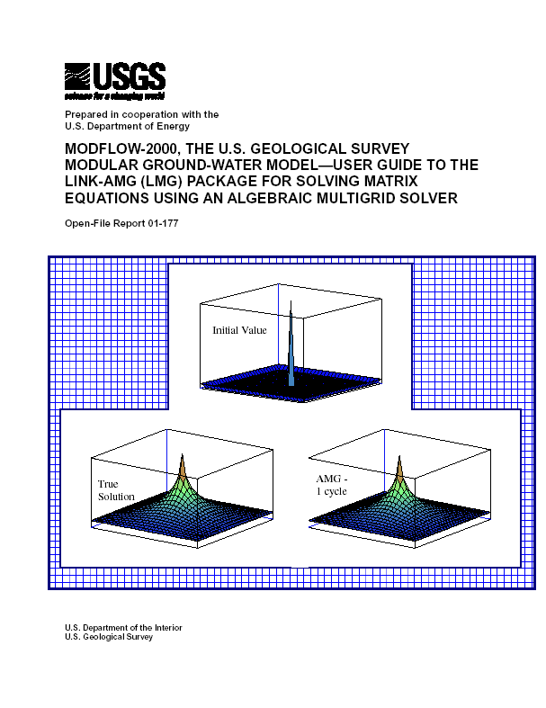
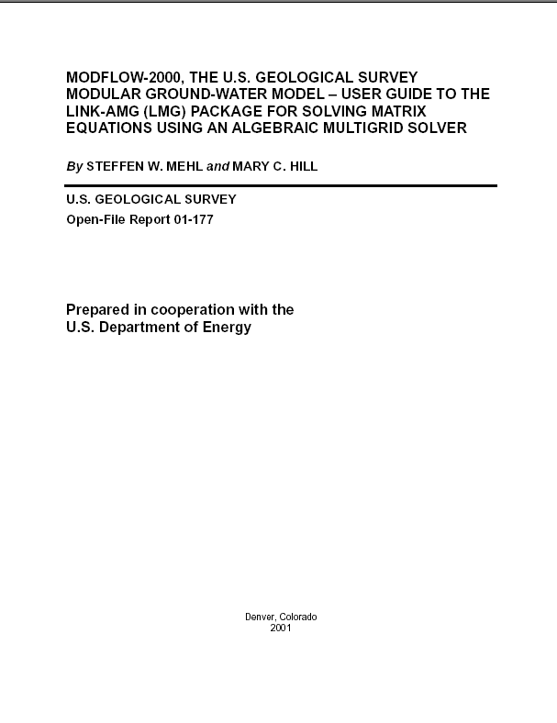
HUF (cont.)
Substitute for BCF and LPF
Internally, HUF works like BCF, LPF
Layers are confined or convertible
Transmissivity and storage are based on saturation for convertible layers
Wetting and drying
New: Vertical leakage changes gradually with saturated thickness
New: specify hydraulic properties by hydrogeologic units (HGU’s) that are independent of model layers
Within each cell, HGU’s are assumed to be layered horizontally
Hydrogeologic units can pinch out
Source: Calibration and uncertainty of models, course notes, USGS, 2002

Slide 27
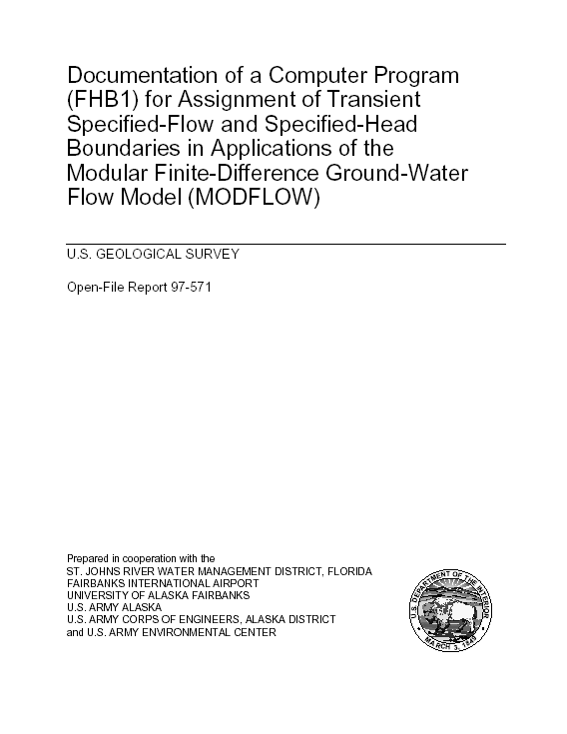
FHB
Flows and heads that vary at times other than starting and ending of stress periods
Now compatible with SEAWAT-2000

Slide 28
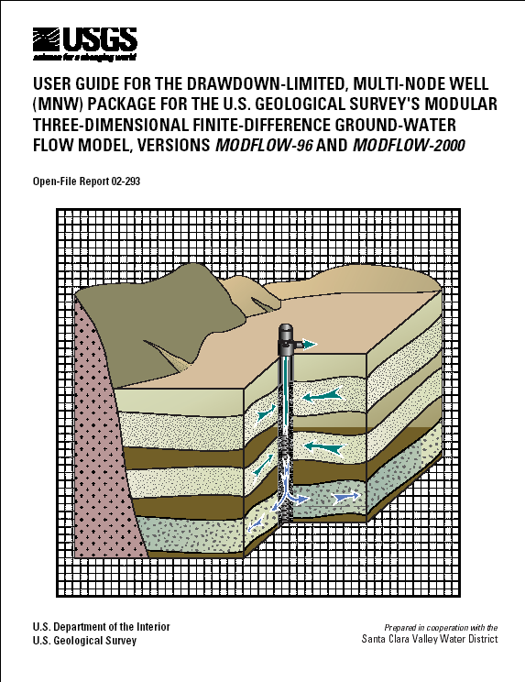
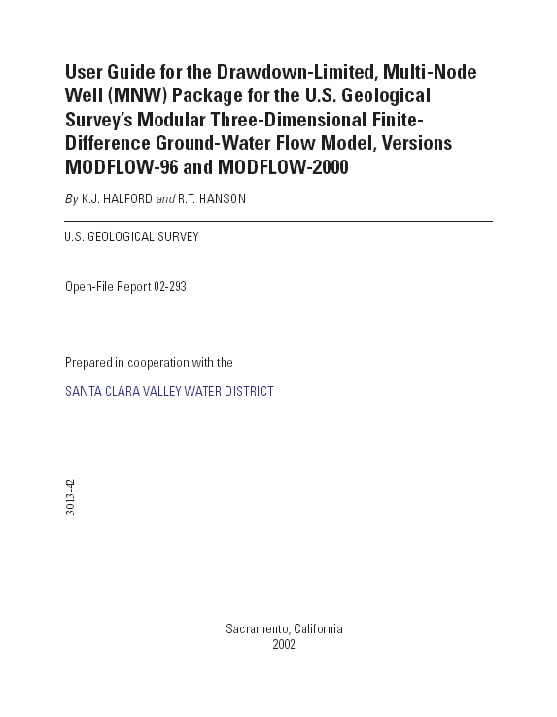
MNW
Represent wells that span several aquifers (or multiple model cells)
Represent leaking wells?
MNW2 not included in SEAWAT-2000

Slide 29
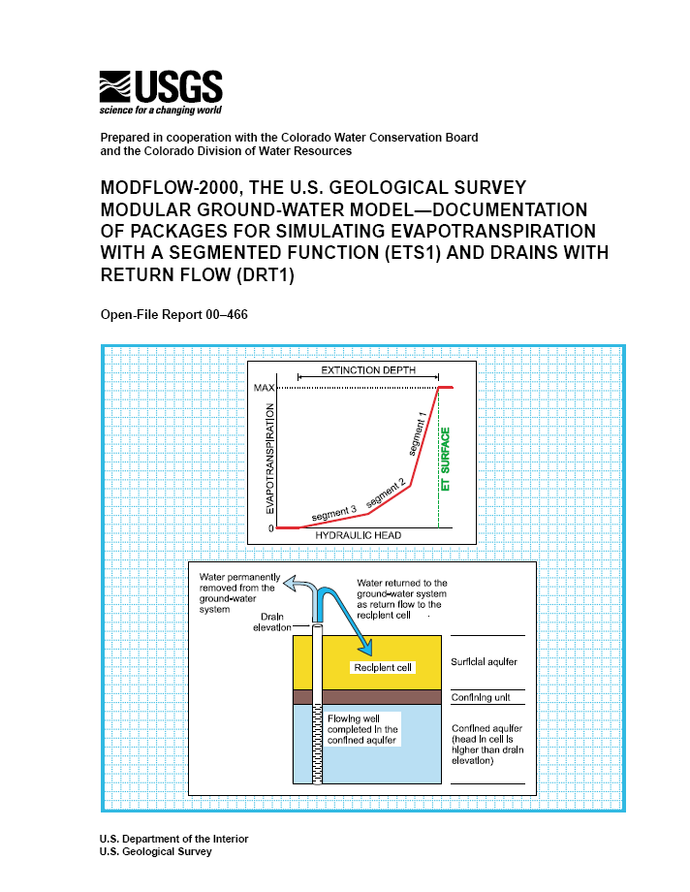
ETS and DRT

Slide 30
LMG Solver
Link to algebraic multi-grid
Can be very fast for big problems (more than about 50,000 cells)
2 to 30 times faster than PCG2 in tests
Uses a lot of RAM
3 times as much as PCG2, or more
Source: Calibration and uncertainty of models, course notes, USGS, 2002

Slide 31
GMG Solver
Geometric Multi-Grid
May substantially improve runtimes for very large models
RCLOSE and HCLOSE

Slide 32
Running MODFLOW-2000
Directly from Groundwater Vistas
Vistas includes Windows version of MODFLOW-2000
Using a batch file
Create a batch file and run from Windows file manager

Slide 33
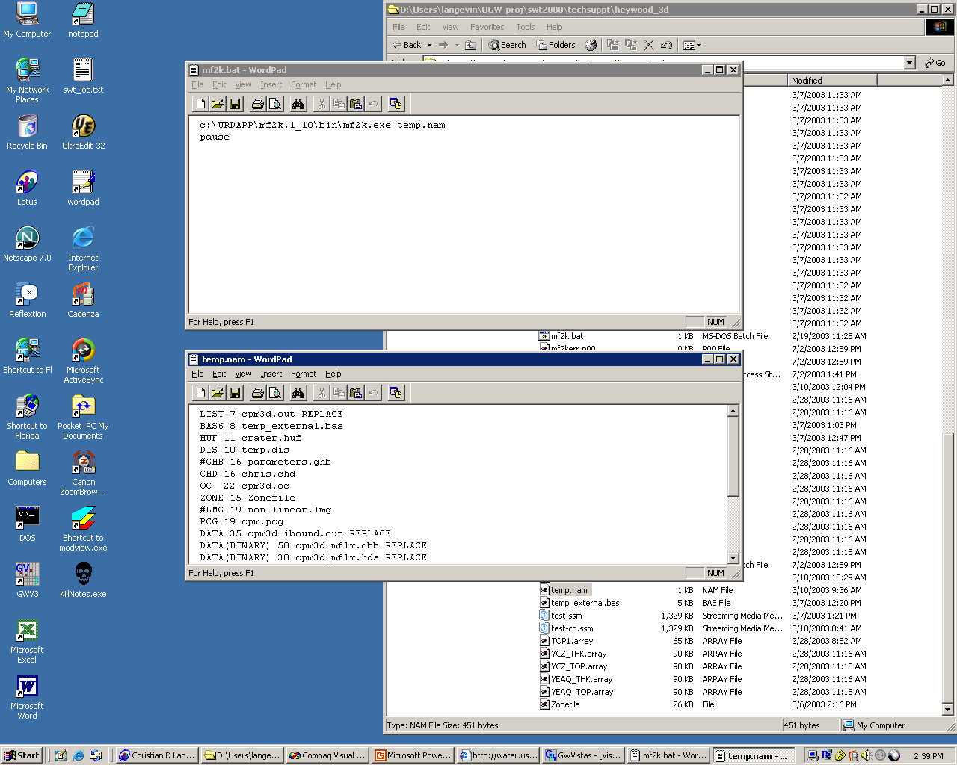

Slide 34
Two Listing Files
LIST
Contains GWF output from the last parameter-estimation iteration
GLOBAL
Contains PES output for each parameter-estimation iteration

Slide 35
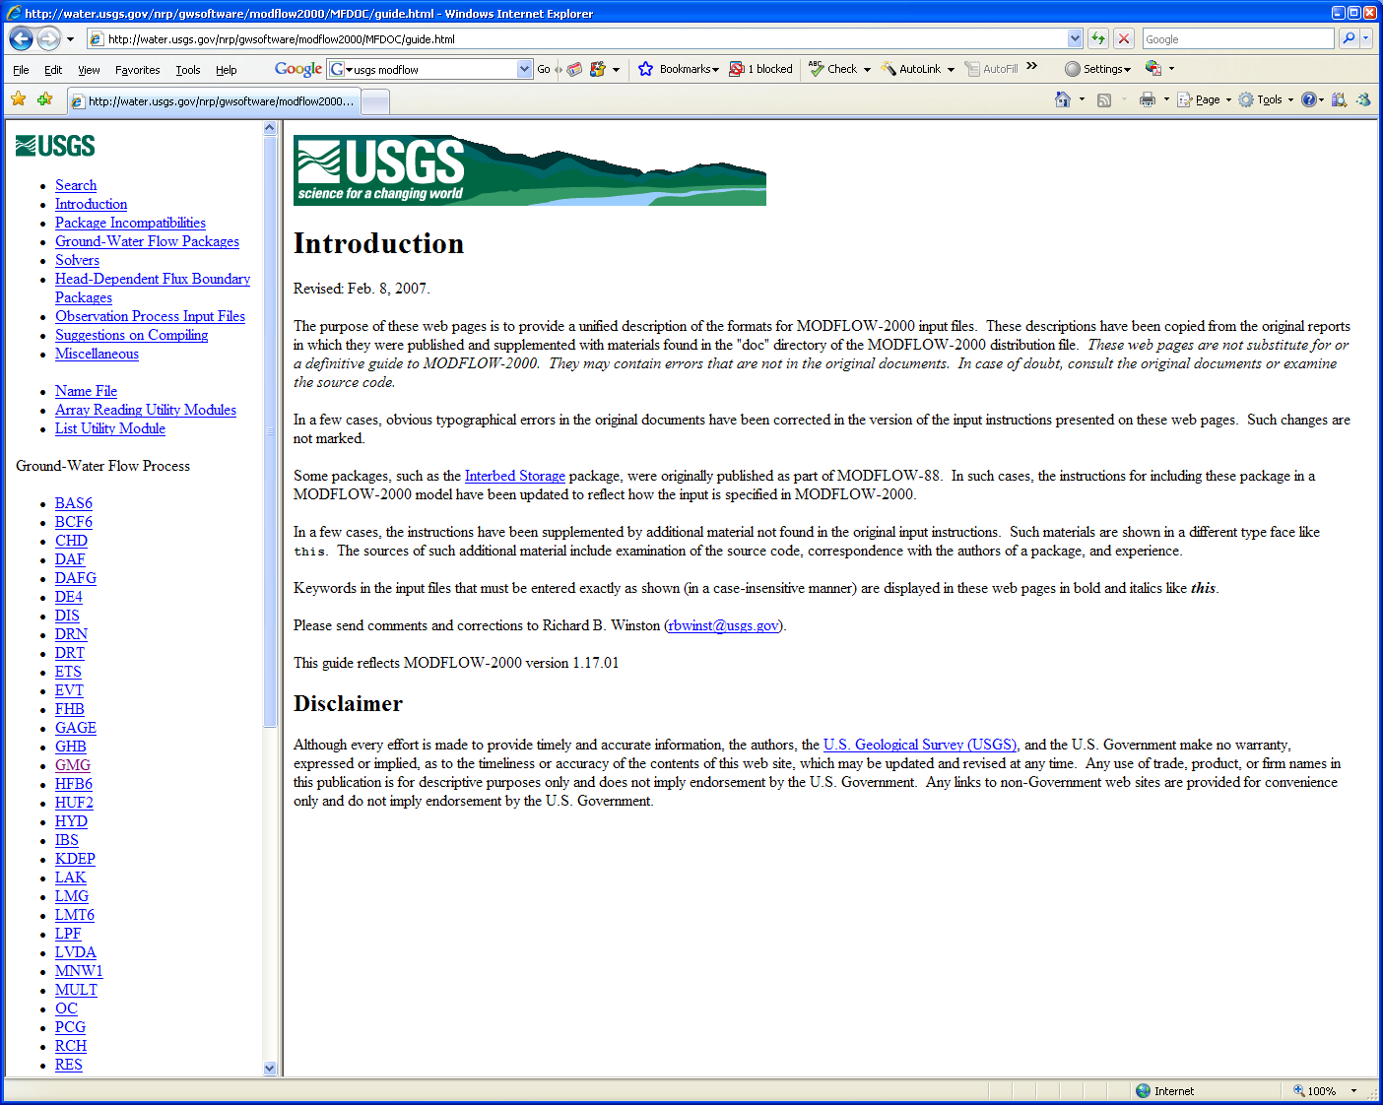
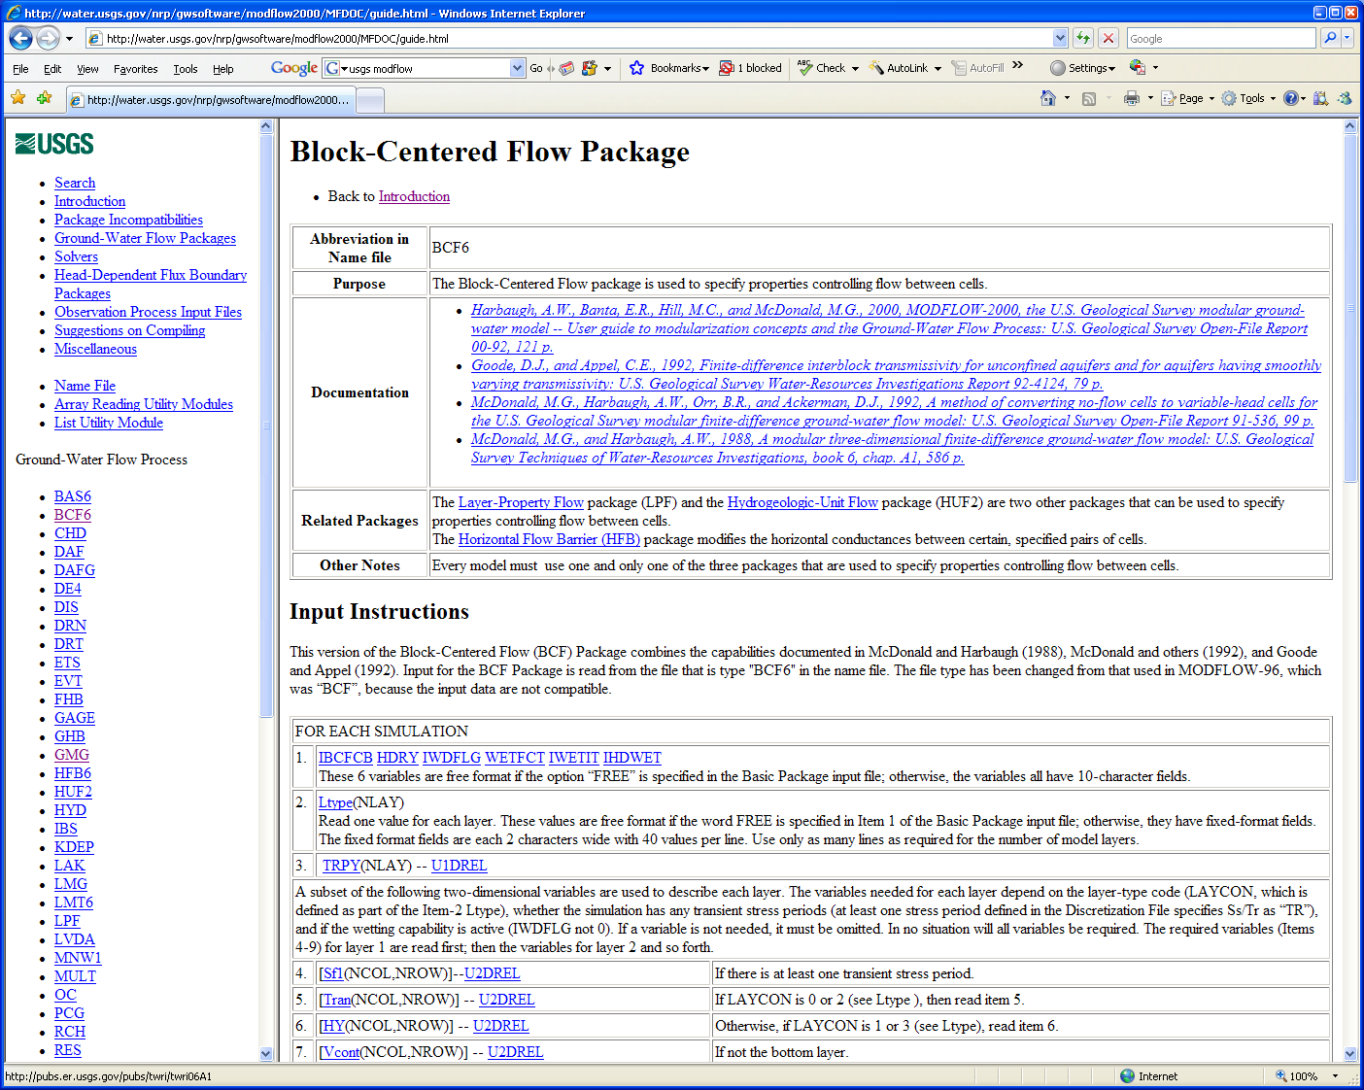
Online MODFLOW Guide
http://water.usgs.gov/nrp/gwsoftware/modflow2000/MFDOC/guide.html

