Slide 1
Presentation 12
Evaluating Output from SEAWAT Version 4
Notes:
SEAWAT Training Course
Lecture 12

Slide 2
Model Results of Interest
Listing Files
  Flow budget
  Solute mass budget
Heads
Flows
Concentrations
  Unformatted concentration file
  Concentration observations
Solute mass budget

Slide 3
Listing Files
Output from both MODFLOW and MT3D are written to either:
  Global Listing File (of FTYPE GLOBAL)
  Forward run listing file (of FTYPE LIST)
Output file contains
  Runtime information
  Flow budgets
  Solute budgets

Slide 4
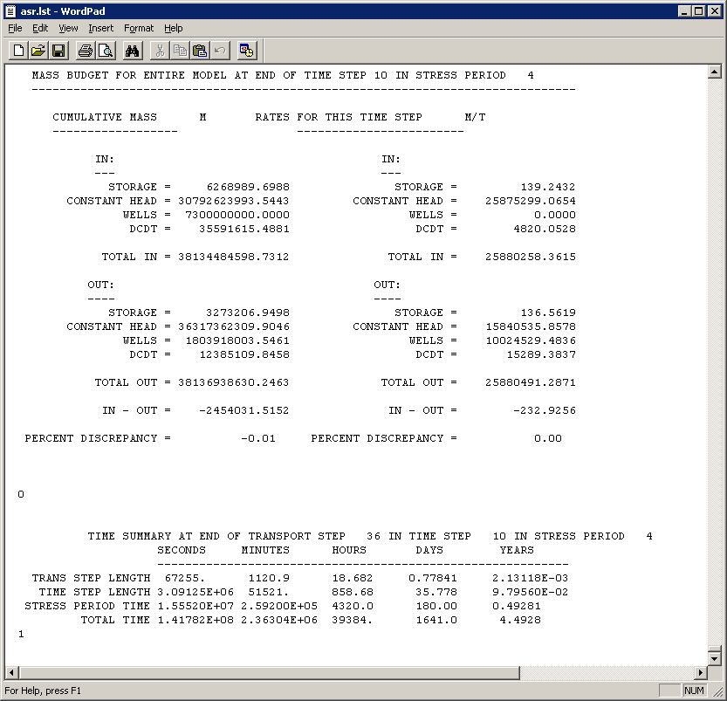
Flow Budget

Slide 5
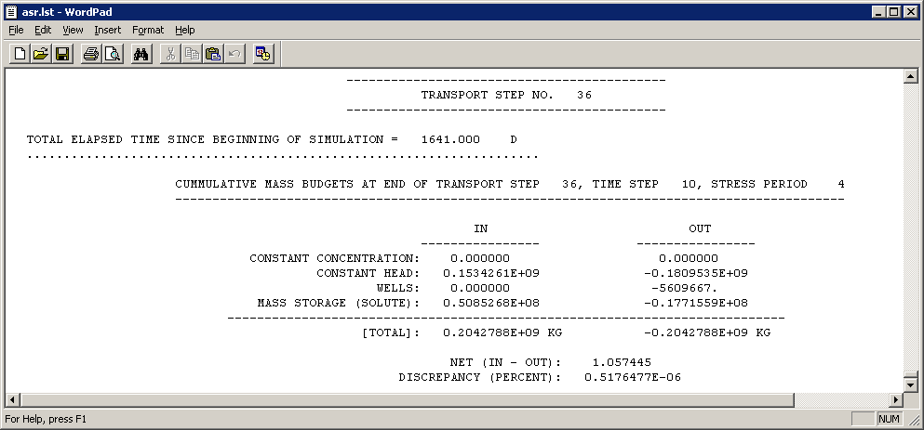
Solute Budget

Slide 6
Heads
Binary head file is “true binary”
Heads (not equivalent freshwater heads)
Used to make water-table and potentiometric surface maps

Slide 7
Concentrations
Unformatted concentration file (mt3d001.ucn; true binary)
  Perhaps most important output from SEAWAT
  Animate with Modelviewer
MT3DMS Observations (mt3d001.obs)
  Import into Excel and prepare plots of concentration versus time for one or many cells
  Saving interval is specified as a multiple of transport timesteps

Slide 8
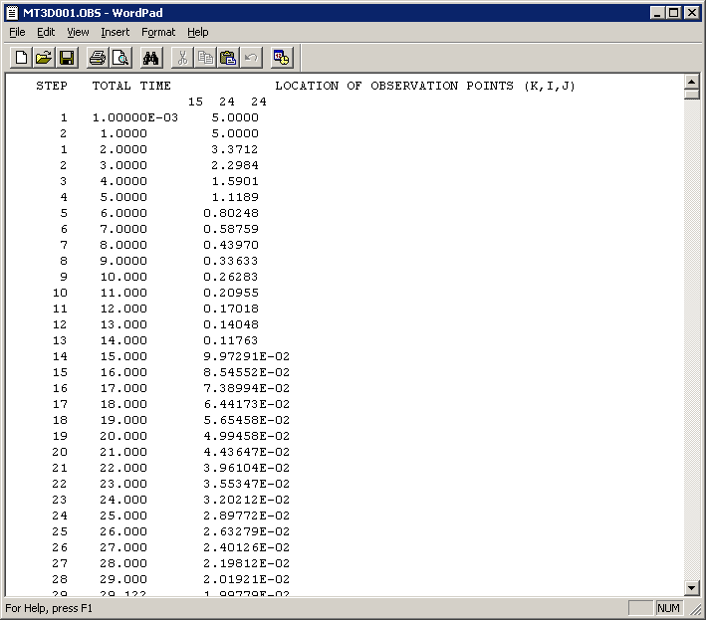
Observation File

Slide 9
Solute Mass Budget
Mass budget information written to:
  Listing file
  Mt3d001.mas
    Written as cumulative mass
    Useful to plot cumulative mass in model domain as a function of time—indicates when steady state is achieved

Slide 10
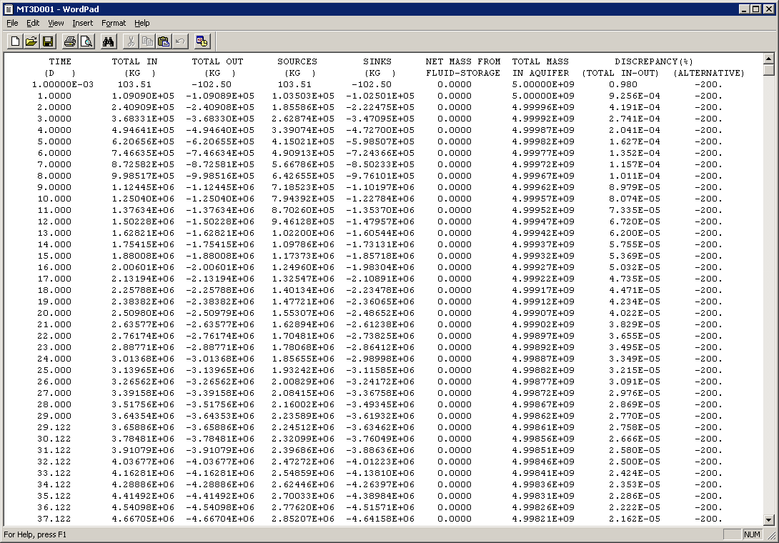
Mt3d001.mas

Slide 11
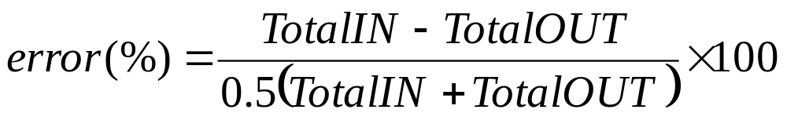
Mass Budget Errors
Mass balance error computation
  Source – Sink = Δ(Storage)
  Source – Sink = Δ(C+) – Δ(C-)
  Source + Δ(C-) = Sink + Δ(C+)
  Total in = Source + Δ(C-)
  Total out = Sink + Δ(C+)

Slide 12
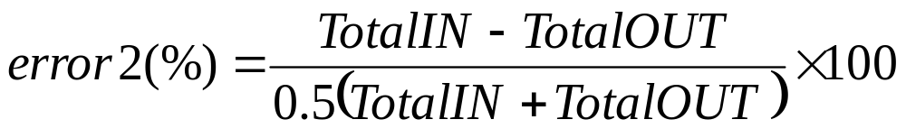
Mass Budget Errors (cont.)
Alternative error computation
  Source + M⁰ = Sink + M^{t}
  M⁰: initial mass in aquifer
  M^{t}: current mass in aquifer
  Total in = Source + M⁰
  Total out = Sink + M^{t}

