Slide 1
Types of Convection
Convection: transfer of heat or solute (advection) caused by movement of a fluid
  Free convection: motion caused by internal variations in fluid density
  Forced convection: transfer of heat or solute due to externally driven fluid flow

Slide 2
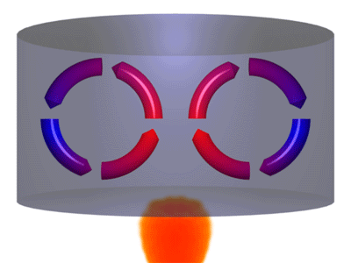
Thermally Driven Free Convection

Slide 3
Forced Convection
Commonly observed in groundwater studies
  Saltwater intrusion
  Aquifer storage and recovery
  Deep well injection

Slide 4
State Variables
Historically
  Pressure
  Solute mass fraction
  Density
More recently
  Head
  Solute concentration
  Density
Can use pressure or head, but there are various ways to define head
  Point-water head
  Equivalent freshwater head
  Environmental head

Slide 5
Dependent Variables
Most variable-density groundwater codes formulate equations in terms of Pressure (P), Density (ρ), and Concentration (C)
Equations in SEAWAT are formulated in terms of Equivalent Freshwater Head (h_{f}), Density (ρ), and Concentration (C)

Slide 6
Dimensionless Numbers
Ratio of buoyancy to conduction
  Rayleigh—heat transport
  Rayleigh—mass transport
Ratio of convection to conduction
  Nusselt—heat transport
  Sherwood—solute transport
Ratio buoyancy force to viscous force
  Grashof—heat transport
  Gr*--mass transport
Ratio of viscous diffusion to thermal diffusion
  Prandtl—heat transport
  Schmidt—mass transport

