Slide 1
MODFLOW 6
Observations and Timeseries

Slide 2
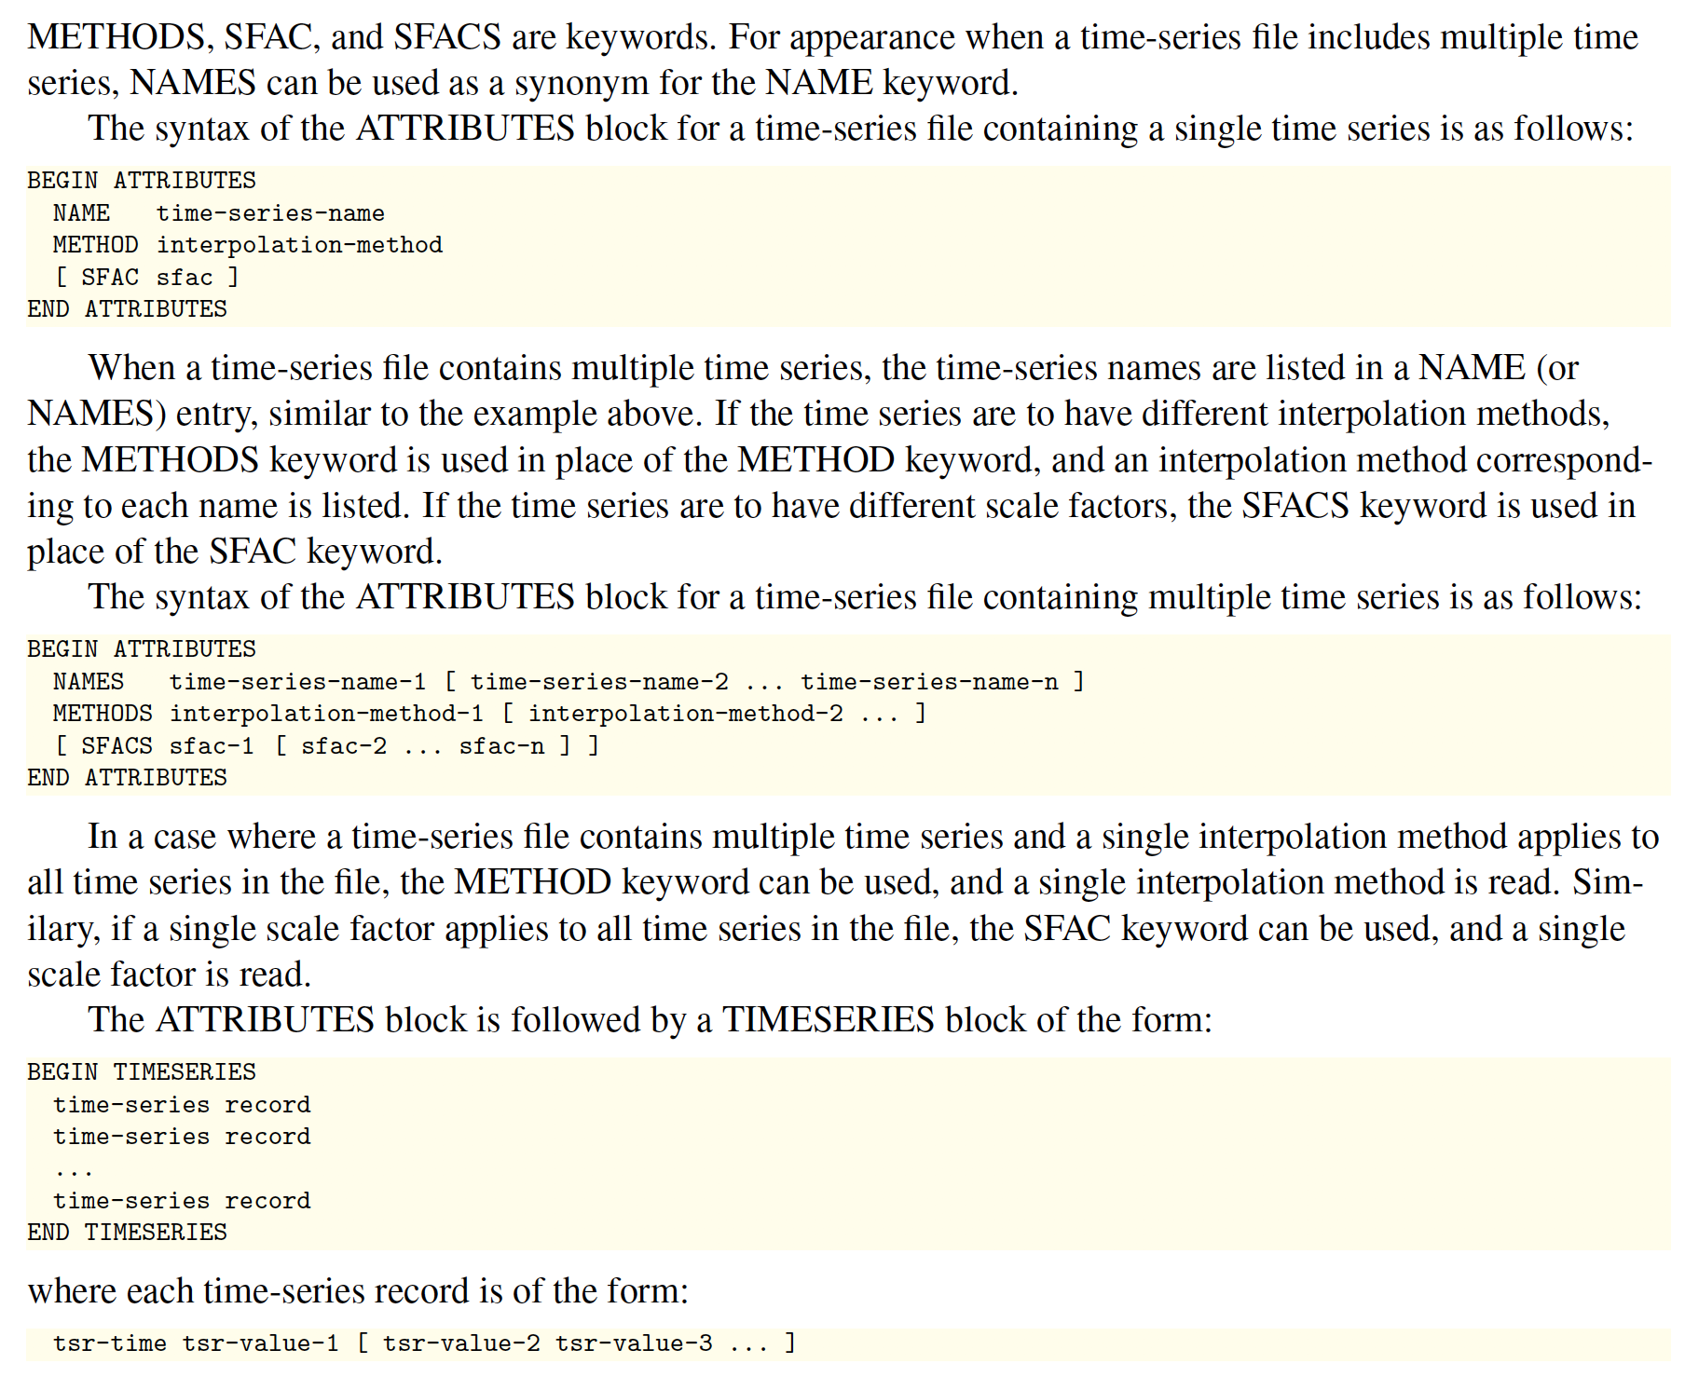
Timeseries

Slide 3

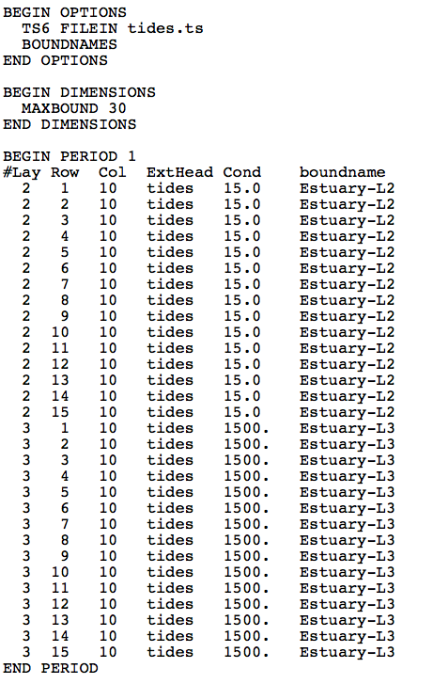
Time Series
tides.ts
GHB Input File

Slide 4
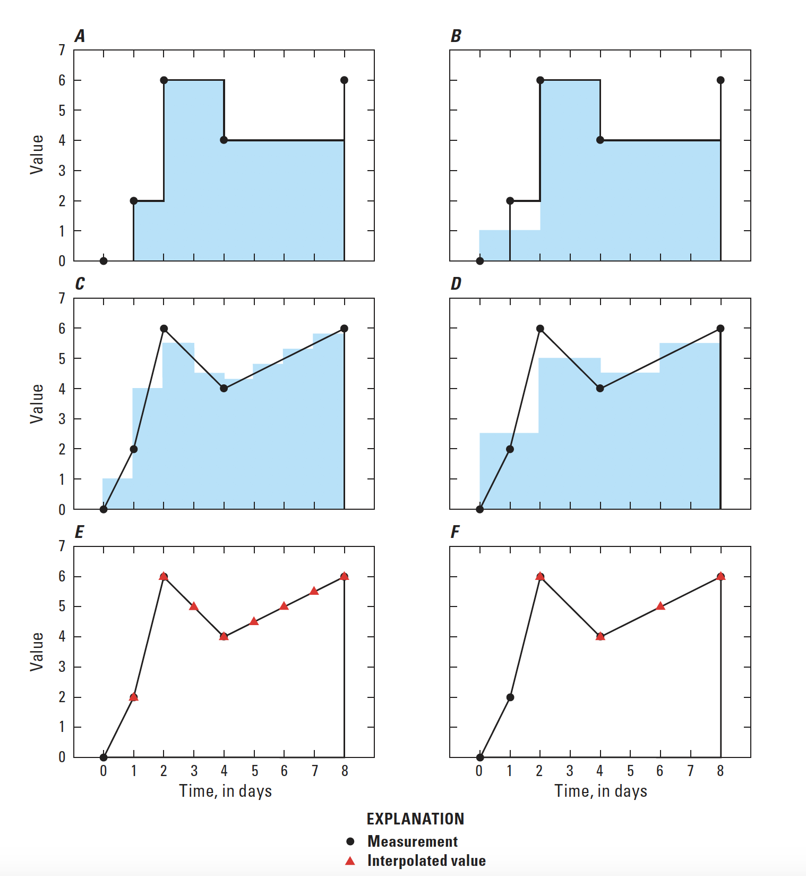
Timeseries
STEPWISE interpolation
LINEAR interpolation
LINEAREND interpolation

Slide 5
Observations

Slide 6

Observations

Slide 7
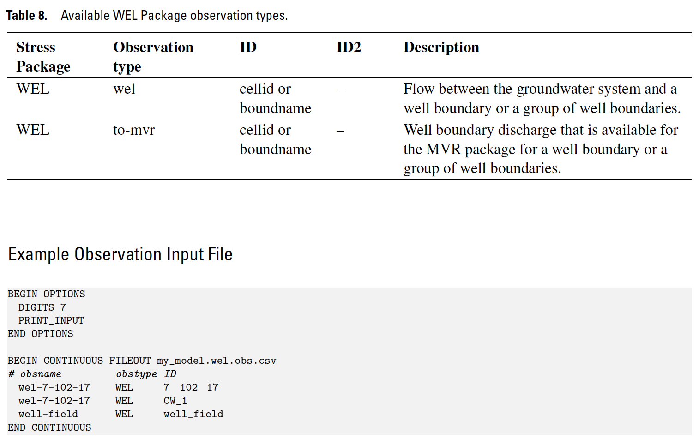
Observations

Slide 8
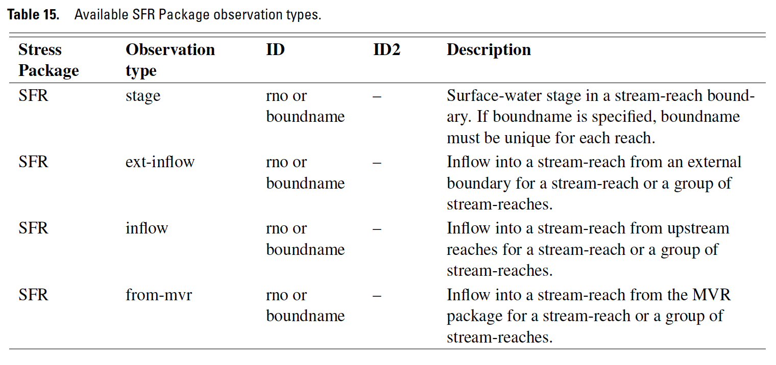
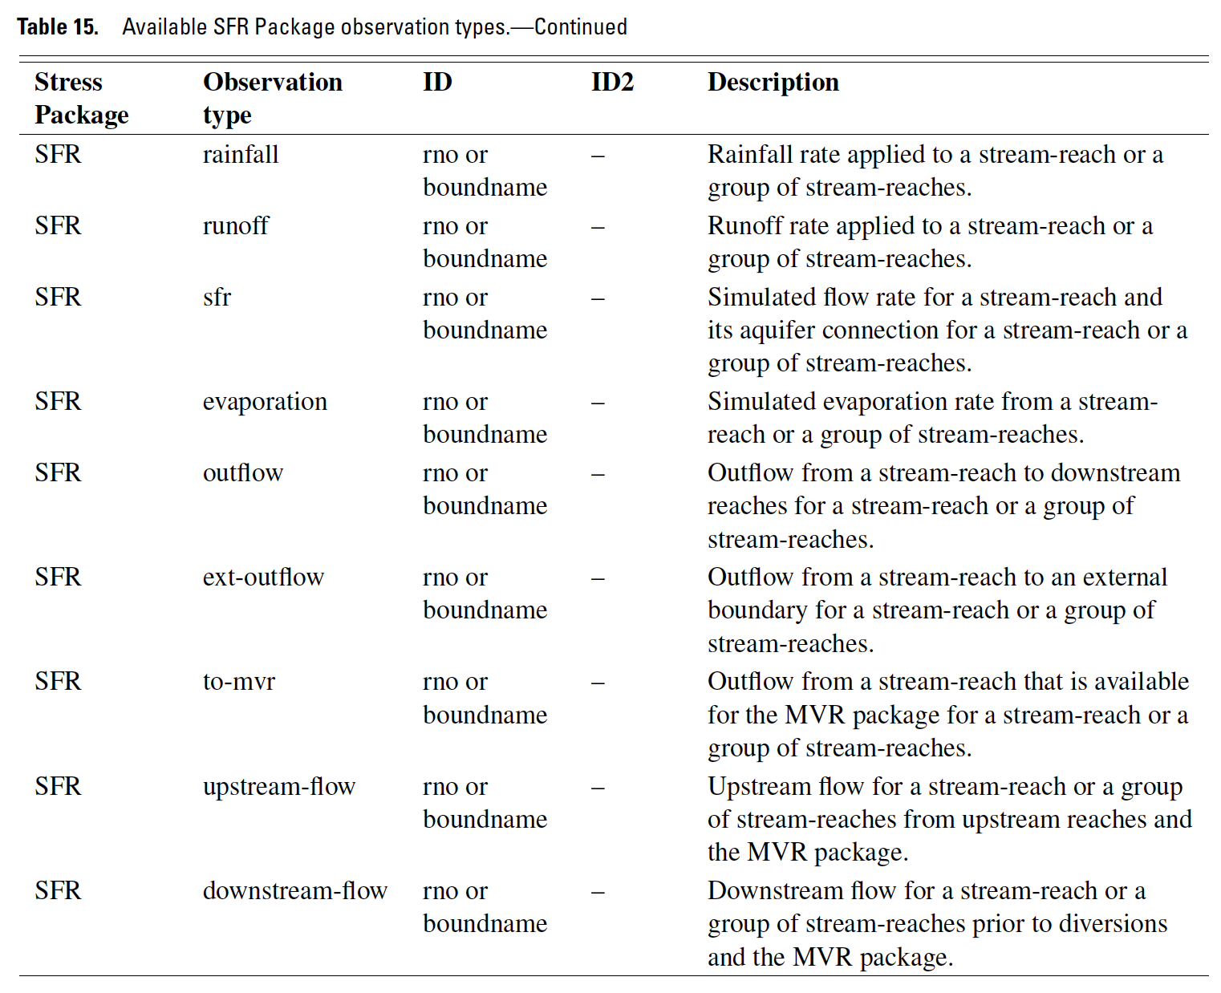
Observations

Slide 9
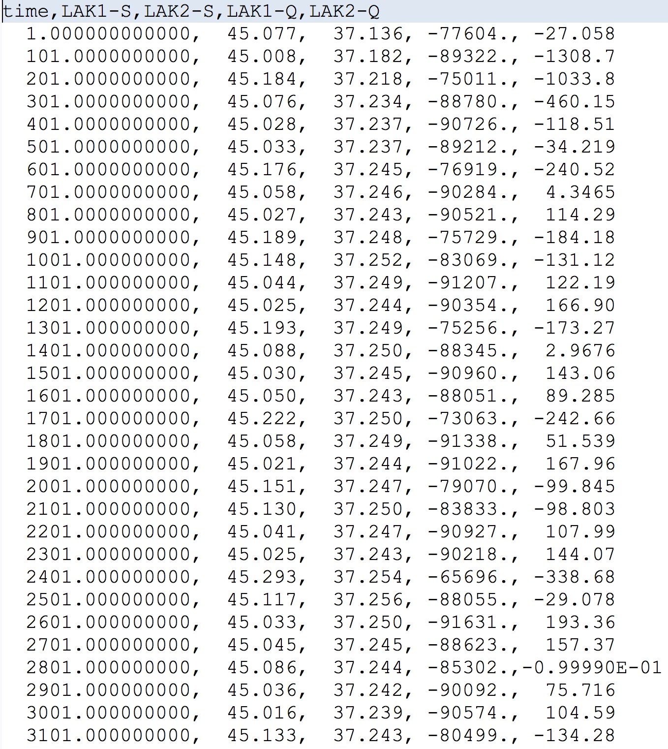
Observations

Slide 10
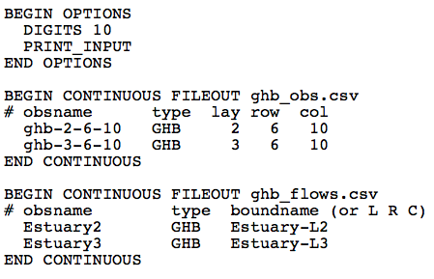
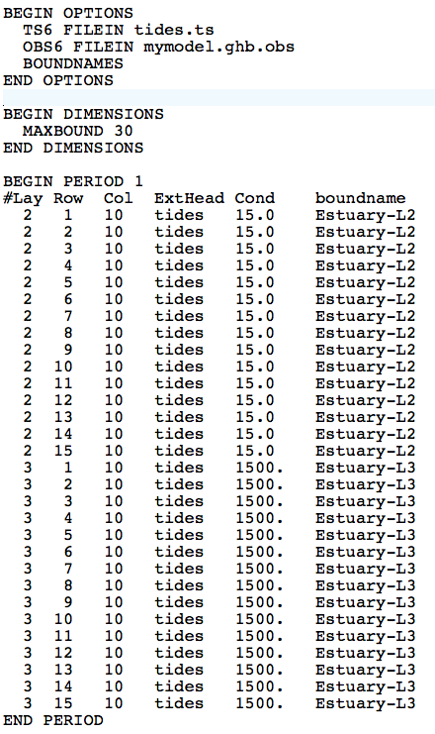
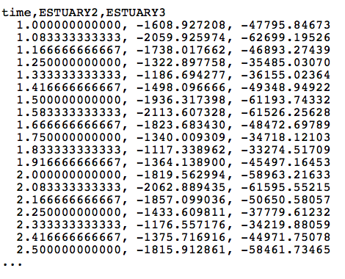
Observations
mymodel.ghb.obs

