Slide 1
XT3D
Advanced Modeling of Groundwater Flow (GW3099)
Lincoln, NE
October 22-26, 2018

Slide 2
Challenge
Simulate fully 3D anisotropy
… on unstructured, cell-centered, finite-volume (MODFLOW 6) grids
… preferably in a way that generalizes the intuitive and familiar finite-difference approach MT3D uses (for dispersion) on regular grids

Slide 3
XT3D
Could be classed as a “gradient reconstruction” method
Inspired in part by Sorab Panday’s prototype BCT transport package for MF-USG
In some ways, a generalization/modification of the MT3D approach

Slide 4


MT3D approach
MT3D → regular grids
Need gradient vector to compute flux at cell interfaces
solute transport
analog for flow

Slide 5
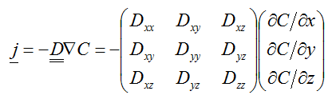
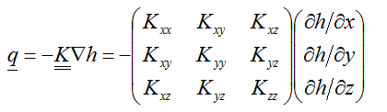
MT3D approach
MT3D → regular grids
Need gradient vector to compute flux at cell interfaces
solute transport
analog for flow

Slide 6
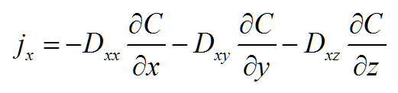
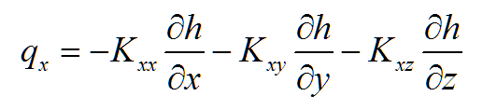
MT3D approach
MT3D → regular grids
Need gradient vector to compute flux at cell interfaces
solute transport
analog for flow

Slide 7
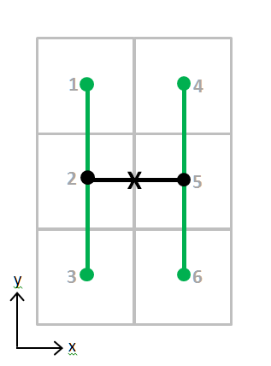
MT3D approach
Need an estimate of the gradient vector
Normal component is straightforward (black)
Tangential component from central differences (green), i.e., “weighted average”
How to generalize?

Slide 8
MAIN IDEAS
Use weighted averaging to incorporate gradient information from neighboring connections
Weight depends on distance
Weight depends on orientation
Combine estimates from both sides of the interface

Slide 9
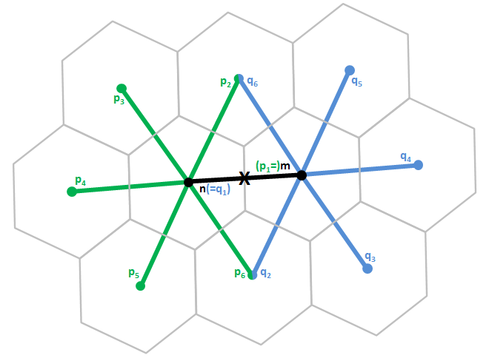
XT3D
Greater weight given to neighboring connections that are closer to the interface of interest

Slide 10
XT3D
Greater weight given to neighboring connections that are more closely aligned with the tangential direction

Slide 11
XT3D
Calculations on both sides of the interface are reconciled by enforcing continuity (solving for an “interface head”)

Slide 12

XT3D flow expression
Flow between two cells expressed in terms of conductance-like coefficients that involve neighbors and neighbors-of-neighbors
Larger stencil than in traditional conductance-based MODFLOW formulation

Slide 13
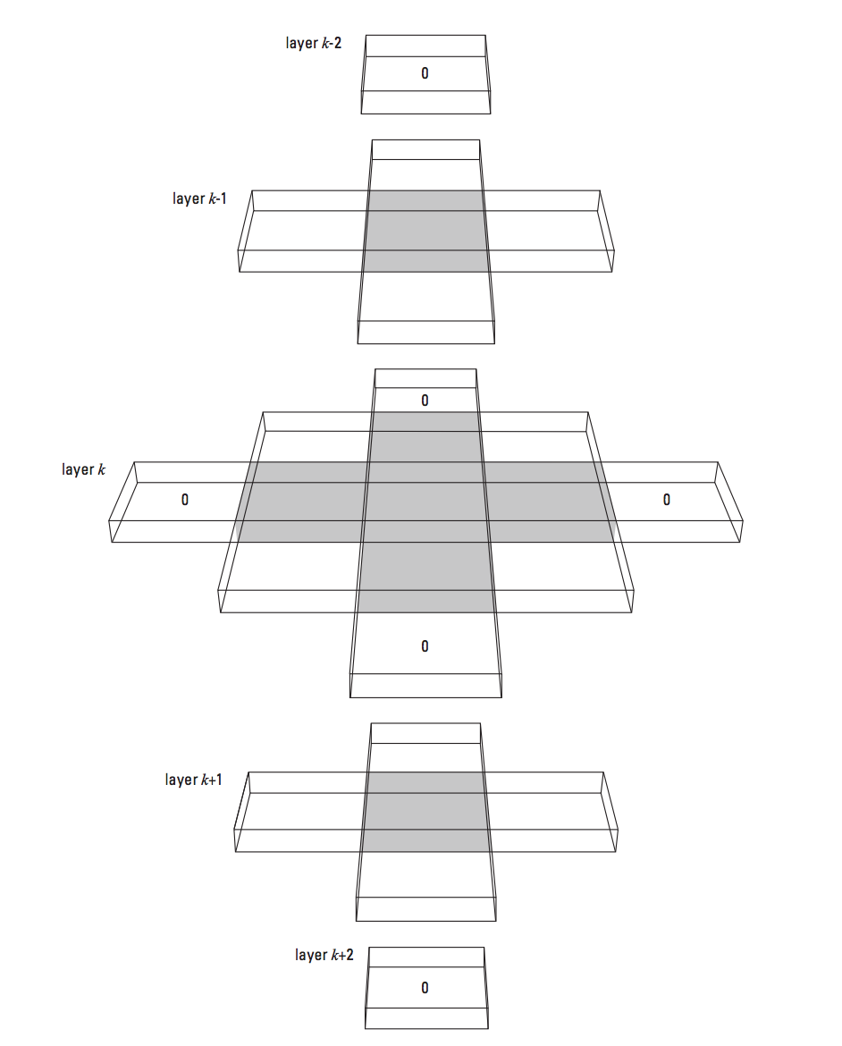
XT3D Stencil for a Regular Grid

Slide 14
XT3D pros & cons
Pros
Handles 3D anisotropy not aligned with the coordinate directions on structured and unstructured grids
Works on unstructured grids even if connections are not normal to interfaces, providing a “ghost-node-like” correction
Applicable to dispersion as well as flow
Cons
Slower than the default method
More memory than the default method
Cell-to-cell flows aren’t “1D”; more “correct” but harder to think about and calculate

Slide 15
Notes
Does not currently correct vertical conductances for partial dewatering
Matrix not necessarily symmetric → use BICGSTAB for linear acceleration
Don’t use ghost nodes at the same time

Slide 16
Using XT3D
Activate by including “XT3D” in the list of NPF Package options
For DIS (structured) and DISV (vertex-based, structured/unstructured) grids, XT3D gets all the information it needs from the standard DIS/DISV and NPF input.
For DISU (unstructured) grids, face-orientation information must be supplied.

