Slide 1
MODFLOW 6 Unstructured Grids
Advanced Modeling of Groundwater Flow (GW3099)
Lincoln, NE
October 22-26, 2018

Slide 2
Unstructured Grids
Definitions
1. Cell can be connected to any number of surrounding cells
2. Not a regular MODFLOW grid
Why use them?
Grid can conform to irregular model domain boundaries
Resolution can be added in areas of interest
Why not use them?
More complicated to work with
Poor grid design can lead to errors in the flow solution that are difficult to find and quantify

Slide 3
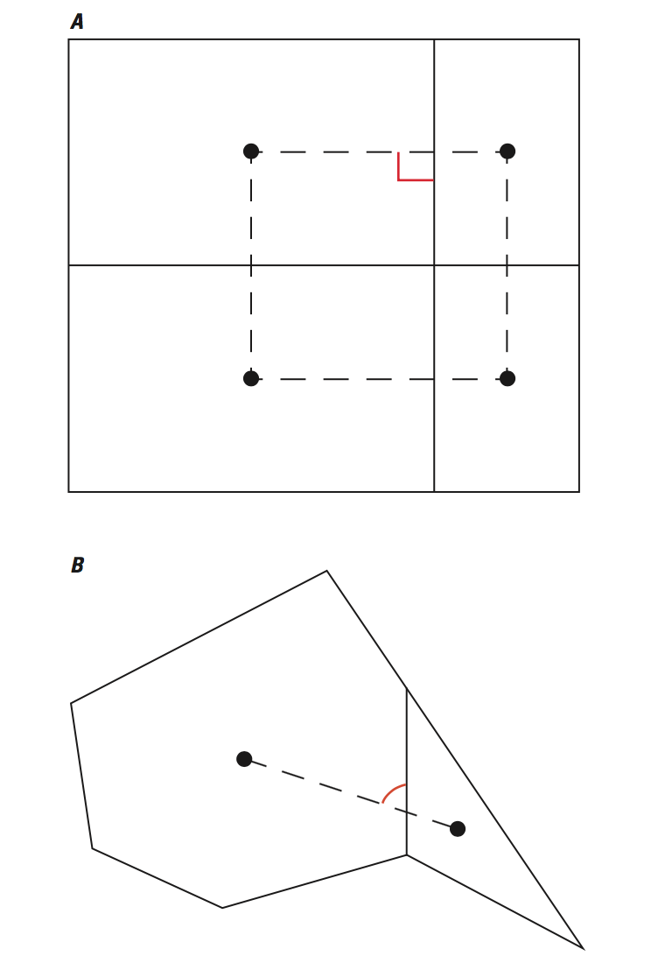
CVFD Requirements
Good
Connecting line bisects shared cell face at right angle
Possible issues

Slide 4
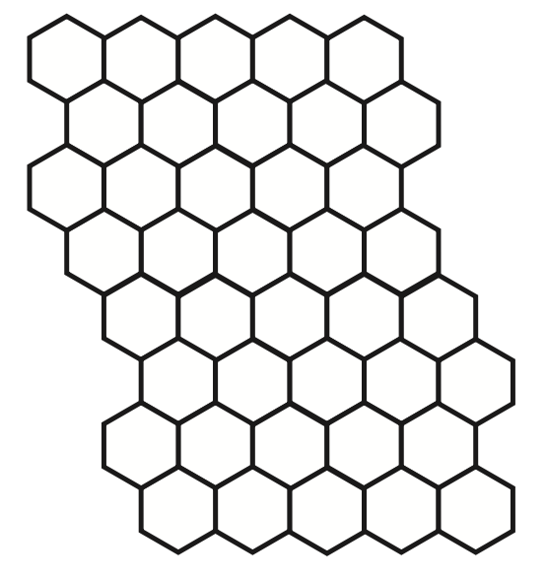
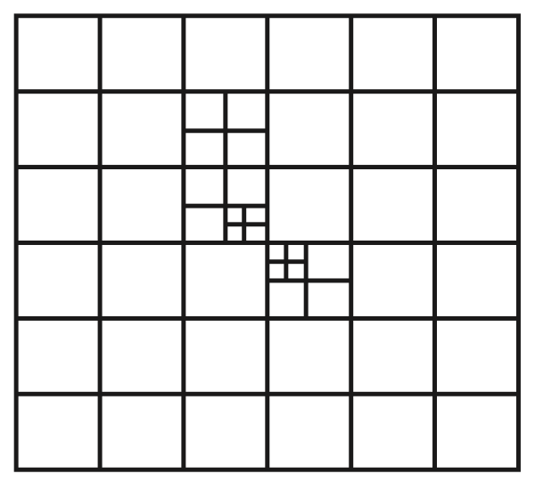
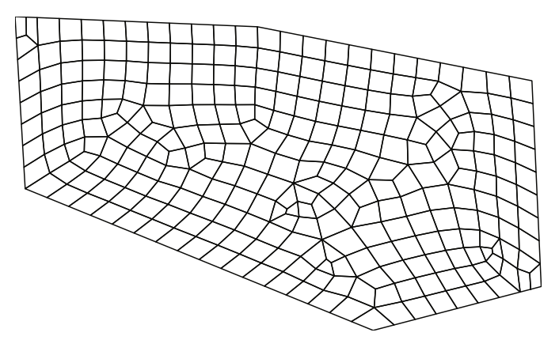
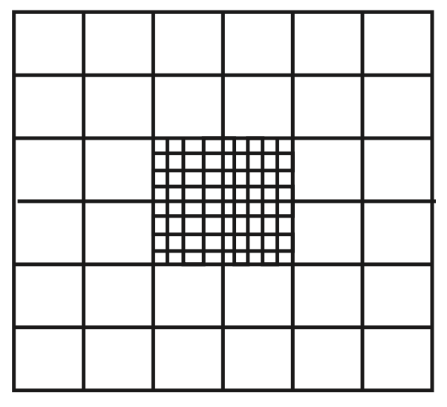
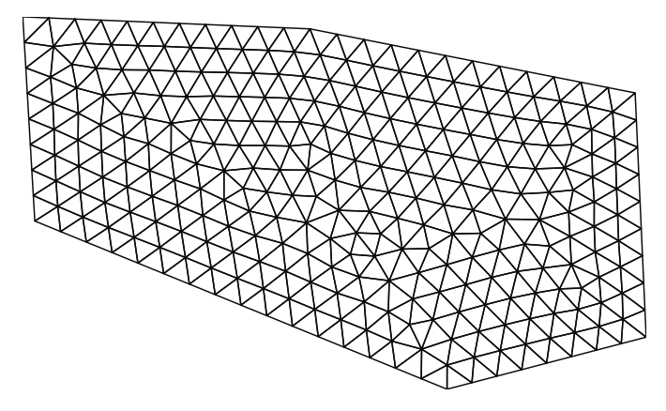
Types of Unstructured Grids
Rectangular based
Quadpatch
Quadtree / Octree
Triangular
Voronoi
Others

Slide 5
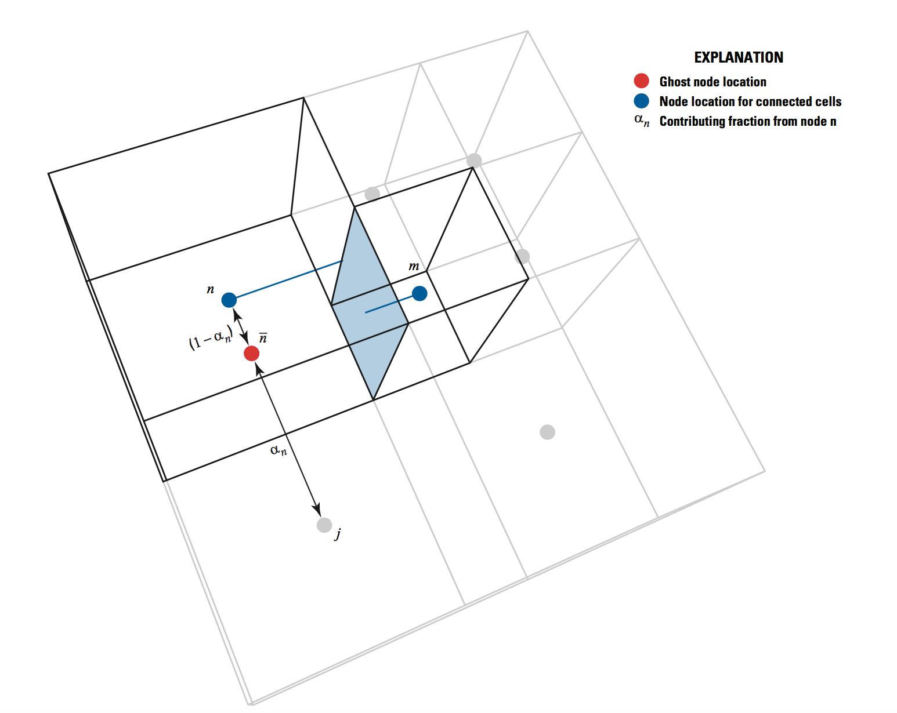
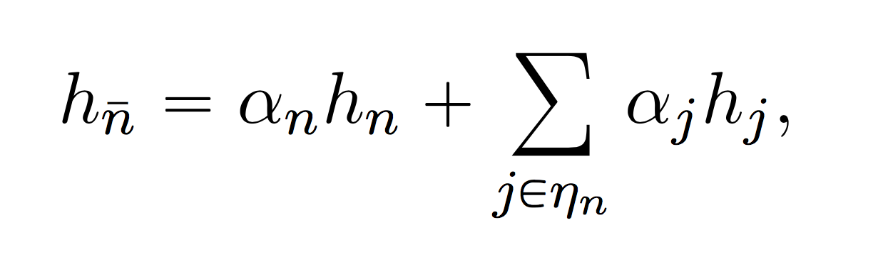
Ghost-Node Correction
Can be used to correct the flow calculation when the CVFD requirement is violated

Slide 6
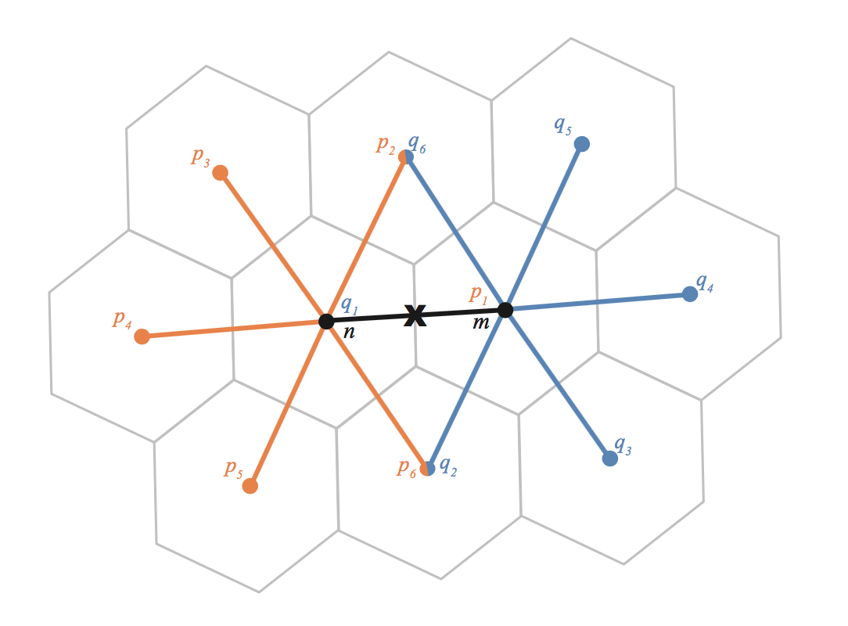
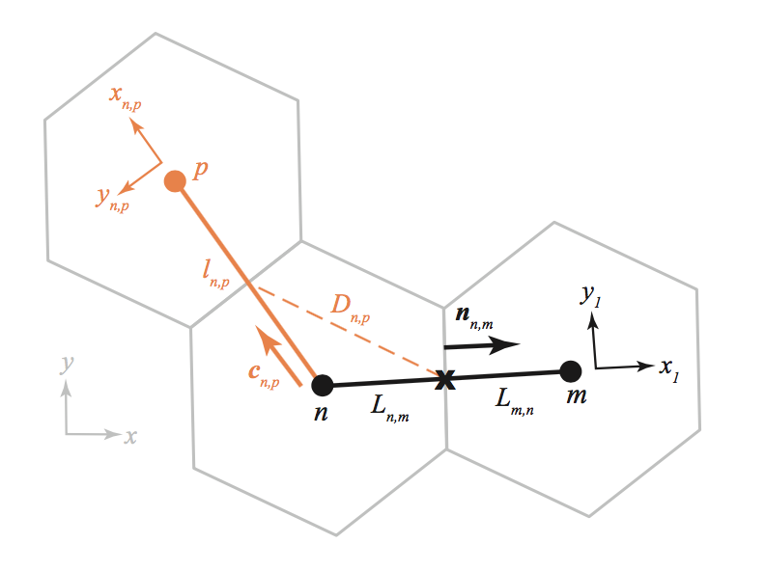
XT3D
Sophisticated flow formulation designed to handle full 3D anisotropy
XT3D also improves flow solution for grids that do not honor the CVFD requirements

Slide 7
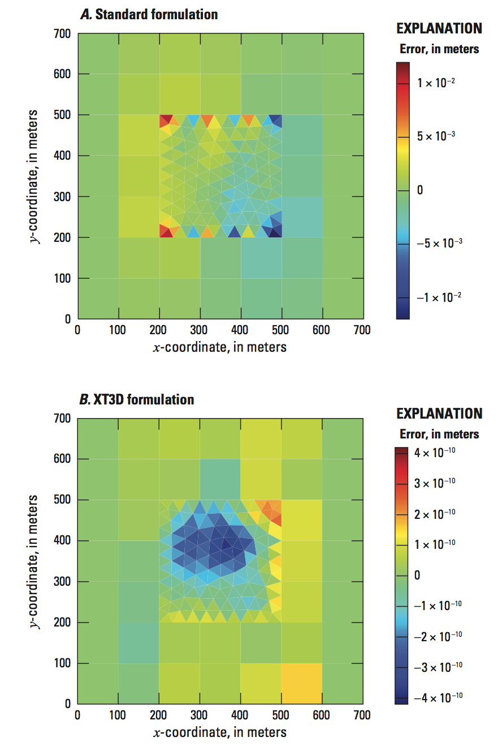
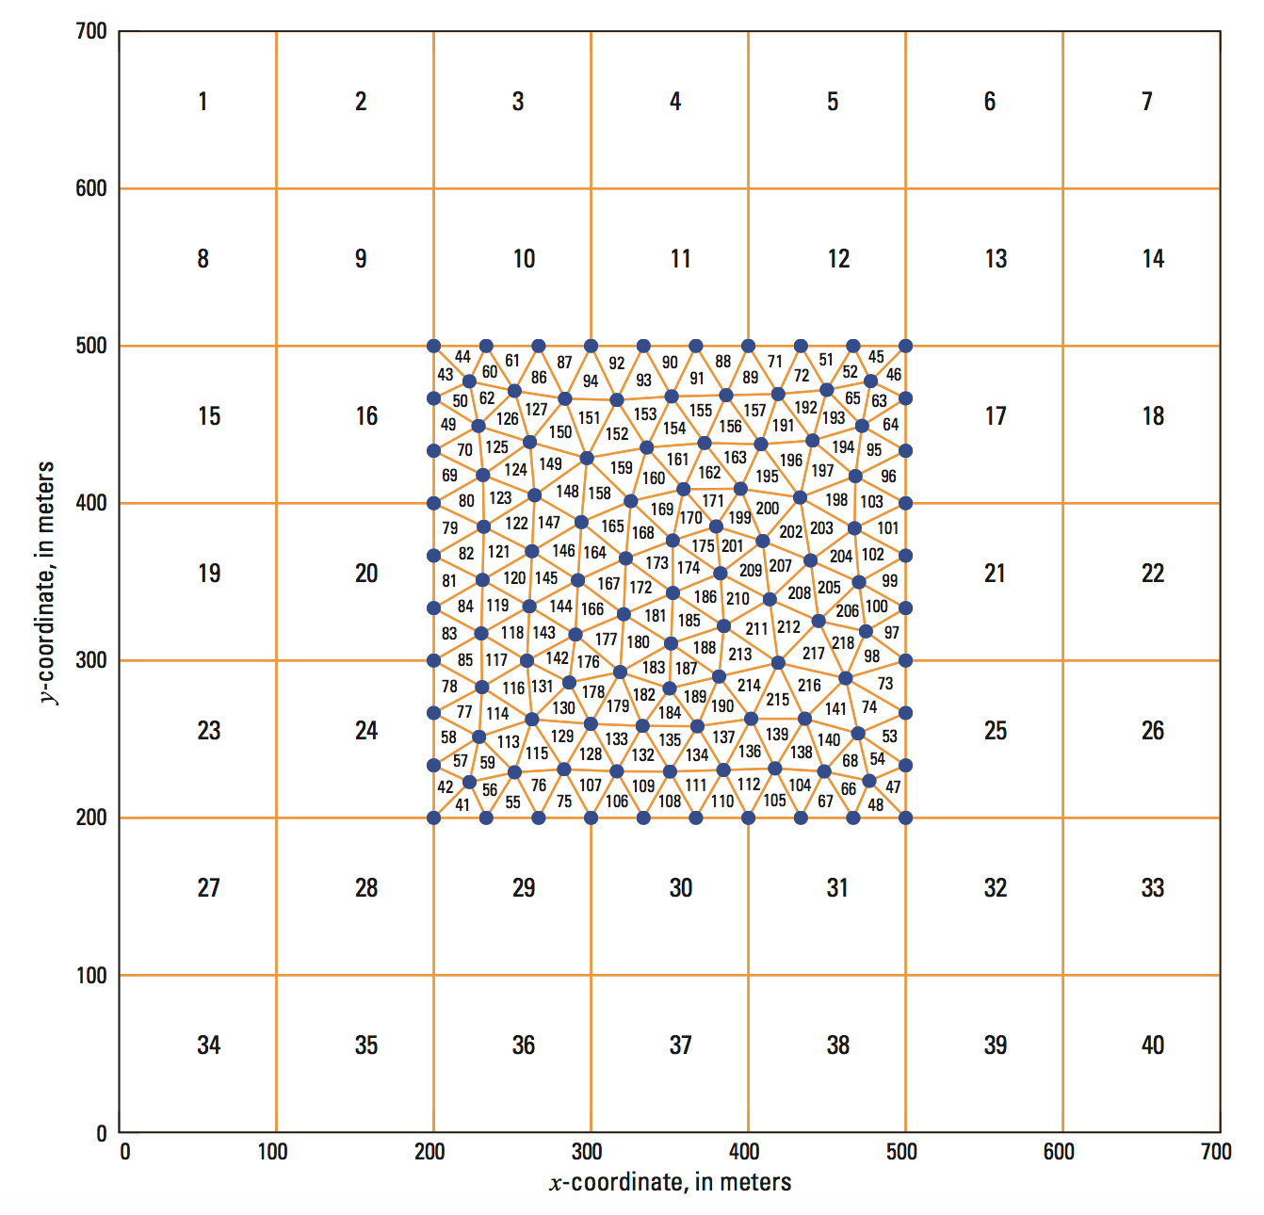
XT3D Solution

Slide 8
Unstructured Grids in MODFLOW 6
Discretization by Vertices (DISV) Package
New in MODFLOW 6
Unstructured Discretization (DISU) Package
Patterned after approach in MODFLOW-USG
Multiple models

Slide 9
“CELLID”
Regular MODFLOW grid (DIS)
(LAYER, ROW, COLUMN)
Discretization by Vertices (DISV)
(LAYER, CELL NUMBER)
Unstructured Discretization (DISU)
(CELL NUMBER)

Slide 10
DISV package

Slide 11
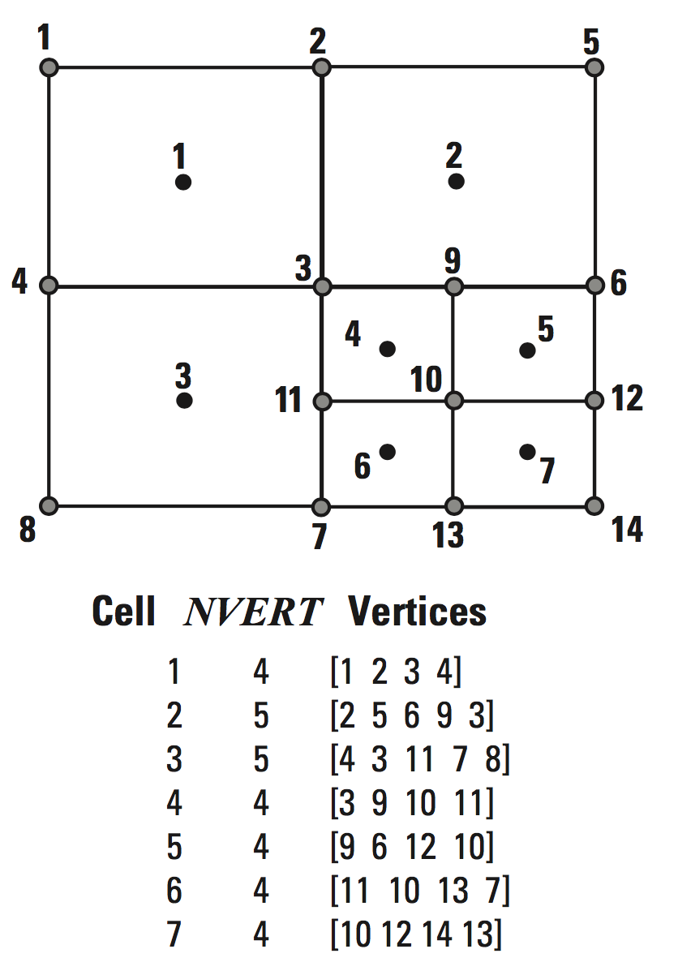
Vertices and Cells

Slide 12
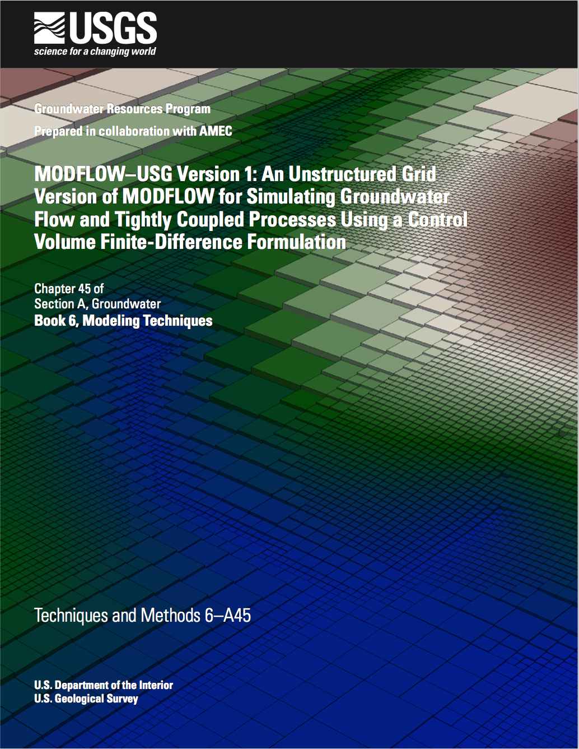
DISU Package

Slide 13
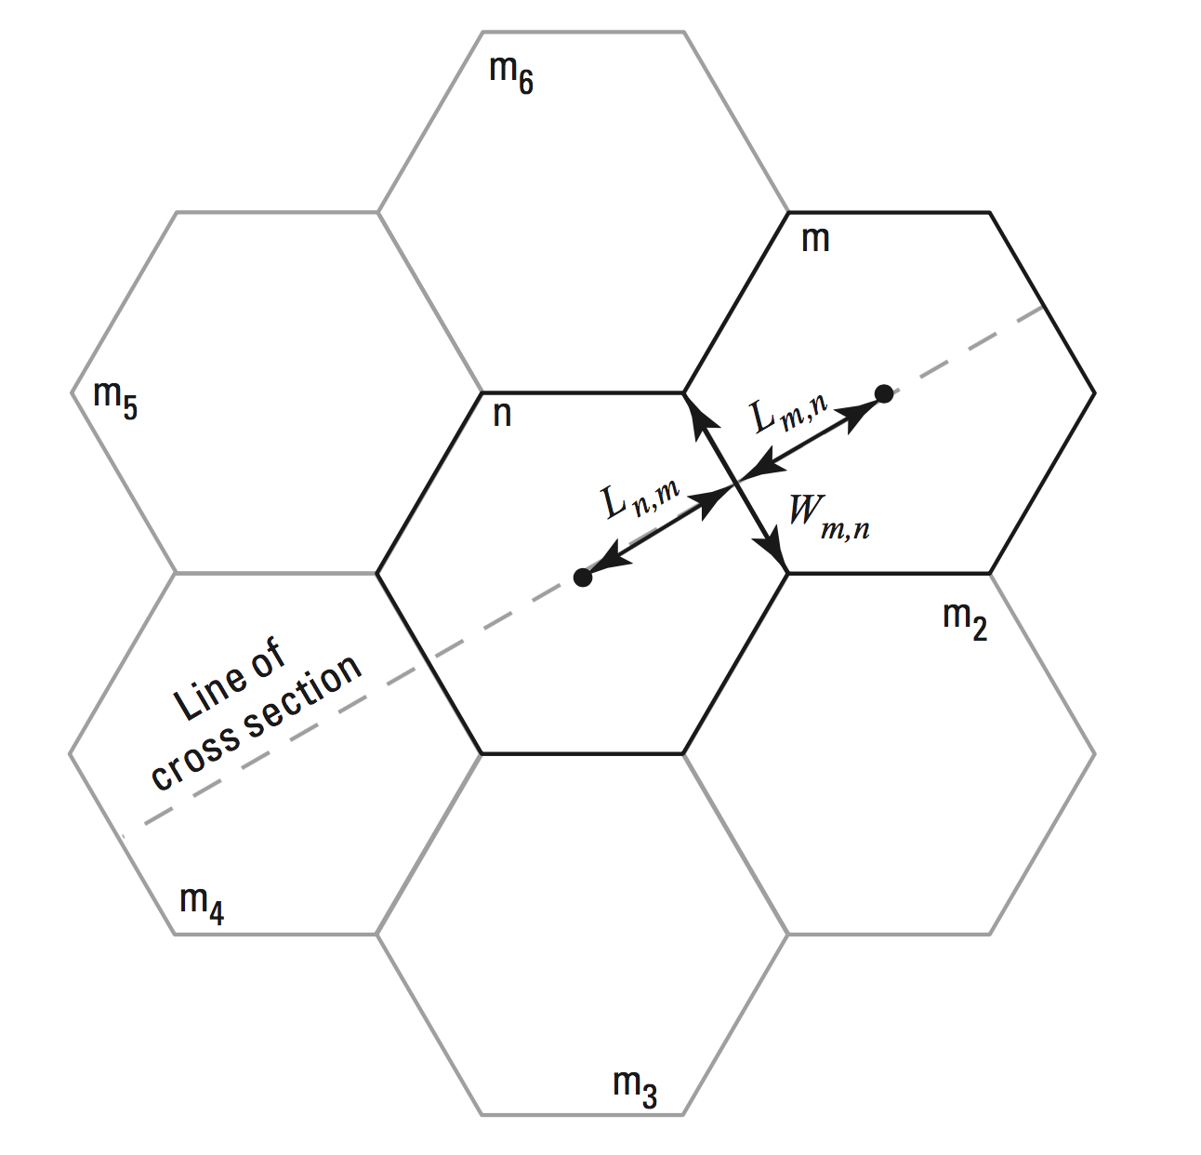
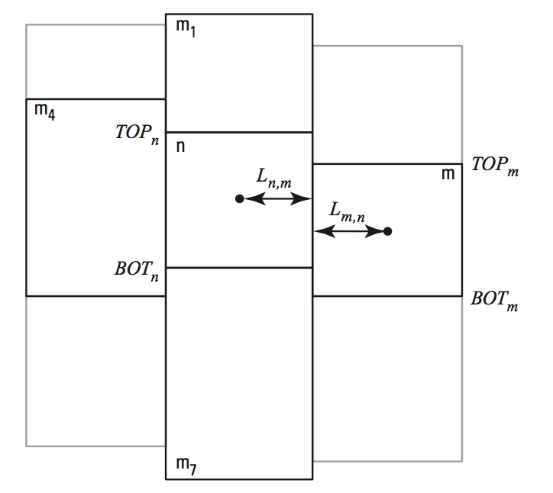
DISU Connections

Slide 14
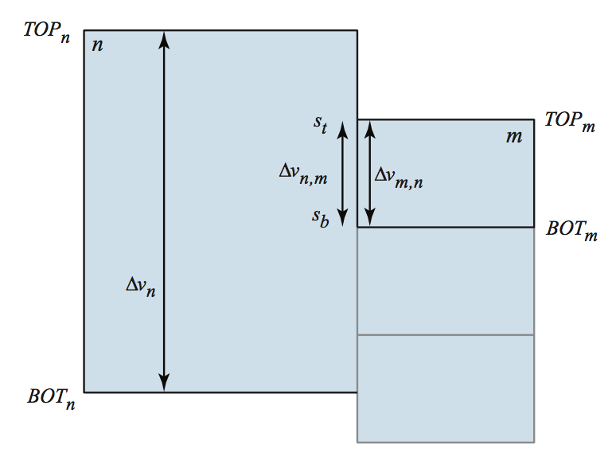
DISU Vertically Staggered Connections
Cell can be connected to more than one cell in a single horizontal direction

Slide 15
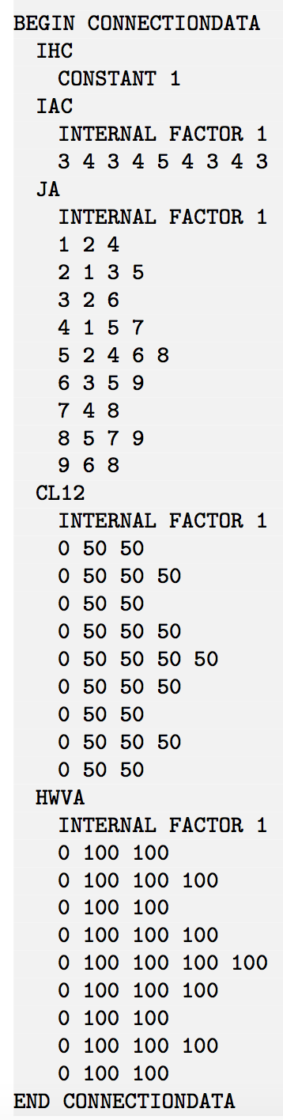
Connection Properties
1
2
3
4
5
6
7
8
9

