Slide 1


Richards’ Equation for 3-D Saturated / Unsaturated Flow
Sebastian Vazquez-Gasty
Dr. Sorab Panday

Slide 2
Overview
Richards’ Equation
Essentials Forms of the Richards’ Equation
Richards Equation solved in our case
Three-dimensional solution to Richards’ Equation
Unsaturated zone flow functions
Implementation
Test Problems
Input/Output
Flopy Package
Next Steps

Slide 3

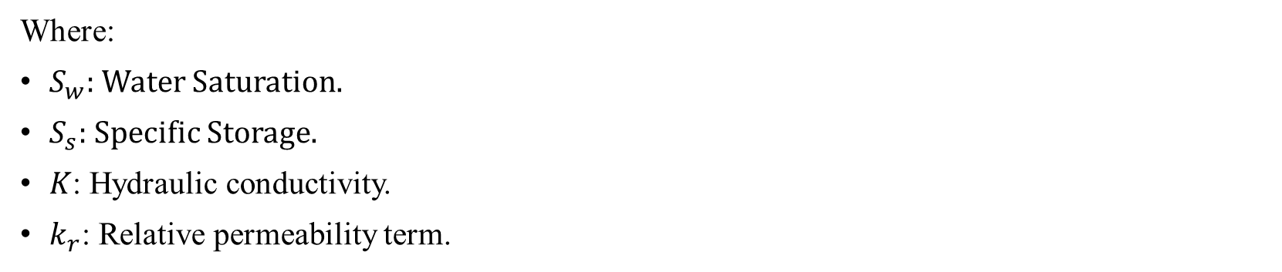
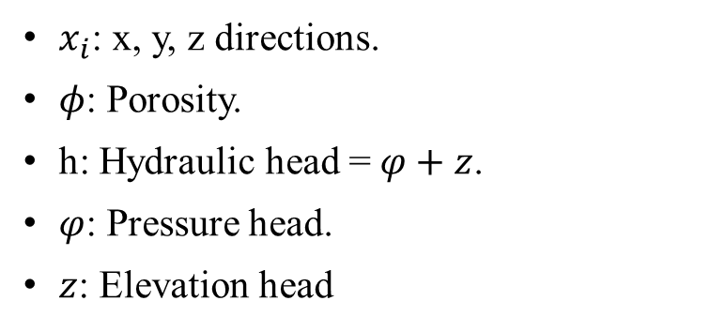

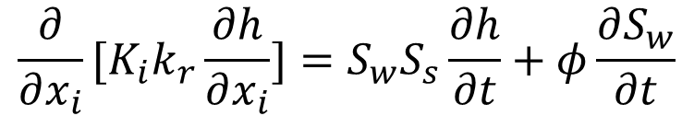
Richards Equation Total Head Based Formulation
$${{\frac{∂}{∂x_{i}}[K_{i}k_{r}\frac{∂h}{∂x_{i}}]=S}_{w}S}_{s}\frac{∂h}{∂t}+φ\frac{∂S_{w}}{∂t}$$
where
$$h=φ+z →φ=h−z$$
$x_{i}$: x, y, z directions.
$φ$: Porosity.
h: Hydraulic head = $φ+z$.
$φ$: Pressure head.
$z$: Elevation head
Where:
$S_{w}$: Water Saturation.
$S_{s}$: Specific Storage.
$K$: Hydraulic conductivity.
$k_{r}$: Relative permeability term.
Unconfined Flow Equation in MF6 cut out of MF6 document:
The equations are the same. MF6 equation ONLY shows for confined case (when MF was first built) so it is not properly written.

Slide 4
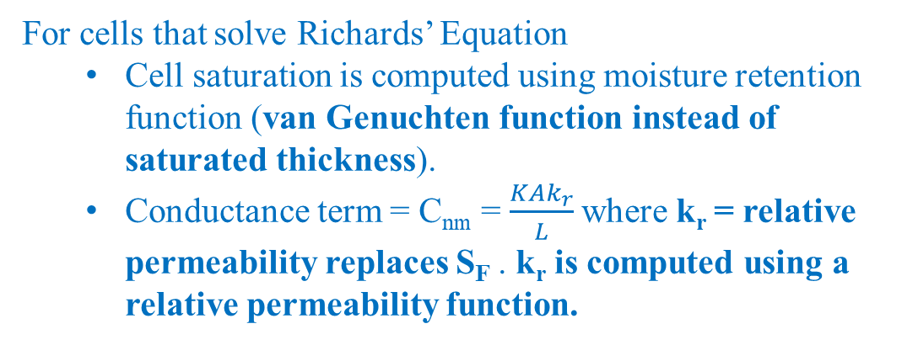
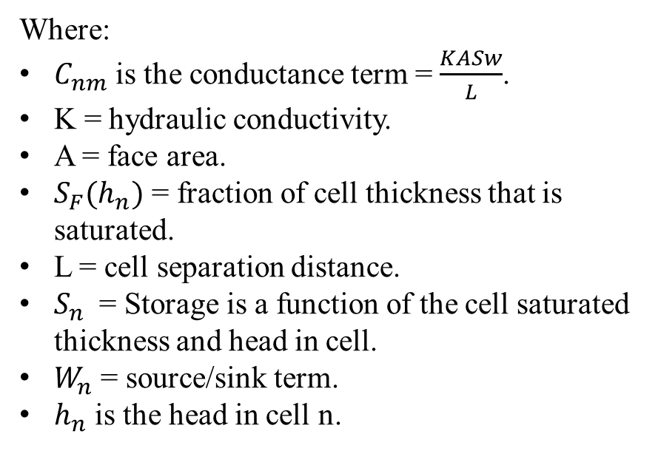
Three-dimensional solution to Richards’ Equation
CVFD expansion of confined/unconfined flow equation solved by MODFLOW 6 upstream weighted scheme
Where:
$C_{nm}$ is the conductance term = $\frac{KASw}{L}$.
K = hydraulic conductivity.
A = face area.
$S_{F}(h_{n})$ = fraction of cell thickness that is saturated.
L = cell separation distance.
$S_{n}$ = Storage is a function of the cell saturated thickness and head in cell.
$W_{n}$ = source/sink term.
$h_{n}$ is the head in cell n.
For cells that solve Richards’ Equation
Cell saturation is computed using moisture retention function (van Genuchten function instead of saturated thickness).
Conductance term = C_{nm} = $\frac{KAk_{r}}{L}$where k_{r} = relative permeability replaces S_{F} . k_{r} is computed using a relative permeability function.

Slide 5
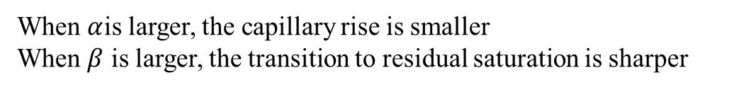
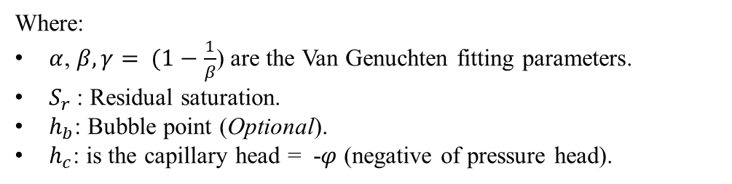
Unsaturated zone flow functions
Moisture retention function (van Genuchten):
Where:
Where:
$α$, $β,γ= (1−\frac{1}{β}$) are the Van Genuchten fitting parameters.
$S_{r}$: Residual saturation.
$h_{b}$: Bubble point (Optional).
$h_{c}$: is the capillary head = -$φ$ (negative of pressure head).
Behavior of the van Genuchten moisture retention function
When $α$is larger, the capillary rise is smaller
When $β$ is larger, the transition to residual saturation is sharper
 | S_{wr} | α (1/L) | β
Clayey | 0.25 | 0.5 | 3
Sandy | 0.1 | 3 | 6

Slide 6
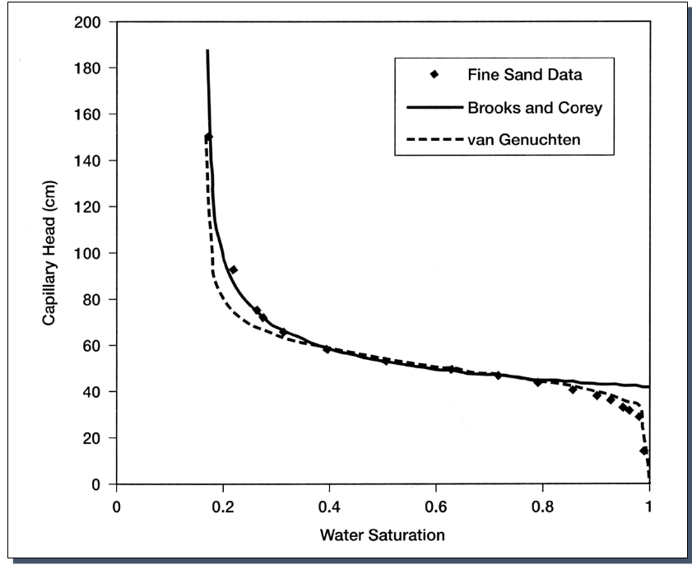
Unsaturated zone flow functions
Relative permeability function (Van Genuchten)
Relative permeability function (Brooks Corey)
Where n is the Brooks Corey exponent
The Brooks Corey and Van Genuchten relative permeability functions are similar when n = 3 + 2/(β - 1)
The Brooks Corey function gives better convergence than Van Genuchten for relative permeability.
 | S_{wr} | α (1/L) | β
Clayey | 0.25 | 0.5 | 3
Sandy | 0.1 | 3 | 6
Brook n
4
3.4
Van Genuchten
Brooks Corey
Curves are similar

Slide 7

Differences between MF6 and Richards’ Equation Flow Term
CVFD equation is the same
As noted before,
For cells that solve Richards’ Equation
Cell saturation is computed using moisture retention function (van Genuchten function instead of saturated thickness).
Conductance term = C_{nm} = $\frac{KAk_{r}}{L}$where k_{r} = relative permeability replaces S_{F} . k_{r} is computed using a relative permeability function.

Slide 8
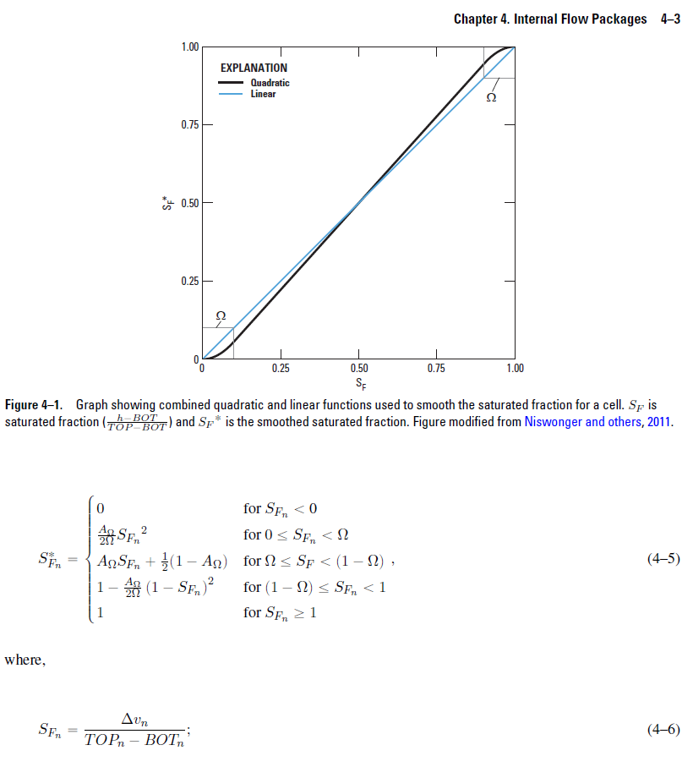

Differences between MF6 and Richards’ Equation Flow Term
So replace
With a function that computes k_{r} as below
$φ=h−z$;
and
For van G or
For Brooks Corey
ALSO
k_{r} is applied to all directions not just horizontal direction
Vertically staggered Grid considerations are not applied

Slide 9

Differences between MF6 and Richards’ Equation Storage Term
The storage term is same, only S is computed differently.
So replace
With a function that computes S_{w} as below
$φ=h−z$;
S_{w} = S_{e} ( 1-S_{r}) + S_{r}

Slide 10
Aside from differences above, rest of writeup is same as in MF 6
Formulation of Newton Raphson solution same as on Pg 2-14 and 2-15 of MF 6 document
Newton Raphson expansion on CVFD cells is same as Section Newton-Raphson Formulation – Horizontal Conductance on pg 4-10, 4-11, and 4-12 of MF6 document
Note that this applies to vertical direction also for a Richard’s equation cell that is an upstream cell.
Storage term expansion is same as in Section Newton-Raphson Formulation, on pg 5-4 and 5-5 of the MF6 document

Slide 11
Input/Output
Use VTK type submodule for Richards’ Equation
Use matrices for input of alpha, beta, Sr, Brooks N
Output Saturation file
Output pressure head file (?)

