Slide 1
What is our Input Data Model?
How do we represent our input so that it can be ”filled” from
MODFLOW 6 Input file
NetCDF
A Python call
Flopy has a way of representing all MODFLOW 6 input. Is there anything we can learn from that? How could we send a flopy mf6 variable through the API and into mf6? Setters/getters? Constructors?

Slide 2
MODFLOW 6 input types
Keyword
String
Integer (array if shape is specified)
Double precision (array if shape is specified)
Record
Recordrepeating
Recarray
Keystring

Slide 3
Memory Manager Option
Memory Manager
Input file
Model Object

Slide 4
Derived-Type Intermediary
Derived Type
(options)
Input file
Model Object
Derived Type
(griddata)

Slide 5
Data Flow
API Injection
MODFLOW 6 Input File
NetCDF
Input File
Memory Manager (new instance?)
From Mf6 input Constructor
From NetCDF Constructor
From Memory Constructor
Derived Type
(GwfDisInputDataType)
Package Object

Slide 6
Data Flow
API Injection
MODFLOW 6 Input File
NetCDF
Input File
Memory Manager (new instance?)
From Mf6 input Constructor
From NetCDF Constructor
From Memory Constructor
Derived Type
(GwfDisInputDataType)
Memory Manager (new instance?)
Package Object

Slide 7
Challenges
Memorylist is a global variable and all mem_allocate() statements add to it. Should maybe create a MemoryManager object so that we can use it more generally.
The Memory Manager knows that a string was allocated, but it does not store a pointer to it, so strings can’t be retrieved later with mem_setptr().
Input doesn’t always cleanly map to the model object variable. For example, the NPF Option, ALTERNATIVE_CELL_AVERAGING can be assigned a text string. This is stored in the NPF object as npf%icellavg, which has a value of 1, 2, or 3.
IDOMAIN is challenging. Input is by nodesuser, but model stores nodesreduced.

Slide 8
Ideas
Store options/dimensions as strings?
Use iso-c types

Slide 9
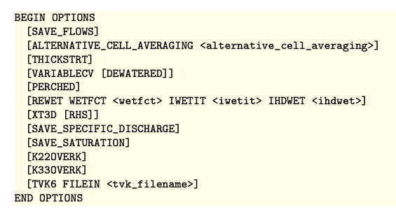
ipakcb = -1
icellavg = 1, 2, 3
Ithickstrt = 1
Ivarcv = 1; idewatcv = 1
Iperched = 1
Wetfct, wetit, ihdwet
Ixt3d = 1, 2
Isavspdis = 1; icalcspdis = 1
Isavsat = 1
Ik22overk = 1
Ik33overk = 1
Intvk = getunit

Slide 10
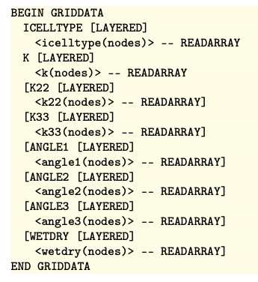
icelltype
K11
K22
K33
Angle1
Angle2
Angle3
wetdry

Slide 11
Construct GwfInput(npackages) from namefile
Construct DisInput first
Then construct NpfInput, IcInput, OcInput, ChdInput, …
Construct Gwf Packages
Questions
Should GwfPackages point to data in the Input classes? Or should we copy the data in, and then destroy the Input objects?
What do we do about subpackages?
TVK, TVS, TS6, OBS6,
GNC6, MVR6

Slide 12
Order of operations
Work on constructing DisInput, NpfInput, IcInput, and ChdInput from a chararray:
Chararray(1) = “DIS6 mymodel.dis”
Chararray(2) = “NPF6 mymodel.npf”
Chararray(3) = “IC6 mymodel.ic”
Chararray(4) = “CHD6 mymodel.ic”
Work on constructing GwfDis, GwfNpf, GwfIc, and GwfChd from the Input data. This construction should replace CR, DF, AR routines
call construct_dis(dis, dis_input)
call construct_npf(npf, npf_input)
call construct_ic(ic, ic_input)
call construct_chd(chd, chd_input)

