Slide 1
Building Java Programs
Chapter 9: Inheritance and Interfaces

Slide 2
Chapter outline
background
  categories of employees
  relationships and hierarchies
inheritance programming
  creating subclasses
  overriding behavior
  multiple levels of inheritance
  interacting with the superclass using the super keyword
  inheritance and design
polymorphism
  "polymorphism mystery" problems
interfaces

Slide 3
Inheritance
  reading: 9.1

Slide 4
The software crisis
software engineering: The practice of conceptualizing, designing, developing, documenting, and testing large-scale computer programs.
Large-scale projects face many issues:
  getting many programmers to work together
  getting code finished on time
  avoiding redundant code
  finding and fixing bugs
  maintaining, improving, and reusing existing code
code reuse: The practice of writing program code once and using it in many contexts.

Slide 5
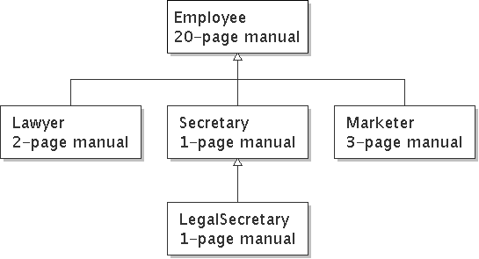
Employee analogy
Consider a law firm with many types of employees.
common rules: hours, vacation time, benefits, regulations, ...
    all employees attend common orientation to learn general rules
    each employee receives 20-page manual of the common rules
each subdivision also has specific rules
    employee attends a subdivision-specific orientation to learn them
    employee receives a smaller (1-3 page) manual of these rules
    smaller manual adds some rules and also changes some rules from the large manual ("use the pink form instead of yellow form"...)

Slide 6
Separating behavior
Why not just have a 22 page Lawyer manual, a 21-page Secretary manual, a 23-page Marketer manual, etc.?
Some advantages of the separate manuals:
  maintenance: If a common rule changes, we'll need to update only the common manual.
  locality: A person can look at the lawyer manual and quickly discover all rules that are specific to lawyers.
Some key ideas from this example:
  It's useful to be able to describe general rules that will apply to many groups (the 20-page manual).
  It's also useful for a group to specify a smaller set of rules for itself, including being able to replace rules from the overall set.

Slide 7
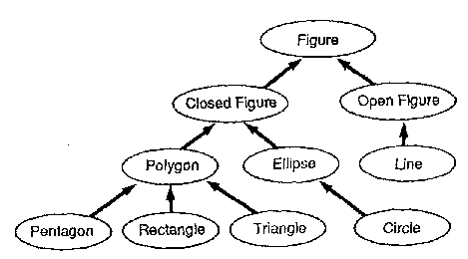
Is-a relationships, hierarchies
is-a relationship: A hierarchical connection where one category can be treated as a specialized version of another.
  every marketer is an employee
  every legal secretary is a secretary
inheritance hierarchy: A set of classes connected by is-a relationships that can share common code.
  Often drawn as a downward tree of connected boxes or ovals representing classes:

Slide 8
Employee regulations
Consider the following employee regulations:
  Employees work 40 hours per week.
  Employees make $40,000 per year, except legal secretaries who make $5,000 extra per year ($45,000 total), and marketers who make $10,000 extra per year ($50,000 total).
  Employees have 2 weeks of paid vacation leave per year, except lawyers who get an extra week (a total of 3).
  Employees should use a yellow form to apply for leave, except for lawyers who use a pink form.
Each type of employee has some unique behavior:
  Lawyers know how to sue.
  Marketers know how to advertise.
  Secretaries know how to take dictation.
  Legal secretaries know how to prepare legal documents.

Slide 9
General employee code
// A class to represent employees in general (20-page manual).
public class Employee {
public int getHours() {
return 40; // works 40 hours / week
}
public double getSalary() {
return 40000.0; // $40,000.00 / year
}
public int getVacationDays() {
return 10; // 2 weeks' paid vacation
}
public String getVacationForm() {
return "yellow"; // use the yellow form
}
}
  Exercise: Implement class Secretary, based on the previous employee regulations.

Slide 10
Redundant secretary code
// A redundant class to represent secretaries.
public class Secretary {
public int getHours() {
return 40; // works 40 hours / week
}
public double getSalary() {
return 40000.0; // $40,000.00 / year
}
public int getVacationDays() {
return 10; // 2 weeks' paid vacation
}
public String getVacationForm() {
return "yellow"; // use the yellow form
}
public void takeDictation(String text) {
System.out.println("Taking dictation of text: " + text);
}
}

Slide 11
Desire for code-sharing
The takeDictation method is the only unique behavior in the Secretary class.
We'd like to be able to say the following:
// A class to represent secretaries.
public class Secretary {
<copy all the contents from Employee class.>
public void takeDictation(String text) {
System.out.println("Taking dictation of text: " + text);
}
}

Slide 12
Inheritance
inheritance: A way to form new classes based on existing classes, taking on their attributes/behavior.
  a way to group related classes
  a way to share code between two or more classes
We say that one class can extend another by absorbing its state and behavior.
  superclass: The parent class that is being extended.
  subclass: The child class that extends the superclass and inherits its behavior.
    The subclass receives a copy of every field and method from its superclass.

Slide 13
Inheritance syntax
Creating a subclass, general syntax:
  public class <name> extends <superclass name> {
  Example:
  public class Secretary extends Employee {
  ....
  }
By extending Employee, each Secretary object now:
  receives a getHours, getSalary, getVacationDays, and getVacationForm method automatically
  can be treated as an Employee by any other code (seen later)
  (e.g. a Secretary could be stored in a variable of type Employee or stored as an element of an Employee[])

Slide 14
Improved secretary code
// A class to represent secretaries.
public class Secretary extends Employee {
public void takeDictation(String text) {
System.out.println("Taking dictation of text: " + text);
}
}
Now we only have to write the portions that are unique to each type.
  Secretary inherits getHours, getSalary, getVacationDays, and getVacationForm methods from Employee.
  Secretary adds the takeDictation method.

Slide 15
Implementing Lawyer
Let's implement a Lawyer class.
Consider the following employee regulations:
  Lawyers who get an extra week of paid vacation (a total of 3).
  Lawyers use a pink form when applying for vacation leave.
  Lawyers have some unique behavior: they know how to sue.
The problem: We want lawyers to inherit most of the behavior of the general employee, but we want to replace certain parts with new behavior.

Slide 16
Overriding methods
override: To write a new version of a method in a subclass that replaces the superclass's version.
  There is no special syntax for overriding.
  To override a superclass method, just write a new version of it in the subclass. This will replace the inherited version.
  Example:
  public class Lawyer extends Employee {
  // overrides getVacationForm method in Employee class
  public String getVacationForm() {
  return "pink";
  }
  ...
  }
  Exercise: Complete the Lawyer class.

Slide 17
Complete Lawyer class
// A class to represent lawyers.
public class Lawyer extends Employee {
// overrides getVacationForm from Employee class
public String getVacationForm() {
return "pink";
}
// overrides getVacationDays from Employee class
public int getVacationDays() {
return 15; // 3 weeks vacation
}
public void sue() {
System.out.println("I'll see you in court!");
}
}
  Exercise: Now complete the Marketer class. Marketers make $10,000 extra ($50,000 total) and know how to advertise.

Slide 18
Complete Marketer class
// A class to represent marketers.
public class Marketer extends Employee {
public void advertise() {
System.out.println("Act now while supplies last!");
}
public double getSalary() {
return 50000.0; // $50,000.00 / year
}
}

Slide 19
Levels of inheritance
Deep hierarchies can be created by multiple levels of subclassing.
  Example: The legal secretary is the same as a regular secretary except for making more money ($45,000) and being able to file legal briefs.
  public class LegalSecretary extends Secretary {
  ...
  }
  Exercise: Complete the LegalSecretary class.

Slide 20
Complete LegalSecretary class
// A class to represent legal secretaries.
public class LegalSecretary extends Secretary {
public void fileLegalBriefs() {
System.out.println("I could file all day!");
}
public double getSalary() {
return 45000.0; // $45,000.00 / year
}
}

Slide 21
Interacting with the superclass: the super keyword
  reading: 9.3

Slide 22
Changes to common behavior
Imagine that a company-wide change occurs that affects all employees.
  Example: Because of inflation, everyone is given a $10,000 raise.
  The base employee salary is now $50,000.
  Legal secretaries now make $55,000.
  Marketers now make $60,000.
We must modify our code to reflect this policy change.

Slide 23
Modifying the superclass
This modified Employee class handles the new raise:
  // A class to represent employees in general (20-page manual).
  public class Employee {
  public int getHours() {
  return 40; // works 40 hours / week
  }
  public double getSalary() {
  return 50000.0; // $50,000.00 / year
  }
  ...
  }
  What problem now exists in the code?
The Employee subclasses are now incorrect.
  They have overridden the getSalary method to return other values such as 45,000 and 50,000 that need to be changed.

Slide 24
An unsatisfactory solution
public class LegalSecretary extends Secretary {
public double getSalary() {
return 55000.0;
}
...
}
public class Marketer extends Employee {
public double getSalary() {
return 60000.0;
}
...
}
  The employee subtypes' salaries are tied to the overall base employee salary, but the subclasses' getSalary code does not reflect this relationship.

Slide 25
Calling overridden methods
A subclass can call an overridden method with the super keyword.
Calling an overridden method, syntax:
  super . <method name> ( <parameter(s)> )
  Example:
  public class LegalSecretary extends Secretary {
  public double getSalary() {
  double baseSalary = super.getSalary();
  return baseSalary + 5000.0;
  }
  ...
  }
  Exercise: Modify the Lawyer and Marketer classes to also use the super keyword.

Slide 26
Improved subclasses
public class Lawyer extends Employee {
public String getVacationForm() {
return "pink";
}
public int getVacationDays() {
return super.getVacationDays() + 5;
}
public void sue() {
System.out.println("I'll see you in court!");
}
}
public class Marketer extends Employee {
public void advertise() {
System.out.println("Act now while supplies last!");
}
public double getSalary() {
return super.getSalary() + 10000.0;
}
}

Slide 27
Inheritance and constructors
Imagine that we want to give employees more vacation days the longer they've been with the company.
  For each year worked, we'll award 2 additional vacation days.
  When an Employee object is constructed, we'll pass in the number of years the person has been with the company.
  This will require us to modify our Employee class and add some new state and behavior.
  Exercise: Make the necessary modifications to the Employee class.

Slide 28
Modified Employee class
public class Employee {
private int years;
public Employee(int years) {
this.years = years;
}
public int getHours() {
return 40;
}
public double getSalary() {
return 50000.0;
}
public int getVacationDays() {
return 10 + 2 * years;
}
public String getVacationForm() {
return "yellow";
}
}

Slide 29
Problem with constructors
Now that we've added the constructor to the Employee class, our subclasses do not compile. The error:
  Lawyer.java:2: cannot find symbol
  symbol : constructor Employee()
  location: class Employee
  public class Lawyer extends Employee {
  ^
  The short explanation: Once we write a constructor (that requires parameters) in the superclass, we must now write constructors for our employee subclasses as well.
  The long explanation: (next slide)

Slide 30
The detailed explanation
Constructors aren't inherited.
  The Employee subclasses don't inherit the
  public Employee(int years) constructor.
  Since our subclasses don't have constructors, they receive a default parameterless constructor that contains the following:
    public Lawyer() {
    super(); // calls public Employee() constructor
    }
But our public Employee(int years) replaces
the default Employee constructor.
  Therefore all the subclasses' default constructors are now trying to call a non-existent default superclass constructor.

Slide 31
Calling superclass constructor
Syntax for calling superclass's constructor:
  super( <parameter(s)> );
  Example:
  public class Lawyer extends Employee {
  public Lawyer(int years) {
  super(years); // call Employee constructor
  }
  ...
  }
  The call to the superclass constructor must be the first statement in the subclass constructor.
  Exercise: Make a similar modification to the Marketer class.

Slide 32
Modified Marketer class
// A class to represent marketers.
public class Marketer extends Employee {
public Marketer(int years) {
super(years);
}
public void advertise() {
System.out.println("Act now while supplies last!");
}
public double getSalary() {
return super.getSalary() + 10000.0;
}
}
  Exercise: Modify the Secretary subclass to make it compile:
    Secretaries' years of employment are not tracked and they do not earn extra vacation for them.
    Secretary objects are also constructed without a years parameter.

Slide 33
Modified Secretary class
// A class to represent secretaries.
public class Secretary extends Employee {
public Secretary() {
super(0);
}
public void takeDictation(String text) {
System.out.println("Taking dictation of text: " + text);
}
}
  Note that since the Secretary doesn't require any parameters to its constructor, the LegalSecretary now compiles without a constructor (its default constructor calls the parameterless Secretary constructor).
This isn't the best solution; it isn't that Secretaries work for 0 years, it's that they don't receive a bonus. How can we fix it?

Slide 34
Inheritance and fields
Suppose that we want to give lawyers a $5000 raise for each year they've been with the company.
The following modification doesn't work:
  public class Lawyer extends Employee {
  public Lawyer(int years) {
  super(years);
  }
  public double getSalary() {
  return super.getSalary() + 5000 * years;
  }
  ...
  }
The error is the following:
  Lawyer.java:7: years has private access in Employee
  return super.getSalary() + 5000 * years;
  ^

Slide 35
Private access limitations
  public class Lawyer extends Employee {
  public Lawyer(int years) {
  super(years);
  }
  public double getSalary() {
  return super.getSalary() + 5000 * years;
  }
  ...
  }
The error is the following:
  Lawyer.java:7: years has private access in Employee
  return super.getSalary() + 5000 * years;
  ^
Private fields cannot be directly accessed from other classes, not even subclasses.
  One reason for this is to prevent malicious programmers from using subclassing to circumvent encapsulation.
  How can we get around this limitation?

Slide 36
Improved Employee code
Add an accessor for any field needed by the superclass.
public class Employee {
private int years;
public Employee(int years) {
this.years = years;
}
public int getYears() {
return years;
}
...
}
public class Lawyer extends Employee {
public Lawyer(int years) {
super(years);
}
public double getSalary() {
return super.getSalary() + 5000 * getYears();
}
...
}

Slide 37
Revisiting Secretary
The Secretary class currently has a poor solution.
  We set all Secretaries to 0 years because they do not get a vacation bonus for their service.
  If we call getYears on a Secretary object, we'll always get 0.
  This isn't a good solution; what if we wanted to give some other reward to all employees based on years of service?
Let's redesign our Employee class a bit to allow for a better solution.

Slide 38
Improved Employee code
Let's separate the standard 10 vacation days from those that are awarded based on seniority.
public class Employee {
private int years;
public Employee(int years) {
this.years = years;
}
public int getVacationDays() {
return 10 + getSeniorityBonus();
}
// vacation days given for each year in the company
public int getSeniorityBonus() {
return 2 * years;
}
...
}
  How does this help us improve the Secretary?

Slide 39
Improved Secretary code
The Secretary can selectively override the getSeniorityBonus method, so that when it runs its getVacationDays method, it will use this new version as part of the computation.
  Choosing a method at runtime like this is called dynamic binding.
public class Secretary extends Employee {
public Secretary(int years) {
super(years);
}
// Secretaries don't get a bonus for their years of service.
public int getSeniorityBonus() {
return 0;
}
public void takeDictation(String text) {
System.out.println("Taking dictation of text: " + text);
}
}

Slide 40
Polymorphism
  reading: 9.2

Slide 41
Polymorphism
polymorphism: The ability for the same code to be used with several different types of objects and behave differently depending on the type of object used.
A reference variable of a type T can legally refer to an object of any subclass of T.
  Employee person = new Lawyer(3);
  System.out.println(person.getSalary()); // 65000.0
  System.out.println(person.getVacationForm()); // pink
  You can call any methods from Employee on the variable person, but not any methods specific to Lawyer (such as sue).
  Once a method is called on the object, it behaves in its normal way (as a Lawyer, not as a normal Employee).

Slide 42
Polymorphism + parameters
You can declare methods to accept superclass types as parameters, then pass a parameter of any subtype.
  public class EmployeeMain {
  public static void main(String[] args) {
  Lawyer lisa = new Lawyer(3);
  Secretary steve = new Secretary(2);
  printInfo(lisa);
  printInfo(steve);
  }
  public static void printInfo(Employee empl) {
  System.out.println("salary = " + empl.getSalary());
  System.out.println("days = " + empl.getVacationDays());
  System.out.println("form = " + empl.getVacationForm());
  System.out.println();
  }
  }
  OUTPUT:
  salary = 65000.0
  vacation days = 21
  vacation form = pink
  salary = 50000.0
  vacation days = 10
  vacation form = yellow

Slide 43
Polymorphism + arrays
You can declare arrays of superclass types, and store objects of any subtype as elements.
  public class EmployeeMain2 {
  public static void main(String[] args) {
  Employee[] employees = {new Lawyer(3), new Secretary(2),
  new Marketer(4), new LegalSecretary(1)};
  for (int i = 0; i < employees.length; i++) {
  System.out.println("salary = " +
  employees[i].getSalary());
  System.out.println("vacation days = " +
  employees[i].getVacationDays());
  System.out.println();
  }
  }
  }
  OUTPUT:
  salary = 65000.0
  vacation days = 21
  salary = 50000.0
  vacation days = 10
  salary = 60000.0
  vacation days = 18
  salary = 55000.0
  vacation days = 10

Slide 44
Polymorphism problems
The textbook has several useful exercises to test your knowledge of polymorphism.
  Each exercise declares a group of approximately 4 or 5 short classes with inheritance is-a relationships between them.
  Then a client program is shown that calls methods on objects of each class.
  Your task is to interpret the code and determine the output of the client program.
  (Example on next slide...)

Slide 45
A polymorphism problem
Assume that the following four classes have been declared:
  public class Foo {
  public void method1() {
  System.out.println("foo 1");
  }
  public void method2() {
  System.out.println("foo 2");
  }
  public String toString() {
  return "foo";
  }
  }
  public class Bar extends Foo {
  public void method2() {
  System.out.println("bar 2");
  }
  }
  (continued on next slide)

Slide 46
A polymorphism problem
  public class Baz extends Foo {
  public void method1() {
  System.out.println("baz 1");
  }
  public String toString() {
  return "baz";
  }
  }
  public class Mumble extends Baz {
  public void method2() {
  System.out.println("mumble 2");
  }
  }
What would be the output of the following client code?
  Foo[] pity = {new Baz(), new Bar(), new Mumble(), new Foo()};
  for (int i = 0; i < pity.length; i++) {
  System.out.println(pity[i]);
  pity[i].method1();
  pity[i].method2();
  System.out.println();
  }

Slide 47
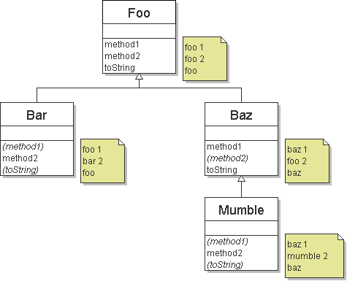
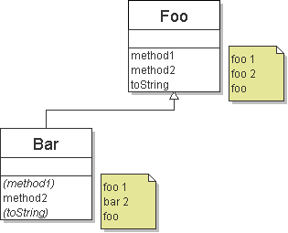
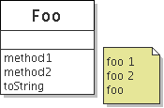
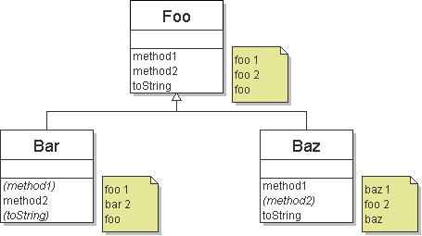
Finding output with diagrams
One way to determine the output is to diagram each class and its methods, including their output:
  Add the classes from top (superclass) to bottom (subclass).
  Include any inherited methods and their output.

Slide 48
Finding output with tables
Another possible technique for solving these problems is to make a table of the classes and methods, writing the output in each square.
method | Foo | Bar | Baz | Mumble
method1
method2
toString
method | Foo | Bar | Baz | Mumble
method1 | foo 1 | foo 1 | baz 1 | baz 1
method2 | foo 2 | bar 2 | foo 2 | mumble 2
toString | foo | foo | baz | baz
method | Foo | Bar | Baz | Mumble
method1 | foo 1 |  | baz 1
method2 | foo 2 | bar 2 |  | mumble 2
toString | foo |  | baz

Slide 49
Polymorphism answer
  Foo[] pity = {new Baz(), new Bar(), new Mumble(), new Foo()};
  for (int i = 0; i < pity.length; i++) {
  System.out.println(pity[i]);
  pity[i].method1();
  pity[i].method2();
  System.out.println();
  }
The code produces the following output:
  baz
  baz 1
  foo 2
  foo
  foo 1
  bar 2
  baz
  baz 1
  mumble 2
  foo
  foo 1
  foo 2

Slide 50
Another problem
Assume that the following classes have been declared:
  The order of classes is changed, as well as the client.
  public class Lamb extends Ham {
  public void b() {
  System.out.println("Lamb b");
  }
  }
  public class Ham {
  public void a() {
  System.out.println("Ham a");
  }
  public void b() {
  System.out.println("Ham b");
  }
  public String toString() {
  return "Ham";
  }
  }
  ...

Slide 51
Another problem 2
  public class Spam extends Yam {
  public void a() {
  System.out.println("Spam a");
  }
  }
  public class Yam extends Lamb {
  public void a() {
  System.out.println("Yam a");
  }
  public String toString() {
  return "Yam";
  }
  }
What would be the output of the following client code?
  Ham[] food = {new Spam(), new Yam(), new Ham(), new Lamb()};
  for (int i = 0; i < food.length; i++) {
  System.out.println(food[i]);
  food[i].a();
  food[i].b();
  System.out.println();
  }

Slide 52
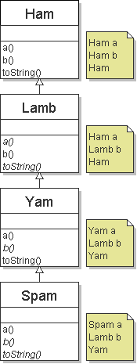
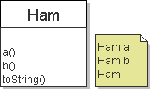
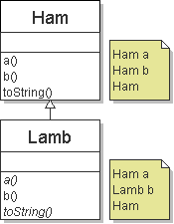
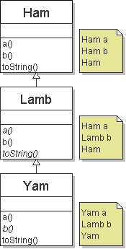
The class diagram
The following diagram depicts each class's behavior:

Slide 53
The table
The following table also depicts each class's behavior:
method | Ham | Lamb | Yam | Spam
a | Ham a |  | Yam a | Spam a
b | Ham b | Lamb b
toString | Ham |  | Yam
method | Ham | Lamb | Yam | Spam
a | Ham a | Ham a | Yam a | Spam a
b | Ham b | Lamb b | Lamb b | Lamb b
toString | Ham | Ham | Yam | Yam
method | Ham | Lamb | Yam | Spam
a
b
toString

Slide 54
The answer
  Ham[] food = {new Spam(), new Yam(), new Ham(), new Lamb()};
  for (int i = 0; i < food.length; i++) {
  System.out.println(food[i]);
  food[i].a();
  food[i].b();
  System.out.println();
  }
The code produces the following output:
  Yam
  Spam a
  Lamb b
  Yam
  Yam a
  Lamb b
  Ham
  Ham a
  Ham b
  Ham
  Ham a
  Lamb b

Slide 55
Interfaces
  reading: 9.6 - 9.7

Slide 56
Relatedness of types
Consider the task of writing classes to represent 2D shapes such as Circle, Rectangle, and Triangle.
There are certain attributes or operations that are common to all shapes.
  perimeter - distance around the outside of the shape
  area - amount of 2D space occupied by the shape
Every shape has these attributes, but each computes them differently.

Slide 57
Shape area, perimeter
Rectangle (as defined by width w and height h):
  area = w h
  perimeter = 2w + 2h
Circle (as defined by radius r):
  area = π r²
  perimeter = 2 π r
Triangle (as defined by side lengths a, b, and c)
  area = √(s (s - a) (s - b) (s - c))
  where s = ½ (a + b + c)
  perimeter = a + b + c

Slide 58
Common behavior
Let's write shape classes with methods named perimeter and area.
We'd like to be able to write client code that treats different shape objects in the same way, insofar as they share common behavior, such as:
  Write a method that prints any shape's area and perimeter.
  Create an array of shapes that could hold a mixture of the various shape objects.
  Write a method that could return a rectangle, a circle, a triangle, or any other shape we've written.
  Make a DrawingPanel display many shapes on screen.

Slide 59
Interfaces
interface: A list of methods that classes can promise to implement.
  Inheritance gives you an is-a relationship and code-sharing.
    A Lawyer object can be treated as an Employee, and
    Lawyer inherits Employee's code.
  Interfaces give you an is-a relationship without code sharing.
    A Rectangle object can be treated as a Shape.
  Analogous to non-programming idea of roles or certifications
    "I'm certified as a CPA accountant. The certification assures you that I know how to do taxes, perform audits, and do management consulting."
    "I'm certified as a Shape. That means you can be sure that I know how to compute my area and perimeter."

Slide 60
Interface syntax
Interface declaration, general syntax:
  public interface <name> {
  public <type> <name>(<type> <name>, ..., <type> <name>);
  public <type> <name>(<type> <name>, ..., <type> <name>);
  ...
  public <type> <name>(<type> <name>, ..., <type> <name>);
  }
  Example:
  public interface Vehicle {
  public double getSpeed();
  public void setDirection(int direction);
  }
abstract method: A method header without an implementation.
  The actual bodies of the methods are not specified, because we want to allow each class to implement the behavior in its own way.
  Exercise: Write an interface for shapes.

Slide 61
Shape interface
An interface for shapes:
  public interface Shape {
  public double area();
  public double perimeter();
  }
  This interface describes the features common to all shapes.
  (Every shape has an area and perimeter.)

Slide 62
Implementing an interface
A class can declare that it implements an interface.
  This means the class contains an implementation for each of the abstract methods in that interface.
    (Otherwise, the class will fail to compile.)
Implementing an interface, general syntax:
  public class <name> implements <interface name> {
  ...
  }
  Example:
  public class Bicycle implements Vehicle {
  ...
  }
  (What must be true about the Bicycle class for it to compile?)

Slide 63
Interface requirements
If we write a class that claims to be a Shape but doesn't implement the area and perimeter methods, it will not compile.
  Example:
  public class Banana implements Shape {
  ...
  }
  The compiler error message:
  Banana.java:1: Banana is not abstract and does not override abstract method area() in Shape
  public class Banana implements Shape {
  ^

Slide 64
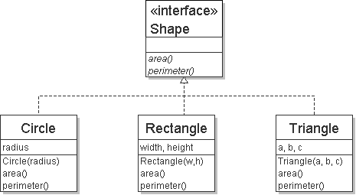
Diagrams of interfaces
We draw arrows upward from the classes to the interface(s) they implement.
  There is a supertype-subtype relationship here;
  e.g., all Circles are Shapes, but not all Shapes are Circles.
  This kind of picture is also called a UML class diagram.
  Exercise: Implement the Circle, Rectangle, and Triangle classes.

Slide 65
Complete Circle class
// Represents circles.
public class Circle implements Shape {
private double radius;
// Constructs a new circle with the given radius.
public Circle(double radius) {
this.radius = radius;
}
// Returns the area of this circle.
public double area() {
return Math.PI * radius * radius;
}
// Returns the perimeter of this circle.
public double perimeter() {
return 2.0 * Math.PI * radius;
}
}

Slide 66
Complete Rectangle class
// Represents rectangles.
public class Rectangle implements Shape {
private double width;
private double height;
// Constructs a new rectangle with the given dimensions.
public Rectangle(double width, double height) {
this.width = width;
this.height = height;
}
// Returns the area of this rectangle.
public double area() {
return width * height;
}
// Returns the perimeter of this rectangle.
public double perimeter() {
return 2.0 * (width + height);
}
}

Slide 67
Complete Triangle class
// Represents triangles.
public class Triangle implements Shape {
private double a;
private double b;
private double c;
// Constructs a new Triangle given side lengths.
public Triangle(double a, double b, double c) {
this.a = a;
this.b = b;
this.c = c;
}
// Returns this triangle's area using Heron's formula.
public double area() {
double s = (a + b + c) / 2.0;
return Math.sqrt(s * (s - a) * (s - b) * (s - c));
}
// Returns the perimeter of this triangle.
public double perimeter() {
return a + b + c;
}
}

Slide 68
Interfaces and polymorphism
Using interfaces doesn't benefit the class author so much as the client code author.
  The is-a relationship provided by the interface means that the client can take advantage of polymorphism.
  Example:
  public static void printInfo(Shape s) {
  System.out.println("The shape: " + s);
  System.out.println("area : " + s.area());
  System.out.println("perim: " + s.perimeter());
  System.out.println();
  }
  Any object that implements the interface may be passed as the parameter to the above method.
  Circle circ = new Circle(12.0);
  Triangle tri = new Triangle(5, 12, 13);
  printInfo(circ);
  printInfo(tri);

Slide 69
Arrays of interface type
We can create an array of an interface type, and store any object implementing that interface as an element.
  Circle circ = new Circle(12.0);
  Rectangle rect = new Rectangle(4, 7);
  Triangle tri = new Triangle(5, 12, 13);
  Shape[] shapes = {circ, tri, rect};
  for (int i = 0; i < shapes.length; i++) {
  printInfo(shapes[i]);
  }
  Each element of the array executes the appropriate behavior for its object when it is passed to the printInfo method, or when area or perimeter is called on it.

