Slide 1

PRASM
Presentation that saves cat pictures!

Slide 2
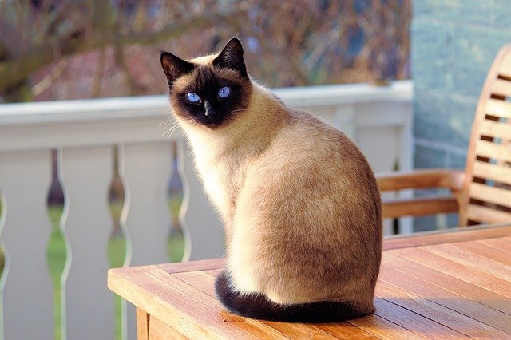
Kitty

Slide 3
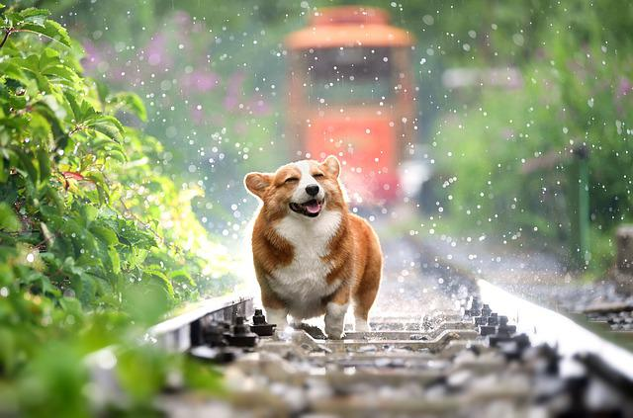
Doggie

Slide 4
usage
usage: ./pics <filename>

Slide 5
_start
Pop rax
Dec rax
Cmp rax, 0
Jne .program

Slide 6
_start
Mov rax, sys_write
Mov rdi, stdout
Mov rsi, usage
Mov rdx, usage$len
Syscall
Mov rdi, 1
Mov rax, sys_exit
syscall

Slide 7
_start
.program:
Rdrand rdi
Mov r9, Kitty
Mov r10, Kitty$len
Test rdi, 1
Jne .continue
Mov r9, Doggie
Mov r10, Doggie$len
.continue:
Mov rdi, [rsp+8]
Call writefile

Slide 8
writefile
; open(rdi: path, rsi: flags, rdx: mode)
Mov rsi, owronly
Or rsi, ocreat
Or rsi, otrunc
Mov rdx, 0o644
Mov rax, sys_open
Syscall
Mov r8, rax

Slide 9
writefile
; write(rdi: fd, rsi: str, rdx: size)
.loop:
Mov rax, sys_write
Mov rdi, r8
Mov rsi, r9
Mov rdx, r10
Syscall
Add rsi, rax
Sub r10, rax
Jne .loop

Slide 10
writefile
; close(rdi: fd)
Mov rdi, r8
Mov rax, sys_close
syscall
; exit(rdi: exit_code)
Mov rdi, 0
Mov rax, sys_exit
syscall

