Slide 1

Vision
“To serve our valued customers with high quality, unique and delicious snacks at affordable price”

Slide 2
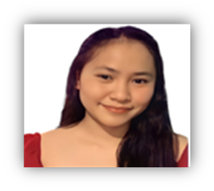
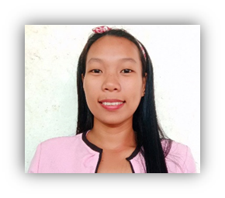
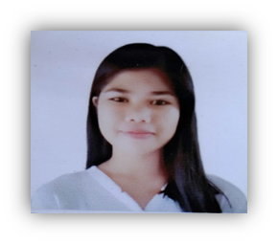
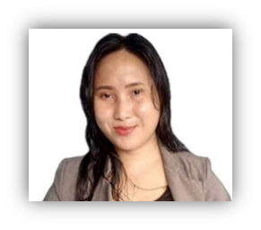
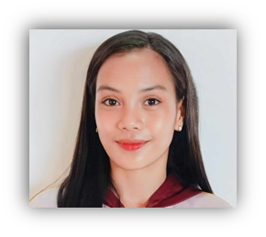
ORGANIZATIONAL STRUCTURE
Marivic Louise A. Carzon
GENERAL MANAGER
Joy M. Bactol
OPERATION MANAGER
ROSE ANN C. BIASA
FINANCIAL MANAGER
GEMMA R. CABELIN
COOK
RICA MAE A. PALERACIO
CASHIER

Slide 3
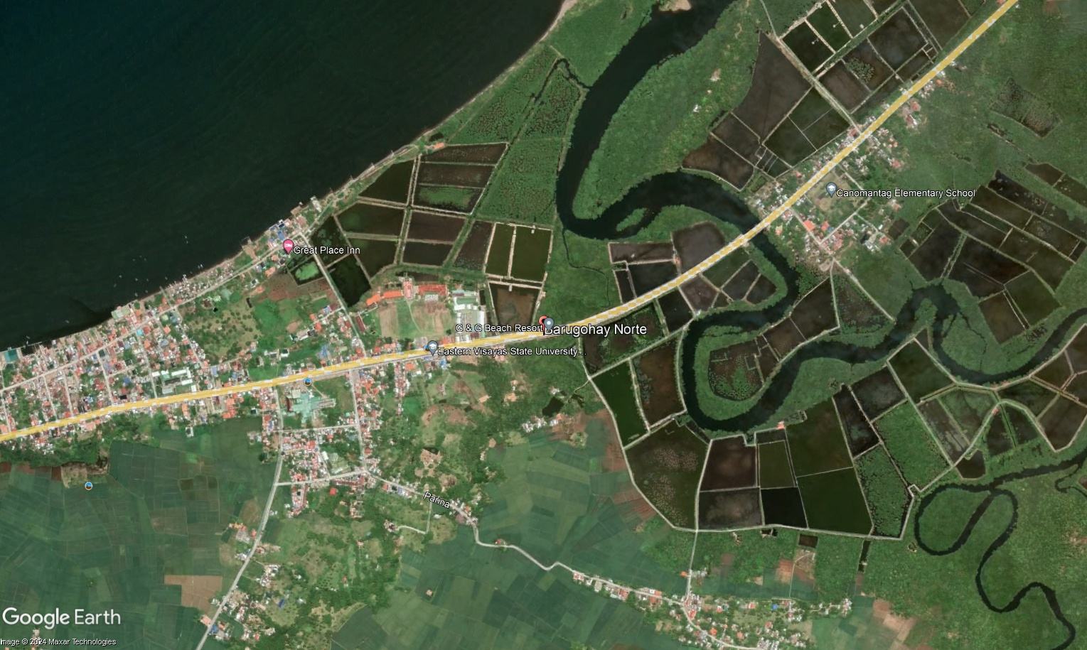
Barugohay Norte, Carigara, Leyte
langkatuladsnackieu@gmail.com

Slide 4
Mission
“To be one of the best places to go, popular for its unique taste snack offerings and satisfactory service”

Slide 5
Objectives
To satisfy customers by providing unique and delicious snacks
To deliver a high quality product that appeals to the taste of EVSU CC students
To offer healthy snacks at an affordable price

Slide 6
Langkatulad Snackieu is founded by group of friends who are students of Bachelor of Science in Entrepreneurship in Eastern Visayas State University, Carigara Campus. We are born out of our passion for bringing unique flavor of snacks and refreshments to students using locally source Langka as the main ingredient in all of our products.

Slide 7
Founders
To satisfy customers by providing unique and delicious snacks
To deliver a high quality product that appeals to the taste of EVSU CC students
To offer healthy snacks at an affordable price

Slide 8
Founders
Rica Mae A. Paleracio
Marivic Louise A. Carzon
Joy M. Bactol
Gemma R. Cabelin
Rose Ann Biasa

