Slide 1
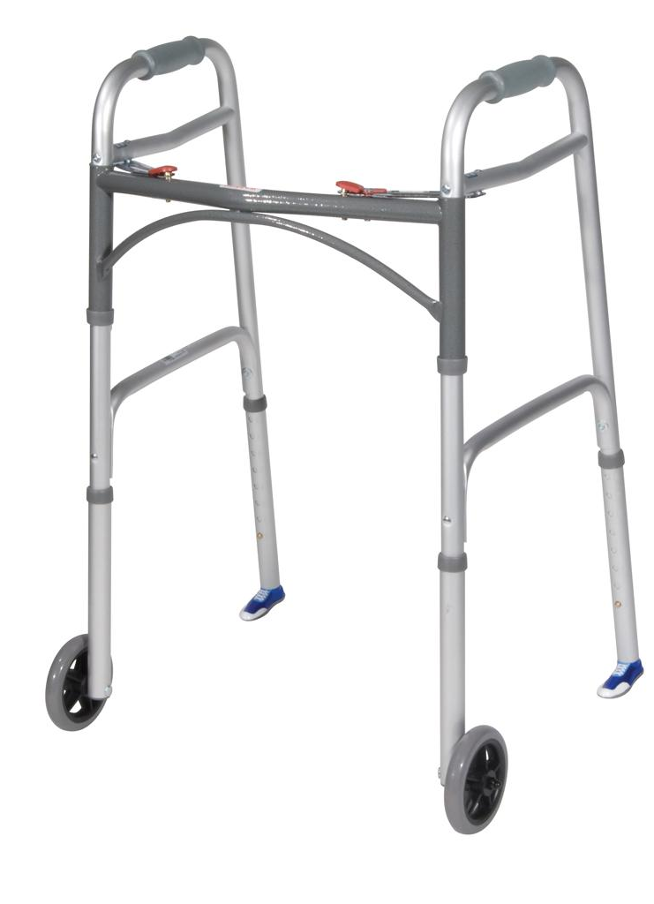
Smart walker
Jackson Farley, Eric Lenien, Ellie Langley
ELC 4438 Spring 2019

Slide 2
Design Purpose
Elderly people living on their own
A walker which detects their presence, keeps track of use and whereabouts allow for elderly to achieve indepence

Slide 3
Design Overview
Presence measurements
Wifi connection
Alarms

Slide 4
Hardware design

Slide 5
Block Diagram

Slide 6
Schematic

Slide 7
Integration

Slide 8
software

Slide 9
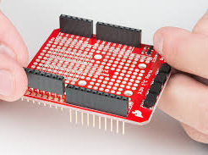
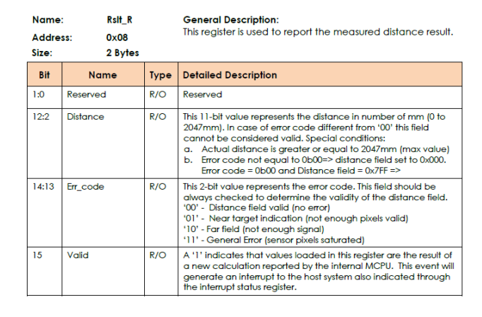
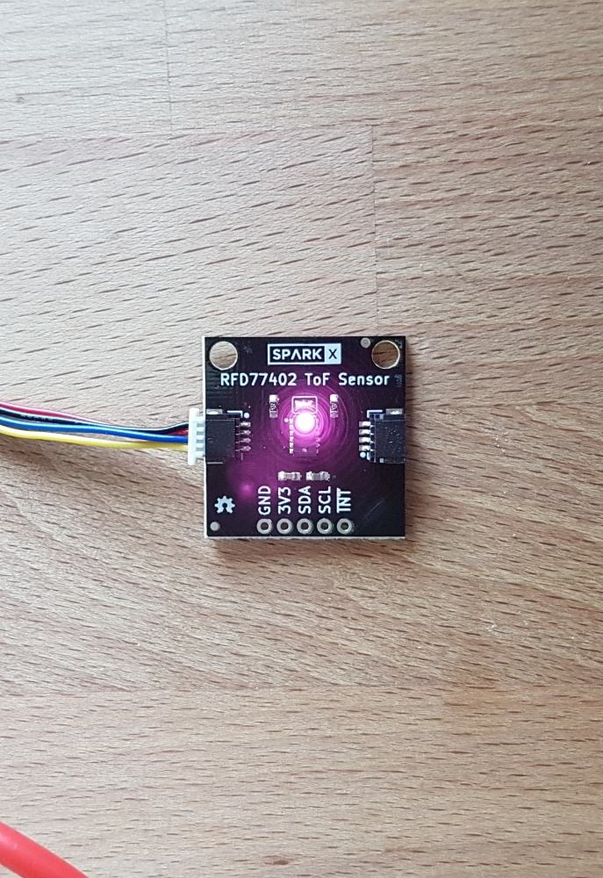
I2C Sensor
RFD7704 Qwic Sensor
Senses human presence up to 2 meters
Library readily available to be implemented in Arduino
8 bit addressing
Connected to qwic shield

Slide 10
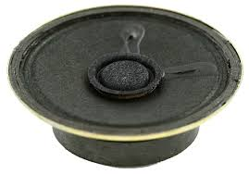

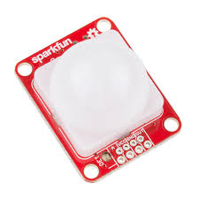
GPIOs
PIR Sensor
Digital input value changes upon sensing movement
Can be powered by 3.3V or 5V
LEDs
Simple LEDs flash on certain commands
Speakers
Used for gentle and strong reminders

Slide 11
Activity Diagrams

Slide 12
Wifi integration

Slide 13
Future plans

Slide 14
Questions?

