Slide 1
Machine Learning of Financial Time Series – a Case Study
Lan Gong April 6th, 2018

Slide 2
Introduction
Financial time series is discrete in time but continuous in value
Asset returns are modeled instead of prices
Prices are usually highly correlated from day to day
Variance of price can grow over time
Returns reflect the change of price over some period (e.g., daily etc.)
Returns have more desirable statistical features
Challenges of Prediction
low signal-to-noise ratio (“noisy”)
Economic uncertainties (“event-driven”)
Predictive methods
Statistical analysis using a few fundamental variables (e.g., indices, GDP, unemployment rate, consumer index)
Machine learning comes into play as more data are collected and used for prediction (e.g. alternative data such as satellite images)

Slide 3
2Sigma Financial Modeling Challenge
Predict investment returns has been a central topic in trading and risk management
Leverage data set of “2sigma financial challenge” as a playground to explore financial time series and apply machine learning methods
Data sets are not “very clean”, representing some of the real world challenges

Slide 4
Overview of Data Set
Description
Time series of financial instruments with anonymized features and one target variable for prediction
No further information provided on the meaning of the features or transformations applied to them
No information about the type of an instrument
Dimensions
5 years & ~1000 instruments per timestamp: total 1MM+ observations
100+ features
The variable to predict is ‘y’ – presumably investment returns

Slide 5
More about the Data Set
Each instrument is labeled with a unique id
An instrument doesn’t need to have values for all the features, e.g., stocks and bonds differ in the available features
Feature values are not centered and can have outliers
Collinearity among the features
‘y’ is approximately normal but may differ slightly among instruments
Notes:
We will see later how these observations will influence the way we model

Slide 6
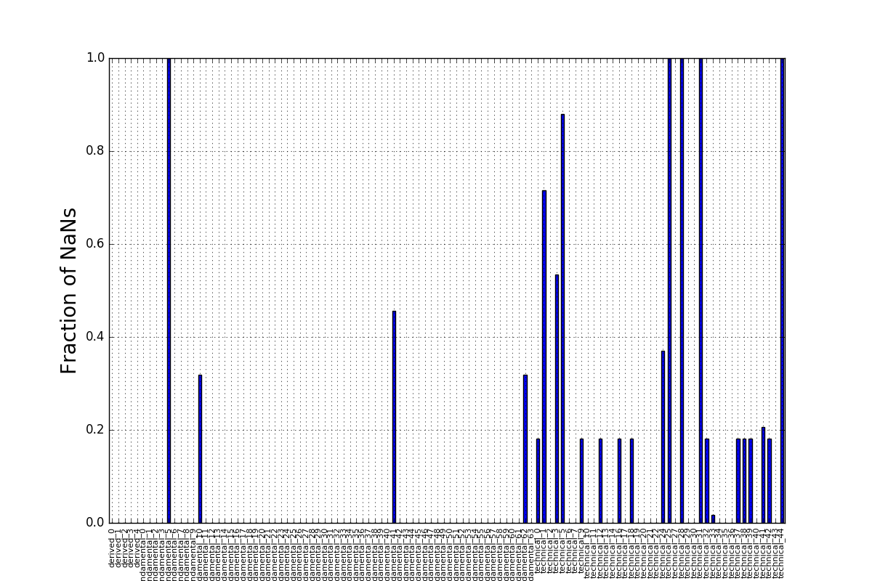
Percent of NaNs for one instrument

Slide 7
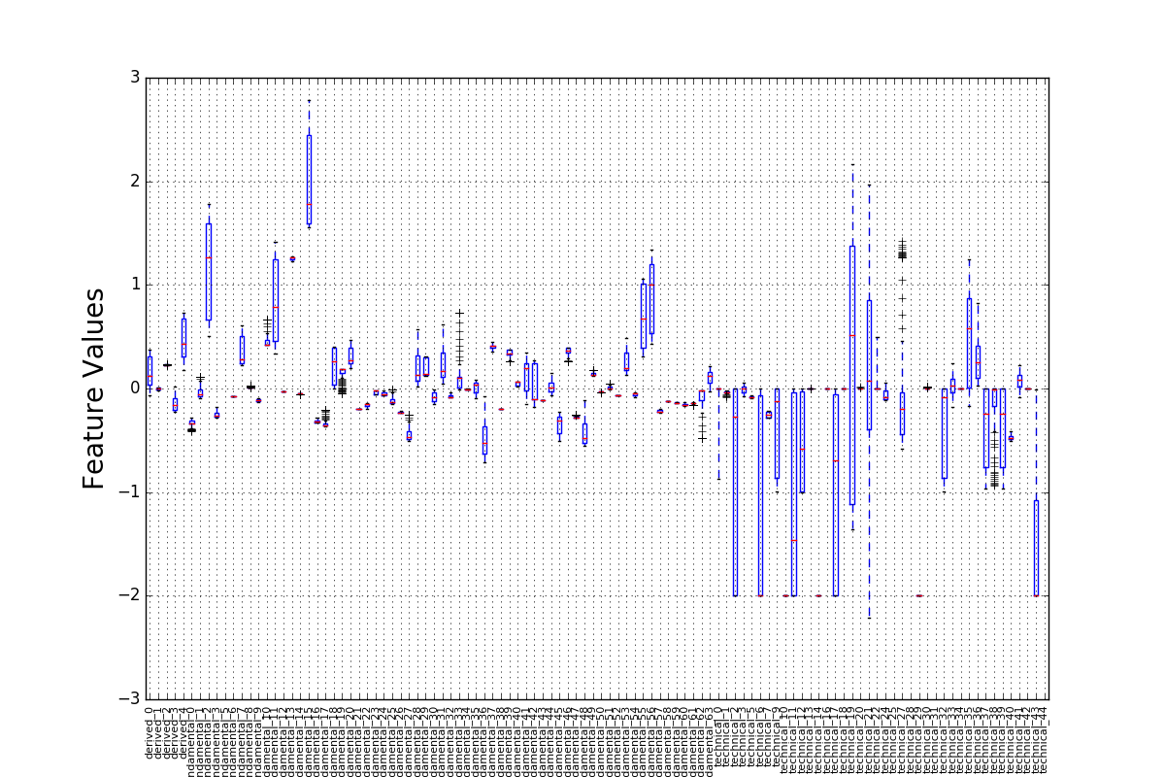
Distribution of feature values for one instrument

Slide 8
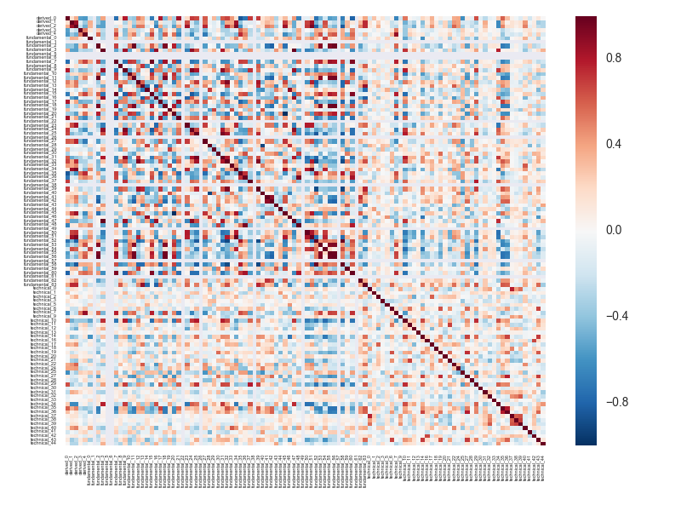
Heat map of pairwise correlation among features

Slide 9
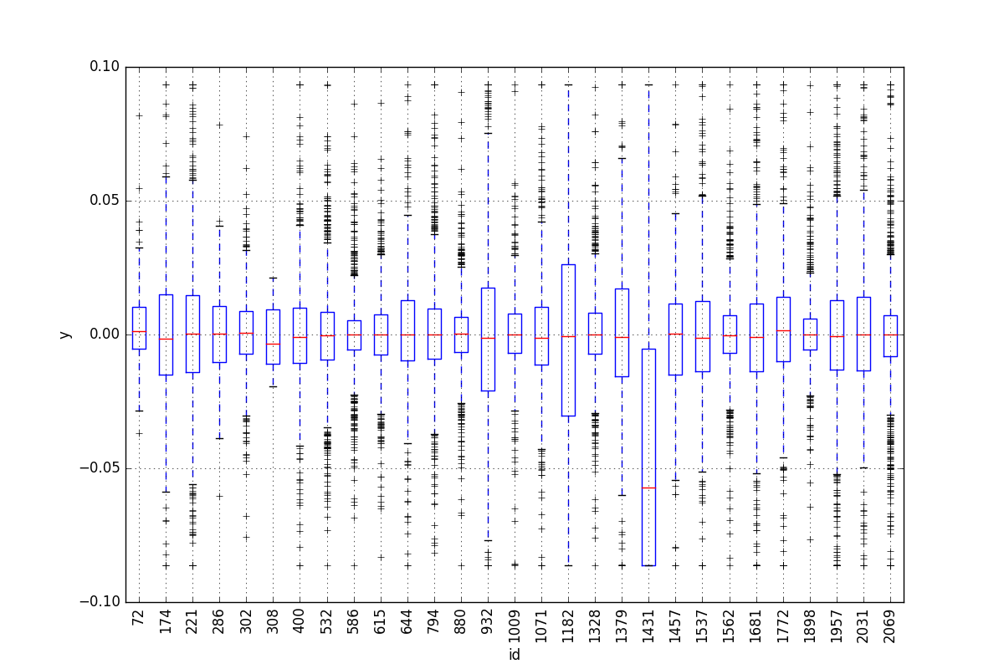
Distribution of returns by id (only a subset of ids is shown)

Slide 10
Data Preprocessing
For each id:
Clip the outliers
Standardize the feature values
Fill the NaNs with means

Slide 11
Modeling Approaches
Ridge Regression
To address the issue of collinearity
Penalty tuning: Cross validation on training set
Coefficients: a few features have larger coefficients than the rest

Slide 12
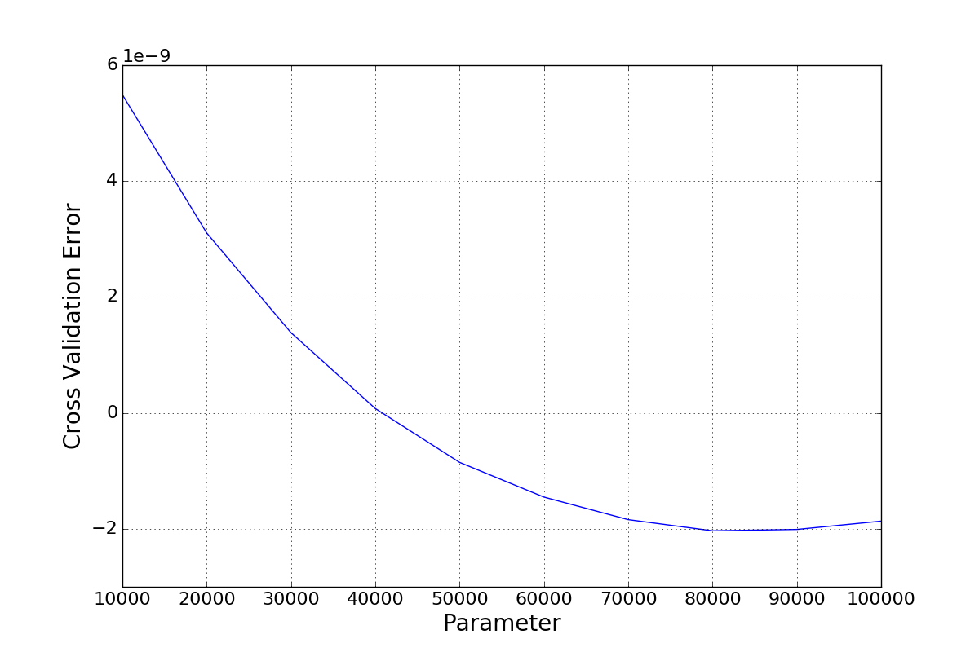
Cross validation error vs. Penalty Parameter

Slide 13
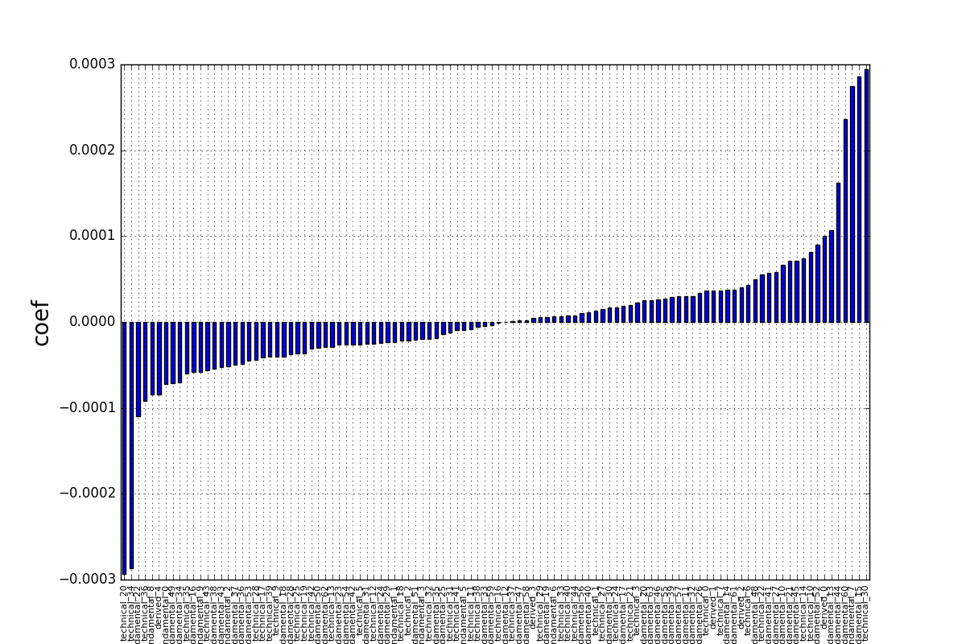
Coefficients of Features

Slide 14
Random Forest
To capture non-linear behaviors
Cross validation to find the optimal parameters, e.g., number of trees, tree depth
Feature importances echo the implication from ridge regression

Slide 15
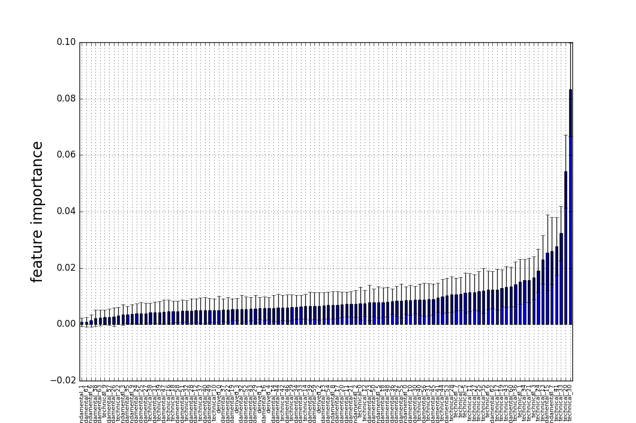
Feature importance

Slide 16
Mixed model
Intuition:
Ridge regression captures the linear influence from a few dominant features
Random forest reflects the hierarchical influence of all variables “conditioned” on prior splits of more dominant ones
Adding historical mean return to ridge results to reflect variability among instruments
Weighted sum of prediction results from each model.

Slide 17
Summary of Testing Results
Modeling Approach | R^2 | Improvement
Principal Component | 0.095% | Baseline
Ridge Regression | 0.10% | 5%
Random Forest | 0.14% | 47%
Mixed Model | 0.2% | 111%

Slide 18
Further Analysis of Important Features
‘technical_20’ and ‘technical_30’ have been shown as important features by both Ridge and Random Forest regressions.
Picking instruments in a strategic way to replicate market movement, e.g. S&P500, is a common practice in portfolio management.
Each instrument can have its own behavior but it is the collective movement of all that matters.
The grouped instruments forms a “portfolio”.
Method of analysis:
Construct a new feature: ‘tech2030’ = technical_20 – technical_30
Compute the portfolio-level statistics of the new feature and ‘y’

Slide 19
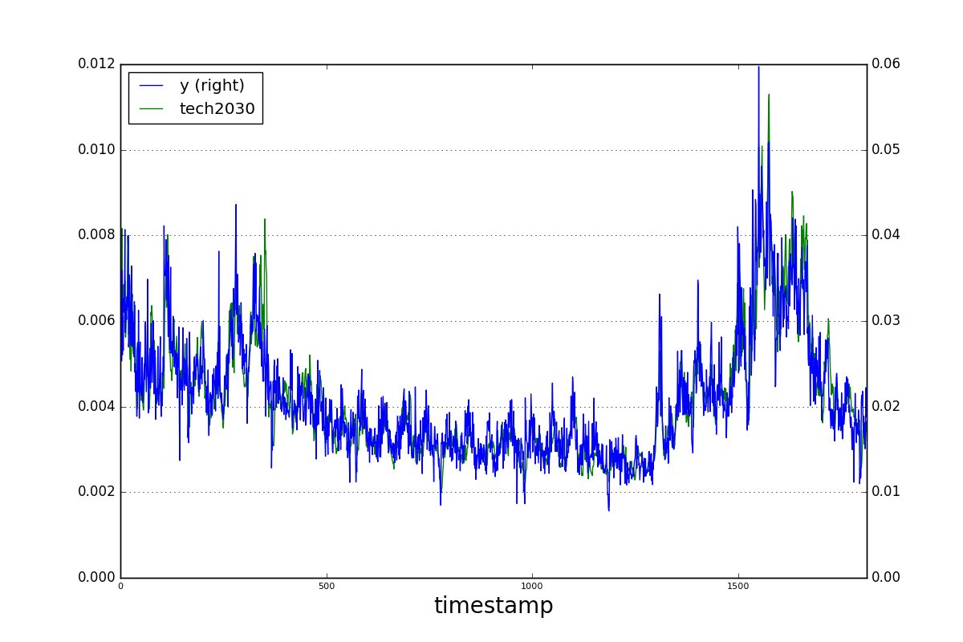
Standard deviation of the constructed feature and ‘y’

Slide 20
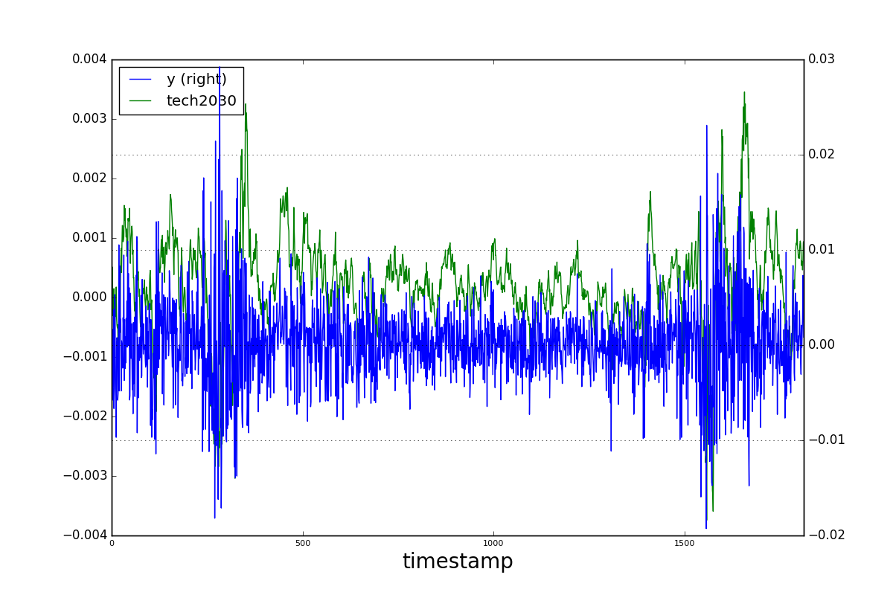
Mean of the constructed feature and ‘y’

Slide 21
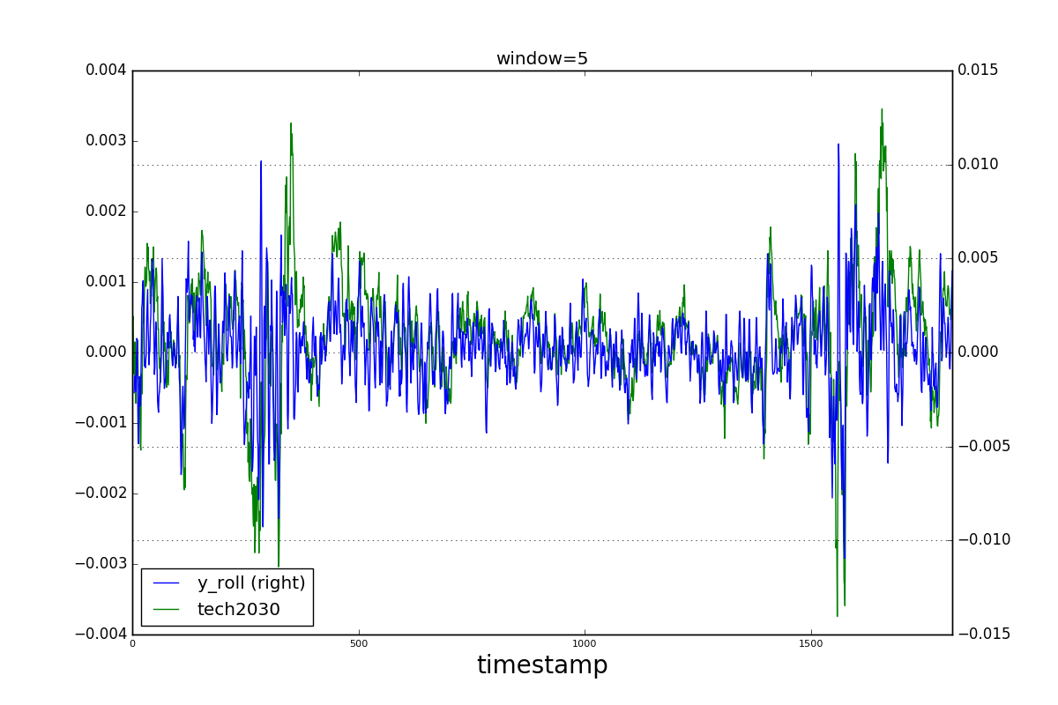
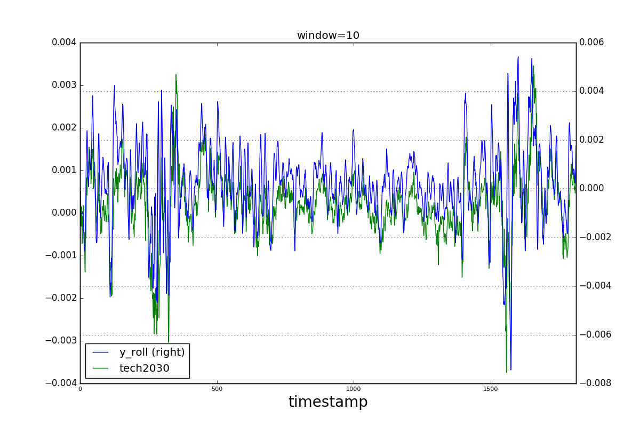
Mean of the constructed feature vs. n-day rolling mean of ‘y’

Slide 22
Conclusions
Initial data exploration helps to choose the proper prediction models
Feature selection using ridge and random forest regression helps to identify a few dominant variables
Mixed model can predict better than the single best model
The constructed feature (i.e., technical_20 – technical30) can be a general market index that the portfolio-level returns try to track

Slide 23
Thank you!

